Slide 1
Chicago crime data analysis
By team 9: Under the Supervision of:
Aashri Tandon Prof. Srikant Krishnamurthy
Pragati Shaw
Sarthak Agarwal

Slide 2
Overview
Data Download and Preprocessing
Time Series Analysis
Geospatial Analysis
Statistical Analysis using D3
Demo
Contributions

Slide 3
Data Download and Preprocessing
Data was automatically downloaded from the following website:
https://data.cityofchicago.org/Public-Safety/Crimes-2001-to-present/ijzp-q8t2/data
Once downloaded, the file was cleaned by removing the nan from latitude and longitude columns
Finally the clean file was uploaded onto S3
The above pipeline has been dockerized and pushed onto docker hub

Slide 4
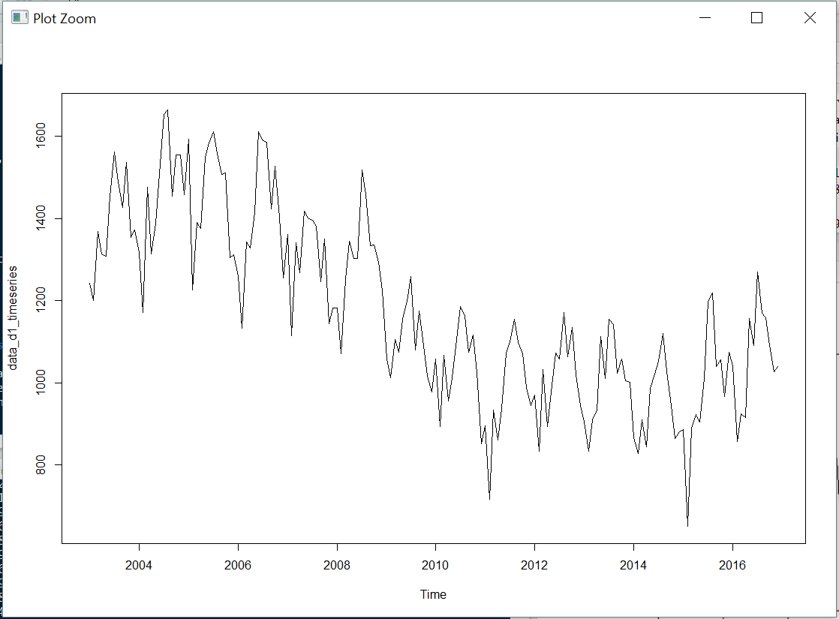
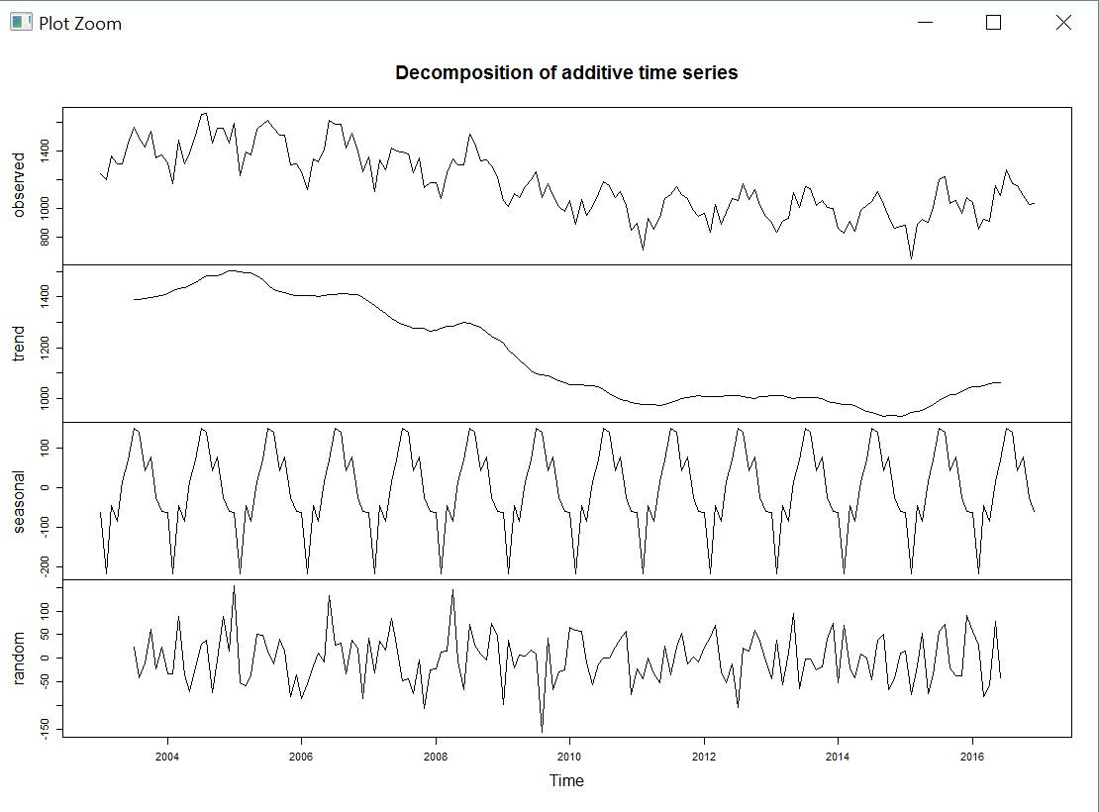
Time Series Analysis
Our first step was to manipulate the dataset into time series format.
The time series for crime rate looks like this:

Slide 5
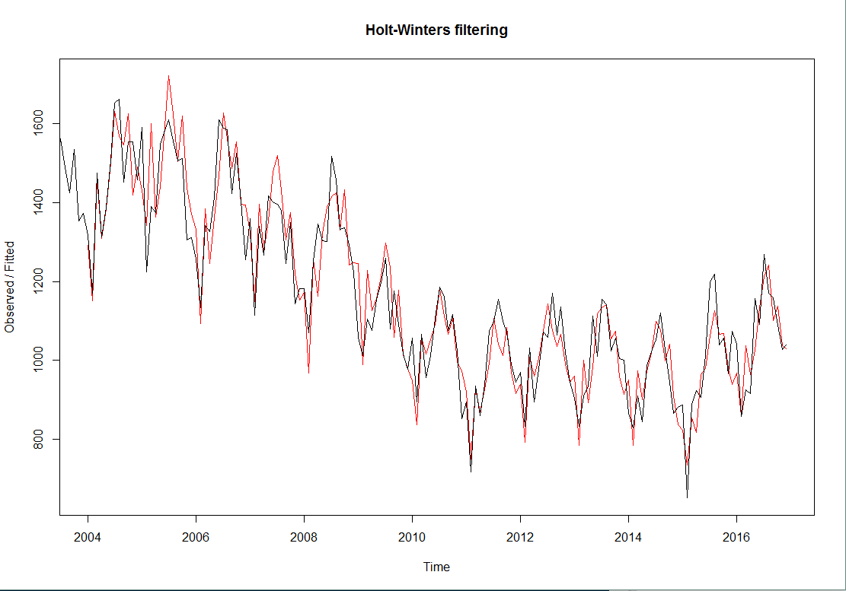
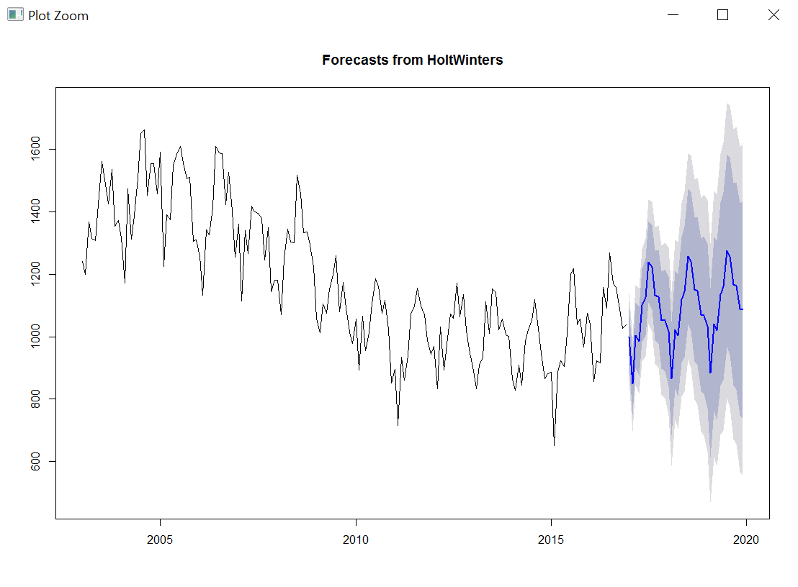
Forecasting results

Slide 6
GEOSPATIAL ANalysis
Top 2 districts with total crime has been district number 8 and 11 for more than a decade.
From 2011 there has been a decrease in crime rate of district 25
For the period of 2001 to present, it has been observed that theft and burglary crime type has been the most.
For district number 8 and 11 crime type assault has been the most.

Slide 7
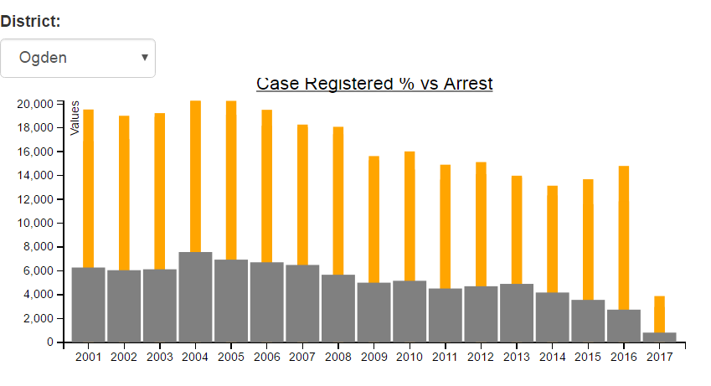
Statistical analysis using D3
D3 has provided us with the capability to generate bar charts, line charts, pie charts dynamically
Case Registered v/s Arrest Bar Chart
We have generated a bar chart that displays the comparison between the number of cases registered in a year and the number of arrests. The graph gets dynamically updated for selected district.
For district Ogden:

Slide 8
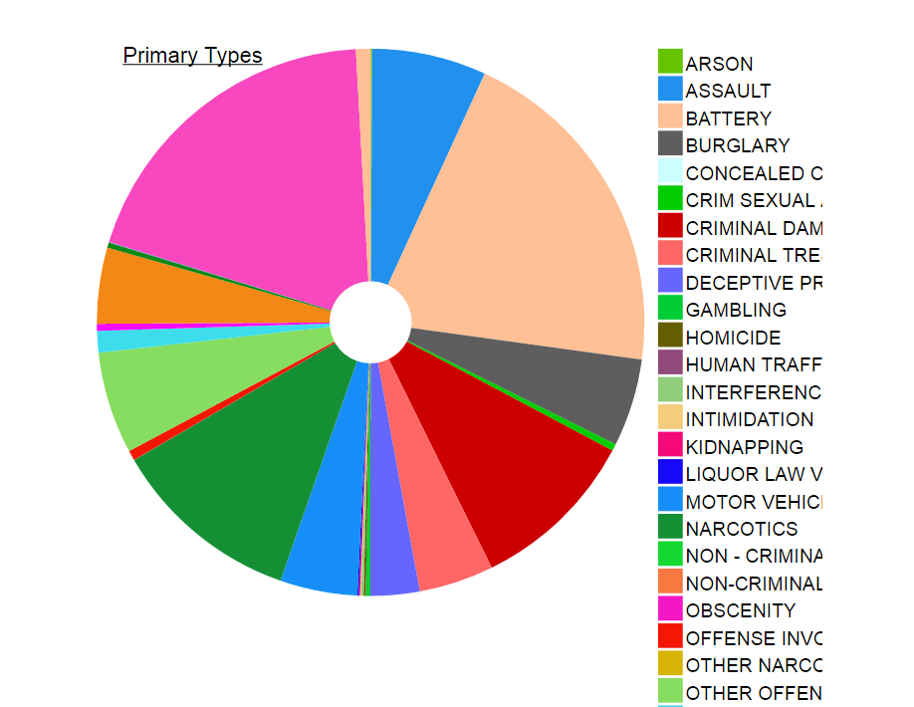
Statistical analysis using D3
D3 has provided us with the capability to generate bar charts, line charts, pie charts dynamically
Primary Types Pie Chart
We have generated a pie chart that displays the count of crimes based on primary crime types that happened in a district. The chart dynamically gets updated when a new district is selected.
For District Wentworth:

Slide 9
DEMO

