Slide 1
Activation Functions
Neural Networks
Sarthak Agarwal

Slide 2
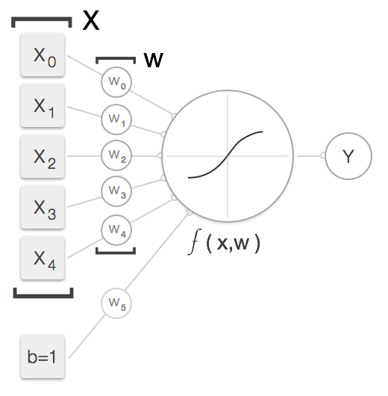
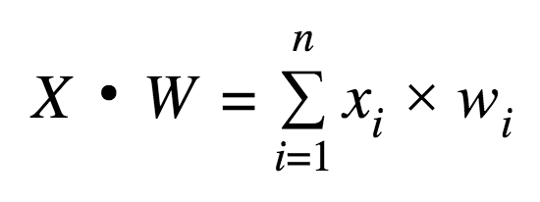
A simple Neural Network:
Inputs = x0, x1, x2, x3, x4
Weights = w0, w1, w2, w3, w4
Bias = b
Outputs:
Why not just call the dot product the final output of the neuron and be done?
Because It can output anything from large +ve, -ve or zero value.
What we want is a CLASSIFIER.

Slide 3
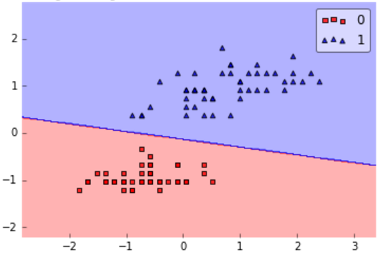
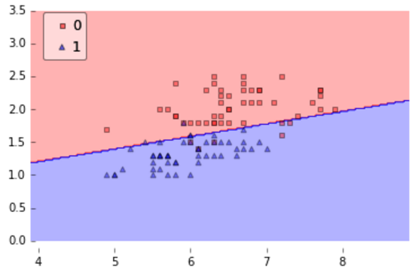
Linear or Non-Linear classifier
Linear classifier works.
Non-Linear Classifier needed

Slide 4
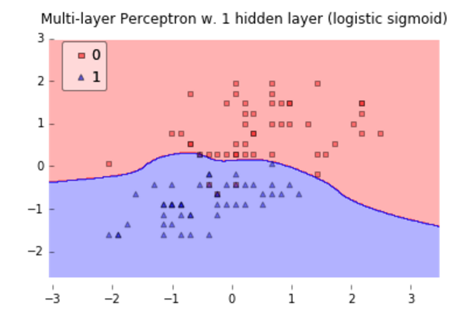

Slide 5
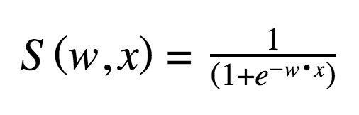
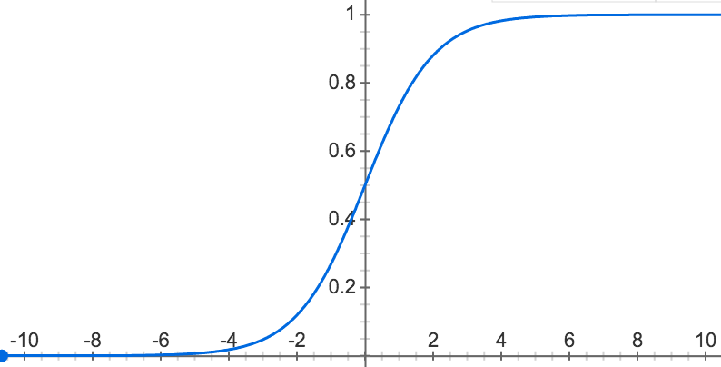
Non Linear Activation functions:
Sigmoid Function
Notes:
If we use a linear activation function it will be difficult to interpret the output of our neuron. For some inputs it may output a very large negative number, zero or a very large positive number. However, we typically want to think of our neuron as a detector (or classifier if you prefer) and not a simple calculator.

Slide 6
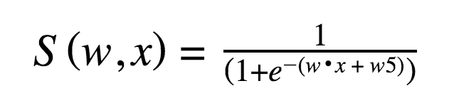
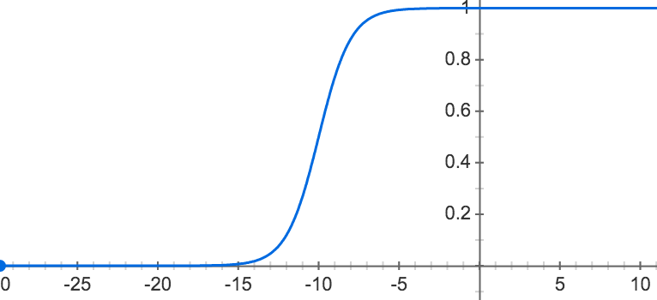
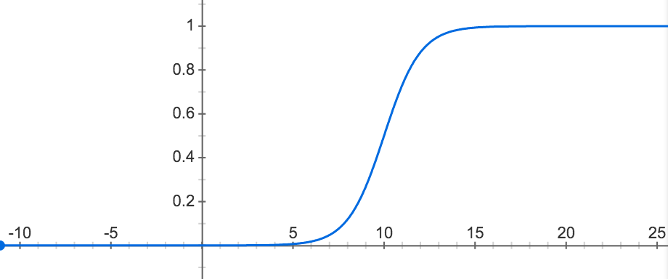
Effect of bias on Sigmoid Function:
Bias = w5 = 10
Bias = w5 = -10

Slide 7
Other Activation Functions:
Linear – the simplest activation function simply maps the input to the output.
Binary Step – an activation function that takes on exactly two values with no intermediate values possible. This function is generally not used because it doesn’t work well during training.
Hyperbolic Tangent or tanh - a very common sigmoid function with properties similar to the logistic function though with an output from -1 to 1, including the ability to shift based on a constant term from the bias unit weight.
Rectified Linear Unit or ReLU - it equals max(0, x). This function clips inputs below zero to zero. Anything above zero is passed through unmodified. This means the ReLU output can grow without bound.
SoftPlus – similar to ReLU in that it outputs values from zero to infinity. It is a continuous function with a similar shape to the ReLU.

Slide 8
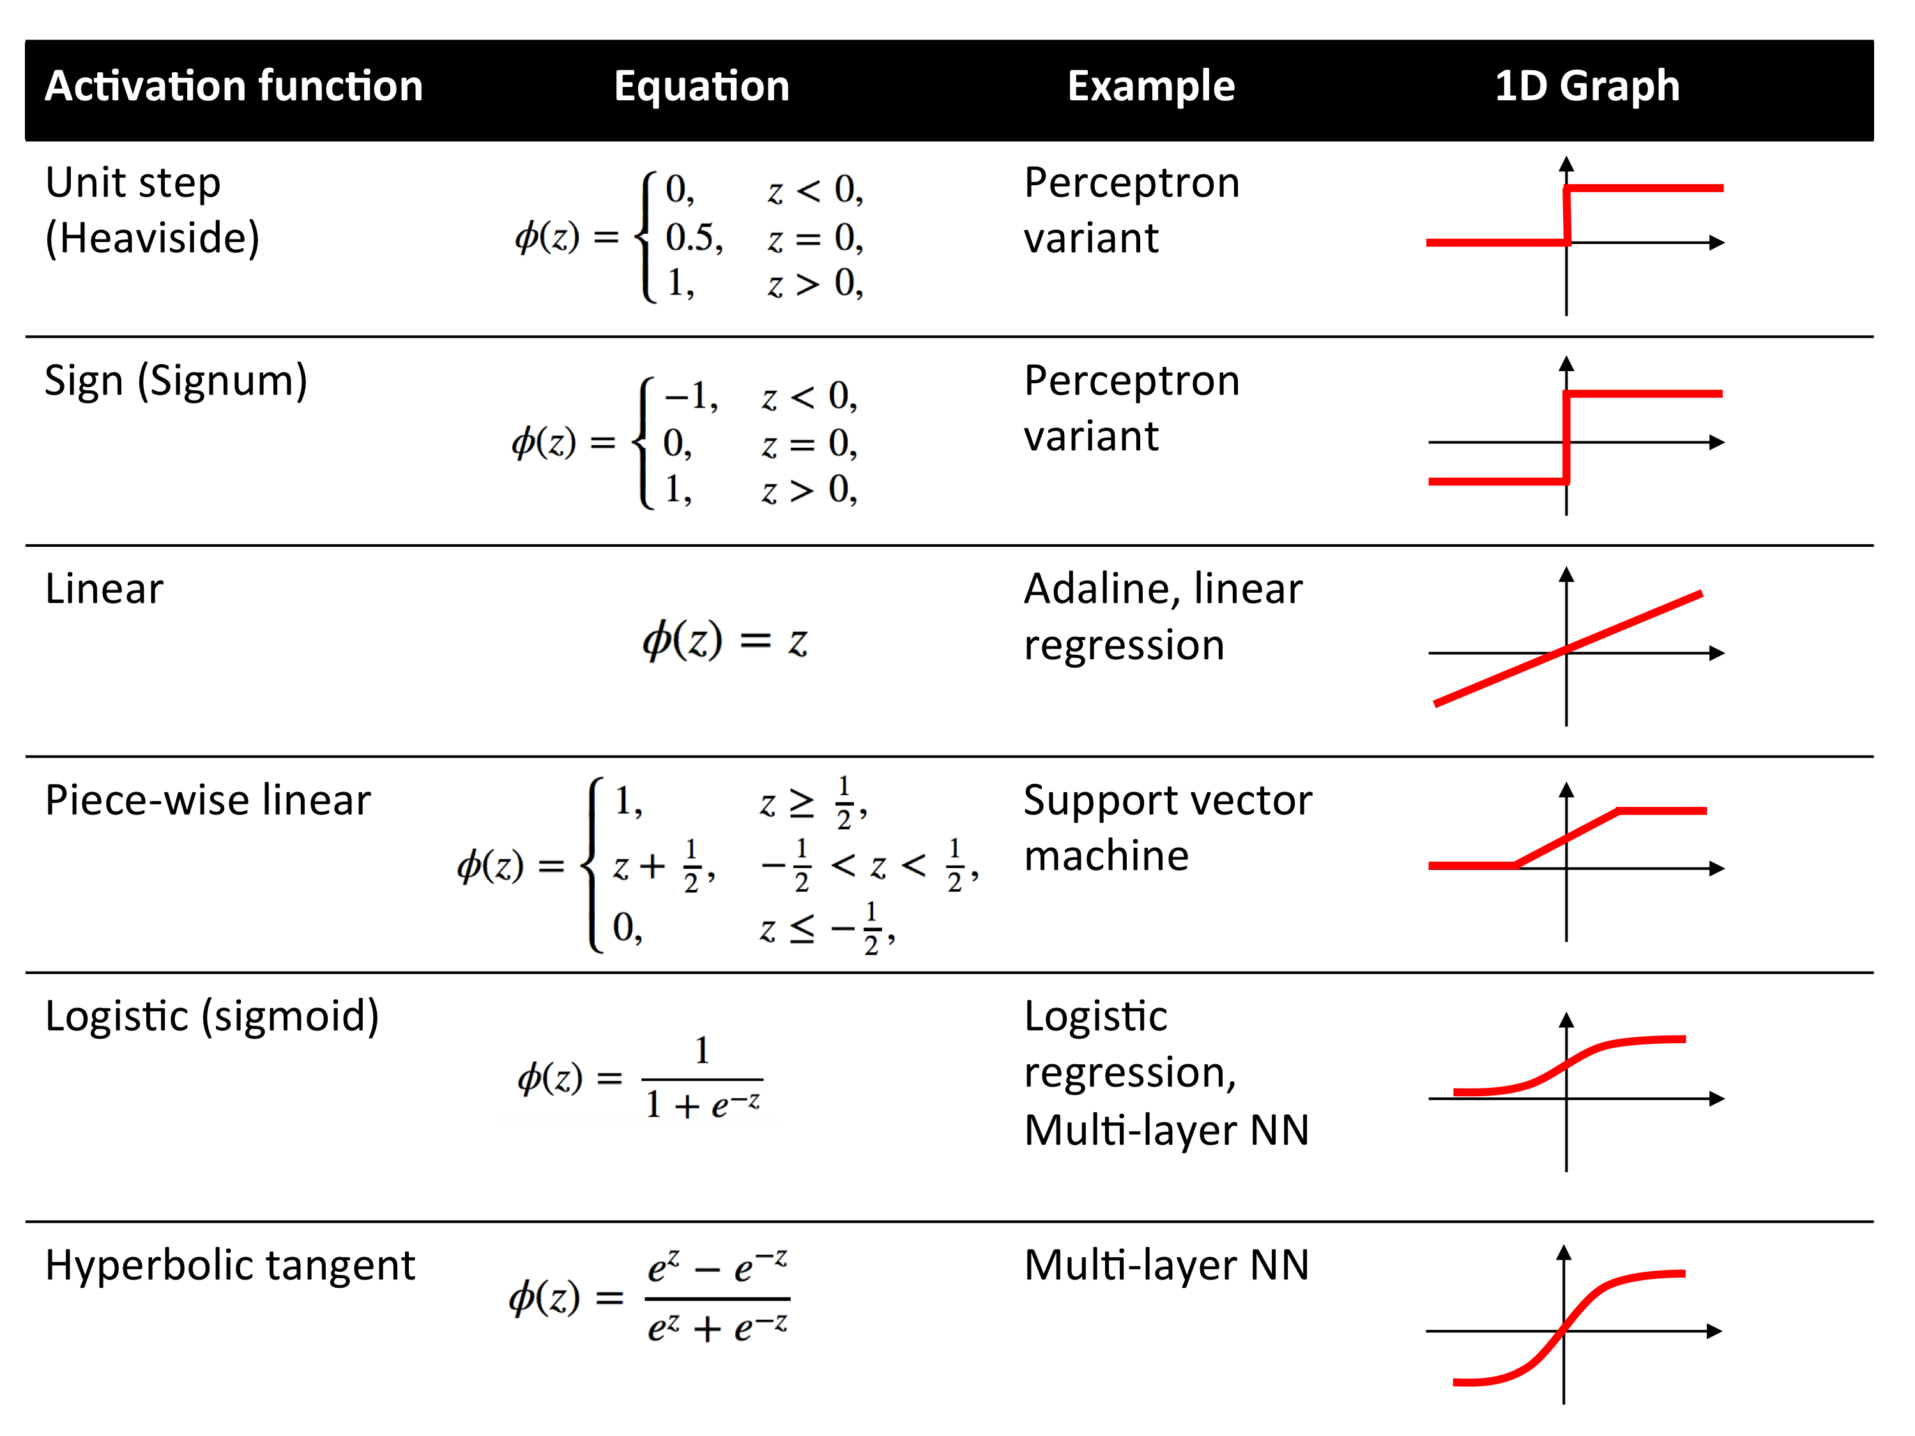
Notes:
http://www.thoughtly.co/blog/deep-learning-lesson-2/
http://ufldl.stanford.edu/tutorial/supervised/MultiLayerNeuralNetworks/
https://www.quora.com/What-is-the-role-of-the-activation-function-in-a-neural-network

Slide 9
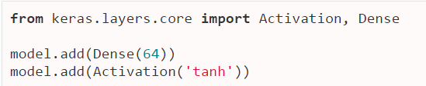

How to implement it in keras:

