Slide 1
Facial Keypoint Detection
- Sarthak Agarwal

Slide 2
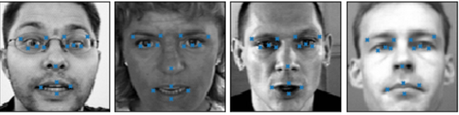
Problem
The task was to detect facial key-points on greyscale images of faces.
Facial key-points are centers and corners of the eyes, eyebrows, nose and mouth, among other facial features.

Slide 3
Tools and Infrastructure
Keras 1.2.2
Tensorflow 1.0.1
AWS GPU g2.2xlarge
CUDA 8.0
Python 3.5.2
Challenge: Finding an AMI on AWS which had all the above versions.
Solution: Updated all the packages in my own AMI

Slide 4
Dataset
Total Images: 7049 with dimensions: 96x96x1
Input (X) => Array of flattened images.
X is between 0 to 255 because greyscale images.
Scaled the input to float values between [0,1]
Shape of X for NN is (# of images, 9216)
Shape of X for CNN is (# of images, 96, 96, 1)
Output(Y) => 30 (x, y) coordinates of the 15 facial keypoints.
Range of Y is from 0 to 96
Scaled the target o float values between [-1, 1]
Finally, shape of Y is (# of images, 30)

Slide 5
Baseline Model
Basic Neural Network with 1 hidden layer having 100 nodes with two sets of hyperparameters.
Execution time = 3 secs on CPU with 100 epochs.
Parameter | Value
Learning rate | 0.01
Momentum | 0.9
Nesterov | True
Parameter | Value
Learning rate | 0.01
Momentum | 0.0
Nesterov | False
Train Loss: 0.0024
Val Loss: 0.0037
Train Loss: 0.0070
Val Loss: 0.0080

Slide 6
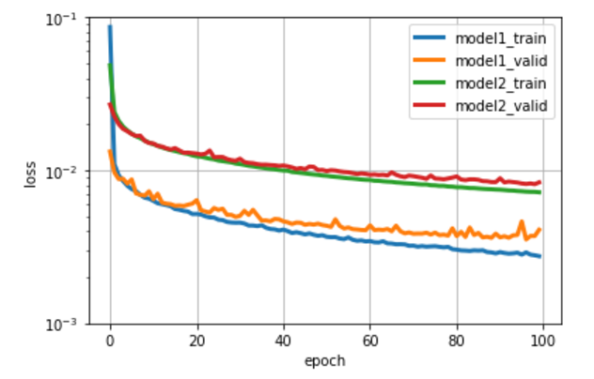
Performance comparison of the two baseline models

Slide 7
CNN Model
Layer | Name | Details | Outputs
0 | Input | - | 1x96x96
1 | Conv2d | 32 filters of 3x3 | 32x94x94
2 | Maxpool | Size 2x2 | 32x47x47
3 | Con2d | 64 filters of 2x2 | 64x46x46
4 | Maxpool | Size 2x2 | 64x23x23
5 | Conv2d | 128 filters of 2x2 | 128x22x22
6 | Maxpool | Size 2x2 | 128x11x11
7 | Flatten | - | 15488
8 | Dense | - | 500
9 | Dense | - | 500
10 | Output | - | 30
No of epochs = 500
Time taken to run = 40mins
Train Loss = 0.0012
Val Loss = 0.0020

Slide 8
Models performance comparison
Model | Model Description | Epoch | Time | Train Loss | Val Loss
Model 1 | NN with 1 hidden layer, 100 nodes | 100 | 3mins CPU | 0.0024 | 0.0037
Model 2 | Model 1 + momentum=0, decay=0, nesterov=False | 100 | 3mins CPU | 0.0070 | 0.0080
Model 3 | CNN | 500 | 40mins GPU | 0.0012 | 0.0020
Model 4 | CNN – Flipped images | Yet to run

Slide 9
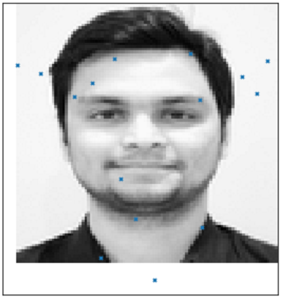
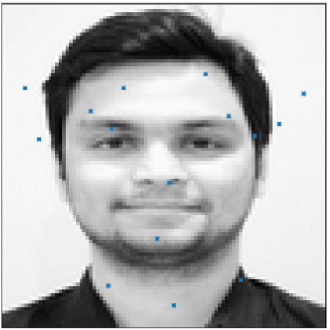
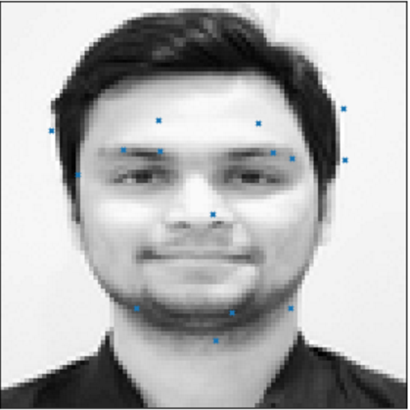
Predicted Results
For each model, I saved the model structure and weights for future prediction.
Simple NN version 1
Simple NN version2
CNN

Slide 10
Future Work

