Slide 1
Kubernetes & Google Container Engine
Presented by
Aashri tandon Pragati Shaw Sarthak Agarwal

Slide 2
Agenda
What are Kubernetes?
Why Kubernetes?
Why Docker is not enough?
Architecture
Kubernetes on Local Machine
Kubernetes on Google Container Engine

Slide 3
Kubernetes
Kubernetes is an open-source platform for automating deployment, scaling, and operations of application containers across clusters of hosts, providing container-centric infrastructure.
With Kubernetes
Deploy
Scale
Roll out new features
Optimize

Slide 4
Why Kubernetes?
Provides the infrastructure to build a truly container-centric development environment
Can schedule and run application containers on clusters of physical or VMs
It packages all necessary tools- orchestration, service discovery, load balancing together

Slide 5
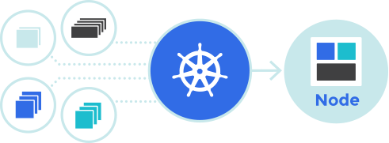
Why Docker is not enough?
Cannot manage containers across multiple nodes, or schedule and manage tasks to be completed across clusters
Kubernetes is available to make working with Docker more efficient and streamlined
Kubernetes is a solution for overseeing and managing multiple containers at scale, rather than just working with Docker on a manually-configured host.

Slide 6
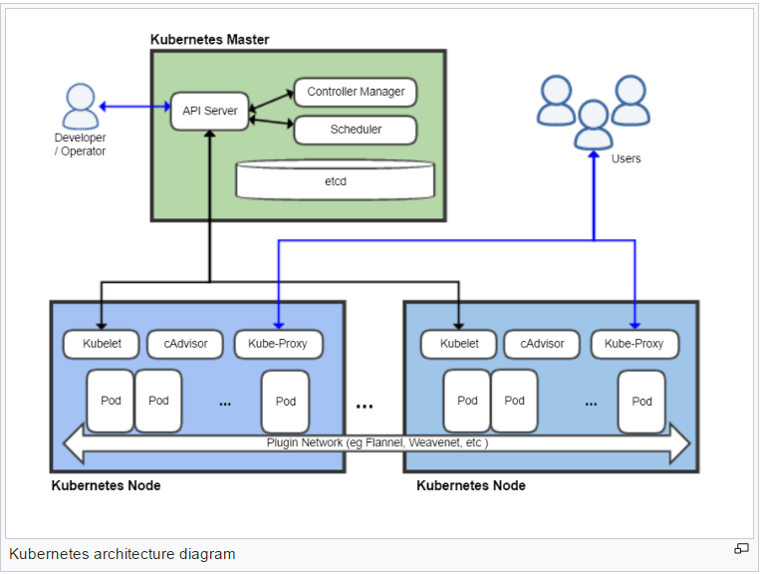
Architecture

Slide 7
Components
Master
The managing machine
Node /Minion
A slave that runs tasks as delegated by the user and master
Pod
An application (or part of an application) that runs on a node

Slide 8
Kubernetes on Local machine
DEMO

Slide 9
Kubernetes on Google Container engine
DEMO

Slide 10

Questions

Slide 11


