Slide 1
Kubernetes & Google Container Engine
Under supervision of
Prof. Srikanth Krishnamurthy
Presented by
Aashri tandon(https://www.linkedin.com/in/aashritandon/)
Pragati Shaw(https://www.linkedin.com/in/pragatishaw/)
Sarthak Agarwal(https://www.linkedin.com/in/sarthaka/)

Slide 2
Agenda
Why Docker is not enough?
What are Kubernetes?
Architecture
Kubernetes on Local Machine
Kubernetes on Google Container Engine

Slide 3
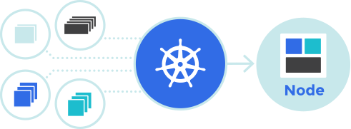
Why Docker is not enough?
Cannot manage containers across multiple nodes, or schedule and manage tasks to be completed across clusters
Kubernetes is available to make working with Docker more efficient and streamlined
Kubernetes is a solution for overseeing and managing multiple containers at scale, rather than just working with Docker on a manually-configured host.

Slide 4
Kubernetes
Kubernetes is an open-source platform for automating deployment, scaling, and operations of application containers across clusters of hosts, providing container-centric infrastructure.
It packages all necessary tools- orchestration, service discovery, load balancing together
With
Kubernetes
Deploy
Scale
Roll out new features
Optimize

Slide 5
Components
Master
The managing machine
Node /Minion
A slave that runs tasks as delegated by the user and master.
Pod
An application (or part of an application) that runs on a node

Slide 6
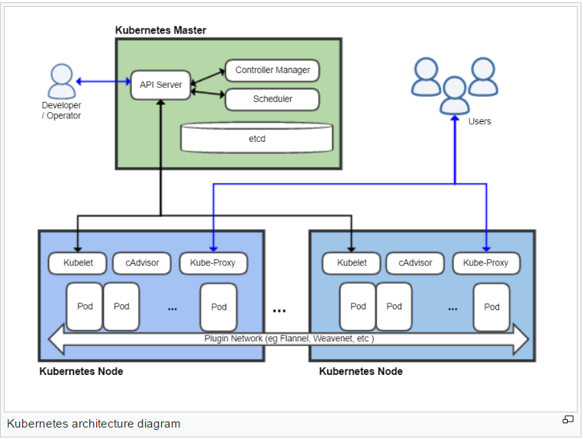
Architecture

Slide 7
Kubernetes on Local machine
DEMO

Slide 8
Kubernetes on Google Container engine
DEMO

Slide 9
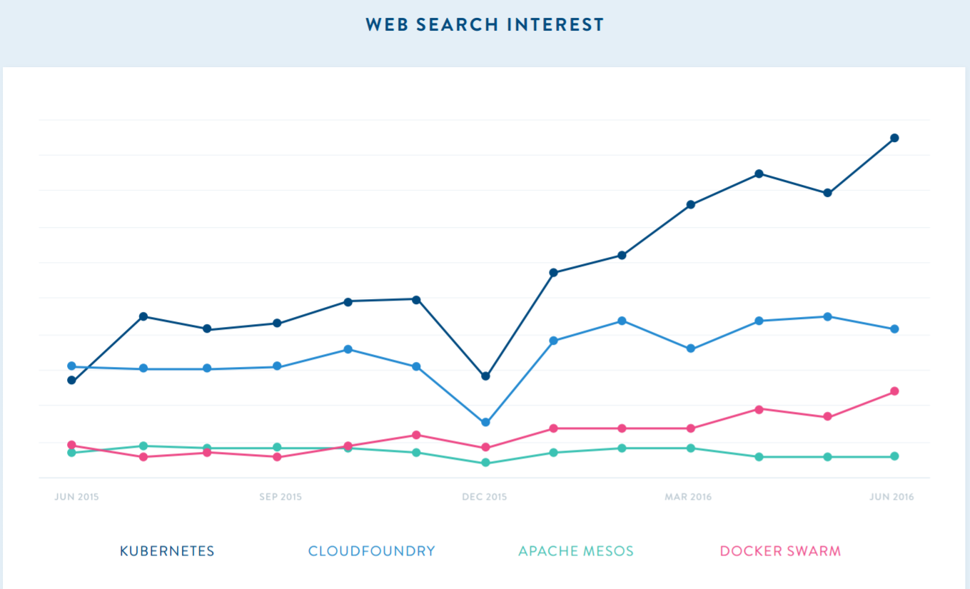
Comparison of Orchestrations

Slide 10
Comparison of Orchestrations
 | KUBERNETES | DOCKER SWARM | CLOUD FOUNDRY
PUBLIC CLOUD SERVICE PROVIDERS | Google Container Engine, Red Hat OpenShift | Azure | IBM, Predix
STRENGTHS | 10 years of Google research and development High availability of persistent storage | Docker owns the current standard for containers Docker Inc is immensly popular. Dockercon has over 5K attendees | Cloud Foundry has been around for a number of years(5+) Decent documentation that has gone through many renditions

Slide 11

Questions

Slide 12


