Slide 1
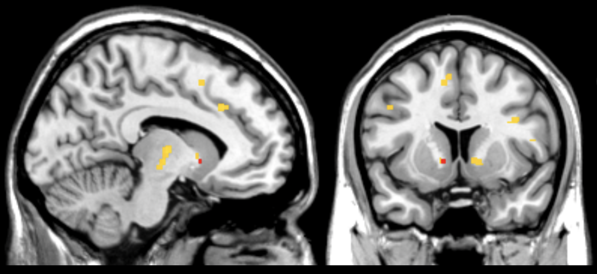
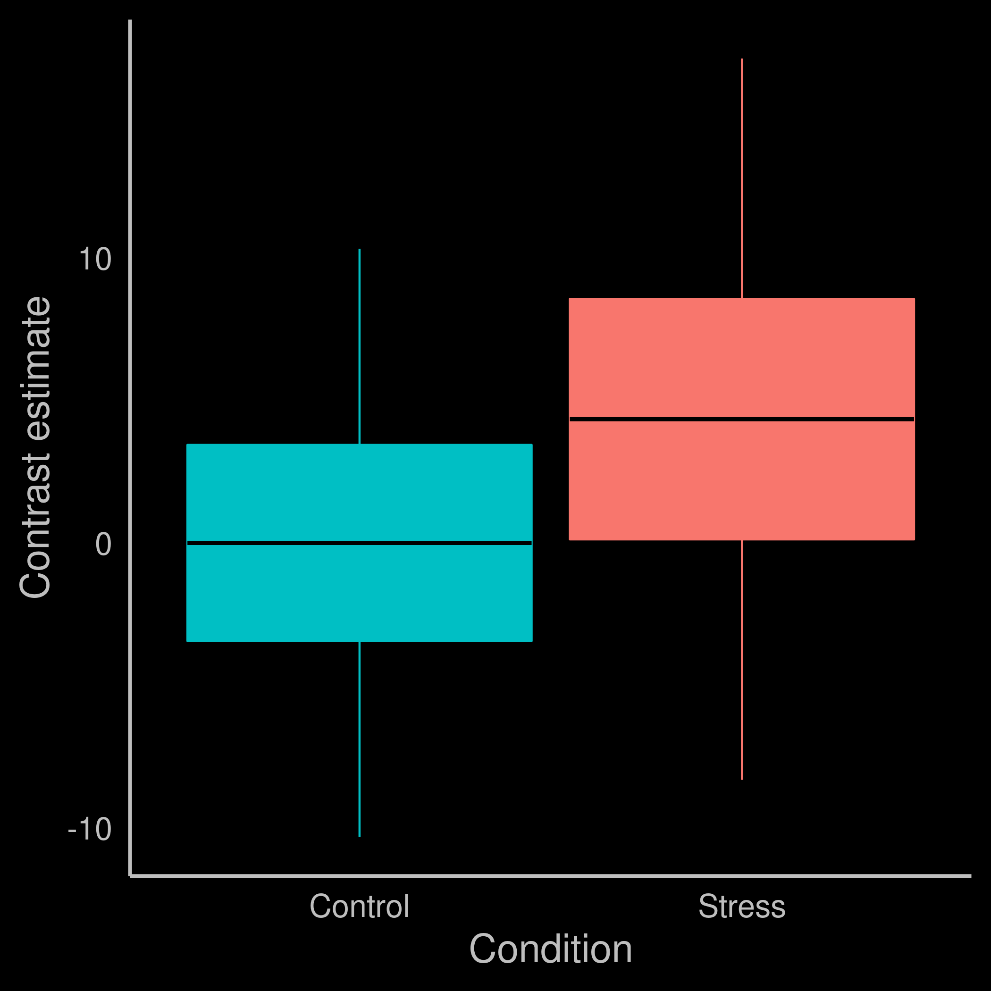
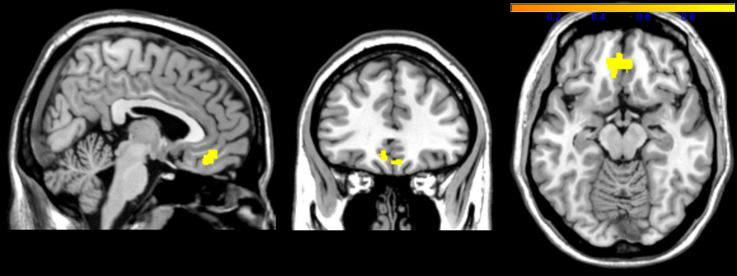
x = -10
y = 10
3 6 9
ST - ∆ > 0
CT - ∆ > 0
ST - ∆ < 0
CT - ∆ < 0

