Slide 1
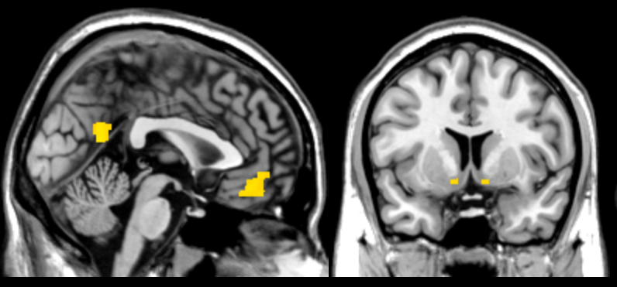
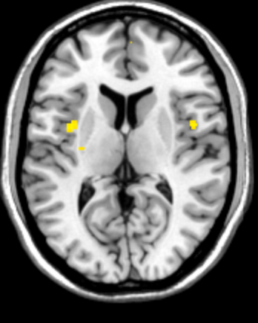

x = 0
y = 8
z = 10
2
4
6
8
t-value

