Slide 1
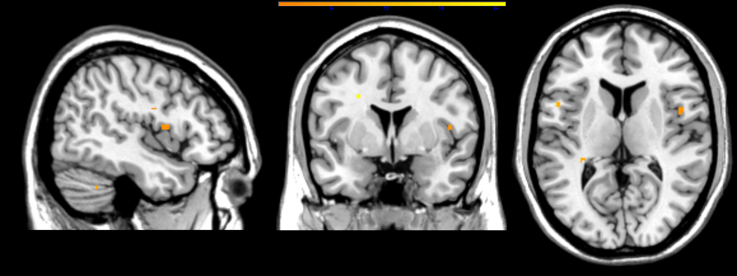
x = 46
z = 10
t-value

