Slide 1
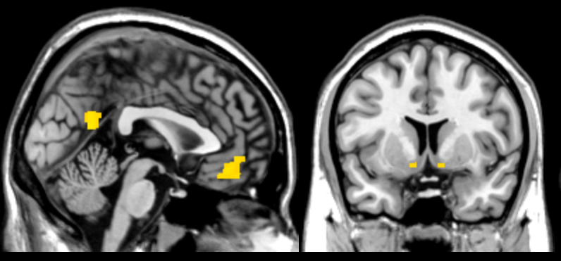

x = 0
y = 8
2
4
6
8
t-value

