Slide 1
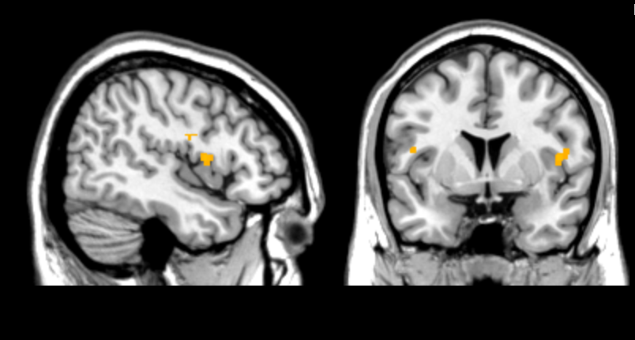
x =
y = 8
2
4
6
8
t-value

