Slide 1
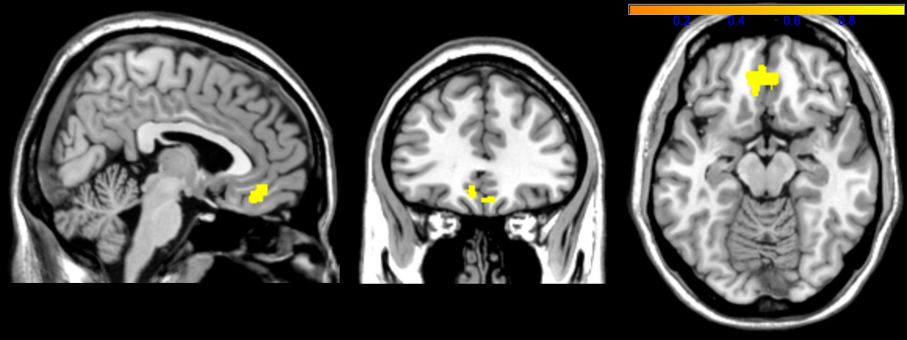
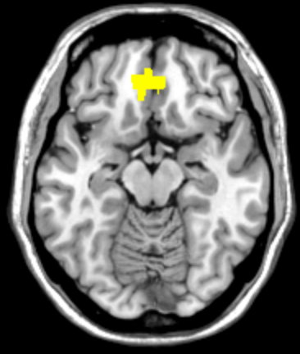
x = 4
z = -18
t-value
ST - ∆ > 0
CT - ∆ > 0
ST - ∆ < 0
CT - ∆ > 0

