Slide 1
Understanding and Transforming Data with Tableau
Jie Zhang
March 12, 2018

Slide 2







Operational Intelligence @ FMS
About Us
Pull data from various sources
Analyze to discover insight
Present to business

Slide 3
Schedule
0. Introductions (15 mins)
Anatomy of a data set (25 mins)
Data Granularity (30 mins)
Break (15 mins)
Joins and Cardinality (40 mins)
Aggregations and Level of Detail (40 mins)

Slide 4
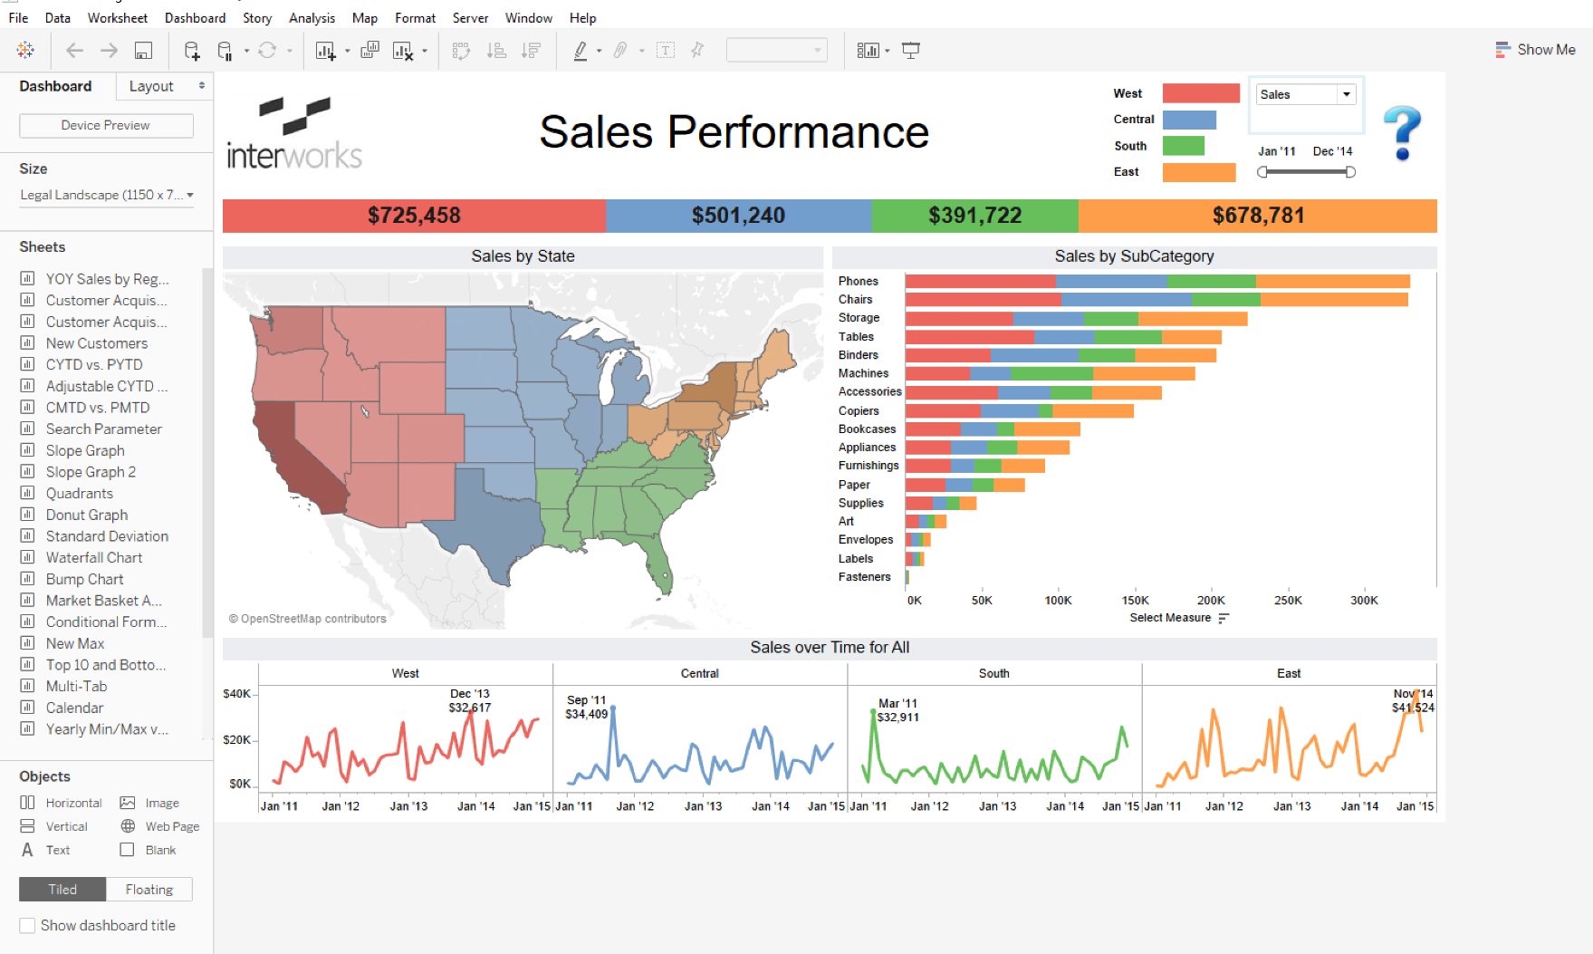
Importance of Data Understanding

Slide 5
“Even something as simple as colour scheme can have a marked impact on the perceived credibility of information presented visually - often a considerably more marked impact than the actual authority of the data source.”
https://www.theguardian.com/news/datablog/2013/jul/24/why-you-should-never-trust-a-data-visualization

Slide 6
1. Anatomy of a data set

Slide 7
A Tabular Data Set
Heading
col0 | col1 | col2 | col3 | col4 | col5 | col6
0 | 0.0 | abc | 5 | 2017-01-01 | zzz | 0
1 | -0.5 | abc | 9 | 2016-08-30 | zzz | 0
2 | 4.0 | abc | 17 | 2017-02-15 | ttt | 1
3 | 7.1 | xyz | 0 | 2017-07-02 | 455 | 0
4 | 0.0 | xyz | 0 | 2017-08-01 | 455 | 1
5 | 5.9 | def | 123 | 2017-07-02 | ttt | 1
Records

Slide 8
Data Types
Heading
col0 | col1 | col2 | col3 | col4 | col5 | col6
0 | 2.3 | abc | 5 | 2017-01-01 | zzz | 0
1 | -0.5 | abc | 9 | 2016-08-30 | zzz | 0
2 | 4.0 | abc | 17 | 2017-02-15 | ttt | 1
3 | 7.1 | xyz | 0 | 2017-07-02 | 455 | 0
4 | 0.0 | xyz | 60 | 2017-08-01 | 455 | 1
5 | 5 | def | 123 | 2017-04-06 | ttt | 1
Records
Number
String
Date
Number
(Boolean)

Slide 9
Dimensions and Measures (Tableau Defaults)
Heading
col0 | col1 | col2 | col3 | col4 | col5 | col6
0 | 2.3 | abc | 5 | 2017-01-01 | zzz | 0
1 | -0.5 | abc | 9 | 2016-08-30 | zzz | 0
2 | 4.0 | abc | 17 | 2017-02-15 | ttt | 1
3 | 7.1 | xyz | 0 | 2017-07-02 | 455 | 0
4 | 0.0 | xyz | 60 | 2017-08-01 | 455 | 1
5 | 5 | def | 123 | 2017-04-06 | ttt | 1
Records
Number
String
Date
Number
(Boolean)
Measure
Dimension
Dimension
Measure

Slide 10
Dimensions and Measures (Preferred)
Heading
col0 | col1 | col2 | col3 | col4 | col5 | col6
0 | 2.3 | abc | 5 | 2017-01-01 | zzz | 0
1 | -0.5 | abc | 9 | 2016-08-30 | zzz | 0
2 | 4.0 | abc | 17 | 2017-02-15 | ttt | 1
3 | 7.1 | xyz | 0 | 2017-07-02 | 455 | 0
4 | 0.0 | xyz | 60 | 2017-08-01 | 455 | 1
5 | 5 | def | 123 | 2017-04-06 | ttt | 1
Records
Dimension
Measure
Dimension
Dimension
Dimension
Primary Key

Slide 11
Discrete and Continuous
Heading
col0 | col1 | col2 | col3 | col4 | col5 | col6
0 | 2.3 | abc | 5 | 2017-01-01 | zzz | 0
1 | -0.5 | abc | 9 | 2016-08-30 | zzz | 0
2 | 4.0 | abc | 17 | 2017-02-15 | ttt | 1
3 | 7.1 | xyz | 0 | 2017-07-02 | 455 | 0
4 | 0.0 | xyz | 60 | 2017-08-01 | 455 | 1
5 | 5 | def | 123 | 2017-04-06 | ttt | 1
Records
Dimension
Measure
Dimension
Dimension
Dimension
Discrete
Continuous
Discrete
Continuous
Discrete

Slide 12
Definitions
Data Type | Description | Examples
Number | Any number (integers or decimals) | 234, -93, 5.56234
String | A string of characters, which can include numbers. ‘0’ is not the same as 0. | ‘abc’, ‘123’
Date | Date value | 1/1/2017
Datetime | Date value with time precision. Date will default to placeholder date if only time exists in field. | 1/1/2017 10:56:40 AM
Boolean | Binary value | True/False, 1/0, Y/N
Geography | Values that Tableau can find on a map | ‘California’, ‘United States’, (37.4108709,-122.1462192)

Slide 13
Definitions
Dimension
Values to group by
Slice and dice the data
Segment and categorize
Measures
Values to group on
Aggregates up to dimensions
Tableau defaults the aggregation to summation
Summation, average, percentile, standard deviation, count

Slide 14
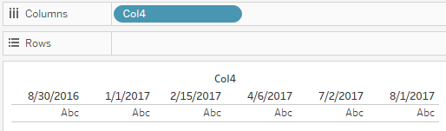
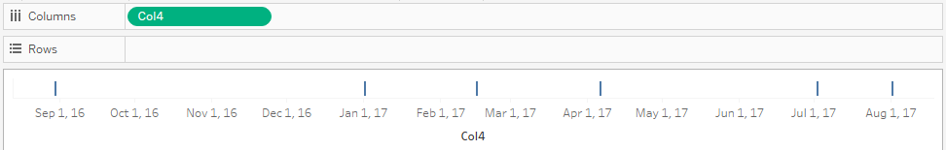
Definitions
Discrete: Tableau will represent only the values represented in the data
Continuous: Tableau will visually represent the gaps between the values

Slide 15
Summary
Data Type | Default Dimension/Measure | Default Discrete/Continuous
Number | Measure | Continuous
String | Dimension | Discrete
Date | Dimension | Continuous
Datetime | Dimension | Continuous
Boolean | Dimension | Discrete
Geography (Place names) | Dimension | Discrete
Geography (Long/Lat) | Measure | Continuous

Slide 16
Demo

Slide 17
Exercise 1

Slide 18
2. Data Granularity

Slide 19
What does each row represent?
Class Name | 2010 | 2011 | 2012 | 2013 | 2014
Principles of Biology | 70 | 67 | 80 | 81 | 84
Computer Science 101 | 20 | 30 | 40 | 45 | 50
Organic Chemistry 1 | 71 | 72 | 79 | 81 | 75
Writing Workshop | 20 | 21 | 30 | 17 | 15
Database Management | 10 | 70 | 50 | 43 | 31
One row per class

Slide 20
Data Granularity
Class Name | Year | Number of Students
Principles of Biology | 2010 | 70
Principles of Biology | 2011 | 67
Principles of Biology | 2012 | 80
Principles of Biology | 2013 | 81
Principles of Biology | 2014 | 84
Computer Science 101 | 2010 | 20
Computer Science 101 | 2011 | 30
……
One row class per year

Slide 21
The Primary Key Indicates the Granularity
Column (or set of columns) in the data set where the values uniquely identify each row in the data
Class Name | 2010 | 2011 | 2012 | 2013 | 2014
Principles of Biology | 70 | 67 | 80 | 81 | 84
Computer Science 101 | 20 | 30 | 40 | 45 | 50
Organic Chemistry 1 | 71 | 72 | 79 | 81 | 75
Writing Workshop | 20 | 21 | 30 | 17 | 15
Database Management | 10 | 70 | 50 | 43 | 31

Slide 22
The Primary Key Indicates the Granularity
Column (or set of columns) in the data set where the values uniquely identify each row in the data
Class Name | Year | # Students
Principles of Biology | 2010 | 70
Principles of Biology | 2011 | 67
Principles of Biology | 2012 | 80
Principles of Biology | 2013 | 81
Principles of Biology | 2014 | 84
Computer Science 101 | 2010 | 20
Computer Science 101 | 2011 | 30
……

Slide 23
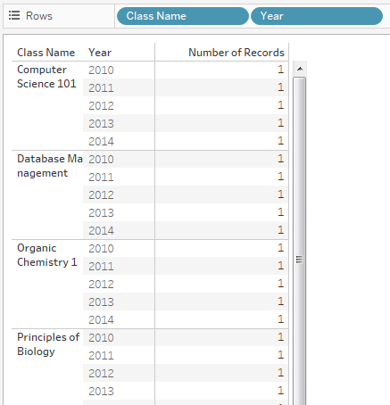
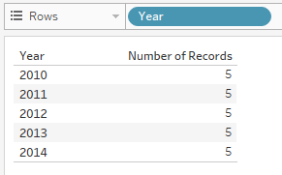
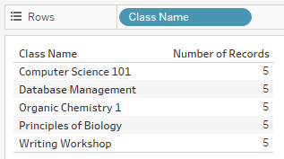
Verifying Granularity in Tableau
Find dimensions in the data set where the number of records per row of dimension values is always 1

Slide 24
Column-to-Row Pivot
Class Name | 2010 | 2011 | 2012 | 2013 | 2014
Principles of Biology | 70 | 67 | 80 | 81 | 84
Computer Science 101 | 20 | 30 | 40 | 45 | 50
Organic Chemistry 1 | 71 | 72 | 79 | 81 | 75
Writing Workshop | 20 | 21 | 30 | 17 | 15
Database Management | 10 | 70 | 50 | 43 | 31
Class Name | Year | # Students
Principles of Biology | 2010 | 70
Principles of Biology | 2011 | 67
Principles of Biology | 2012 | 80
Principles of Biology | 2013 | 81
Principles of Biology | 2014 | 84
Computer Science 101 | 2010 | 20
Computer Science 101 | 2011 | 30
……
Pivoting changes the granularity for the data
Reduces columns, increases rows
Increases flexibility when slicing and dicing

Slide 25
When to pivot
Column headings can be viewed as data (e.g. years)
Simplifies your data set from a very wide table into a skinny table
Constant need to group columns together
May need to perform additional calculations on the heading values

Slide 26
Unions
2010 Table:
Class Name | # Students
Principles of Biology | 70
Computer Science 101 | 20
Organic Chemistry 1 | 71
Writing Workshop | 20
Database Management | 10
Class Name | # Students
Principles of Biology | 67
Computer Science 101 | 30
Organic Chemistry 1 | 72
Writing Workshop | 21
Database Management | 70
Class Name | # Students
Principles of Biology | 80
Computer Science 101 | 40
Organic Chemistry 1 | 79
Writing Workshop | 30
Database Management | 50
Class Name | # Students
Principles of Biology | 81
Computer Science 101 | 45
Organic Chemistry 1 | 81
Writing Workshop | 17
Database Management | 43
2011 Table:
Class Name | # Students
Principles of Biology | 84
Computer Science 101 | 50
Organic Chemistry 1 | 75
Writing Workshop | 15
Database Management | 31
2012 Table:
2013 Table:
2014 Table:

Slide 27
Unions
Table Name | Class Name | # Students
2010 Table | Principles of Biology | 70
2010 Table | Computer Science 101 | 20
2010 Table | Organic Chemistry 1 | 71
2010 Table | Writing Workshop | 20
2010 Table | Database Management | 10
2011 Table | Principles of Biology | 67
2011 Table | Computer Science 101 | 30
2011 Table | Organic Chemistry 1 | 72
2011 Table | Writing Workshop | 21
2011 Table | Database Management | 70
… | … | …

Slide 28
Demo

Slide 29
Exercise 2

Slide 30
3. Joins and Cardinality

Slide 31
Is this data set still one row per class?
Class Name | 2010 | 2011 | 2012 | 2013 | 2014
Principles of Biology | 70 | 67 | 80 | 81 | 84
Computer Science 101 | 20 | 30 | 40 | 45 | 50
Organic Chemistry 1 | 71 | 72 | 79 | 81 | 75
Writing Workshop | 20 | 21 | 30 | 17 | 15
Database Management | 10 | 70 | 50 | 43 | 31
Organic Chemistry 1 | 71 | 72 | 79 | 81 | 75
No primary key exists
Not enough information to determine the granularity

Slide 32
Is this data set still one row per class?
Program | Class Name | 2010 | 2011 | 2012 | 2013 | 2014
Biology | Principles of Biology | 70 | 67 | 80 | 81 | 84
Computer Science | Computer Science 101 | 20 | 30 | 40 | 45 | 50
Biology | Organic Chemistry 1 | 71 | 72 | 79 | 81 | 75
General | Writing Workshop | 20 | 21 | 30 | 17 | 15
Computer Science | Database Management | 10 | 70 | 50 | 43 | 31
Chemistry | Organic Chemistry 1 | 71 | 72 | 79 | 81 | 75
One row class per program

Slide 33
Table joins may affect granularity
Program | Class Name
Biology | Principles of Biology
Computer Science | Computer Science 101
Biology | Organic Chemistry 1
Chemistry | Organic Chemistry 1
General | Writing Workshop
Computer Science | Database Management
Class Name | 2010 | …
Principles of Biology | 84 | …
Computer Science 101 | 50 | …
Organic Chemistry 1 | 75 | …
Writing Workshop | 15 | …
Database Management | 31 | …

Slide 34
Cardinality
Program-Class Mapping
Class
Many
One
One instance of class can have many instances in program-class mapping
Granularity will adopt that of the many table when tables are joined together
Both inner and outer join types will obey this rule

Slide 35
Cardinality
Program
Program-Class Mapping
Class
Every row in Program-Class will repeat for every row in Class-Student
Cartesian product
Class-Student Mapping

Slide 36
Ideal Situation
Dimensions
Dimensions
Measures
Dimensions
Dimensions

Slide 37
Less Ideal Situation
Dimensions
Dimensions
Measures
Values here will be duplicated
Measures
Dimensions
Dimensions

Slide 38
Worst Situation
Dimensions
Dimensions
Measures
Measures
Dimensions
Dimensions
Dimensions
Measures
Values in both tables will be duplicated

Slide 39
When joining tables…
Know the cardinality of the joins
If you are unsure, sum over the entire dataset a measure column before and after the join.
If total values differ, than the granularity has changed
Outer joins will not save you!

Slide 40
Using Cartesian products to your advantage
Some times you may want to force rows to be duplicated in order to change the granularity of your data set
Class Name | Start Time | End Time
Principles of Biology | 9:00 | 11:30
Computer Science 101 | 9:30 | 12:00
Organic Chemistry 1 | 14:00 | 16:00
Writing Workshop | 12:30 | 13:45
Database Management | 18:15 | 20:00
On any given minute, what classes are in session?
Repeat class name for all minutes that class in session

Slide 41
Cartesian Join
Time | Static
0:00 | 1
0:01 | 1
0:02 | 1
0:03 | 1
… | …
23:59 | 1
Static | Class Name | Start Time | End Time
1 | Principles of Biology | 9:00 | 11:30
1 | Computer Science 101 | 9:30 | 12:00
1 | Organic Chemistry 1 | 14:00 | 16:00
1 | Writing Workshop | 12:30 | 13:45
1 | Database Management | 18:15 | 20:00

Slide 42
Cartesian join result
Time | Static | Static | Class Name | Start Time | End Time
0:00 | 1 | 1 | Principles of Biology | 9:00 | 11:30
0:01 | 1 | 1 | Principles of Biology | 9:00 | 11:30
0:02 | 1 | 1 | Principles of Biology | 9:00 | 11:30
…
9:00 | 1 | 1 | Principles of Biology | 9:00 | 11:30
9:01 | 1 | 1 | Principles of Biology | 9:00 | 11:30
…
11:31 | 1 | 1 | Principles of Biology | 9:00 | 11:30
…
0:00 | 1 | 1 | Computer Science 101 | 9:30 | 12:00
…
9:30 | 1 | 1 | Computer Science 101 | 9:30 | 12:00

Slide 43
Cartesian join result with additional filter
Time | Static | Static | Class Name | Start Time | End Time
0:00 | 1 | 1 | Principles of Biology | 9:00 | 11:30
0:01 | 1 | 1 | Principles of Biology | 9:00 | 11:30
0:02 | 1 | 1 | Principles of Biology | 9:00 | 11:30
…
9:00 | 1 | 1 | Principles of Biology | 9:00 | 11:30
9:01 | 1 | 1 | Principles of Biology | 9:00 | 11:30
…
11:31 | 1 | 1 | Principles of Biology | 9:00 | 11:30
…
0:00 | 1 | 1 | Computer Science 101 | 9:30 | 12:00
…
9:30 | 1 | 1 | Computer Science 101 | 9:30 | 12:00

Slide 44
Tableau Data Blend
Granularity is not effected by data blending Tableau data sources
Any columns from the secondary data source in a data blend are aggregated first and then joined together
Ideally suited for bringing in measures from the secondary source
Dimensions will get aggregated using the ATTR() Tableau function

Slide 45
Demo

Slide 46
Exercise 3

Slide 47
4. Aggregations and Level of Detail

Slide 48
How aggregations work
col0 | col1 | col2 | col3 | col4 | col5 | col6
0 | 0.0 | abc | 5 | 2017-01-01 | zzz | 0
1 | -0.5 | abc | 9 | 2016-08-30 | zzz | 0
2 | 4.0 | abc | 17 | 2017-02-15 | ttt | 1
3 | 7.1 | xyz | 0 | 2017-07-02 | 455 | 0
4 | 0.0 | xyz | 0 | 2017-08-01 | 455 | 1
5 | 5.9 | def | 123 | 2017-07-02 | ttt | 1
col2 | col3
abc | [5,9,17]
xyz | [0,0]
def | [123]
col2 | sum(col3)
abc | 31
xyz | 0
def | 123

Slide 49
How aggregations work
col0 | col1 | col2 | col3 | col4 | col5 | col6
0 | 0.0 | abc | 5 | 2017-01-01 | zzz | 0
1 | -0.5 | abc | 9 | 2016-08-30 | zzz | 0
2 | 4.0 | abc | 17 | 2017-02-15 | ttt | 1
3 | 7.1 | xyz | 0 | 2017-07-02 | 455 | 0
4 | 0.0 | xyz | 0 | 2017-08-01 | 455 | 1
5 | 5.9 | def | 123 | 2017-07-02 | ttt | 1
col2 | col3
abc | [5,9,17]
xyz | [0,0]
def | [123]
col2 | avg(col3)
abc | 10.33333
xyz | 0
def | 123

Slide 50
How aggregations work
col0 | col1 | col2 | col3 | col4 | col5 | col6
0 | 0.0 | abc | 5 | 2017-01-01 | zzz | 0
1 | -0.5 | abc | 9 | 2016-08-30 | zzz | 0
2 | 4.0 | abc | 17 | 2017-02-15 | ttt | 1
3 | 7.1 | xyz | 0 | 2017-07-02 | 455 | 0
4 | 0.0 | xyz | 0 | 2017-08-01 | 455 | 1
5 | 5.9 | def | 123 | 2017-07-02 | ttt | 1
col2 | col3
abc | [5,9,17]
xyz | [0,0]
def | [123]
col2 | count(col3)
abc | 3
xyz | 2
def | 1

Slide 51
How aggregations work
col0 | col1 | col2 | col3 | col4 | col5 | col6
0 | 0.0 | abc | 5 | 2017-01-01 | zzz | 0
1 | -0.5 | abc | 9 | 2016-08-30 | zzz | 0
2 | 4.0 | abc | 17 | 2017-02-15 | ttt | 1
3 | 7.1 | xyz | 0 | 2017-07-02 | 455 | 0
4 | 0.0 | xyz | 0 | 2017-08-01 | 455 | 1
5 | 5.9 | def | 123 | 2017-07-02 | ttt | 1
col2 | col3
abc | [5,9,17]
xyz | [0,0]
def | [123]
col2 | countd(col3)
abc | 3
xyz | 1
def | 1

Slide 52
How aggregations work
col0 | col1 | col2 | col3 | col4 | col5 | col6
0 | 0.0 | abc | 5 | 2017-01-01 | zzz | 0
1 | -0.5 | abc | 9 | 2016-08-30 | zzz | 0
2 | 4.0 | abc | 17 | 2017-02-15 | ttt | 1
3 | 7.1 | xyz | 0 | 2017-07-02 | 455 | 0
4 | 0.0 | xyz | 0 | 2017-08-01 | 455 | 1
5 | 5.9 | def | 123 | 2017-07-02 | ttt | 1
col2 | col3
abc | [5,9,17]
xyz | [0,0]
def | [123]
col2 | attr(col3)
abc | *
xyz | 0
def | 123

Slide 53
String Aggregations
col0 | col1 | col2 | col3 | col4 | col5 | col6
0 | 0.0 | abc | 5 | 2017-01-01 | zzz | 0
1 | -0.5 | abc | 9 | 2016-08-30 | zzz | 0
2 | 4.0 | abc | 17 | 2017-02-15 | ttt | 1
3 | 7.1 | xyz | 0 | 2017-07-02 | 455 | 0
4 | 0.0 | xyz | 0 | 2017-08-01 | 455 | 1
5 | 5.9 | def | 123 | 2017-07-02 | ttt | 1
Can we perform aggregations on non-numeric columns?
Yes: count(), countd(), attr()

Slide 54
Change in granularity can affect aggregations
Order Number | Order Total Amount
1 | $100
2 | $50
3 | $75
Order Number | Order Line | Order Line Amount
1 | 1.1 | $90
1 | 1.2 | $10
2 | 2.1 | $50
3 | 3.1 | $75
[100,50,75] [90,10,50,75]
Sum: $225 $225
Avg: $75 $56.25
Med: $75 $62.50
When changing the grain of a measure, any aggregation that relies on the distribution of the numbers will be affected. (i.e. average, percentile, standard deviation, min, max)

Slide 55
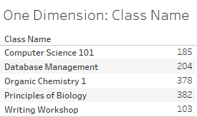
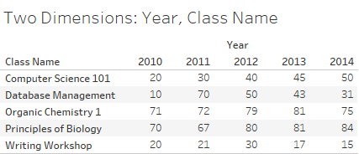
Tableau Level of Detail
Measures in Tableau always aggregate to the dimensions specified in the visualization
This is call the “view LoD”

Slide 56
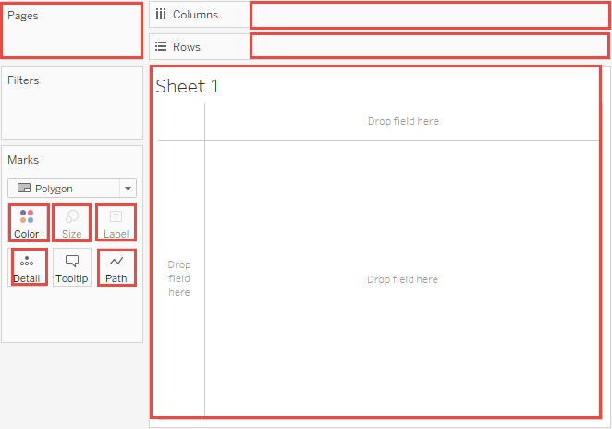
Tableau shelves that affect view LoD

Slide 57
Level of Detail Calculation
What if we need to compare the view LoD values with an aggregation independent to view?
E.g. I want to know the difference between the number of students by class and the total amount of students in the data set
Class Name | # Students | Total # Students | Total - Students
Principles of Biology | 382 | 1252 | 870
Computer Science 101 | 185 | 1252 | 1067
Organic Chemistry 1 | 378 | 1252 | 874
Writing Workshop | 103 | 1252 | 1149
Database Management | 204 | 1252 | 1048

Slide 58
LoD Calculation Syntax
{[FIXED | INCLUDE | EXCLUDE] <dimension declaration> : <aggregate expression>}
FIXED: lock to the exact dimensions specified
INCLUDE: in addition to the view LoD, include these dimensions
EXCLUDE: remove from the view LoD these dimensions
Comma separate list of dimension columns
E.g. [Class Name], [Year]
Specify the type of aggregation to use
E.g. SUM([# Students])

Slide 59
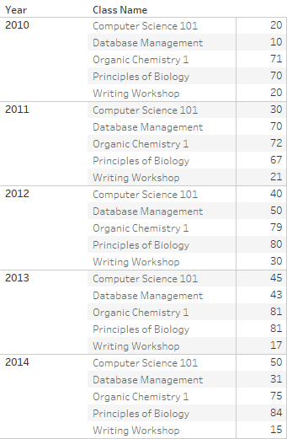
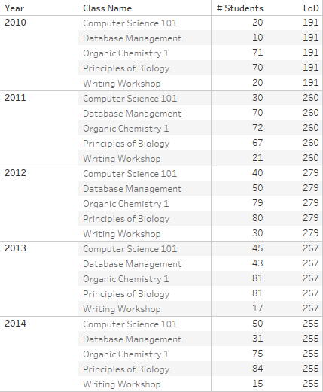
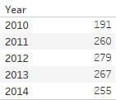
LoD calculation specifies a separate table
{ fixed [Year] : sum([# Students]) }
If the LoD table is at a higher level (i.e. fewer dimensions) than the view LoD, then the LoD calculation repeats for each point in the data.

Slide 60
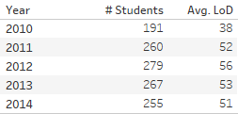
LoD calculation specifies a separate table
{ fixed [Year], [Class Name] : sum([# Students]) }
If the LoD table is at a lower level (i.e. more dimensions) than the view LoD, then the LoD values are aggregated a second time to the view level based on the measure aggregation.

Slide 61
Resolving data transformation issues with LoD’s
Program | Class Name | # Students
Biology | Principles of Biology | 70
Computer Science | Computer Science 101 | 20
Biology | Organic Chemistry 1 | 71
General | Writing Workshop | 20
Computer Science | Database Management | 10
Chemistry | Organic Chemistry 1 | 71
# Students gets double counted because Organic Chemistry 1 row was duplicated for each program it is in
{ fixed [Class Name] : max([# Students]) }
Creates a separate table where class name is the only dimension and single out one instance of the # Students value using max() or min()

Slide 62
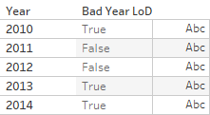
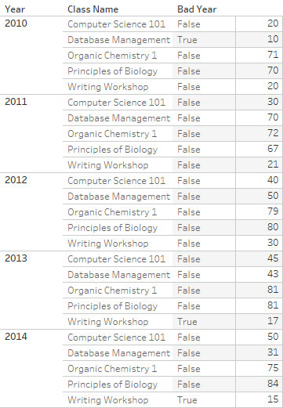
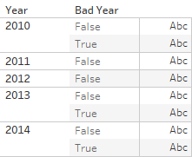
Resolving data transformation issues with LoD’s
Distinguish between bad years and good years
Bad year is when any class in the year has an enrollment count less than 20
Good year is when all class in the year has an enrollment count 20 or above
[# Students] < 20
{ fixed [Year] : max([# Students]<20) }

Slide 63
Demo

Slide 64
Exercise 4

Slide 65


Jie Zhang Operational Intelligence Manager
Financial Management Services 3145 Porter Drive, Palo Alto, CA 94304 T: +1 650.736.7905 E: jzhang28@stanford.edu http://fingate.stanford.edu
Stanford Slack Grid
@jie
jzhang28

