Slide 1
Education seminar lesson: intro to phylogenetic analyses
TEMPLE
UNIVERSITY
Avery Selberg
Notes:
Put logos on here

Slide 2
Goal: understanding the relationship between genotype and phenotype
A worked example

Slide 3
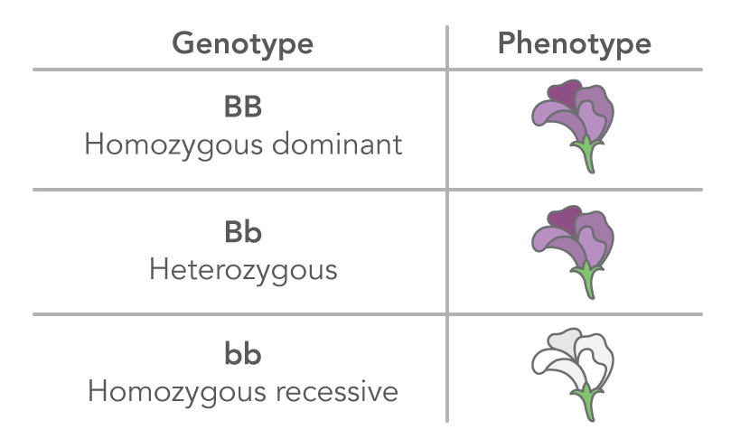
Recap: genotype → Phenotype
From the nucleotide sequence
Notes:
Figure image for genotype and phenotype

Slide 4
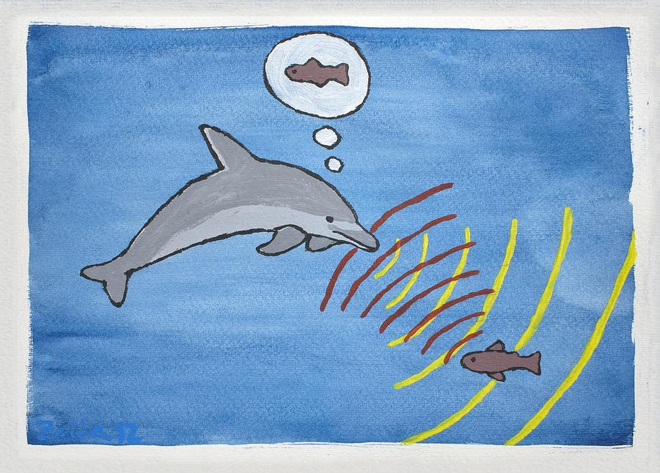
Question:
We are studying marine mammals. We want to know: is a hearing (echolocation) gene in marine mammals adaptively evolving?
Notes:
Picture - echolocation

Slide 5
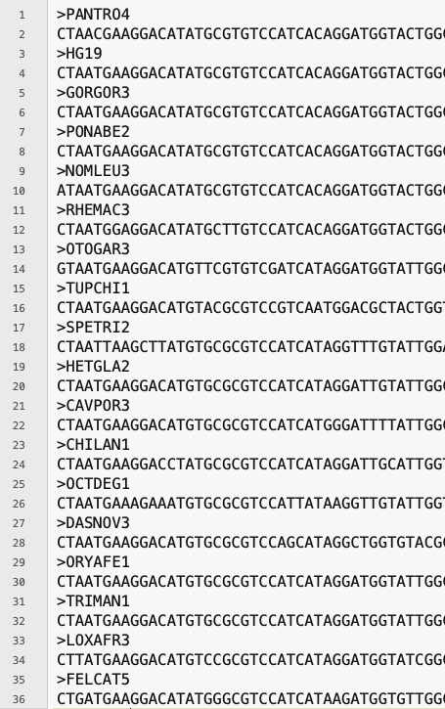
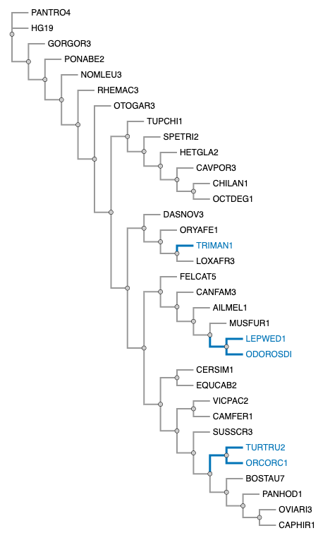
mammalian tree (From the tree lab)
RECAP: FROM PREVIOUS LABS
Echolocation Gene sequence (from the alignment lab)
Notes:
ask what an alignment is

Slide 6
How do we Use our sequence and tree to measure adaptation?

Slide 7
Initial genotype
CCT GAG GAG
Pro
Glu
Glu

Slide 8
Initial genotype
Genotype after a single nucleotide change
CCT GAG GAG
CCT GAA GAG
No change in amino acid encoded
Pro
Glu
Glu
Pro
Glu
Glu

Slide 9
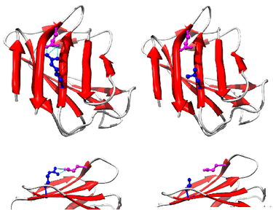
Initial genotype
Genotype after a single nucleotide change
Direct connection to phenotype
CCT GAG GAG
CCT GAA GAG
No change in amino acid encoded
Pro
Glu
Glu
Pro
Glu
Glu
Protein from: Al-Haggar et al., Eur J Hum Genet 2012

Slide 10
Initial genotype
Genotype after a single nucleotide change
Direct connection to phenotype
dS
CCT GAG GAG
CCT GAA GAG
No change in amino acid encoded
Pro
Glu
Glu
Pro
Glu
Glu
Protein from: Al-Haggar et al., Eur J Hum Genet 2012

Slide 11
Initial genotype
Genotype after a single nucleotide change
Direct connection to phenotype
CCT GAG GAG
Pro
Glu
Glu
dS
CCT GAG GAG
CCT GAA GAG
No change in amino acid encoded
Pro
Glu
Glu
Pro
Glu
Glu
Protein from: Al-Haggar et al., Eur J Hum Genet 2012

Slide 12
Initial genotype
Genotype after a single nucleotide change
Direct connection to phenotype
CCT GAG GAG
CCT GTG GAG
Glu
Val
Change in amino acid encoded
Pro
Glu
Pro
Glu
dS
CCT GAG GAG
CCT GAA GAG
No change in amino acid encoded
Pro
Glu
Glu
Pro
Glu
Glu
Protein from: Al-Haggar et al., Eur J Hum Genet 2012

Slide 13
Initial genotype
Genotype after a single nucleotide change
Direct connection to phenotype
CCT GAG GAG
CCT GTG GAG
Glu
Val
Change in amino acid encoded
Pro
Glu
Pro
Glu
dS
CCT GAG GAG
CCT GAA GAG
No change in amino acid encoded
Pro
Glu
Glu
Pro
Glu
Glu
Protein from: Al-Haggar et al., Eur J Hum Genet 2012

Slide 14
Initial genotype
Genotype after a single nucleotide change
Direct connection to phenotype
dN
CCT GAG GAG
CCT GTG GAG
___
Glu
Val
Change in amino acid encoded
Pro
Glu
Pro
Glu
dS
CCT GAG GAG
CCT GAA GAG
No change in amino acid encoded
Pro
Glu
Glu
Pro
Glu
Glu
Protein from: Al-Haggar et al., Eur J Hum Genet 2012

Slide 15
Selective pressure scenario
dN
Most nucleotide substitutions change the amino acid
In this case: adaptive evolution!
___
> 1
Few substitutions keep the same amino acid
dS
Notes:
Possibly add challenge question poll everywhere

Slide 16
IN PRACTICE
People think of adaptive evolution in different ways
We have models to try to explain different mechanisms
Example of a model: ”In a flowering plant, there is a 75% chance that the flower will be purple”
Models are not 100% correct, but they are helpful in making inferences
TODAYS MODEL: BUSTED to estimate where adaptive evolution happened.
Notes:
Explain what a model is

Slide 17
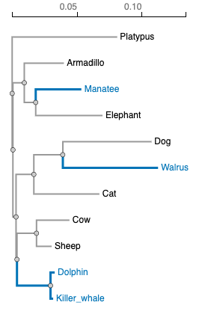
Unconstrained model:
Allow dN/dS to be any value
Estimate dN/dS along marine branches
Notes:
If were starting with an unconstrained what do you think were comparing it to?

Slide 18
Constrained (null) model:
Does not allow
dN/dS ≥1 (no adaptive evolution allowed)
Estimate dN/dS along marine branches with restrictions

Slide 19
We have our two models, we want test our hypothesis that the alternative is more likely than the null
Alternative model
Null model
Estimate dN/dS along marine branches
Estimate dN/dS along marine branches with restrictions

Slide 20
p-value tells us if the alternative model is significantly more likely than the null
LRT
Alternative model
Null model
Estimate dN/dS along marine branches
Estimate dN/dS along marine branches with restrictions

Slide 21
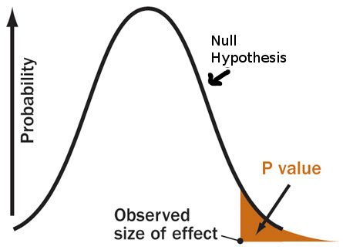
P-value
We use 0.05 to say that there is less than 5% chance the null is true (incorrectly rejected)

Slide 22
Worksheet instructions
Go to https://datamonkey.org/
Under the header “Methods and tools” choose BUSTED
Upload your nexus (.nex) file that we generated during our previous classes
Use the default parameters and click “Run Analysis”
Select the marine mammal branches to test. Recall these species from previous weeks. Important: Save a picture of your chosen branches to test. Click “Save branch selection” to run the analysis
Hint: if you’ve forgotten which branches to select, try uploading your tree to https://phylotree.hyphy.org/ to visualize the marine mammal species we specified in previous weeks.
While your analysis is running, begin answering questions for the worksheet

Slide 23
Other Selective pressure scenarios
Few nucleotide substitutions change the amino acid
dN
In this case: Negative selection!
___
< 1
dS
Most substitutions keep the same amino acid

Slide 24
Other Selective pressure scenarios
In this case: Neutral evolution!
dN
Equal number of substitutions that cause changes in amino acids and keep the same amino acid
___
= 1
dS

