Slide 1


Slide 2

MongoDB
Pedro González
Jovan Varga
Barcelona; January 27th, 2017

Slide 3
Lecture goals
Get familiar with MongoDB’s shell and Java API
Understand the Aggregation Framework

Slide 4
Table of contents
Introduction
CRUD operations
The Aggregation Framework
Java API
References

Slide 5
Documents
Ordered set of keys with associated values
Data structure:
  Map, Hash, Dictionary or Object → JSON (BSON)
Keys in a document must be Strings
  No duplicate keys
Documents are grouped in Collections
  Schemaless

Slide 6
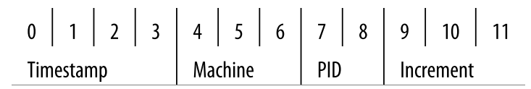
Data Types
Basic Data Types
  null, Boolean, Integer, String, Binary, …
Complex Data Types
  Array, Embedded Documents, Date, …
Special Data Types
  ObjectIds ( _id )
    Unique value representing the key of the document
    12 bytes
Notes:
ObjectIds
Timestamp: when the document was created in seconds since the epoch
Machine: unique identifier of the machine on which it was generated (hash of the hostname)
PID of the process to avoid collissions when multiple processes créate documents
Increment: responsable for uniqueness within a second in a single process (you can generate up to 16,777,216 ObjectIds per second).

Slide 7
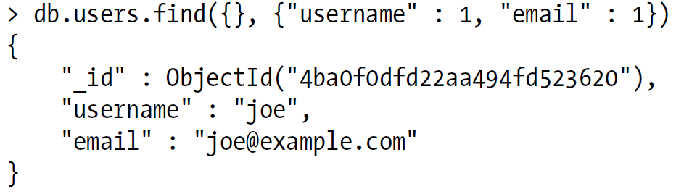
Querying Documents
Find all documents in a collection
  db.collection.find()
Query by example (build a document that looks similarly to the one you want)
  db.collection.find({“course”:“Big Data”})
Attribute projection

Slide 8
Querying Documents (II)
Conditionals
  Find users with age between 18 and 30
    db.users.find({“age”: {“$gte”:18, “$lte”:30}})
  Also available $lt, $lte and $gt
OR query ($or / $in / $nin )
  Normal AND-type query, you want to narrow your results down as far as possible in as few arguments as possible. OR-type queries are the opposite: they are most efficient if the first arguments match as many documents as possible.
Full documentation: https://docs.mongodb.org/manual/tutorial/query-documents/

Slide 9
Inserting Documents
Insert will automatically add an id key to the document (if not exists)
db.collection.insert({“name”:”Sergi”})
Internal implications
  The driver checks that the document does not exceed 4MB
  Check for non UTF-8 strings
  Check for unrecognized types
Full documentation: https://docs.mongodb.org/manual/tutorial/insert-documents/

Slide 10
Removing Documents
Removing documents
db.collection.remove()
  Does not drop the collection and indexes will still exist
Remove with selection
db.collection.remove({“name”:”Sergi”})
Dropping a collection
db.drop_collection(“users”)
Full documentation: https://docs.mongodb.org/manual/tutorial/remove-documents/

Slide 11
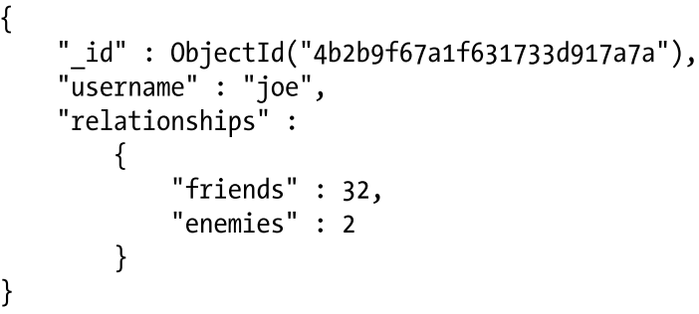
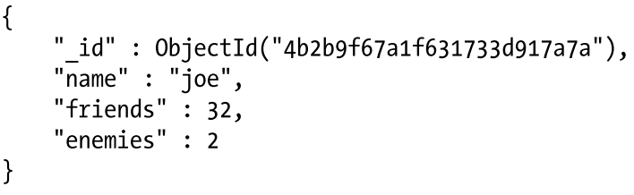
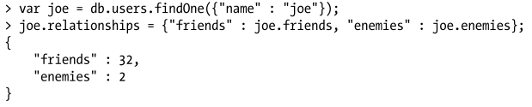
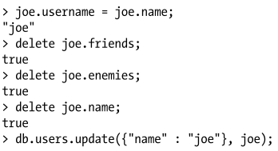
Updating Documents
Full documentation: https://docs.mongodb.org/manual/tutorial/modify-documents/

Slide 12
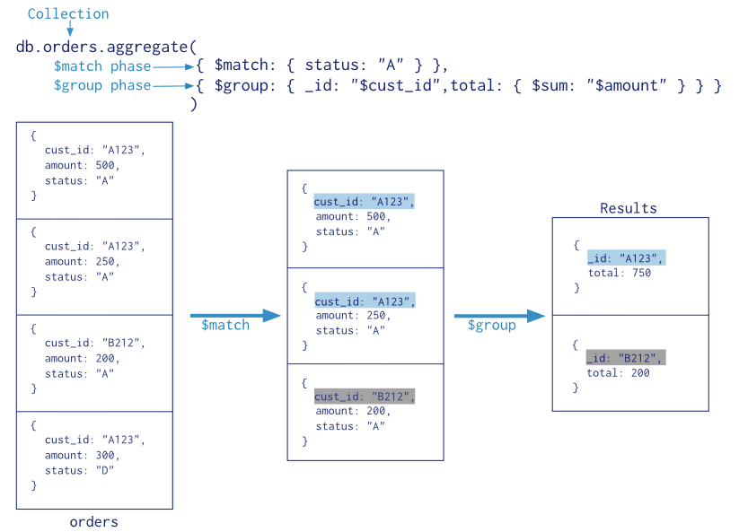
Aggregation Framework (Pipeline)

Slide 13
Aggregation Framework: Phases
$project – adds or removes attributes for each document
$match – filters the document stream
$limit – passes the first n documents
$skip – skips the first n documents
$group – applies a groupBy function. Returns the grouper field and accumulator fields
$sort – reorders the stream
And many more…
Full documentation: https://docs.mongodb.org/manual/core/aggregation-introduction/

Slide 14


MongoDB Java API
Get a collection
Create object {“x”:1, “y”:“foo”}
Save, find, …
  Same as the Shell API

Slide 15
References
K. Chodorow, M. Dirolf. MongoDB: The Definitive Guide, O’Reilly Media 1st edition (2010)
MongoDB Manual
  https://docs.mongodb.org/manual/
Getting Started with MongoDB (Java)
  https://docs.mongodb.org/getting-started/java/

