Slide 1


Slide 2

Linked Open Data – SPARQL in Practice
Emmanuel JAMIN
Jovan VARGA
Barcelona; 3rd of February, 2017

Slide 3

SPARQL in practice · Emmanuel Jamin, Jovan Varga · Barcelona; 3rd of February 2017
Index
What is the Semantic Web?
What is Linked Open Data?
What is Virtuoso? and DBpedia?
Virtuoso on the Big Data ecosystem
Virtuoso main features
What is Virtuoso intended for?
What is NOT Virtuoso intended for?
Common Pitfalls

Slide 4

SPARQL in practice · Emmanuel Jamin, Jovan Varga · Barcelona; 3rd of February 2017
What is the Semantic Web? (1)
the Semantic Web is
"a web of data that can be processed directly and indirectly by machines."
Tim Berners Lee (2001)

Slide 5
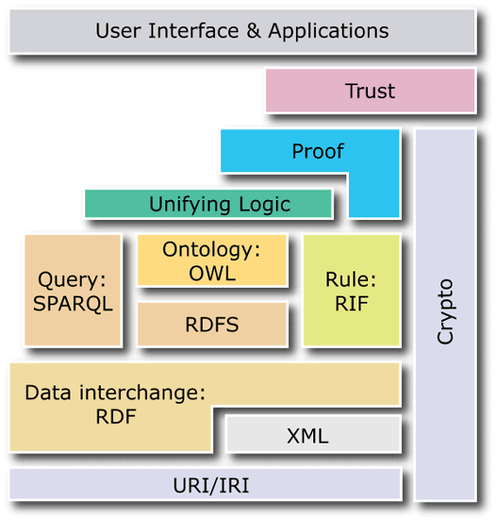

B –
SPARQL in practice · Emmanuel Jamin, Jovan Varga · Barcelona; 3rd of February 2017
What is the Semantic Web? (2)
The W3C normalization / scale
From: http://mmt.me.uk/slides/london011209/#(2)

Slide 6
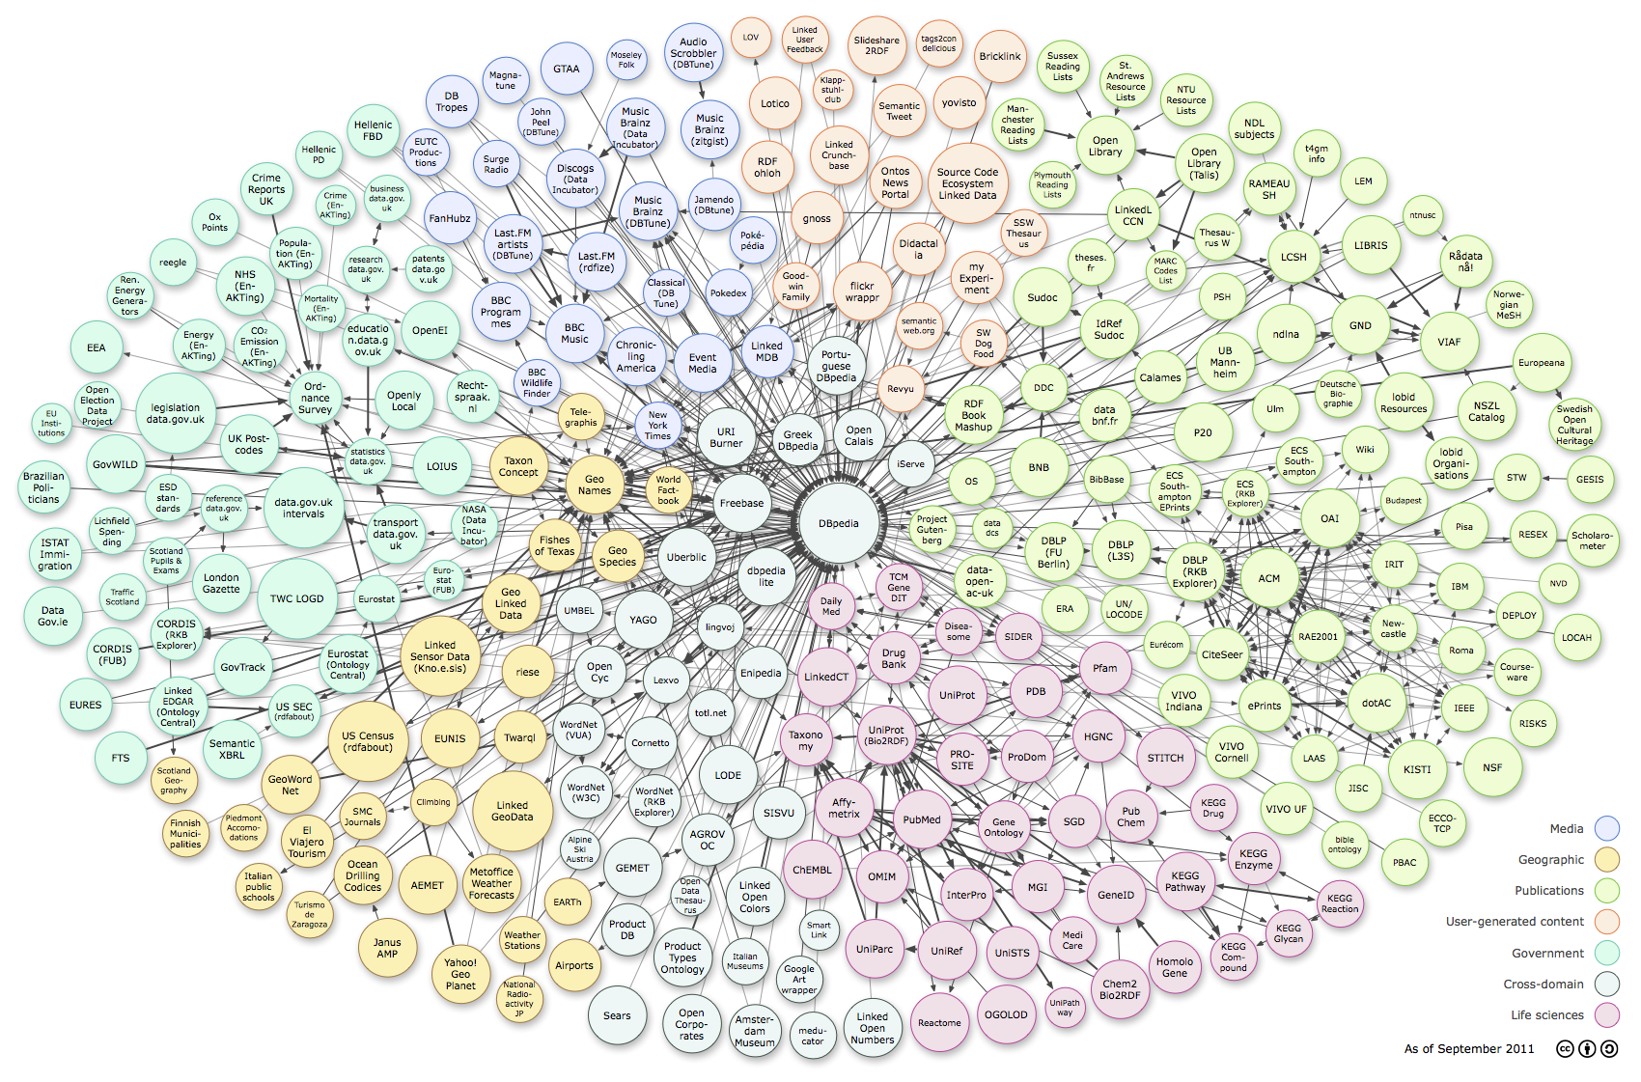

B – SW – Big Giant Graph
SPARQL in practice · Emmanuel Jamin, Jovan Varga · Barcelona; 3rd of February 2017
What is Linked Open Data? (1)
Open Data + Data Interconnection
Linked Open Data
  25 billion RDF triples over the web
Linked Open Data
From: http://www.w3.org/DesignIssues/diagrams/lod/2010-color.png

Slide 7
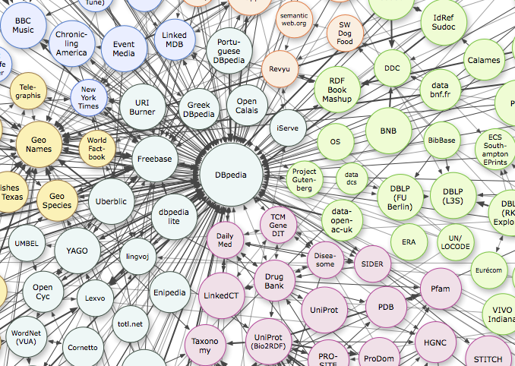
Neo4J in practice · Emmanuel Jamin · Barcelona; 27 de marzo de 2015
What is Linked Open Data? (2)
Linked Open Data

Slide 8
SPARQL in practice · Emmanuel Jamin, Jovan Varga · Barcelona; 3rd of February 2017
What is Virtuoso? And DBpedia?
Virtuoso is a triple store (RDF repository)
Large RDF repository to store Linked Open Data
Share the semantic resources through the SPARQL endpoint
DBpedia
  is a project aiming to extract structured content from the information created as part of the Wikipedia project
SPARQL endpoints
  http://dbpedia.org/sparql
  http://dbpedia.org/snorql

Slide 9
SPARQL in practice · Emmanuel Jamin, Jovan Varga · Barcelona; 3rd of February 2017
What is Jena?
Jena is the Java library to manage RDF content and SPARQL queries
Jena documentation
  https://jena.apache.org/getting_started/
An example of Java project with Jena
  https://github.com/castagna/jena-examples

Slide 10
SPARQL in practice · Emmanuel Jamin, Jovan Varga · Barcelona; 3rd of February 2017
RDF principles
RDF
(Subject, predicate, object)

Slide 11
SPARQL in practice · Emmanuel Jamin, Jovan Varga · Barcelona; 3rd of February 2017
RDF principles
RDF triples
  w3c.html has author Tim Berners Lee
  W3C has CEO Tim Berners Lee
  w3c.html is published at Web conference 2012

Slide 12
SPARQL in practice · Emmanuel Jamin, Jovan Varga · Barcelona; 3rd of February 2017
RDF principles
RDF triples

Slide 13
SPARQL in practice · Emmanuel Jamin, Jovan Varga · Barcelona; 3rd of February 2017
RDF principles
RDF-S → RDF-Schema
  Definition of
    Classes (concepts)
    Properties (conceptual relations)
  Relation between instances and schema is done through
    rdf:type
  Triples are always of the form:
Concept → Property → Concept
  Hierachy organisation with conceptual relations

Slide 14
SPARQL in practice · Emmanuel Jamin, Jovan Varga · Barcelona; 3rd of February 2017
RDF principles
RDFS

Slide 15
SPARQL in practice · Emmanuel Jamin, Jovan Varga · Barcelona; 3rd of February 2017
RDF principles
  w3c.html has author Tim Berners Lee
  w3c.html is type of Document
  Tim Berners Lee is type of Person
  w3c.html is published at Web conference 2012
  Web conference 2012 is type of Conference
  Conference is sub-class of Event

Slide 16
SPARQL in practice · Emmanuel Jamin, Jovan Varga · Barcelona; 3rd of February 2017
RDF principles
RDF triples => RDF graph

Slide 17
SPARQL in practice · Emmanuel Jamin, Jovan Varga · Barcelona; 3rd of February 2017
SPARQL principles
Used to retrieve information from RDF triple stores
Syntax similar to SQL
Main clauses:
  SELECT
  WHERE
  FILTER
  ORDER BY
  GROUP BY

Slide 18
SPARQL in practice · Emmanuel Jamin, Jovan Varga · Barcelona; 3rd of February 2017
SPARQL principles
Select all instances that are of type conference
SELECT ?conference
WHERE {
?conference rdf:type dbo:Conference .
}

Slide 19
SPARQL in practice · Emmanuel Jamin, Jovan Varga · Barcelona; 3rd of February 2017
SPARQL principles
Select all the documents along with the author and the conference of each of them
SELECT ?document ?author ?conference
WHERE {
?document rdf:type dbo:Document .
?document dbo:hasAuthor ?author .
?document dbo:isPublishedAt ?conference .
}

Slide 20
SPARQL in practice · Emmanuel Jamin, Jovan Varga · Barcelona; 3rd of February 2017
SPARQL principles
Select all the documents whose author is Tim Berners-Lee
SELECT ?document ?author
WHERE {
?document rdf:type dbo:Document .
?document dbo:hasAuthor ?author .
FILTER regex(str(?author), "Tim Berners-Lee") .
}

