Slide 1


Slide 2

Big Data Architectures in Hadoop
Petar Jovanovic
Sergi Nadal
Barcelona; December 14th, 2016

Slide 3
Lecture goals
Get familiar with different available storage formats in Hadoop
Understand the key factors that drive the design of a big data architecture
Data ingestion
Data movement
The Lambda Architecture as a generic big data architecture

Slide 4
Table of contents
Introduction and motivation
Data Storage Formats
Data Ingestion and Movement
Architectural Patterns in Hadoop
Summary
References

Slide 5
Data Storage Options in Hadoop
We already discussed SequenceFile
Some specialized formats
Serialization formats
Thrift
Protocol Buffers
Avro
Columnar formats
RCFile
ORC
Parquet

Slide 6
Serialization Formats
Serialization, convert data structures to byte streams for storage or network transmission
Serialization is core in a distributed system to reduce network latency
Hadoop’s built-in serialization format: Writables
Compact and fast
Not easy to extend from other languages than Java

Slide 7
Thrift¹ and Protocol Buffers²
Characteristics
Used to build cross-language interfaces to services
Interface Definition Language (IDL)
C style definitions
Also includes an RPC layer
Drawbacks for Hadoop
No internal compression of records
Not splittable
No native MapReduce support
1 - https://thrift.apache.org/
2 - https://developers.google.com/protocol-buffers/

Slide 8
Avro
Addresses lack of portability from of Writables
Stores the schema in the header of each file
Compressed and splittable
Support for schema evolution (add new fields)
The schema used to read a file does not need to match the schema used to write the file
https://avro.apache.org/

Slide 9
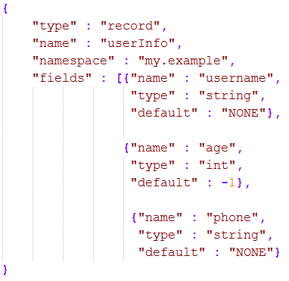
Avro (II)
Avro schema
Read more about schema evolution

Slide 10
Columnar Formats
Columnar storage provides several benefits
Skips I/O and decompression on columns that are not part of the query
Suitable in queries accessing a small column subset
Compression is more efficient (data is more similar within the same column)
Suitable for applications that require aggregations

Slide 11
RCFile
Developed specifically for efficient processing in MapReduce applications
In practice, only used as Hive storage format
Breaks files into row splits, within each split uses column oriented storage
Improves performance w.r.t. SequenceFiles, but has some deficiencies for query times and compression
This is improved in ORC and Parquet

Slide 12
Optimized Row Columnar (ORC)
Improvement of RCFile
Specifically query performance + storage efficiency
Allows predicates to be pushed down to the storage layer
Only the required data is brought back in queries
Splittable
Drawbacks: targeted only to Hive

Slide 13
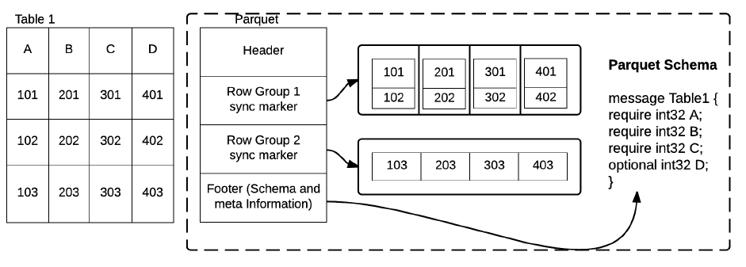
Parquet
Same ideas as ORC but intented to be a general purpose storage format for Hadoop
Hybrid format
Data is divided into row groups
Each row in the group is divided into columns
https://parquet.apache.org/

Slide 14
Data Ingestion
Some considerations when importing data into Hadoop
Timeliness of data ingestion
Incremental updates
Access patterns
Original source system and data structure
Push or pull

Slide 15
Timeliness of Data Ingestion
Macro Batch
Anything over 15min to hours, or even a daily job
Micro Batch
Every 1-2min, but no more tan 15min
Near Real-Time Decision Support
Immediately actionable by recipient of information
Data delivered in less than 2min but more than 2sec
Near Real-Time Event Processing
Under 2sec

Slide 16
Incremental Updates
Whether new data will append an existing dataset or modify it
If append only, HDFS will work mostly
Downside of HDFS is the inability to do appends or random writes to files once created
If updates are required, it is required first to write “delta” files and run a “compaction” job
Data is sorted by primary key, traverse delta and old file writing to a new one all changes.

Slide 17
Access Patterns
How is data going to be used once in Hadoop?
MapReduce
Large batch processes
Hive
Batch processing with SQL-like language
Pig
Batch processing with a dataflow language

Slide 18
Access Patterns (II)
Spark
Fast interactive processing
Giraph
Batch graph processing
Impala
MPP* style SQL
HBase
Atomic puts, gets and deletes on record level data
*Massive Parallel Processing

Slide 19
Original Source System and Data Structure
Read speed of the devices on source systems
Analyze disk I/Os and network
Original file type
Compression
Transferring a compressed file is better
Compression outside Hadoop (Gzip) is not splittable
RDBMS
Sqoop vs. File dumps
Streaming data

Slide 20
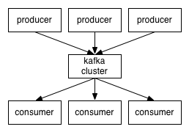
Data Ingestion: Kafka (I)
Distributed publish-subscribe messaging system
It maintains a feed of messages categorized into topics

Slide 21
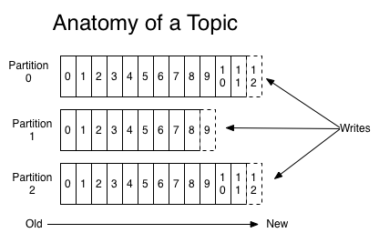
Data Ingestion: Kafka (II)
Applications can publish messages on Kafka or they can subscribe to topics and receive messages published on those topics

Slide 22
Data Ingestion: Sqoop
Used to extract data from an external storage system (e.g. RDBMS) and move it to Hadoop
It requires parameters such as source and target systems, connection information or tables to extract
Need to make sure it does not interfere with the source system’s peak load time

Slide 23
Data Movement: Flume (I)
Distributed collection, aggregation and movement of streaming data
Components
Flume sources consume events from external sources and forward to channels
Flume interceptors allow to modify events in flight
Selectors provide routing for events
Flume channels store events until they are consumed by a sink
Sink remove events from a channel and deliver

Slide 24
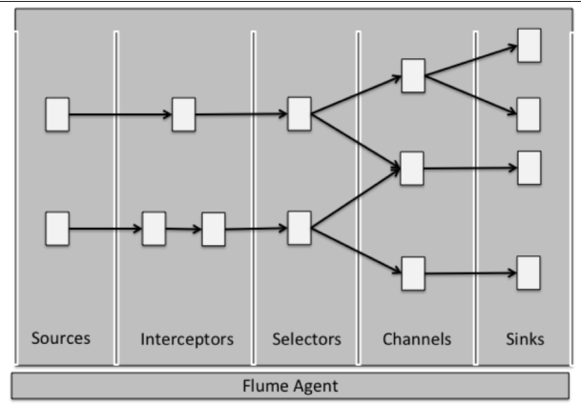
Data Movement: Flume (II)

Slide 25
Architectural Patterns in Hadoop
Lambda Architecture: capability to compute arbitrary functions on arbitrary data in real-time
Achieved by splitting it into three layers
Batch Layer
Serving Layer
Speed Layer

Slide 26
Batch Layer
Stores a master copy of the dataset
It is an immutable copy of the raw data entering the system
Precomputes batch views, loads them and makes them available for low latency querying
Some technologies
HDFS
Sqoop
MapReduce
Spark

Slide 27
Serving Layer
Indexes the batch views, loads them and makes them available for low latency querying
Different technologies can be used for different serving requirements
Some technologies
HBase
MongoDB
Neo4j

Slide 28
Speed Layer
Creates views on data as arrives in the system
It will be likely implemented by a streaming processing system
Some technologies
Spark streaming
Kafka
Storm
Flume

Slide 29
The Lambda Architecture (I)
New data is sent to the batch and speed layers
In the batch layer the new data will be appended to the master dataset
In the speed layer the new data is used to update real-time views
Once data is available in the batch and serving layers it can be discarded from the speed

Slide 30
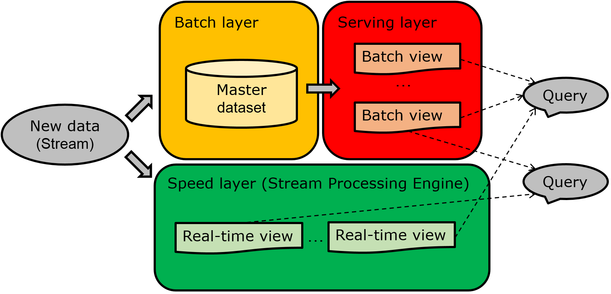
The Lambda Architecture (II)

Slide 31
Summary
Several storage options available in Hadoop for different requirements
The decision will highly impact performance
Need to consider different factors when designing a big data architecture
Aligned with your requirements!
The Lambda Architecture
Provides a reliable and fault tolerant way to serve applications that require low latency processing

Slide 32
References
Rana Faisal Munir et al. 2015. ResilientStore: A Heuristic based Storage Format Selector for Intermediate Results. In Press
Mark Grover et al. 2014. Hadoop Application Architectures, O’Reilly
http://lambda-architecture.net/

