Slide 1


Slide 2

Apache Spark Graphs
Petar Jovanovic
Sergi Nadal
Barcelona; December 2nd, 2016

Slide 3
Lecture goals
Get familiar with GraphFrames API
Undestand the BSP programming model
Learn how to perform graph analysis using GraphFrames

Slide 4
Table of contents
Introduction and motivation
GraphFrames
Bulk Synchronous Programming
Summary
References

Slide 5
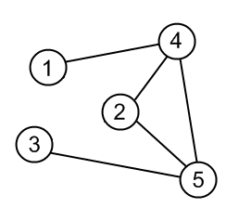
Graphs 101
Graph: a representation of a set of objects
G = (V,E)
V = Vertices (nodes)
E = Edges (links)
Graphs capture the relationship between objects
Graphs can be directed or undirected

Slide 6
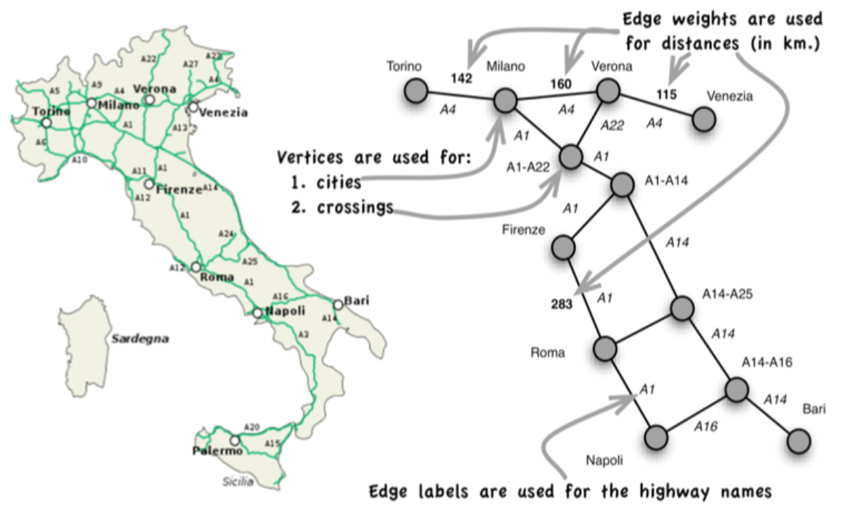
Motivation: Graph Analysis
Graphs are used to represent connected data
Social networks
Mobile phone systems
URLs in the Internet
Friend recommendation
Fake account detection
Product recommendation
Route planning

Slide 7
Challenges
Scale of graphs
Google indexes ~50B pages
Facebook has ~1.1B users
Twitter has ~530M users
Complexity of graphs
Explorative and iterative algorithms

Slide 8
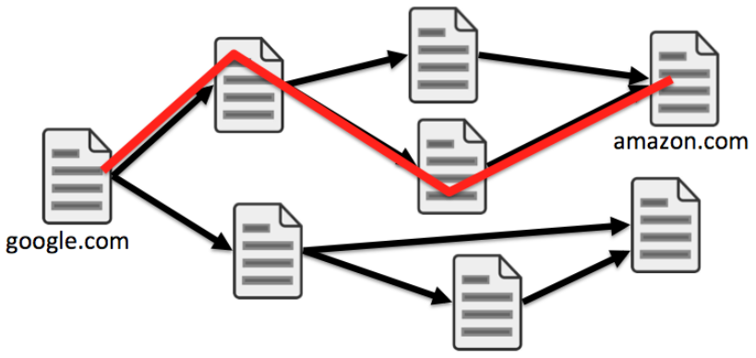
Challenges (II)
Compute shortest distance from “google.com”
Multiple passes to compute the result
Inherent dependencies make it hard to parallelize

Slide 9
What About Graph Databases?
Some graph databases
Neo4j, Titan, ArangoDB, Virtuoso (RDF), …
Drawbacks
Usually do not scale well
Don’t integrate with HDFS
Combine storage and computational layers
Plenty of APIs

Slide 10
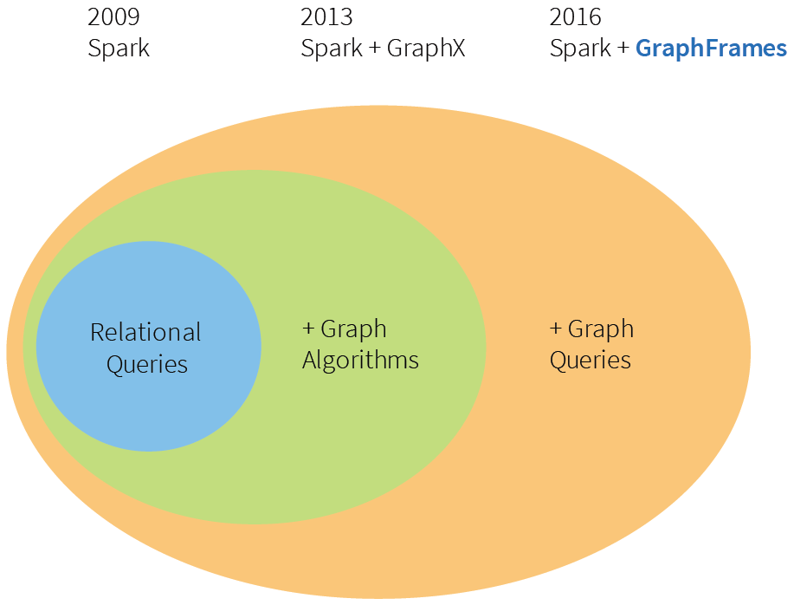
Support for Graph Analysis in Spark

Slide 11
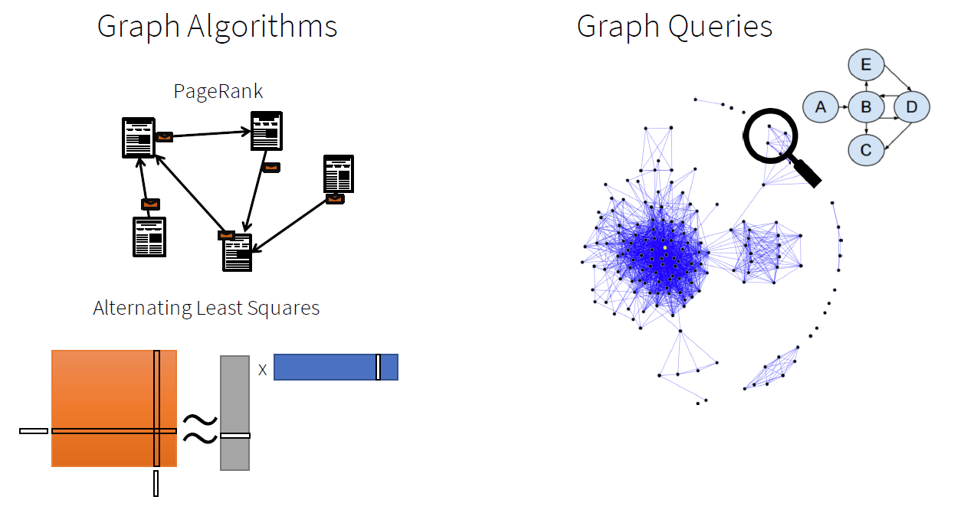
Graph Algorithms vs. Graph Queries

Slide 12
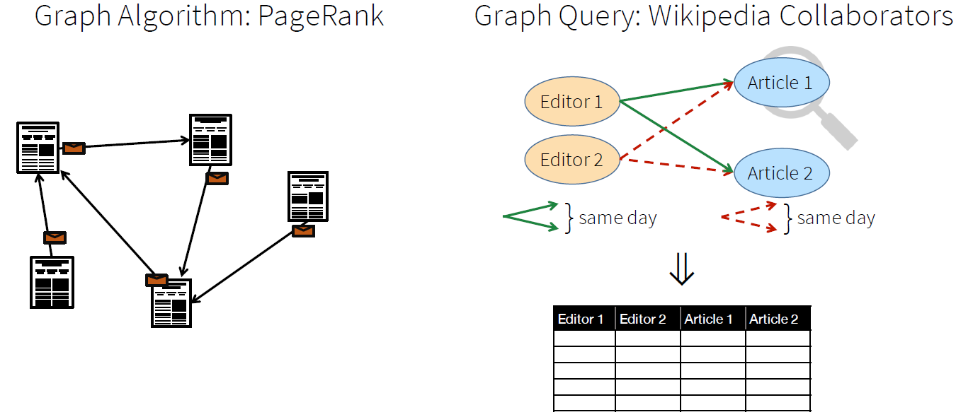
Graph Algorithms vs. Graph Queries

Slide 13
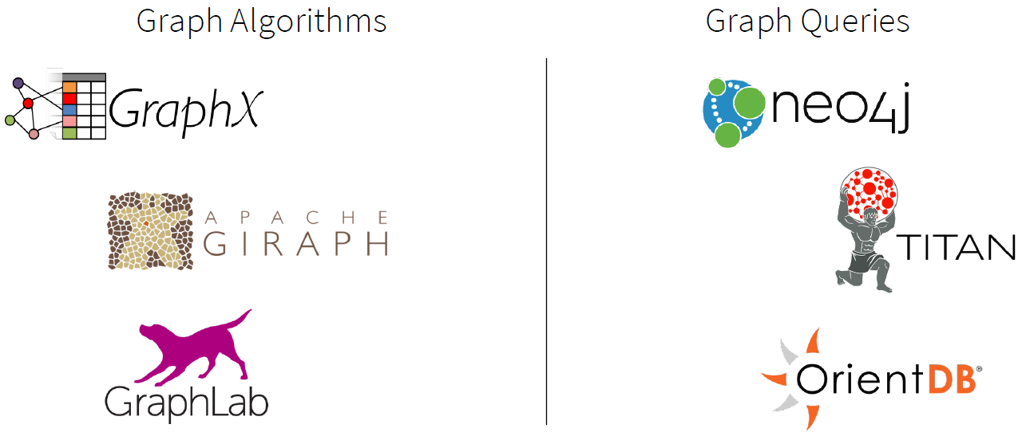
Separate Systems

Slide 14
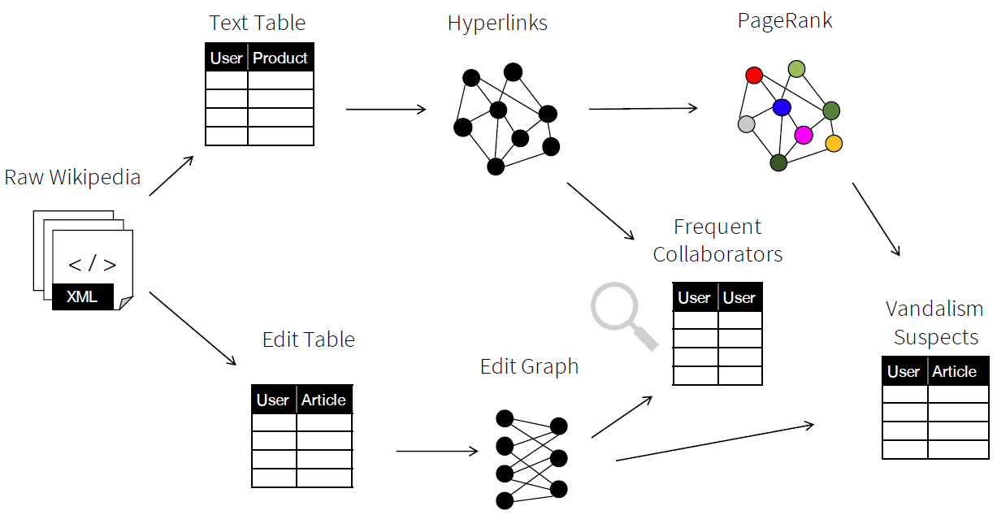
Problem: Mixed Graph Analysis

Slide 15
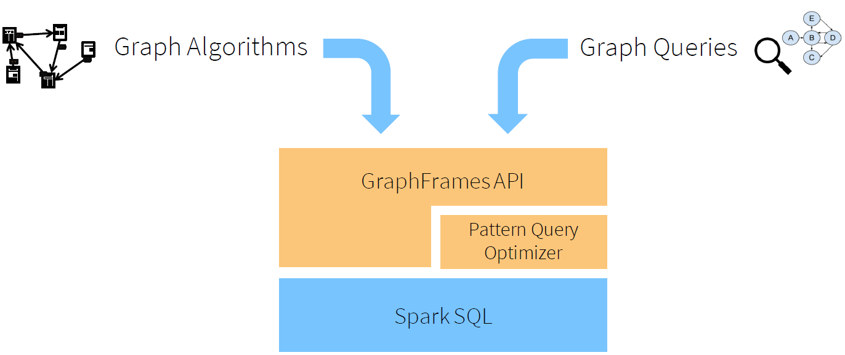
Solution: GraphFrames

Slide 16
Bulk Synchronous Parallel (BSP)
Based on message passing and collective communication
A BSP program consists of a sequence of supersteps, each superstep has the following phases:
Local computation
Process comunication
Barrier synchronization
Pregel is a distributed implementation of it

Slide 17
Bulk Synchronous Parallel (BSP)
s ynch ba r r i e r
P1
P2
P3
superstep t
superstep t+1
Local computation phase
Communication phase

Slide 18
“Thinking Like a Vertex”
I know my local state
I know my neighbours
I can send messages to vertices
I can declare that I am done
I can mutate graph topology

Slide 19
“Thinking Like a Vertex”
Compute shortest path from “google.com”
2
5
2
1
3
google.com
2
4
2
1
1

Slide 20

Shortest Paths
I only know my value and who my neighbors are
2
∞
5
∞
∞
2
1
∞
3
0
2
google.com
4
∞
2
∞
1
∞
1

Slide 21
Receive messages → Update Value → Send Messages
2
∞
5
1
∞
2
1
∞
3
0
2
google.com
4
∞
2
2
1
∞
1
Vertices compute
asynchronously

Slide 22
Global Synchronization
2
∞
5
1
∞
2
1
∞
3
0
2
google.com
4
∞
2
2
1
∞
1
Synchronization barrier

Slide 23
And again
2
3
5
1
∞
2
1
4
3
0
2
google.com
4
6
2
2
1
3
1

Slide 24
And again
2
3
5
1
6
2
1
4
3
0
2
google.com
4
4
2
2
1
3
1

Slide 25
Summary
GraphFrames = DataFrames + GraphX
You can run queries on the graph
BSP for iterative algorithms
Performance, scalability and fault-tolerance thanks to Spark RDDs

Slide 26
References
Grzegorz Malewicz et al. 2010. Pregel: a system for large-scale graph processing. In SIGMOD '10
Ankur Dave. GraphFrames: Graph Queries in Spark SQL. In Spark Summit East'16

