Slide 1


Slide 2

Apache Spark Streaming
Petar Jovanovic
Sergi Nadal
Barcelona; November 25th, 2016

Slide 3
Lecture goals
Understand Spark streaming model, when is it useful and when not
Get familiar with specific streaming operations available in Spark
Understand how streaming data can be combined with the other APIs in Spark

Slide 4
Table of contents
Introduction and motivation
Real-time processing
Spark Streaming
Summary
References

Slide 5
Motivation: Real-time Processing
Analyze social media feeds
  E.g., detect trends in updates from users of a social media site
Analyze financial feeds
  E.g., anomaly detection in a user’s account activity
Analyze machine data feeds
  E.g., raising alerts in the case of anomalies or errors in application logs

Slide 6
Data Processing Models
Batch Processing
  Processing large amounts of stable, existing data
  High latency
  Examples: MapReduce, Spark Core.
Event-Stream Processing
  One-at-a-time, each element is processed on arrival
  Example: Storm
Micro-Batching
  Like batch processing but with very small batch size
  Example: Spark Streaming

Slide 7
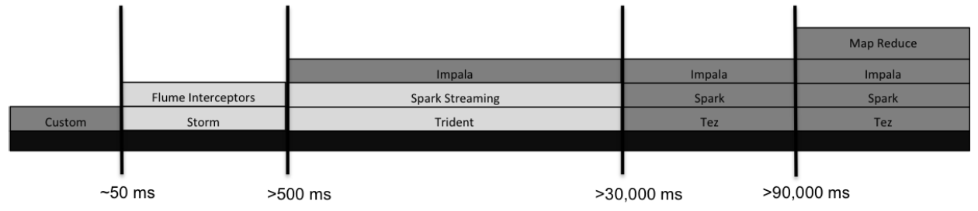
Near Real-time Processing Tools
- Flume: usually coupled with Kafka for data dispatching
- Trident: builts on top of Storm and adds extra functionalities

Slide 8
Storm vs Spark Streaming
 | Storm | Spark Streaming
Delivery Semantics | At least once* | Exactly once
Applicability | Near real-time analysis, data normalization, ETL | Iterative machine learning and interactive analytics
Latency | Sub-second | Second
Development | New paradigm (spouts+bolts) | Similar code as for batch
Fault tolerance (Cluster Manager) | Mesos | YARN, Mesos or Standalone
* However with Trident you can get exactly once processing at the cost of
adding complexity to topologies, lower performance and state generation.
More in http://www.slideshare.net/ptgoetz/apache-storm-vs-spark-streaming

Slide 9
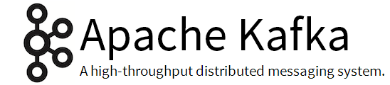
What about Apache Kafka?
Kafka is a distributed message bus (queue)
Targets reliable message delivery with architectures with high rates of events
It does not provide processing functionalities
Kafka is often a key part of architectures involving stream processing
  Data delivery and no data loss is guaranteed

Slide 10
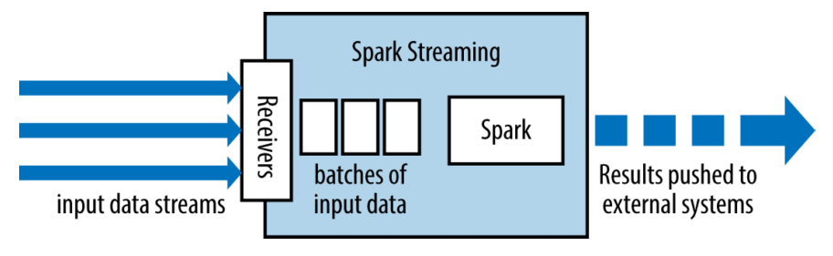
Spark Streaming Architecture
Micro-Batch: Runs a streaming computation as a series of very small, deterministic batch jobs
Chop up the live stream into batches of X seconds
Spark treats each batch of data as RDDs (all primitives are available!)
Finally, the processed results of the RDD operations are returned in batches

Slide 11
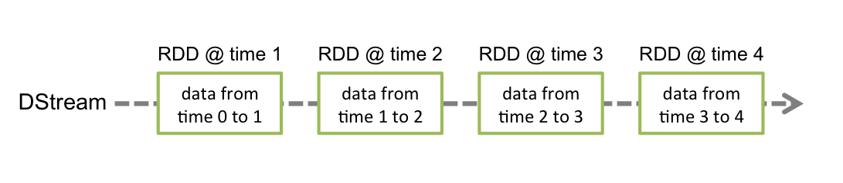
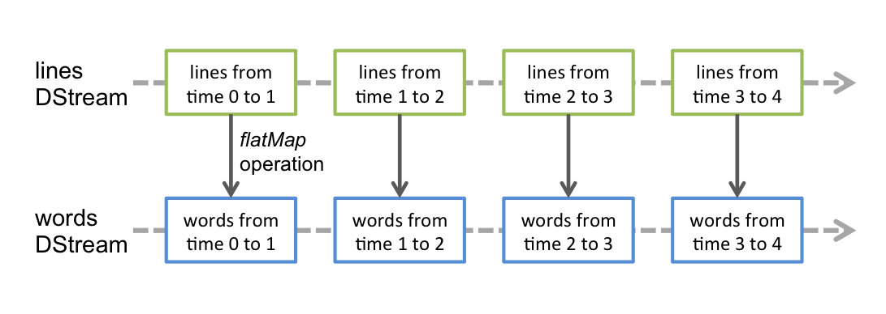
Discretized Streams (DStreams)
Represent a continuous stream of data
  It can be either:
    The input data stream received from the source
    The processed data stream generated by transforming the input stream
A DStream is a continuous series of RDDs
Operations to DStreams apply to the underlying RDDs

Slide 12
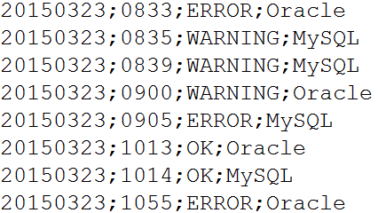
Example: Real-Time Mining (in class)
Load error messages from a log into memory, then interactively search for various patterns
hdfs://192.168.1.1:9000/logs/dbLog.txt

Slide 13
Example: Real-Time Log (in class)

Slide 14
Streaming in Cluster Mode (I)
For each input, Spark launches receivers in Worker nodes
  Replication to other worker for fault tolerance
    Default value is 2
Data is stored in memory as cached RDDs
The StreamingContext, periodically runs Spark jobs to process the data
Checkpointing mechanism which periodically saves the state (every 5 – 10 batches)
  Used when recovering, only need to retrieve the last

Slide 15
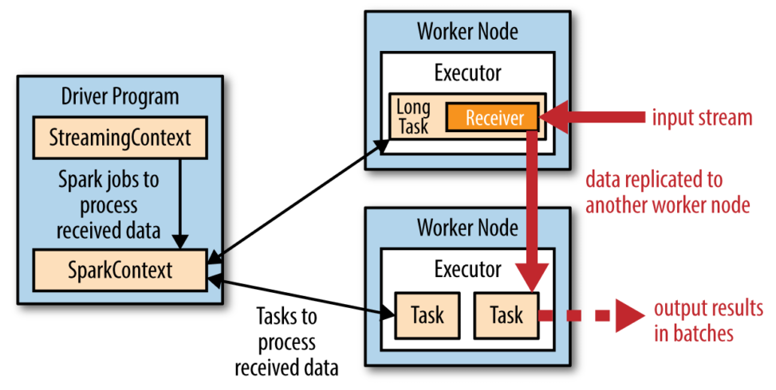
Streaming in Cluster Mode (I)

Slide 16
Transformations
Stateless
  The processing of each batch does not depend on the data of its previous batches
Stateful
  Uses data or intermediate results from previous batches to compute the results of the current batch
    Sliding windows, state tracking, etc.
  Checkpointing is mandatory

Slide 17
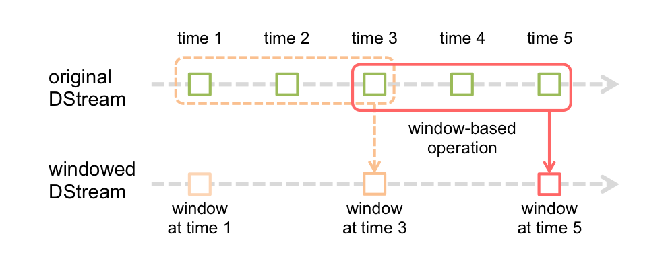
Window Operations
Windowed computations allow the application of transformations over a sliding window of data
Two parameters are required:
  Window length: the duration of the window (3 in the figure)
  Sliding interval: the interval at which the window operation is performed (2 in the figure)

Slide 18
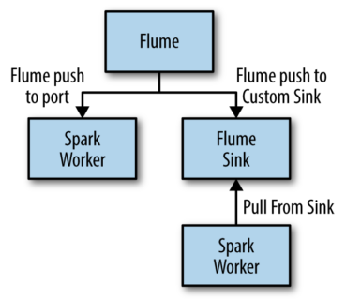
Input Sources
Online streams
Files
Kafka
  Spark receives pairs <topic, message>
Flume
  Push-based receiver
  Pull-based receiver
More on Spark-Flume: http://spark.apache.org/docs/latest/streaming-flume-integration.html
Notes:
From Flume’s website:
A Flume source consumes events delivered to it by an external source like a web server. The external source sends events to Flume in a format that is recognized by the target Flume source. For example, an Avro Flume source can be used to receive Avro events from Avro clients or other Flume agents in the flow that send events from an Avro sink. A similar flow can be defined using a Thrift Flume Source to receive events from a Thrift Sink or a Flume Thrift Rpc Client or Thrift clients written in any language generated from the Flume thrift protocol. When a Flume source receives an event, it stores it into one or more channels. The channel is a passive store that keeps the event until it’s consumed by a Flume sink. The file channel is one example – it is backed by the local filesystem. The sink removes the event from the channel and puts it into an external repository like HDFS (via Flume HDFS sink) or forwards it to the Flume source of the next Flume agent (next hop) in the flow. The source and sink within the given agent run asynchronously with the events staged in the channel.

Slide 19
Structured Streaming
Stream processing in SparkSQL
Gets ideas from CQL (Continuous QL)
  Stream aggregations
  Event-time windows
  Stream-to-batch joins
Still an experimental API
  We won’t see it here!

Slide 20
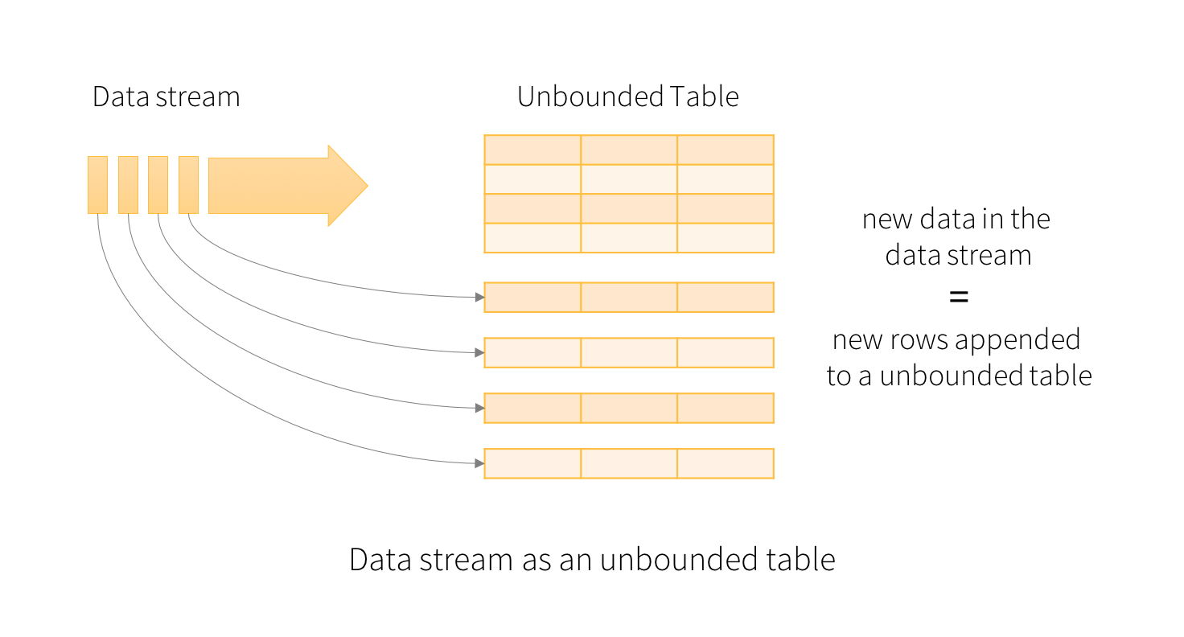
Unbounded Tables
From Structured Streaming Programming Guide: https://spark.apache.org/docs/latest/structured-streaming-programming-guide.html

Slide 21
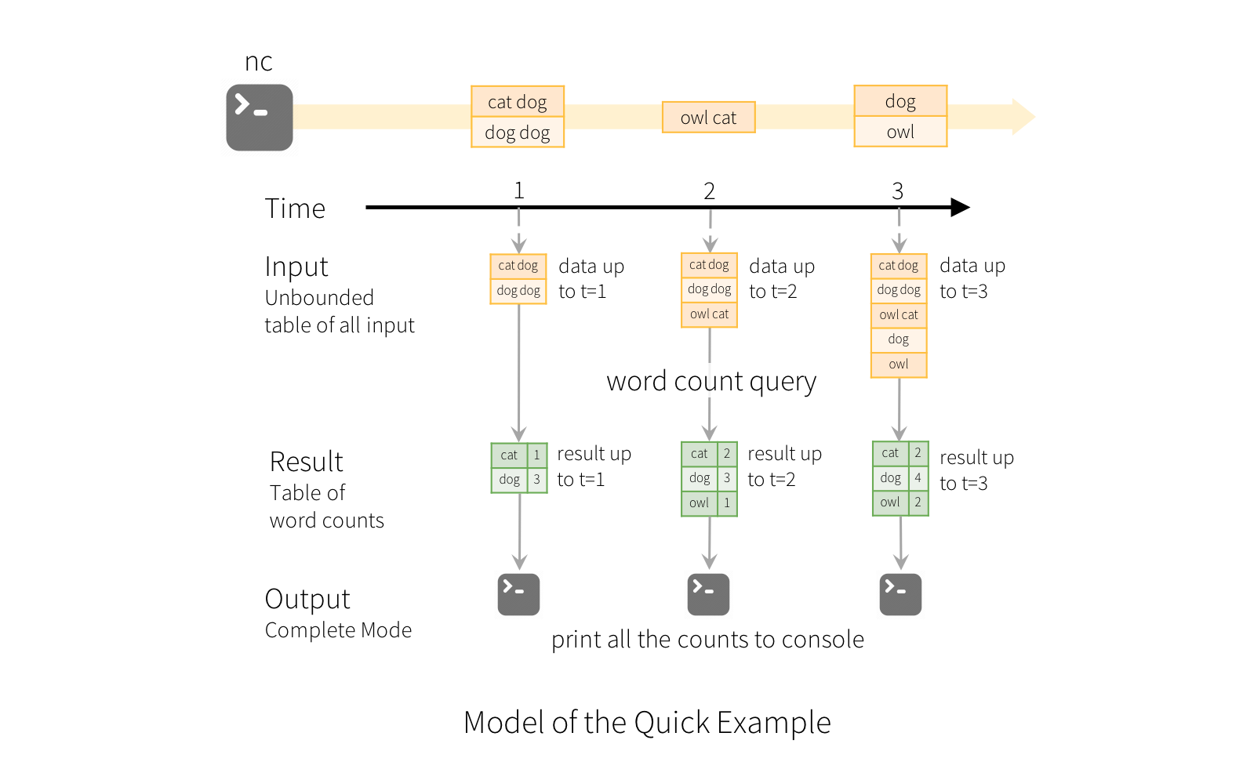
Unbounded Tables
From Structured Streaming Programming Guide: https://spark.apache.org/docs/latest/structured-streaming-programming-guide.html

Slide 22
5. Summary
Spark provides a micro-batching architecture for stream processing
Relying on RDDs, guarantees fault tolerance and exactly-once message delivery
The Spark Core API is fully applicable to streams

Slide 23
6. References
Apache Spark. http://spark.apache.org/
Databricks Blog. https://databricks.com/blog
H.Karau, A.Konwinski, P.Wendell. Learning Spark – Lightning-fast Big Data Analysis, O’Reilly 1st edition (2015)
S.Ryza, U.Laserson, S.Owen, J.Wills. Advanced Analytics with Spark – Patterns for Learning From Data at Scale, O’Reilly 1st edition (2015)
http://www.slideshare.net/ptgoetz/apache-storm-vs-spark-streaming
http://zdatainc.com/2014/09/apache-storm-apache-spark/

