Slide 1


Slide 2

Apache Spark
Petar Jovanovic
Sergi Nadal
Barcelona; November 18th, 2016

Slide 3
Lecture goals
Understand the main differences between MapReduce and Spark.
Get familiar with the set of operators offered by Spark.
Be able to reason why Spark provides better performance than MapReduce.
Get insights on SparkSQL and its data model.

Slide 4
Table of contents
Introduction and motivation
Spark in the Big Data landscape
Spark components and architecture
Spark Internals
SparkSQL
Summary
References

Slide 5
What is Apache Spark?
Fast and general cluster computing system, interoperable with Hadoop.
Improves efficiency through
  In-memory computing primitives
  General computation graphs
Improves usability through
  Rich APIs in Scala, Java, Python
  Interactive shell
Notes:
- Spark replaces the MapReduce side, the computation engine.
Computation graph: before we only had Map followed by Reduce. Here we have a pipeline of operations without having to spill data to disk.
Efficiency!!

Slide 6
Addressed limitations
Resource sharing
Computation composition
Work duplication
  Raise abstraction level for
    Work distribution
    Fault tolerance
Management and administration
  Unify execution model
Limited scope of programming model

Slide 7
Spark in the Big Data landscape
Provides an easier to use alternative to Hadoop MapReduce
It builds on top of HDFS
Functional style operators (avoids changing-state and mutable data)
Available in Scala, Python and Java
  But internally your code will always be converted to Scala

Slide 8
Spark main features
Run in Hadoop clusters through YARN/Mesos
Process data from HDFS, HBase, Hive, or any Hadoop input format
Unified stack (operations and data model) for:
  Batch processing
  Data streaming
  Interactive querying
  Machine learning

Slide 9
What is (not) Spark?
A distributed file system
A distributed database
A specific GUI tool

Slide 10
Spark Components
SparkSQL
Structured Data
Spark Streaming
Real-Time
MLlib/SparkR
Machine Learning
GraphFrames/GraphX
Graph Processing
Spark Core
Standalone Scheduler
YARN
Mesos

Slide 11
Spark Components (I)
Spark Core
  Basic functionalities of Spark
  Task scheduling
  Memory management
  Fault recovery
  Interaction with storage systems
SparkSQL
  To work with structured data
  Uses HiveQL syntax
  Many data sources: Hive, Parquet, JSON, …

Slide 12
Spark Components (II)
Spark Streaming
  Processing of live streams of data
MLlib
  Common machine learning (ML) functionalities
  Classification, regression, clustering, collaborative filtering, …
  SparkR is an R package to use Spark from R via distributed data frames.
GraphFrames/GraphX
  Graph manipulation and graph-parallel computation

Slide 13
Spark Architecture
SparkSQL
Spark Streaming
MLlib
SparkR
GraphX
Apache Hive
Apache Storm
Apache Spark
Hadoop MapReduce
HDFS
Data Stream
Open Data
Data Warehouse
Text File
Legend:
Spark Ecosystem
External Projects
Data Sources

Slide 14
Spark Data Model
Write programs in terms of transformations on distributed datasets
Core data structure: RDDs
  Resilient Distributed Datasets
  Collections of objects that can be stored in memory or disk across a cluster
    Partition size by default HDFS block.
    #partitions <= #cores
  Parallel functional transformations (map, filter, ...)
  Automatically rebuilt on failure
  RDDs can be built either loading an external dataset or distributing a collection in their driver program.
Notes:
RDD: representation of some dataset that is distributed throughout the cluster
RDDs are inmutable, I can’t change them but I can apply transformations to them.
As a programmer I can abstract from failures, Spark will handle it.

Slide 15
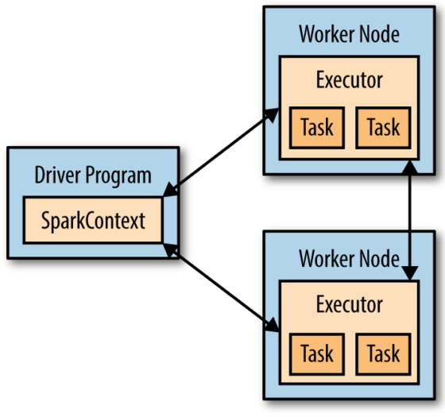
Distribution Model
Driver (“master”)
  Launches parallel operations on the cluster.
  The SparkContext object is the link to the cluster.
  Defines and transforms RDDs, represented as a DAG of operations (lineage graph).
Executors (“slaves”)
  Execute actions.
  Share results with the
  Driver or other Executors.

Slide 16

Transformations vs. Actions
Transformation
  Create a new dataset (RDD) from an existing one
  Lazy execution, will trigger when used by actions.
Action
  Return a value after running a computation on a RDD
Lambda functions / UDFs
Notes:
A lambda function is an anonymous function, Spark just knows
the signature. Therefore it acts as a black box to it.

Slide 17
Much more than Map&Reduce
By knowing each operator’s semantics, it is possible to optimize the computation graph
map | reduce | sample
filter | count | take
groupBy | fold | first
sort | reduceByKey | partitionBy
union | groupByKey | mapWith
join | cogroup | pipe
leftOuterJoin | cross | save
rightOuterJoin | zip | ...
Check JavaRDD and JavaPairRDD for the full API doc

Slide 18
Transformations on RDDs
distinct(T): RDD[T] → RDD[T]
map(f:T→U): RDD[T] → RDD[U]
flatMap(f:T→Seq[U]): RDD[T] → RDD[U]
filter(f:T→bool): RDD[T] → RDD[T]
sample(fraction:Float): RDD[T] → RDD[T]
union/intersection/substract(): RDD[T],RDD[T]→RDD[T]
crossProduct(): (RDD[T], RDD[U]) → RDD[T,U]
partitionBy(hash): RDD[T] → RDD[T]
persist(): RDD[T] → RDD[T]
mapToPair(f:T → (K,V)): RDD[T] → RDD[(K,V)]
Notes:
Union does not remove duplicates, but intersection and substraction do. They shuffle and thus they are more expensive.

Slide 19
Transformations on PairRDDs
mapValues(f: V → W): RDD[(K,V)] → RDD[(K,W)]
sort(c:comparator[K]): RDD[(K,V)] → RDD[(K,V)]
groupByKey(): RDD[(K,V)] → RDD[(K, Seq(V))]
reduceByKey(f:(V,V) → V): RDD[(K,V)] → RDD[(K,V)]
join(): (RDD[(K,V)],RDD[(K,W)]) → RDD[(K,(V,W))]
cogroup(): (RDD[(K,V)],RDD[(K,W)]) → RDD[(K,(Seq[V],Seq[W]))]
partitionBy(p:partitioner[K]): (RDD[(K,V)]) → RDD[(K,V)]
keys(): RDD[(K,V)] → RDD[K]
values(): RDD[(K,V)] → RDD[V]

Slide 20
Actions on RDDs
save(path: String): store RDD
collect(): RDD[T] → Seq[T]
take(k: Int): RDD[T] → Seq[T]
first(): RDD[T] → T
count(): RDD[T] → Long
countByValue(): RDD[T] → Seq[(T,Long)]
reduce(f:(T,T) → T): RDD[T] → T
foreach(f:T→U): RDD[T] → Void

Slide 21
Actions on PairRDDs
countByKey(): RDD[(K,V)] → Seq[(K,Long)]
lookup(k: K): RDD[(K,V)] → Seq[V]

Slide 22
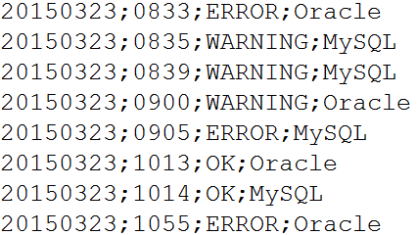
Example: Log Mining (in class)
Load error messages from a log into memory, then interactively search for various patterns
hdfs://192.168.1.1:9000/logs/dbLog.txt

Slide 23
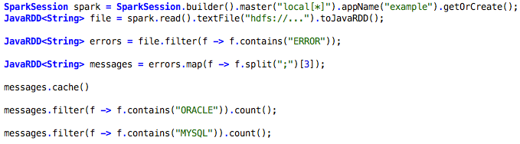

Example: Log Mining (in class)
results
Executor
messages
Cache 1
Driver
tasks
file
Block 1
Executor
messages
Cache 2
Executor
file Block 2
messages
Cache 3
file
Block 3
Notes:
got plenty of log data, something gone wrong in my production system and I want to track it down.
Cluster of machines: the driver is where the program runs, and then there are a set of workers that hold the data and will do the computation.
1- spark is the SparkContext. I create an RDD from the base dataset. Loads the data from HDFS and is distributed across the cluster.
- Careful! At this point nothing has happened yet!
2- I don’t care about all the lines that are not errors, I filter them.
The inner function goes trough each line and allows only to pass those that start with ERROR.
3- Split the data in fields. The lines are separated in “;”, take the 3rd column.
4- The messages dataset is important. I want to cache it in memory.
- When you compute the messages RDD keep the partitions in memory.
- Careful, lines and errors will not be saved in memory after pipelining the results!
5- Let’s check how many of the errors are related to Oracle
- Here the computation occurs
- Partitions are loaded in parallel
- Messages are cached
6- Let’s check how many of the errors are related to MySQL
- They are computed from the cache

Slide 24
Narrow dependencies
Map/Filter
Join with inputs co-partitioned
Union
Notes:
Narrow dependency: each partition of the parent RDD is used by at most one partition of the child RDD. This means the task can be executed locally and we don’t have to shuffle. (Eg: map, flatMap, Filter, sample)

Slide 25
Wide (shuffle) dependencies
groupByKey
Join with inputs not co-partitioned
Notes:
Wide dependency: multiple child partitions may depend on one partition of the parent RDD. This means we have to shuffle data unless the parents are hash-partitioned (Eg: sortByKey, reduceByKey, groupByKey, cogroupByKey, join, cartesian)
Matei, page 23
This is a shuffle join (Matei, page 52)

Slide 26



Scheduling
A:
B:
G:
groupBy
C:
D:
F:
map
E:
join
union
Notes:
Matei, page 25
This is more a broadcast join (Matei, page 52), where F is being broadcasted to the nodes where B is already partitioned.

Slide 27
Parallelism
Degree is automatically inferred from partitions
Too few parallelism wastes resources
Too much parallelism may generate significant overheads
Notes:
Karau 155

Slide 28
Partitioning
Initially based on data locality
  Useful based on keys
    Hash
      partitionBy
      groupByKey
    Range
      sortByKey
Partitions stored in workers’ memory
Different RDDs can use the same key
  Similar to vertical partitioning
Transformations lose partitioning information
  mapValues retains partitioning information
Notes:
Matei 45-46
Karau 62-66

Slide 29
Shared variables
Accumulators
  Usage
    Initialized by the driver
    Incremented by workers (write-only)
    Value accessed by driver
  Guarantees
    Consistent inside actions
    Unpredictable result inside transformations
      In case of rexecution
Broadcast variables
  Usage
    Passed as a serializable object to the context
    Accessed by workers (read-only)
  Guarantees
    The value is sent only once to each worker
Notes:
Matei 45-46
Karau 62-66

Slide 30
RDD representation
A set of partitions
A set of dependencies on parent RDDs
A function for computing the dataset
Partitioning schema (hash/range)
Data placement
Notes:
Matei 45-46
Karau 62-66

Slide 31
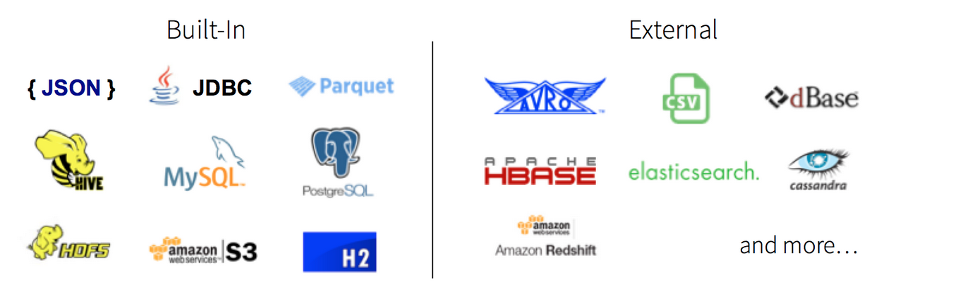
SparkSQL Overview
Tightly integrated way to work with structured data (tables with rows/columns)
Transform RDDs using SQL
Offers a JDBC interface on which third party applications can plug-in, e.g. BI tools.

Slide 32
Adding Schema to RDDs
Spark + RDDs
  Functional transformations
  on partitioned collections of
  opaque objects
SQL + Datasets
  Declarative transformations on
  partitioned collections of
  tuples
User
User
User
User
User
User
Name | Age | Height
Name | Age | Height
Name | Age | Height
Name | Age | Height
Name | Age | Height
Name | Age | Height
Legend:
String
Int
Float
Notes:
With SparkSQL we have the analogous concept of RDDs, those are DataFrames
When you work with Spark you pass lambda expressions, which are parallel
but are not optimized internally, e.g. it doesn’t know you are just reading 1 field
out of a 100 from a JSON file.
SparkSQL uses declarative language that Spark is able to optimize knowing
the inner structure of the data (columns, types, ...).

Slide 33
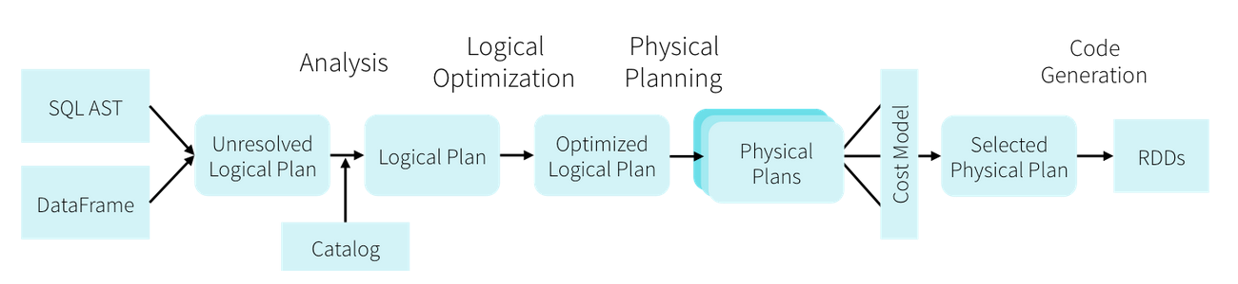
Datasets and DataFrames
Dataset = RDD + SQL
DataFrame = Dataset[Row] (named columns)
DataFrames evolve Spark’s RDD model
Ability to apply SQL optimization techniques

Slide 34
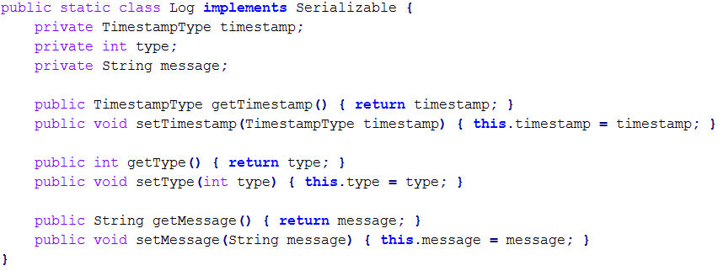
Example: Log Querying (in class)
Let’s convert it to a table and query it
Take into account that Scala/Python offer a much more elegant solution without need to provide class Log

Slide 35
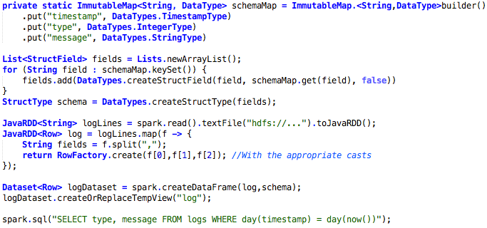
Example: Log Querying (in class)
Notes:
1- Read textfile from SparkContext and apply it a map function
which converts each comma separated line to a Log instance.
2- From the RDD we create a DataFrame and name the table “log”
3- Query in SQL for teenager people via SparkSQL context.
4- Convert it back to an RDD which will abstract the person instance to “Row”.
Collect() will create a Java list → non-distributed object!!!

Slide 36
5. Summary
Apache Spark provides us an engine for distributed in-memory data processing
With a large set of primitives, the engine is able to optimize the computation graph
The SQL component allows us to query information in a SQL-like structured manner

Slide 37
6. References
Apache Spark. http://spark.apache.org/
Databricks Blog. https://databricks.com/blog
H.Karau, A.Konwinski, P.Wendell. Learning Spark – Lightning-fast Big Data Analysis, O’Reilly 1st edition (2015)
S.Ryza, U.Laserson, S.Owen, J.Wills. Advanced Analytics with Spark – Patterns for Learning From Data at Scale, O’Reilly 1st edition (2015)

