Slide 1


Slide 2

Column-Family Key-Value Stores. HBase
Petar Jovanovic
Sergi Nadal
Barcelona; November 4th, 2016

Slide 3
Lecture goals
Understand the data model of the column-family key-value stores.
  HBase as example
Gain insight about some distributed database design techniques. Example:
    Horizontal partitioning
    Vertical partitioning
Deep understanding of other technical issues of HBase.

Slide 4
Table of contents
Introduction to column-family key-values
HBase in the Big Data landscape
HBase internals
  At logical level
  At physical level
HBase data distribution
Summary
References

Slide 5
1. Introduction to column-family key-values
Idea of classical key-values.
  One key maps to one value.
In column-family key-values, this is extended.
  One key may map to different families of columns.
    A [key, family] pair may map to different columns.
      A [key, family, column] triple maps to a single value.
  Schemaless properties at column level.
    Families must be given at table creating time.
key value

Slide 6
1. Introduction to column-family key-values
      A [key, family, column] triple maps to a single value
      This type of databases were born/popularized after Google’s BigTable
family A
family B
key
column a
column b
column c
column a
column d
value
value
value
value
value
Columns in different families can have the same name

Slide 7
2. HBase in the Big Data landscape
HBase runs on top of HDFS
  HDFS stores pure data files
  HBase adds a data management layer atop.
    So that column-family key-value store concepts and properties take place.
HBase and Cassandra are the two top Apache projects for column-family key-value stores.

Slide 8
2. HBase in the Big Data landscape
HBase vs. Cassandra. Small review.
 | HBase | Cassandra
CAP theorem | CP | AP
Data distribution | Based on an clustered index and a B+ tree | Based on consistent hash
Scalability | Higher in Cassandra
File system | HDFS | Cassandra File System
Compatibility with the Hadoop ecosystem (as main Big Data platform) | Much higher in HBase since it runs on top of HDFS. For instance, MapReduce is almost naturally compatible with HBase
Latest stable version | 1.1.2 | 2.1.11 (much more mature, for instance, it has secondary indexes)

Slide 9
3. HBase internals
Logical level:
  Data is structured in two levels:
    Rows. Horizontally. Allows reading in parallel.
    Families. Vertically. Allows improving hit ratio.
      In HBase, a value is actually mapped by a quadruple composed of:
        Key, family, qualifier (column), version (historic)
  When merging such two levels, data is structured:
    Firstly horizontally.
    Secondly vertically.

Slide 10
3. HBase internals
Logical level
Table
Table
family A
family B
qualifier a
qualifier b
qualifier a
Key 1
value
value
value
Key 2
value
value
value
Key 3
value
value
value
Key 4
value
value
value

Slide 11
3. HBase internals
Region 1
family A
family B
Logical level
qualifier a
qualifier b
qualifier a
Table
Key 1
value
value
value
Firstly horizontally
Key 2
value
value
value
Region
Region 2
family A
family B
qualifier a
qualifier b
qualifier a
Key 3
value
value
value
Key 4
value
value
value

Slide 12
3. HBase internals
Store 1.1
Store 1.2
family A
family B
Logical level
qualifier a
qualifier b
qualifier a
Table
Key 1
value
value
value
Firstly horizontally
Key 2
value
value
value
Region
Store 2.1
Store 2.2
Secondly vertically
Store
family A
family B
qualifier a
qualifier b
qualifier a
Key 3
value
value
value
Key 4
value
value
value

Slide 13
3. HBase internals
Store 1.1
Store 1.2
family A
family B
Logical level
qualifier a
qualifier b
qualifier a
Table
Key 1
value
value
value
Firstly horizontally
Key 2
value
value
value
Region
Store 2.1
Store 2.2
Secondly vertically
Store
family A
family B
Hard disk part
qualifier a
qualifier b
qualifier a
Memstore
Storefile
Key 3
value
value
value
In-memory part
Key 4
value
value
value
Blocks
HBase blocks

Slide 14
3. HBase internals
Reading example (nomenclature family:qualifier)
  Return A:a and A:b
  Return only A:a
family A
family B
qualifier a
qualifier b
qualifier a
Key 1
value
value
value
Key 2
value
value
value
Allows reading in parallel
Allows improving hit ratio
family A
family B
qualifier a
qualifier b
qualifier a
Key 3
value
value
value
Key 4
value
value
value

Slide 15
3. HBase internals
Reading example (nomenclature family:qualifier)
  Return A:a and A:b
  Return only A:a
Qualifiers do not matter when reading
  Only at network cost
    More data to read, more data to send
Families only matter at what is to be read

Slide 16
3. HBase internals
Data is physically stored
  Firstly in the Memstore that corresponds to the Store its [key, family] belongs to.
  When such Memstore is full (128MB by default) then data is flushed to the HDFS in a persistent file named Storefile:
    Storefile format is HFile:
      HFile stores data in blocks (i.e., HBase blocks) of a given size (by default, 64KB)
        This is written in a HDFS plain file (hence, split in block of 128MB)
Storefile
(format is HFile)
(written in HDFS)
64K
64K
64K
64K
64K
64K
128MB
64K
64K
…
64K
64K
64K
64K
64K
64K
128MB
64K
64K
…

Slide 17
3. HBase internals
Physical level
  Data is stored in a clustered index with a distributed B+ on top of it:
    Order is lexicographic
    B+ root node tracked by ZooKeeper
  This clustered index makes HBase specially good for:
    Random accesses
    Ranged (sequential) accesses
  But not specially optimal for full scans:
    Too much metadata to read along the way

Slide 18
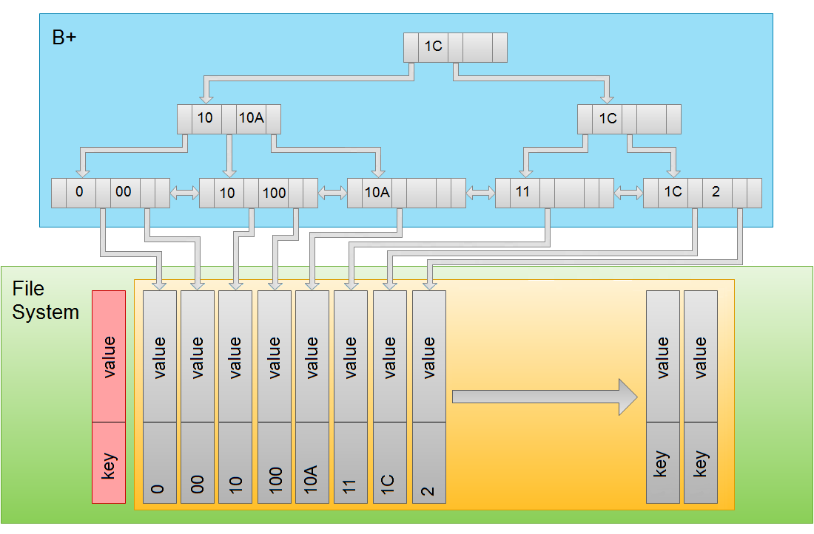
3. HBase internals
Random access: Give me row with key 11.

Slide 19
3. HBase internals
Ranged access: Give me rows from key 10 to 1C.

Slide 20
4. HBase data distribution
What steps does HBase really take in order to distribute data across the cluster?
Starting situation:
  Three RegionServers running on top of one DataNode each.
  A Table has been just created.
    Therefore, it contains only one Region up to now.
  For simplification, assume there is only one column-family in that Table.
    Therefore, only one Store in each Region

Slide 21
HMaster
RegionServer
RegionServer
RegionServer
Region
Store
MemStore
DataNode
DataNode
DataNode

Slide 22
HMaster
Inserts are coming so the HMaster decides to store them in the only current Region. Hence, its Memstore starts filling
RegionServer
RegionServer
RegionServer
Region
Store
MemStore
DataNode
DataNode
DataNode

Slide 23
HMaster
At some point, such Memstore will be full and therefore it will be flushed to disk, creating a new Storefile which will be stored in HDFS
RegionServer
RegionServer
RegionServer
Region
Store
MemStore
St.File
First copy of such Storefile is stored in the DataNode where that RegionServer runs on, but other copies are placed in different DataNodes
DataNode
DataNode
DataNode

Slide 24
HMaster
Inserts keep coming so the Memstore starts filling again
RegionServer
RegionServer
RegionServer
Region
Store
MemStore
St.File
DataNode
DataNode
DataNode

Slide 25
HMaster
At some point, such Memstore will be full again and will need to be flush, creating another Storefile
RegionServer
RegionServer
RegionServer
Region
Store
MemStore
St.File
St.File
DataNode
Replication as usual
DataNode
DataNode

Slide 26
HMaster
RegionServer
RegionServer
RegionServer
Region
Store
MemStore
This process keeps on repeating until a given number of Storefiles are created. Then, HBase compacts them in a single (but larger) Storefile
St.File
St.File
St.File
DataNode
DataNode
DataNode

Slide 27
HMaster
Deletes, for instance, occur at this time by basically not copying them in the new compacted Storefile. Also, the old Storefile block replicas must be deleted in HDFS. This then is how data is materialized in disk since files in HDFS are immutable. By doing this, however, Storefiles grow and grow until one of them is larger than a given threshold. Then a Region split is accordingly triggered
RegionServer
RegionServer
RegionServer
Region
Store
MemStore
St.File
DataNode
DataNode
DataNode

Slide 28
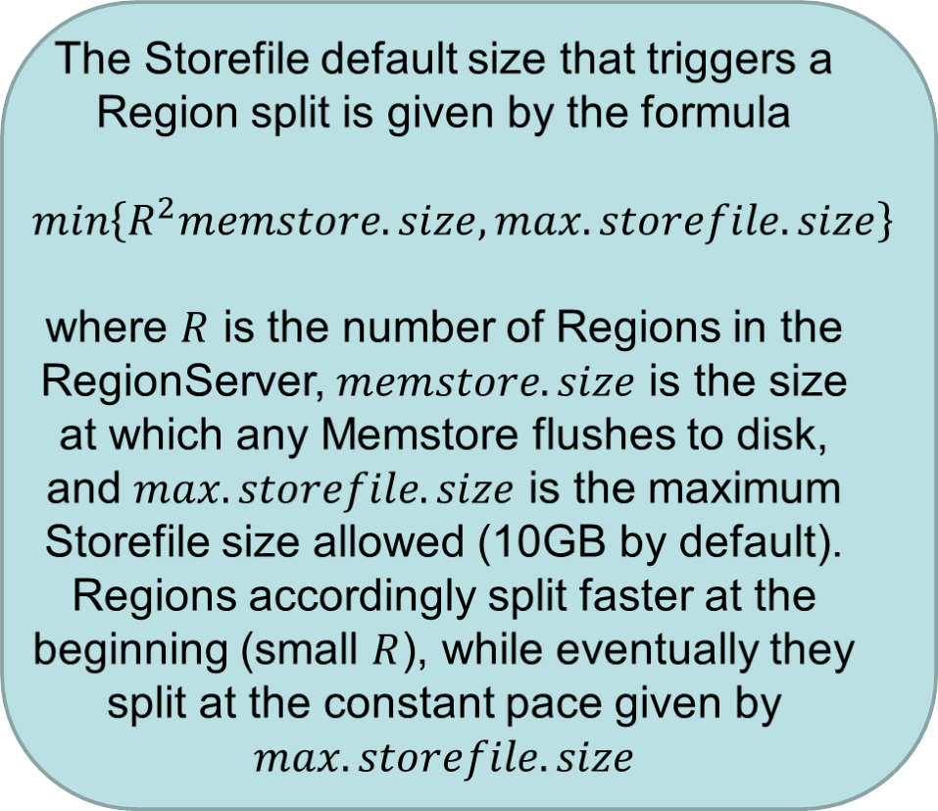
HMaster
RegionServer
RegionServer
RegionServer
Region
Store
MemStore
St.File
DataNode
DataNode
DataNode

Slide 29
HMaster
The Region split creates a new Region where there is a reference Storefile which, instead of storing data, it stores a pointer to the half part of the old Storefile. Logically, that half part of the old file onward belongs to the new Region
RegionServer
RegionServer
RegionServer
Region
Region
Store
Store
MemStore
MemStore
St.File
St.File
DataNode
DataNode
Replication as usual
DataNode

Slide 30
HMaster
Inserts keep coming but now we have two Memstores which are filling
RegionServer
RegionServer
RegionServer
Region
Region
Store
Store
MemStore
MemStore
St.File
St.File
DataNode
DataNode
DataNode

Slide 31
HMaster
RegionServer
RegionServer
RegionServer
Region
Region
Store
Store
MemStore
MemStore
At some point this Memstore will be flushed, creating a new Storefile. After this happens few times, there will be in such Store enough Storefiles as to run a compaction
St.File
St.File
St.File
DataNode
Replication as usual
DataNode
DataNode

Slide 32
HMaster
RegionServer
RegionServer
RegionServer
Region
Region
Store
Store
MemStore
MemStore
This last compaction, then, moves the referenced data to the new Storefile, and the one in the old Region is finally removed
St.File
St.File
DataNode
DataNode
DataNode

Slide 33
HMaster
Inserts keep coming and coming… And this process will repeat on and on and on…
RegionServer
RegionServer
RegionServer
Region
Region
Region
Store
Store
Store
MemStore
MemStore
MemStore
St.File
St.File
St.File
St.File
DataNode
DataNode
DataNode

Slide 34
5. Summary
Column-family key-value stores are an extension of simple key-value stores:
  Values are mapped by triples [key, family, column]
    But another dimension for versioning is also commonly included.
HBase is the column-family key-value store that runs on top of HDFS.
Tables, Regions, Stores, Memstores, Storefiles and Blocks

Slide 35
5. Summary
  Data is ordered and distributed by means of a clustered index with a B+ tree.
    This gives very nice performance for:
      Random accesses.
      Ranged (sequential) accesses.
Regions are created progressively as new data arrives to the cluster.
  Data firstly saved in memory.
  Data secondly materialized to hard disk.

Slide 36
6. References
Apache Cassandra. http://cassandra.apache.org/
Apache HBase. http://hbase.apache.org/
Eben Hewitt. Cassandra – The Definitive Guide, 1st edition
L.George. HBase – The Definitive Guide. 1st edition
O.Romero, V.Herrero, A.Abelló, J.Ferarrons. Tuning small analytics on Big Data: Data partitioning and secondary index in the Hadoop ecosystem, Information Systems. September 2014
T.Rabl, M.Sadoghi, H.A.Jacobsen, S.Gómez-Villamor, V.Muntés-Mulero, S.Mankowskii. Solving Big Data Challenges for Enterprise Application Performance Management. PVLDB 5(12), 1724-1735 (2012)
Tom White. Hadoop – The Definitive Guide. 3rd edition

