Slide 1


Slide 2

Introduction to the Hadoop Ecosystem
Petar Jovanovic
Sergi Nadal
Barcelona; October 28th, 2016

Slide 3
Lecture goals
Understand what Big Data means
  And why it is so important nowadays
Gain a general picture of
  New appearing data-related concepts
  Current technology approach
Understand what Hadoop is
  Deep understanding of HDFS and YARN
  Landscape of other related technologies

Slide 4
Table of contents
Big Data
What Hadoop is/is not? From v1.x to v2.x
The Hadoop ecosystem
  Core technologies
  Landscape
Summary
References

Slide 5






1. Big Data
Reports
Dailiy activity
DW
(RDBMS)
OLAP
Logs
Regression
SVM
PCA
Clustering
…
External data
Notes:
Before
relational sources
ETL processes
relational DW
After
new sources
structured, semistructured and unstructured
predictive analytics

Slide 6
1. Big Data
Business Intelligence requirements have gone way beyond what classical solutions may achieve
One size does not fit all
Variety →Data is extracted from multiple heterogeneous sources
Volume →The amount of data has drastically increased
Velocity →Data arrives at rates of milliseconds
Big Data
Notes:
Problem is the unión of the 3Vs
Talk about Variability and Veracity

Slide 7
1. Big Data
NOSQL → Not Only SQL
  Fast performance → Normally at cost of ACID
    BASE properties
      Basically Available Soft State Eventually Consistent
  Data model
    Key-value stores
    Column-family key-value stores
    Document-oriented stores
    Graph databases
Notes:
Atomicity Consistency Isolation Durability
Basically Available → system does guarantee availability, in terms of the CAP theorem
Soft State → the state of the system may change over time, even without input. This is because of the eventual consistency model
Eventual Consitency → the system will become consistent over time, given that the system doesn't receive input during that time
CAP theorem

Slide 8
1. Big Data
Key-value stores
  Entries in form of key-values
    One key maps only to one value
  Query on key only
  Schemaless
key
value
Bob
Michael_Elisabeth_30_Bobby_2010

Slide 9
1. Big Data
Column-family key-value stores
  Entries in form of key-values
    But now values are splitted in columns!
  Normally query on key
    May have some support for values
  Schemaless within a column
key
columns
Bob
mother:Elisabeth
father:Michael
connections:30
name:Bobby
birth_year:2010

Slide 10
1. Big Data
Document-oriented stores
  Entries can also be seen as key-values
    But now values are documents!
  Query on both keys and document fields
  Schemaless
document
{
parents: { father:Michael, mother:Elisabeth },
connections:30,
name:Bobby,
birth_year:2010
}
key
Bob

Slide 11
1. Big Data
Graph databases
  Entries are nodes and edges
    Attributes on both nodes and edges
    Edges may represent entities
  Native support for graph theory
give_birth:2010
Elisabeth
mother
Bob
spouse
Michael
father

Slide 12
1. Big Data
NewSQL
  High performance
    But keeping ACID properties
  Data saved in main memory instead of hard disk
    Avoid hitting disk as much as possible
  Some numbers
Memory / node | 32GB-100GB
Number of nodes | 20
Total | 640GB-2TB
Cost | ~ 50,000 USD
Space per warehouse | 100MB
Number of warehouses | 1000
Total | 100GB
For TPC-C
Notes:
Memory has a cost!
You can have a DW in memory, no problem!

Slide 13
1. Big Data
In-memory databases. Theoretical foundations
  Optimizing the usage of memory hierarchies
  Using parallelism
  Optimizing the data layout
  Using compression
  Virtualizing
    Limited overhead
      When reading memory pages, the hypervisor is often not required to be called

Slide 14
1. Big Data
Stream processing
“Class of software systems that deals with processing streams of high volume messages with very low latency ”
Michael Stonebraker, Encyclopedia

Slide 15
1. Big Data
Stream processing. Examples
  Internet traffic analysis
  High-way traffic monitoring
  Log monitoring
    Google receives several hundred million search queries per day
  Click analysis
    Yahoo! Acceps billions of clicks per day
  Scientific data processing (i.e., sensor data)

Slide 16



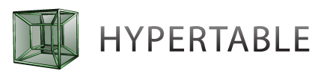


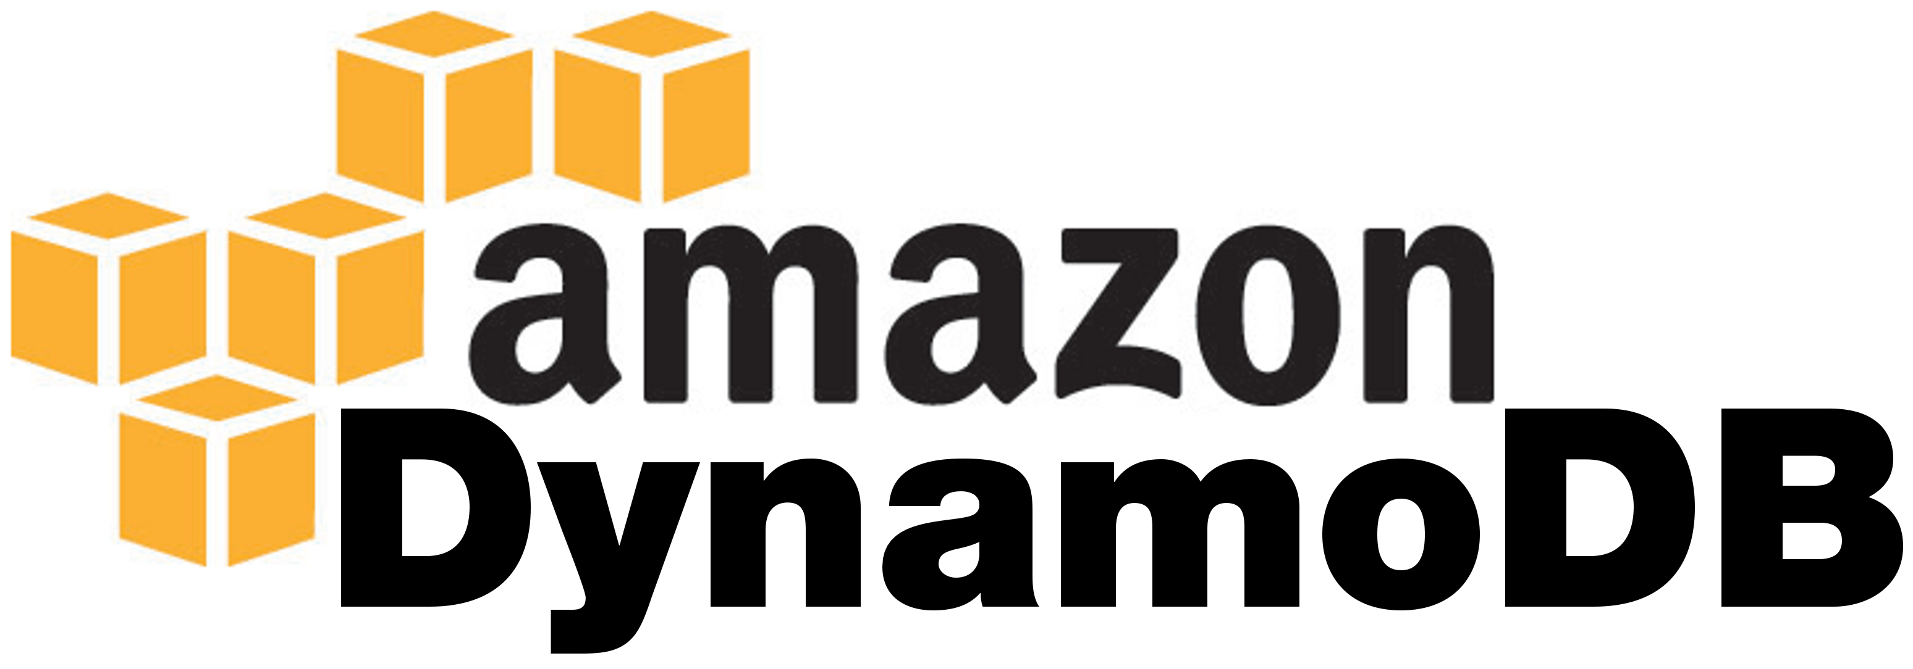










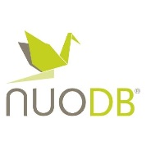
1. Big Data
Streaming
column-family key-value
key-value
document-oriented
graph
NOSQL
NewSQL

Slide 17
2. What Hadoop is/is not? From v1.x to v2.x
What Hadoop is
“The Apache™ Hadoop® project develops open-source software for reliable, scalable, distributed computing.”
“The Apache Hadoop software library is a framework that allows for the distributed processing of large data sets across clusters of computers using simple programming models. It is designed to scale up from single servers to thousands of machines […].
Notes:
Set of tools oriented at distributed processing
Hadoop follows the paradigm master-slave (1 master - many slaves)

Slide 18
2. What Hadoop is/is not? From v1.x to v2.x
What Hadoop is not
  Mostly defined as the MapReduce open source implementation
    It is much more than that!
    Mentality changing with v2.x
  Neither is the new universal solution
    What is it really suitable for?
      Not general answer! But normally:
        Large volumes of data + Distributed processing
        Use-case specific requirements ← Elicitation

Slide 19
2. What Hadoop is/is not? From v1.x to v2.x
From v1.x to v2.x
  Hadoop has been out there since 2003
    Who knew about it before 2010?
      Only in big IT companies with Big Data requirements the investment would pay off
  Hadoop v2.x is a more refined framework
    Clearer definition of what Hadoop is/is not
    Born after acceptance of Hadoop as general standard for Big Data processing
      Many other technologies are implemented around it

Slide 20
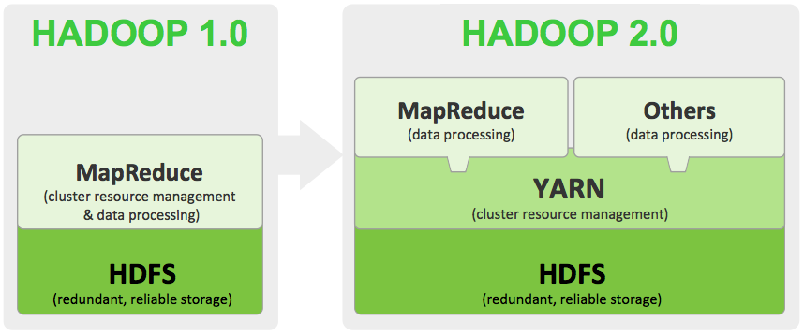
2. What Hadoop is/is not? From v1.x to v2.x
From Hortonworks

Slide 21
3. The Hadoop ecosystem
Core technologies
MapReduce (Batch processing)
YARN (Resource manager)
HDFS (Data layer)

Slide 22
3. The Hadoop ecosystem
MapReduce
  Distributed batch data processing framework
    Based on divide-and-conquer strategy
      Input split depends on the input source
  Three phases:
    Mappers ingest input data and output key-values
    MergeSort sorts/merges them based on such keys
    Reducers apply some aggregate operation
  Mappers and Reducers run user code

Slide 23
3. The Hadoop ecosystem
YARN
  YARN keeps track of the cluster resource usage
  Architecture
    Master
      ResourceManager (global)
        Arbitrates resources among all applications
    Slaves
      NodeManagers (node) → Executes jobs

Slide 24
3. The Hadoop ecosystem
YARN
  ApplicationMaster
    Launches the applications (Negotiates the first container)
    Monitors and negotiates resources with the ResourceManager
  Scheduler
    Allocates resources to the running applications
      Based on application requirements
    Includes concept Container
      Memory, CPU, disk, etc.

Slide 25
3. The Hadoop ecosystem
HDFS
  Hadoop Distributed File System
  Basic idea is to store a very large file such that it can be processed in a distributed fashion
    Bad idea to use it for very small files
      Scalability will be poor
  Strongest points: Replication + Balancing

Slide 26

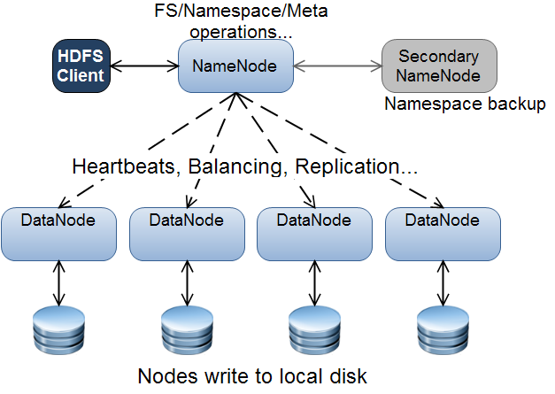
INTRODUCTION TO HADOOP 2· Herrero Otal, Víctor· Barcelona; 27 de febrero de 2015
1
1
2
2
1
2
2
1
Notes:
Namenode == master
Datanode == slaves

Slide 27
3. The Hadoop ecosystem
HDFS
  Replication at block level → 1 (first) + 2 (replicas)
    If writer is running on top of a DataNode then the first copy is written in the same DataNode
      Data locality achieved this way
  Block size of 128MB
    MapReduce parallelism triggered based on the number of blocks → Block size is key!
  Files are immutable
    Only appends allowed
Notes:
If a MapReduce job outputs to disk, it will write in the DataNode being executed

Slide 28
3. The Hadoop ecosystem
HDFS
  Reliability due to replication
    Safe mode → % Blocks succesfully replicated
    Running → Nothing written if can’t be replicated
  A namenode is still a single point of failure (SPOF)
    High availability thanks to active-standby namenodes
      They must use highly shared storage to share the edit log
      DataNodes must send block reports to both namenodes
      Clients must be configured to handle namenode failover

Slide 29
3. The Hadoop ecosystem
HDFS
  Different compressions
Format | Algorithm | Splittable?
Gzip | DEFLATE | No
Bzip2 | bzip2 | Yes
LZO | LZO | No
LZ4 | LZ4 | No
Snappy | Snappy | No

Slide 30
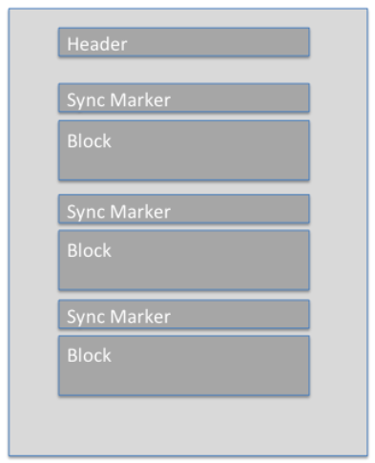
3. The Hadoop ecosystem
File
HDFS block 1
HDFS block 2
HDFS
  File formats
    Plain formats
      SequenceFile
        Enables splittability if compression is at SequenceFile block or Record level
    Serialization formats: Thrift, Protocol Buffer, Avro
      Avro is basically the same as SequenceFile but with a header containing metadata
        Designed to be portable across languages
    Columnar formats: RCFile, ORC, Parquet
SequenceFile Block 1
SequenceFile Block 3
Record
Record
Record
Record
…
…
…
SequenceFile Block 2
SequenceFile Block 4
Record
Record
Record
Record
…
…
SequenceFile using block
compression
Notes:
SequenceFile is a flat file consisting of binary key/value pairs
There are 3 different SequenceFile formats:
Uncompressed key/value records.
Record compressed key/value records - only 'values' are compressed here.
Block compressed key/value records - both keys and values are collected in 'blocks' separately and compressed. The size of the 'block' is configurable.
Example, log
Key → timestamp
Value → whathever

Slide 31
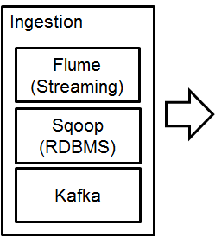
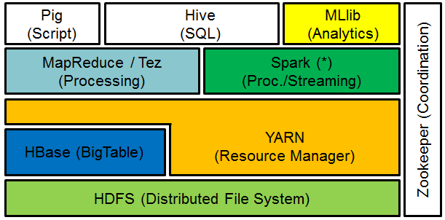

3. The Hadoop ecosystem
Landscape

Slide 32
3. The Hadoop ecosystem
Batch processing
  Tez → Run multiple MapReduce jobs in a single Tez job
    Build a Directed Acyclic Graph (DAG)
      Specially useful to run iterative-exhaustive algorithms
Data exploitation
  Pig → Provides a high-level language for expressing data analysis programs
    Program evaluation for optimization
  Hive → Provides a SQL-like interface which then transforms queries into MapReduce/Spark-SQL jobs

Slide 33
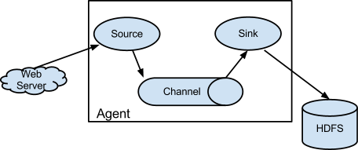
3. The Hadoop ecosystem
Data ingestion
  Flume
    Good to ingest streaming data
    Allows data to flow through different steps until target storage is reached

Slide 34
3. The Hadoop ecosystem
Data ingestion
  Sqoop
    Transfers bulk data between RDBMS and the Hadoop ecosystem
  Kafka → Distributed, partitioned, commit log service
    Producers deliver messages of a given topic to Kafka
    Messages are saved in Kafka for any given period of time
      They can be read an infinite number of times
    Consumers are free to read any message they want
      Normally based on message offsets

Slide 35
3. The Hadoop ecosystem
Coordination
  Zookeeper
    Distributed system that allows centralizing some system information that can’t be distributed
Workflow management
  Oozie
    Allows running workflow jobs where different Hadoop technologies can take part
      Event and time based scheduling
      Supports workflows with decisions

Slide 36
4. Summary
Big Data is appearing on stage with brand new BI requirements
“What do you need?” solution
  Different new DBMS with different data model
NewSQL. In-memory databases
Hadoop is a platform to distribute storage and processing of data
  HDFS, YARN and MapReduce as core technologies
  Many other use-case specific solutions around it

Slide 37
5. References
Alberto Abelló, Oscar Romero. In-Memory Databases, Slides 2014/2015
Alberto Abelló, Oscar Romero, Stream management, Slides 2014/2015
H.Plattner, A.Zeier. In-memory data management: technology and applications, Springer 2012
Michael Stonebraker. http://cacm.acm.org/blogs/blog-cacm/162095-what-does-big-data-mean-part-4/fulltext
Tom White. Hadoop – The Definitive Guide, 3rd edition

Slide 38
5. References
More:
  Ambari. http://ambari.apache.org/
  Flume. http://flume.apache.org/
  Hadoop. http://hadoop.apache.org/
  Hive. https://hive.apache.org/
  Kafka. http://sqoop.apache.org/
  Knox. http://ambari.apache.org/
  Oozie. http://oozie.apache.org/
  Pig. http://oozie.apache.org/
  Sqoop. http://sqoop.apache.org/
  ZooKeeper. http://zookeeper.apache.org/

