Slide 1
An Introduction To The Backpropagation Algorithm
Who gets the credit?

Slide 2
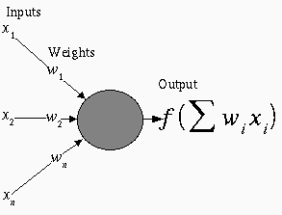
Basic Neuron Model In A Feedforward Network
Inputs x_{i} arrive through pre-synaptic connections
Synaptic efficacy is modeled using real weights w_{i}
The response of the neuron is a nonlinear function f of its weighted inputs
Copyright G. A. Tagliarini, PhD

Slide 3
Inputs To Neurons
Arise from other neurons or from outside the network
Nodes whose inputs arise outside the network are called input nodes and simply copy values
An input may excite or inhibit the response of the neuron to which it is applied, depending upon the weight of the connection
Copyright G. A. Tagliarini, PhD

Slide 4
Weights
Represent synaptic efficacy and may be excitatory or inhibitory
Normally, positive weights are considered as excitatory while negative weights are thought of as inhibitory
Learning is the process of modifying the weights in order to produce a network that performs some function
Copyright G. A. Tagliarini, PhD

Slide 5
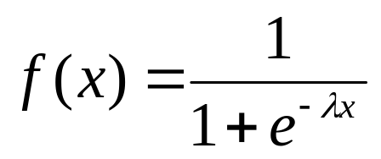
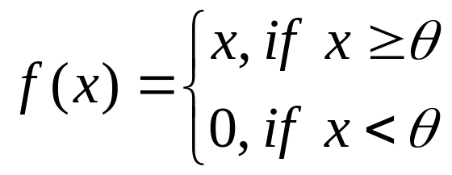
Output
The response function is normally nonlinear
Samples include
  Sigmoid
  Piecewise linear
Copyright G. A. Tagliarini, PhD

Slide 6
Backpropagation Preparation
Training Set
A collection of input-output patterns that are used to train the network
Testing Set
A collection of input-output patterns that are used to assess network performance
Learning Rate-η
A scalar parameter, analogous to step size in numerical integration, used to set the rate of adjustments
Copyright G. A. Tagliarini, PhD

Slide 7
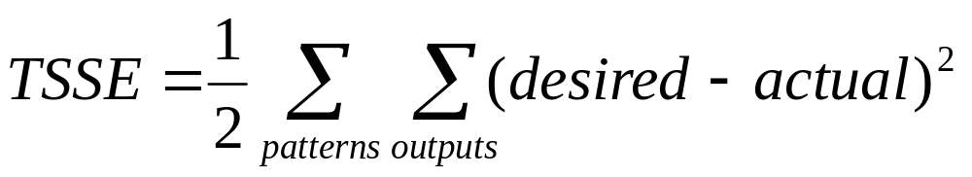
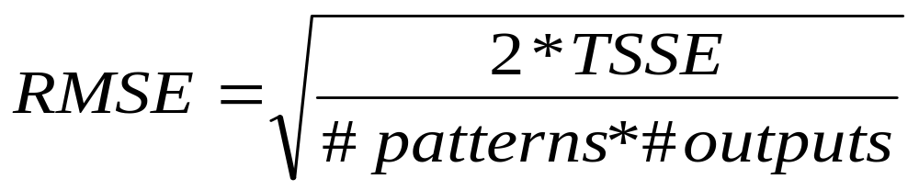
Network Error
Total-Sum-Squared-Error (TSSE)
Root-Mean-Squared-Error (RMSE)
Copyright G. A. Tagliarini, PhD

Slide 8
A Pseudo-Code Algorithm
Randomly choose the initial weights
While error is too large
  For each training pattern (presented in random order)
    Apply the inputs to the network
    Calculate the output for every neuron from the input layer, through the hidden layer(s), to the output layer
    Calculate the error at the outputs
    Use the output error to compute error signals for pre-output layers
    Use the error signals to compute weight adjustments
    Apply the weight adjustments
  Periodically evaluate the network performance
Copyright G. A. Tagliarini, PhD

Slide 9
Possible Data Structures
Two-dimensional arrays
  Weights (at least for input-to-hidden layer and hidden-to-output layer connections)
  Weight changes (Δ_{ij})
One-dimensional arrays
  Neuron layers
    Cumulative current input
    Current output
    Error signal for each neuron
  Bias weights
Copyright G. A. Tagliarini, PhD

Slide 10
Apply Inputs From A Pattern
Apply the value of each input parameter to each input node
Input nodes compute only the identity function
Feedforward
Inputs
Outputs
Copyright G. A. Tagliarini, PhD

Slide 11
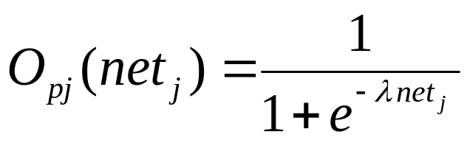
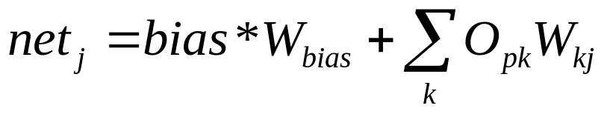
Calculate Outputs For Each Neuron Based On The Pattern
The output from neuron j for pattern p is O_{pj} where
and
k ranges over the input indices and W_{jk} is the weight on the connection from input k to neuron j
Feedforward
Inputs
Outputs
Copyright G. A. Tagliarini, PhD

Slide 12
Calculate The Error Signal For Each Output Neuron
The output neuron error signal δ_{pj} is given by δ_{pj}=(T_{pj}-O_{pj}) O_{pj} (1-O_{pj})
T_{pj} is the target value of output neuron j for pattern p
O_{pj} is the actual output value of output neuron j for pattern p
Copyright G. A. Tagliarini, PhD

Slide 13
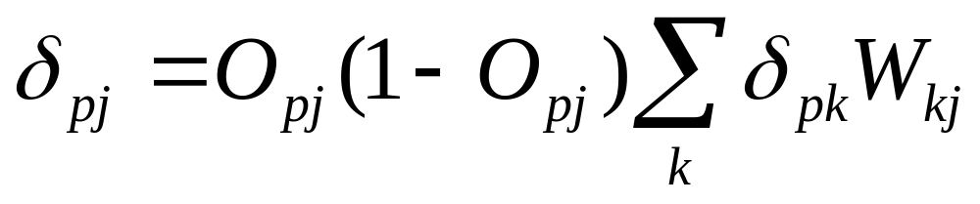
Calculate The Error Signal For Each Hidden Neuron
The hidden neuron error signal δ_{pj} is given by
where δ_{pk} is the error signal of a post-synaptic neuron k and W_{kj} is the weight of the connection from hidden neuron j to the post-synaptic neuron k
Copyright G. A. Tagliarini, PhD

Slide 14
Calculate And Apply Weight Adjustments
Compute weight adjustments ΔW_{ji} at time t by
ΔW_{ji}(t)= η δ_{pj} O_{pi}
Apply weight adjustments according to
W_{ji}(t+1) = W_{ji}(t) + ΔW_{ji}(t)
Some add a momentum term α∗ΔW_{ji}(t-1)
Copyright G. A. Tagliarini, PhD

Slide 15
An Example: Exclusive “OR”
Training set
  ((0.1, 0.1), 0.1)
  ((0.1, 0.9), 0.9)
  ((0.9, 0.1), 0.9)
  ((0.9, 0.9), 0.1)
Testing set
  Use at least 121 pairs equally spaced on the unit square and plot the results
  Omit the training set (if desired)
Copyright G. A. Tagliarini, PhD

Slide 16
An Example (continued): Network Architecture
inputs
output(s)
Copyright G. A. Tagliarini, PhD

Slide 17
An Example (continued): Network Architecture
Target output
0.9
0.1
Sample input
1
0.9
1
1
Copyright G. A. Tagliarini, PhD

Slide 18
Feedforward Network Training by Backpropagation: Process Summary
Select an architecture
Randomly initialize weights
While error is too large
  Select training pattern and feedforward to find actual network output
  Calculate errors and backpropagate error signals
  Adjust weights
Evaluate performance using the test set
Copyright G. A. Tagliarini, PhD

Slide 19
An Example (continued): Network Architecture
??
Actual output
???
Target output
0.9
0.1
??
Sample input
??
??
1
??
??
0.9
??
1
??
??
1
Copyright G. A. Tagliarini, PhD

