Slide 1
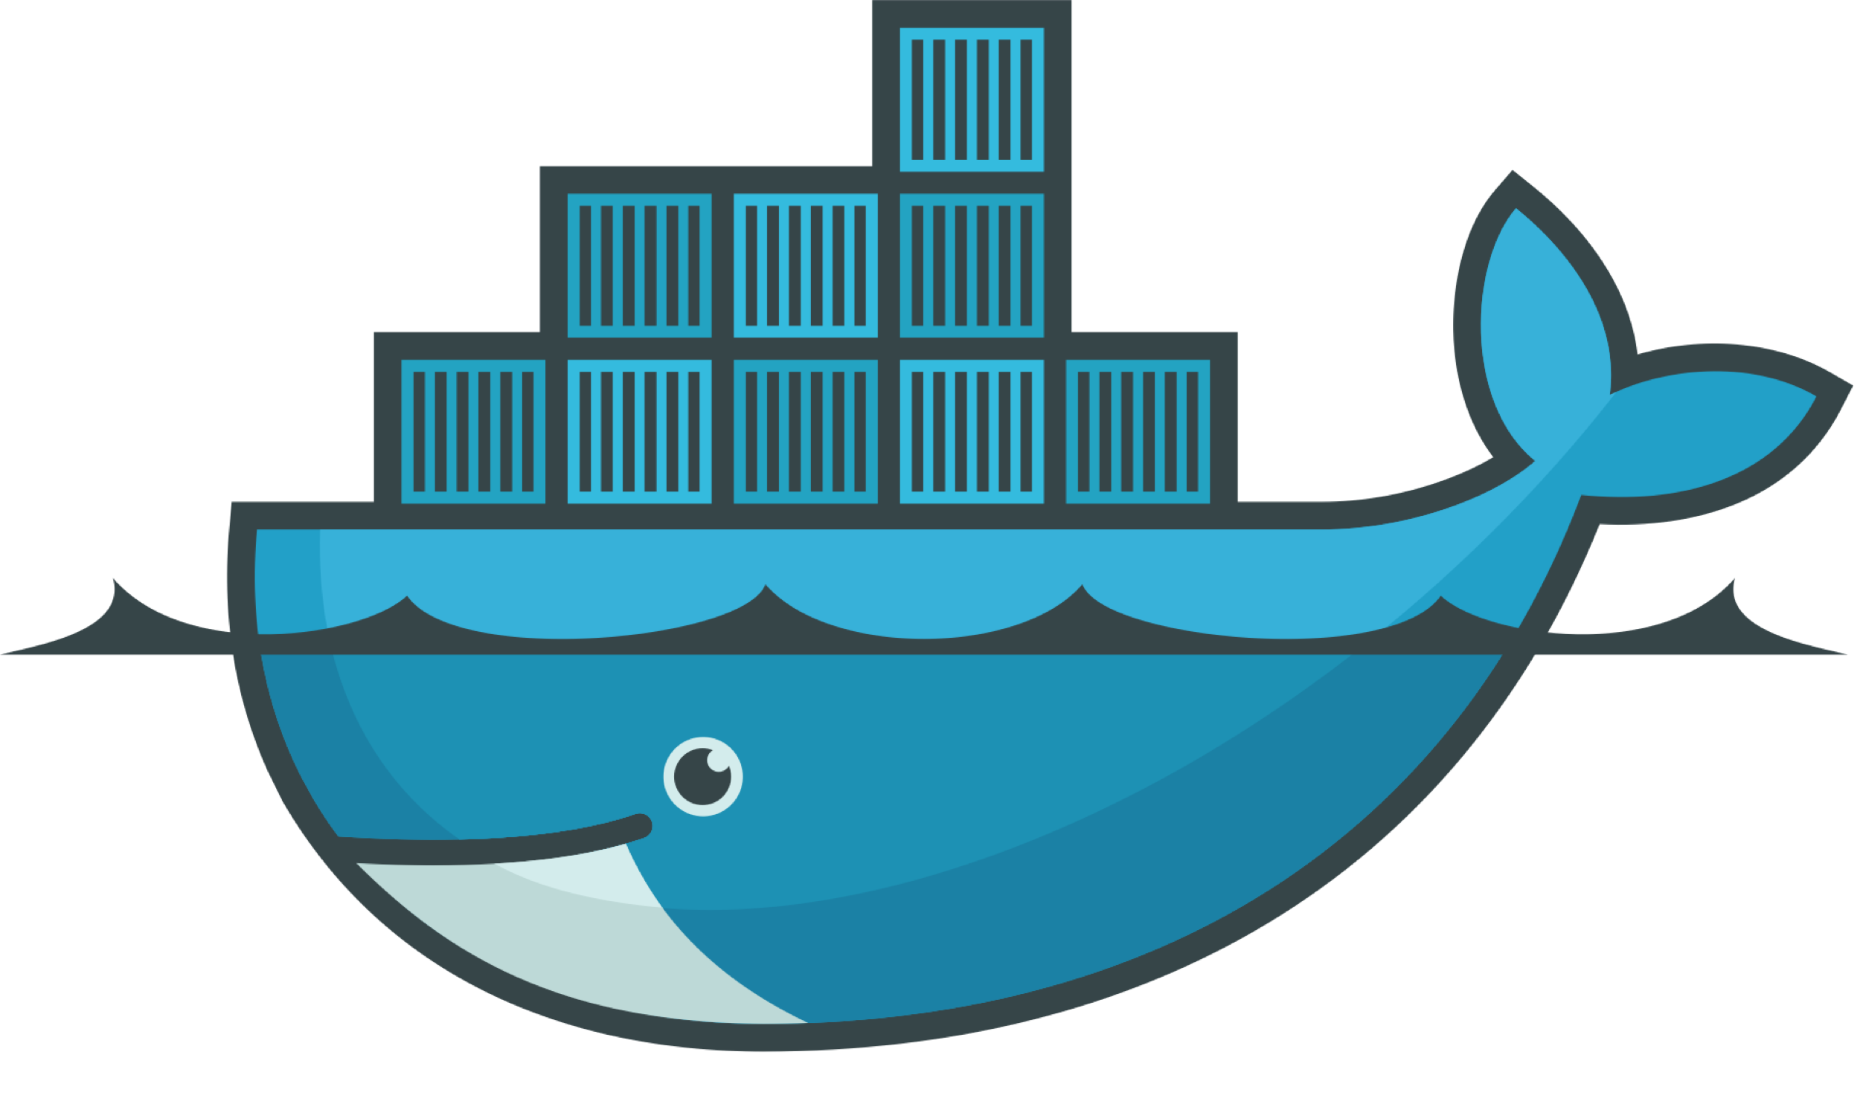
Intro to Containers and Docker
Alexander Simeonov

Slide 2
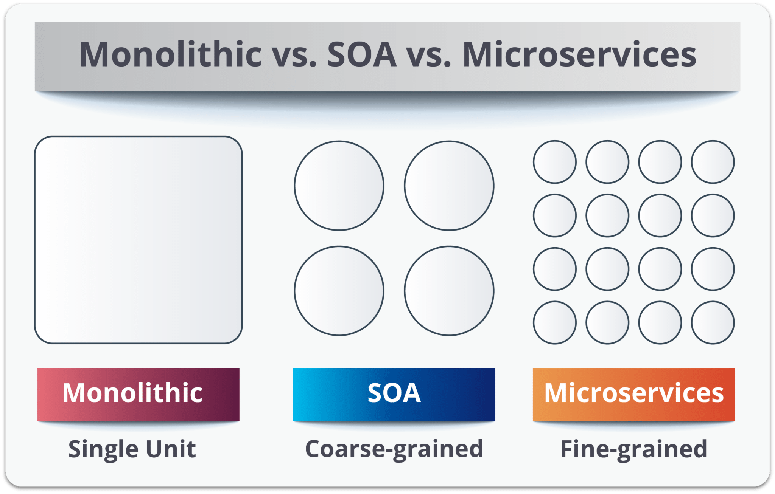
Application Architecture

Slide 3
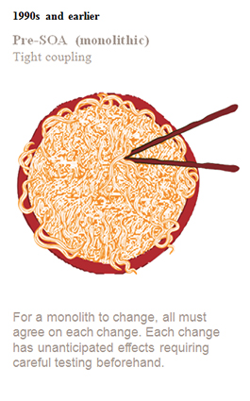
Monoliths
Developers build cool application
More features requested
Add more features to cool application
Application is not as simple but it does the job
Please add more features!
Features added, getting a tad hard to maintain…
But we also need this other feature, let’s add it!
I have no idea what is going on… How did I get here?

Slide 4
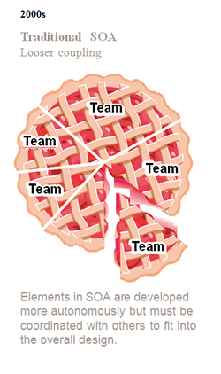
Service Oriented Architecture
Learns from the Monolith’s mistakes and build applications around a single clear purpose, rather than an amalgamation of features.
Black box (self contained).
May contain multiple services.

Slide 5
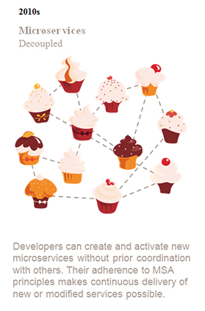
Microservices
Share as little as possible
Statelessness and reproducibility
Focuses on decoupling features as much as possible
Why is this awesome?
Easy to add new services/features
More developer freedom
Easier to test/update/deploy

Slide 6
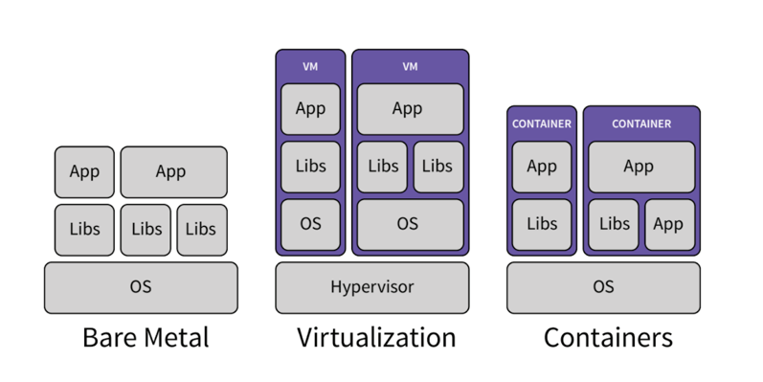
Application Infrastructure
Bare Metal
Virtual Machines
Containers

Slide 7
Why does this matter?
Companies tend to have a hard time jumping straight to containers.
Usually it is a process that evolves in terms of bother application architecture and infrastructure over time.
When we introduce a few containers to break up that monolith we can jump into service based architecture first.
When we start introducing new services and break the monolith up even further we find ourselves in a microservice world!

Slide 8
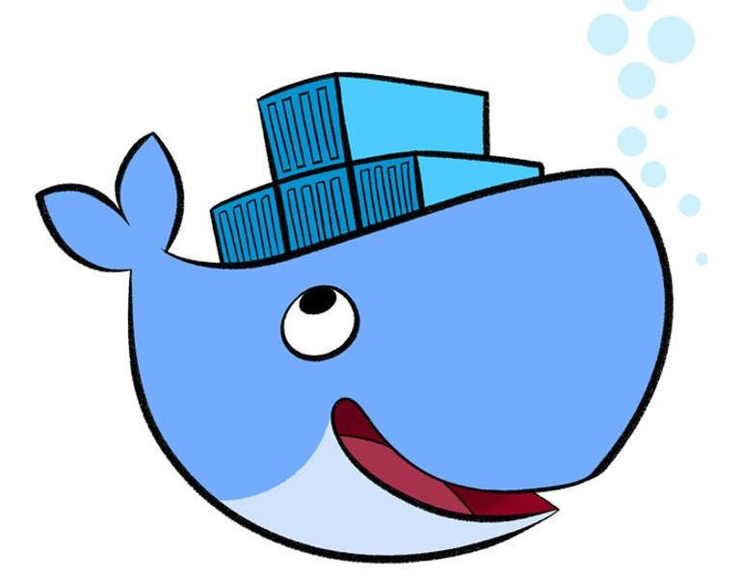
So what are containers?
Containers stay true to their name!
In simple terms they package a piece of code in a predefined environment with only what that piece of code needs to run and nothing else.
Many can run on a single machine and share the kernel.
Each container is isolated and does not known about the host or other services/containers running on the host.
Isolation even involves disk, networking, permissions, and other system resources such as memory.
Portable , stateless, lightweight on resources, and secure.

Slide 9
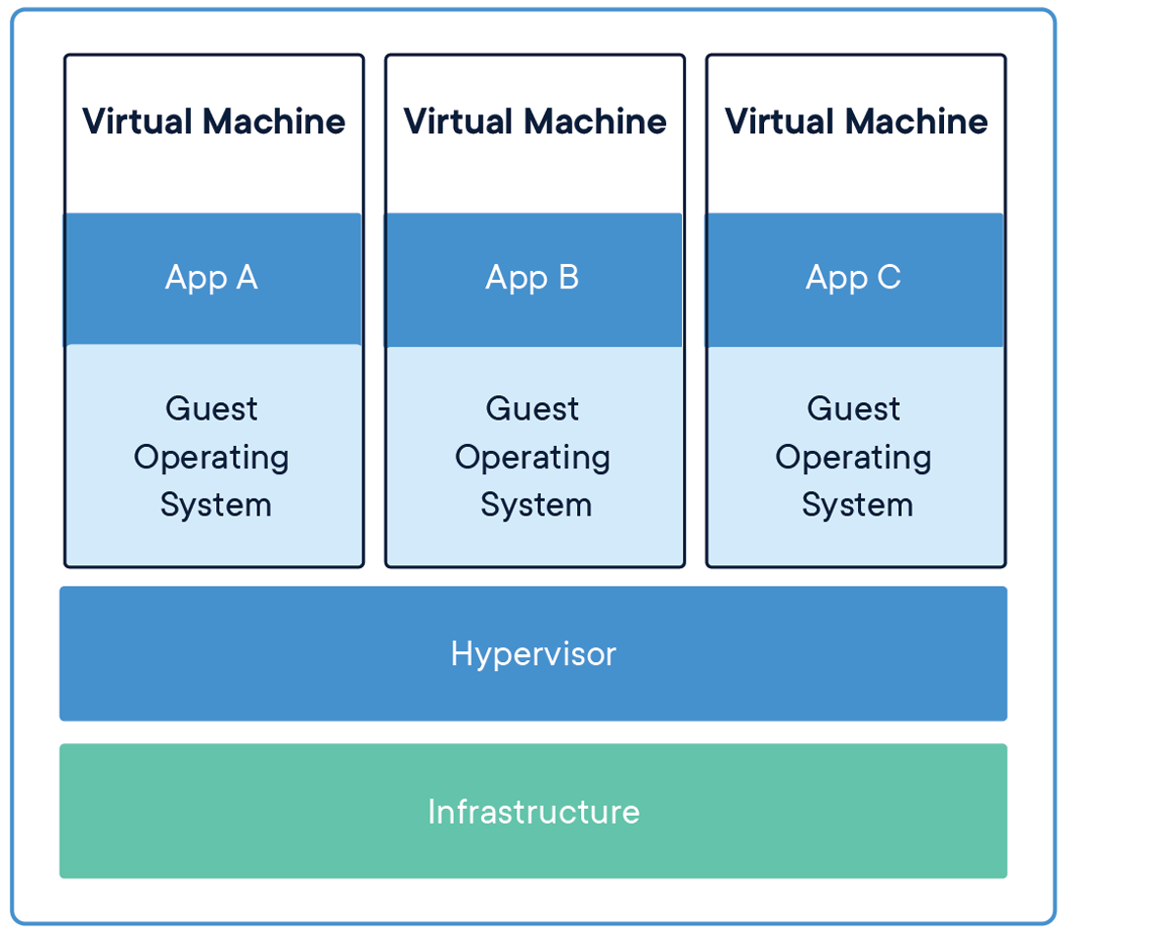
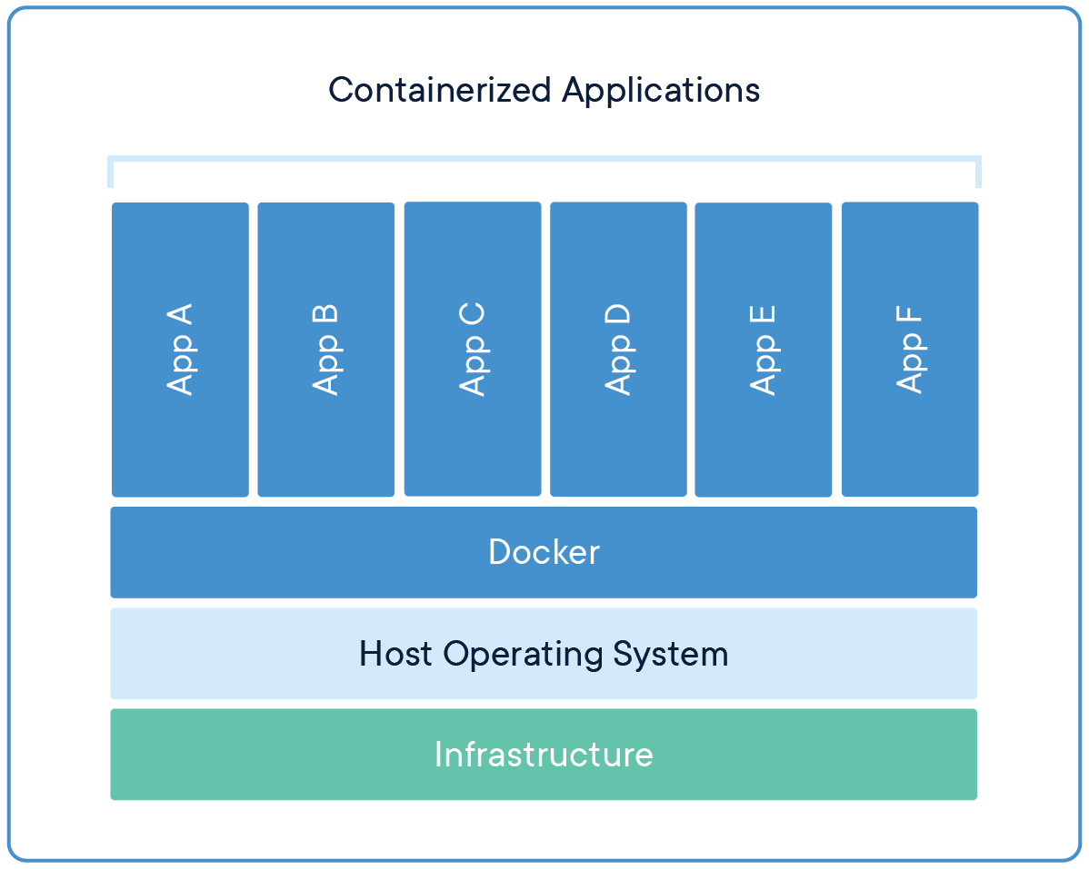
Containers and VMs
People often compare them

Slide 10
Why do developers use containers?
Development:
- Only need to know about what I am currently working on.
Testing:
- I can do it all on my own! - No more clunky requirements, or complicated setup scripts.
Deployments:
- Fast and easy!
- But it worked on my machine… Reproducibility is your friend. Do not embrace the unexpected!

Slide 11
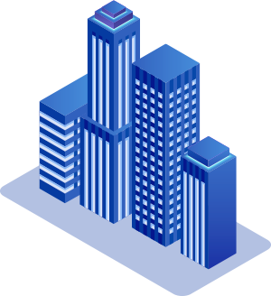
Why do companies like containers?
Faster (continuous) delivery.
Microservice architecture makes your team more efficient.
Portability and reproducibility make client deliverables easy to handle. (weeks with some on site to a few hours over the phone)
Better resource utilization - servers are expensive!

Slide 12

Cool, cool!
But enough of these slides show me some containers!
How can I create one?

Slide 13
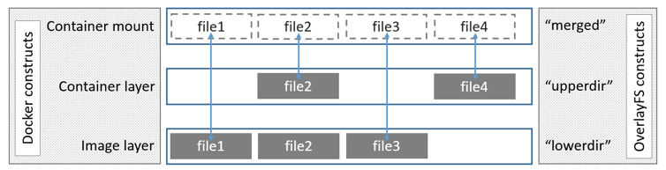
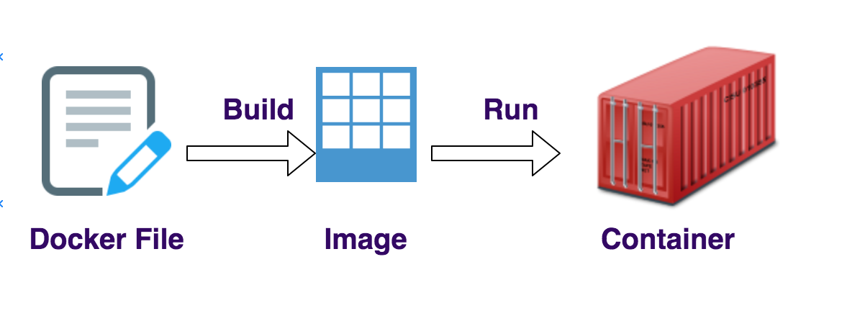
What did this actually do?
Images – what are they?
How do images store data. Wouldn’t packaging a whole OS and many containers on a system use up a lot disk space? Layering and overlay.
Let us look at docker save really quick as an example.
Containers - what is the difference? What happens when I run an image?
Note that we run only a single thing!

Slide 14
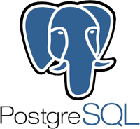
Can I run my database in Docker?
You sure can! Let’s run one and add some data.
Have you tried turning it off and on again?

Slide 15

But you said containers are stateless…
Where did my data go?
Let’s see what we can do about this!
Volumes
Bind Mounts!

Slide 16
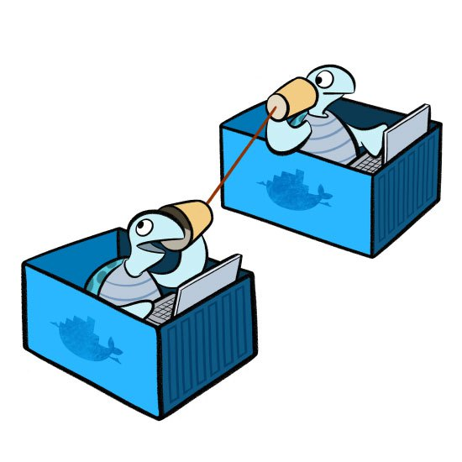
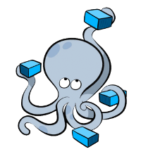
I am building a networked app
Docker’s got you!
You are going to need to run more than 1 container though!
Let’s look at docker-compose.

Slide 17

Some extra notes!
What was that wait-for-it.sh script?
You would have a hard time breaking things.
You can set up multiple networks.

Slide 18
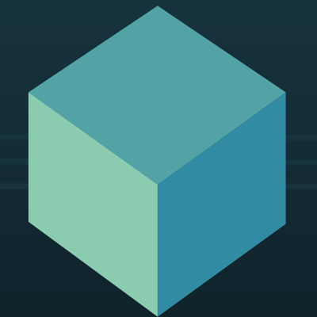
Testing and Docker
You should no longer need to set up a whole environment to test.
You don’t need to test against remote servers.
You don’t need to test using embedded databases.
You can use the same container you will use in production thus having more faithful tests.

Slide 19
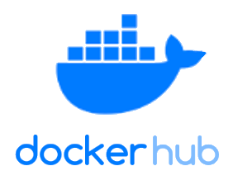
Distribution Management
Docker Registries
Stores different tags as well as latest
Has third party and Docker approved images
https://hub.docker.com/
Images deployed via docker push/pull
Can host your own registry and configure via: docker login

Slide 20
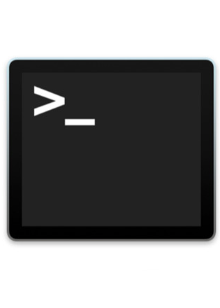
Basic/Common commands overview
docker info
docker build
docker run/start/stop/pause/unapuse/restart/rm
docker logs
docker ps
docker volume ls
docker network ls
docker image ls
docker stats
docker pull/push

Slide 21
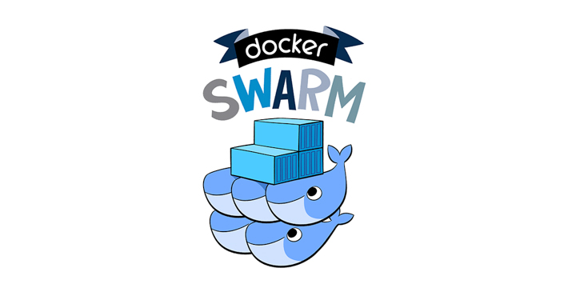
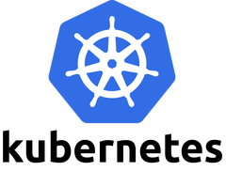
Container Orchestration
Docker Swarm and Kubernetes
A presentation on it’s own but lets introduce the topic briefly.

Slide 22
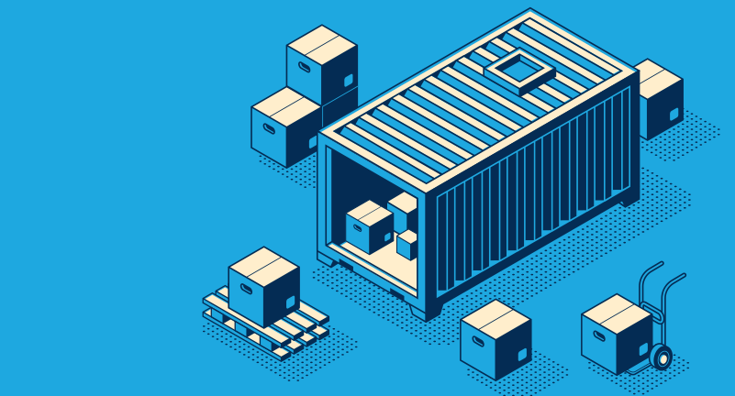
Features
Scaling
Load balancing
Health checks and disaster recovery/self healing
Easy to use networking
Rolling updates

Slide 23
How can I start using containers?
Docker works best on Linux but there is Docker for Mac and Docker for Windows which run it in a Hypervisor, install and start playing.
There are Windows containers but I seldomly see them used.
Do a quick tutorial online (there are a bunch of them).
Run your tests using containers.
Run some of your scripts using containers.
Put your next app/project in a container.
Do I really need a VM to do this? Try using a container instead.

Slide 24
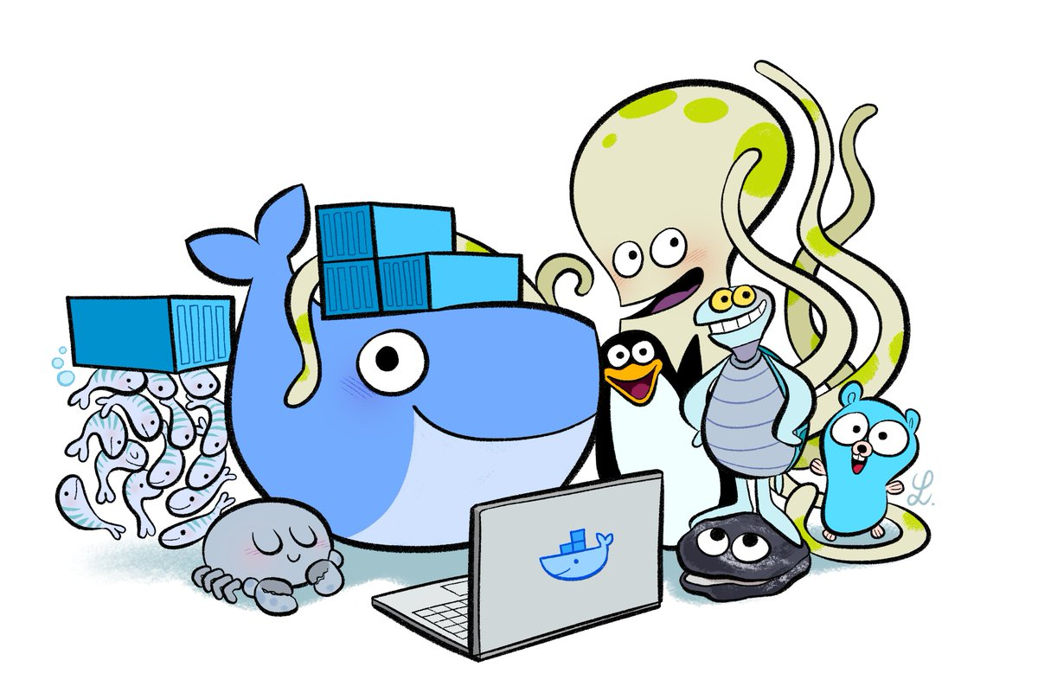
Questions?
https://github.com/agsimeonov/docker-intro-presentation

