Slide 1
Excel Challenge – Question 6
Andrew Simor - Submission

Slide 2
Adjustments to Assessed Value of Insured Assets
Focus: Adjusting For Crime Rates and Avg. Rainfall in Flooding Regions

Slide 3
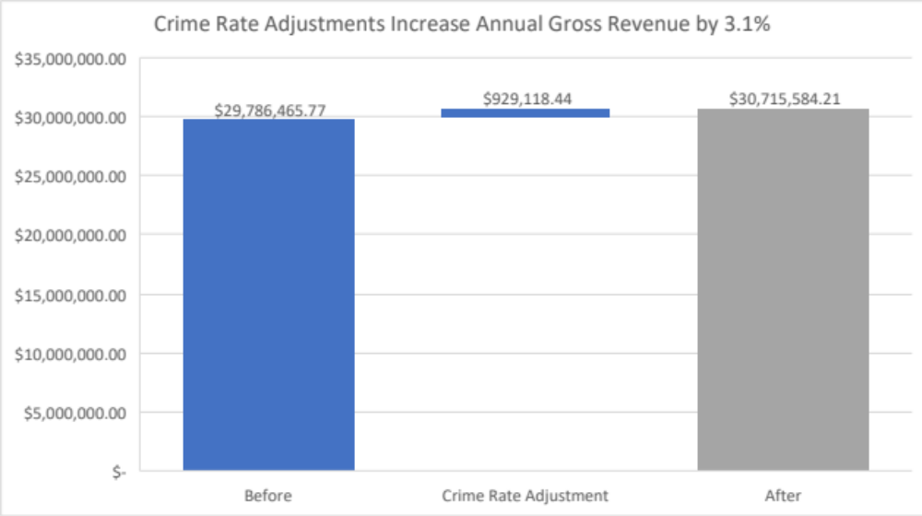
Adjusting Total Insured for Above Average Crime Rates
To account for increased risk of claims in areas with high crime rates, we have explored an approach to adjust insured values by state
Methodology:
  Inversely adjust the assessed value of insured assets by for a policy based on the residing state’s crime rate vs. the national average.
The outcome of this exercise projects a +3.1% increase in gross annual revenue, $929,118 in total

Slide 4
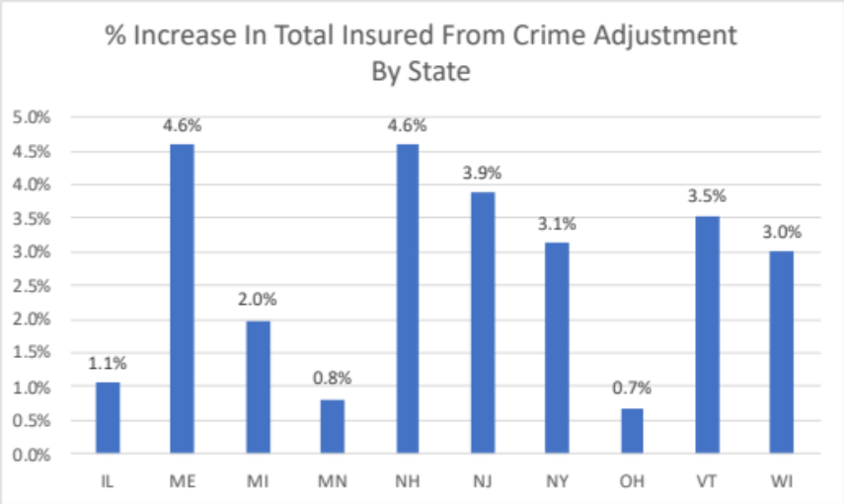
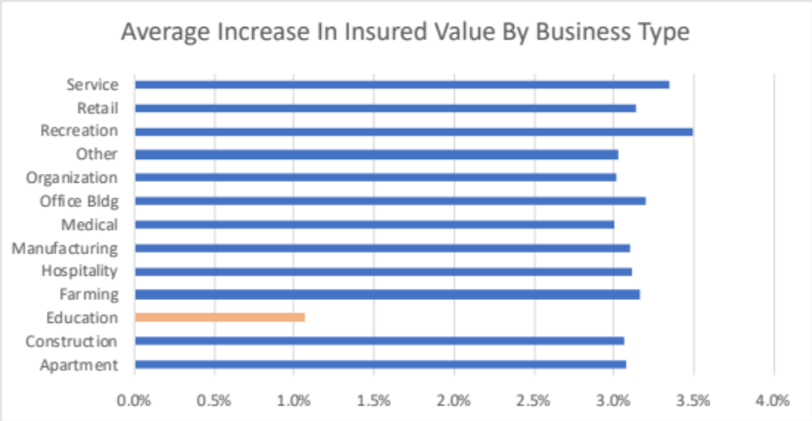
Outcome of Crime Adjustment
Pros:
  As previously stated, we expect a +3.1% increase in gross annual revenue, $929k in total incremental gross revenue.
    AGR = 0.1% * total insured * 12 Months
  Methodology yields increases in insured value across all states
Cons:
  The average increase in insured value is disproportionately low for educational businesses
    This limits revenue increases for Educational Business Types while we see increases >=3% across all other business types
In summary:
  We recommend applying adjustments for crime rate with a second look into our methodology to further adjust increases for businesses in the educational function in order to fairly impact businesses across the board.

Slide 5
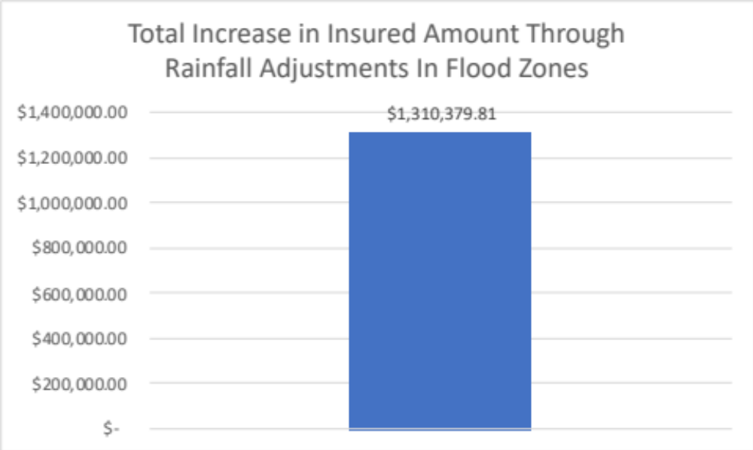
Adjusting For High Rainfall In Flood Risk Policies
To account for increased risk of flood damage in states with above average rainfall we have explored an approach to adjust insured values by state
Methodology:
  Adjust the assessed value of insured assets by for a policy based on the respective state’s avg. annual rainfall vs. the national average if the asset is in a flooding zone
The outcome of this exercise projects a ~$1.31M increase in total insured amount for our current assets

Slide 6
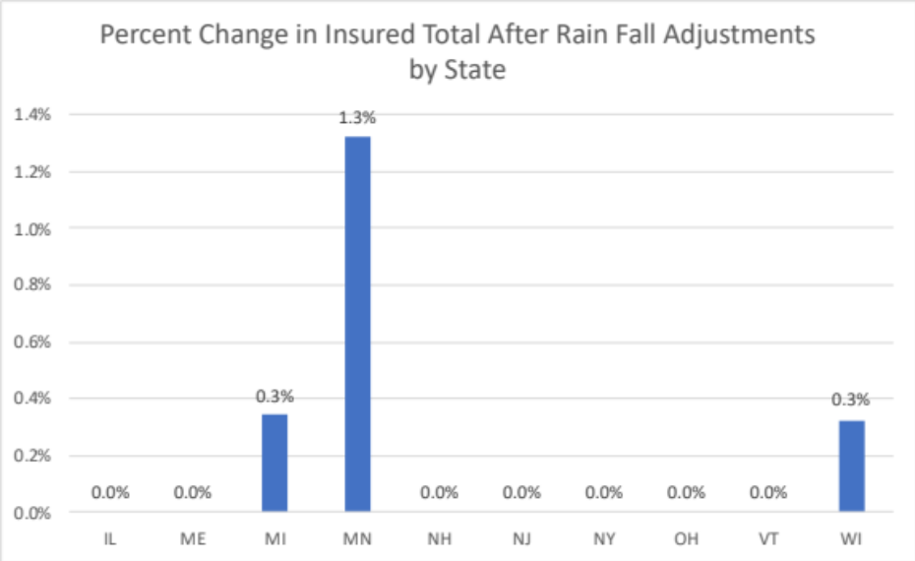
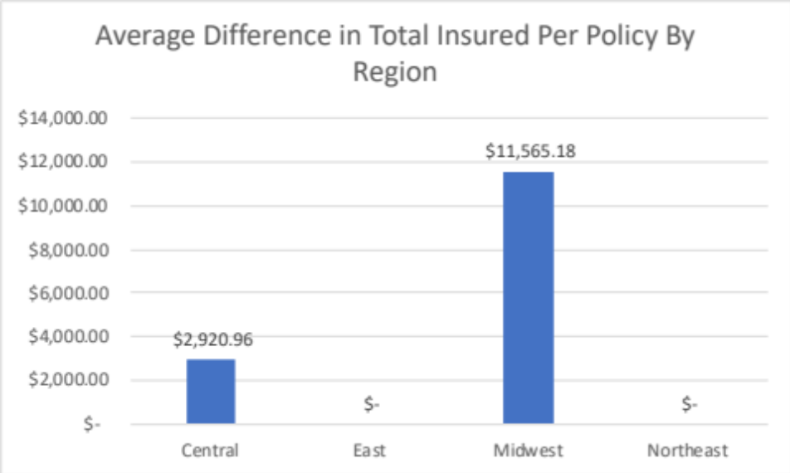
Outcome of Rainfall Adjustments
Pros:
  Increases in insured amounts only impact 3 states: MI, MN, and WI
  Regionally, this means we will see increases in annual revenue for both the Central and Midwest
Cons:
  The methodology used may be applying adjustments at too low of a granularity:
    If a policy lies within a high rainfall area, but the state it is in does not we are missing potential increases that could prove to be liabilities.

