Slide 1

Apache Kafka: Real-Time Data Streaming Platform
Course: MET CS777 - Big Data Analytics
Presented by: Sneha Agrawal

Slide 2
Introduction to Apache Kafka
Open-source distributed system for event streaming.
Backbone for real-time data flow in various applications.
Scalable, fault-tolerant, and reliable for handling high data volumes.

Slide 3
Why Kafka for Big Data Analytics?
Handles large data streams with fault tolerance and horizontal scalability (distributed server).
Essential for real-time analytics and decision-making in various industries which we will discuss later.

Slide 4
Kafka Architecture Overview
Producers: Send data to Kafka.
Consumers: Read and process data from Kafka.
Brokers: Manage and store data.
Topics & Partitions: Organize and segment data for parallel processing.

Slide 5
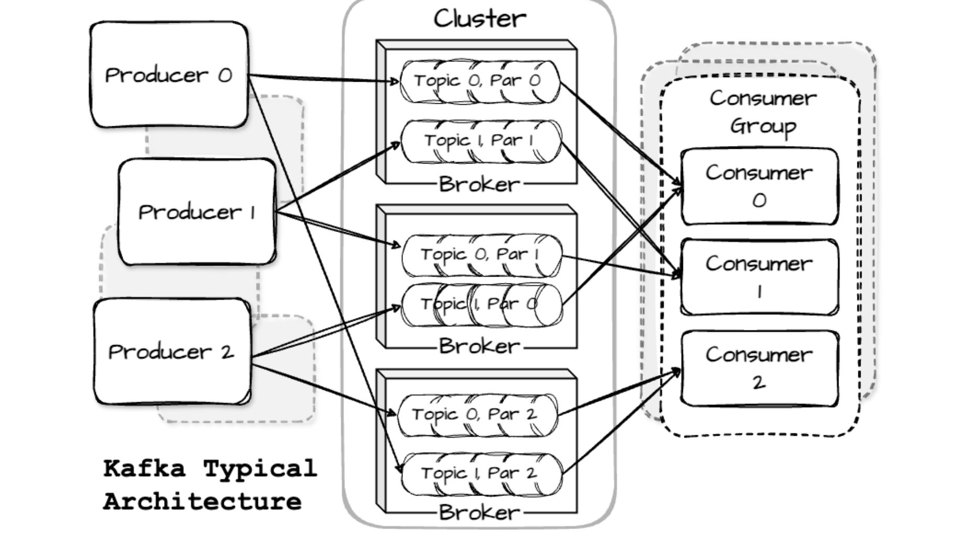

Slide 6
Role of Zookeeper & KRaft Mode
Zookeeper’s role is to manage brokers and coordinating clusters.
Transition to KRaft mode for improved scalability and internal coordination.

Slide 7
Key Features and Benefits
Durability and data replication.
Fault tolerance through distributed architecture.
Scalability via horizontal partitioning.
High throughput with minimal latency.

Slide 8
Comparison with Other Technologies
Kafka can handle massive amounts of data without slowing down, unlike traditional systems.
It processes data continuously, unlike RabbitMQ and ActiveMQ that focus on message queuing and delivery.
Kafka grows easily by adding servers, handling increased loads seamlessly.
It can collect data from many sources and distribute it to multiple destinations effectively.
Kafka’s distributed design ensures continued operation even if some servers fail.

Slide 9
Use Cases of Kafka
LinkedIn: User activity tracking.
Netflix: Monitoring infrastructure.
Spotify: Real-time event processing for music recommendation.
Amazon: Order tracking and inventory updates.
Financial Sector: Fraud detection and transaction monitoring.
Twitter: Content streaming and trend identification.

Slide 10
Demo 1: Real-Time Data Processing
Steps to set up a basic Kafka system.
Topic creation, message production, and consumption.
Real-time data processing demonstration using Python.

Slide 11
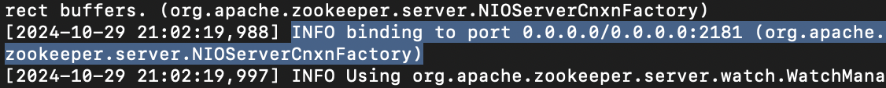
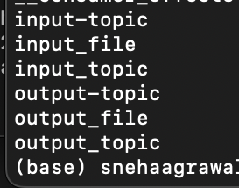
cd /Users/snehaagrawal/Downloads/kafka-3.8.0-src
bin/zookeeper-server-start.sh config/zookeeper.properties
bin/kafka-server-start.sh config/server.properties
bin/kafka-topics.sh --create --topic input-topic --bootstrap-server localhost:9092 --partitions 3 --replication-factor 1
bin/kafka-topics.sh --create --topic output-topic --bootstrap-server localhost:9092 --partitions 3 --replication-factor 1
bin/kafka-topics.sh --list --bootstrap-server 127.0.0.1:9092

Slide 12
cd "/Users/snehaagrawal/Documents/SEM 3/Big Data/Course Code/Demo1/"
python stream_processor.py
python interactive_producer.py
python output_consumer.py

Slide 13
Demo 2: Real-Time User Management System
Integration with PostgreSQL and Streamlit.
User registration and login tracking.
Real-time event handling using Kafka.

Slide 14
cd /Users/snehaagrawal/Downloads/kafka-3.8.0-src
bin/zookeeper-server-start.sh config/zookeeper.properties
bin/kafka-server-start.sh config/server.properties
bin/kafka-topics.sh --create --topic login-events --bootstrap-server localhost:9092 --partitions 1 --replication-factor 1
bin/kafka-topics.sh --list --bootstrap-server localhost:9092 # To verify topic creation
python3 -m venv kafka-env
source kafka-env/bin/activate
pip install streamlit kafka-python bcrypt
bin/kafka-console-consumer.sh --topic login-events --from-beginning --bootstrap-server localhost:9092 # Consumer console

Slide 15
cd "/Users/snehaagrawal/Documents/SEM 3/Big Data/Course Code/Demo 2/"
streamlit run app.py
To see table:
select * from users;
To see events:
select * from events;

Slide 16
Challenges and Limitations
Requires clusters and partitioning careful setup and expertise to handle distributed servers and split data effectively.
Guarantees that each message is processed only once can be complex to achieve.
Balancing quick data delivery (latency) with handling large amounts of data (throughput) is challenging.
Requires planning and monitoring to manage disk space efficiently and avoid unnecessary costs or data loss.

Slide 17
Conclusion
Apache Kafka Is a critical technology for real-time event streaming.
Scalable and reliable solution for diverse applications.
Future developments enhancing efficiency and scalability.

