Slide 1
Object Detection on Google's Open Images Dataset A Distributed Computing Approach
Course: MET CS777 - Big Data Analytics Presentation by: Deepak Swaminathan & Sneha Agrawal

Slide 2

Project Overview:
Focused on object detection
Developed scalable object detection pipeline.
Investigated Faster R-CNN and SSD models.

Slide 3
What is Object Detection?
A computer vision task to detect and localize objects within an image or video.
Outputs include bounding boxes and labels.

Slide 4
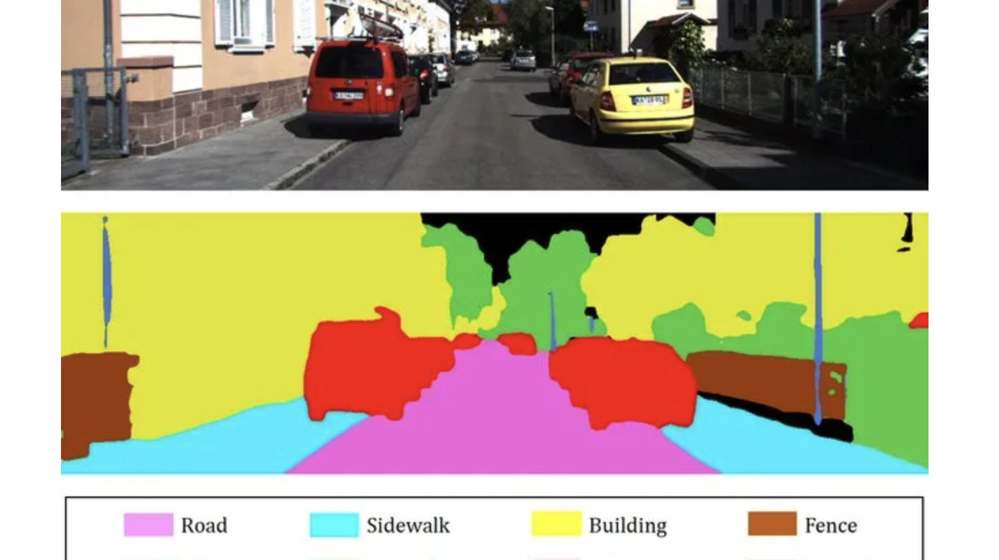

Slide 5
Dataset Overview
Dataset: Google Open Images Dataset V7
Characteristics: 1 million images with detailed annotations with bounding box
Selection: 5 object categories chosen for focused analysis.

Slide 6
Data Preparation Pipeline
Downloaded selective images using a custom Python script.
Resized images to 299x299 dimensions.
Proportional adjustment of bounding boxes.
Saved in Parquet format for optimized processing.

Slide 7
Model Architecture

Slide 8
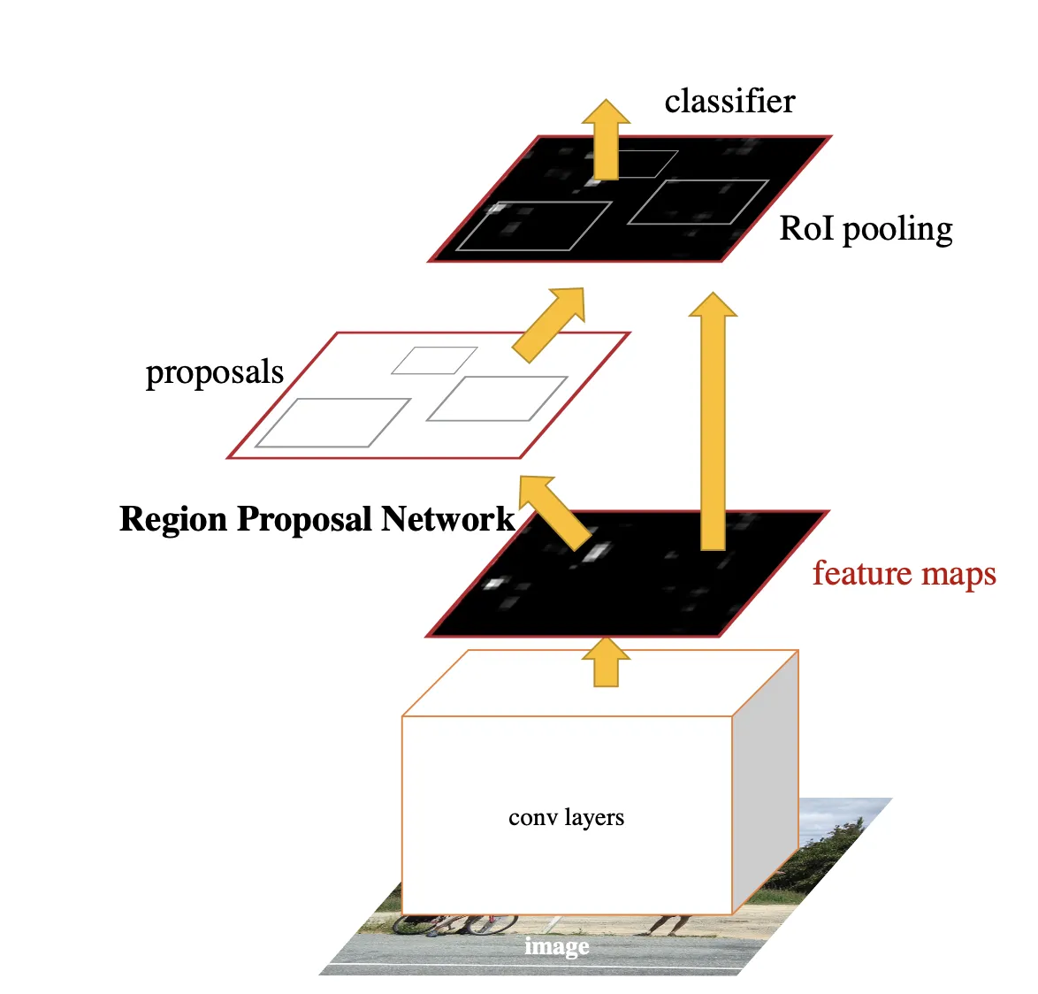
Faster R-CNN:
High accuracy, two-stage detection.
Region-based convolutional approach.
Stage 1: Region Proposal Network (RPN) to suggest object regions.
Stage 2: Classification and regression on proposed regions.

Slide 9
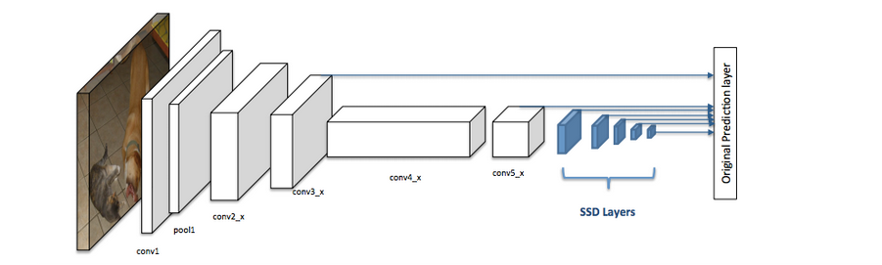
SSD:
Faster inference times.
Single-stage detection mechanism.
Real time application
Multi-scale feature map (Zoom in, Zoom out, Normal)
Ability to detect small objects in a image, which YOLO fails to capture.

Slide 10
Use Cases
Autonomous Vehicles: Detect pedestrians, vehicles, and road signs.
Healthcare: Identifying tumours or abnormalities in medical images.
Security: Surveillance for unauthorized activities.
Agriculture: Monitoring crops for disease or pest infestation.
Retail: Inventory tracking and customer behaviour analysis

Slide 11
Training Infrastructure
Objective: Leverage parallel processing.
Challenges:
GPU resource constraints.
Limited distributed training.
Mitigations:
Reduced dataset size.
Optimized preprocessing pipelines.

Slide 12
Performance Metrics
Evaluating:
Intersection over Union (IoU)
Mean Average Precision (mAP)
Precision, Recall, F1-Score
Visualizing:
- Comparative bounding box overlays for predictions vs. ground truth.

Slide 13

Results & Discussion

Slide 14
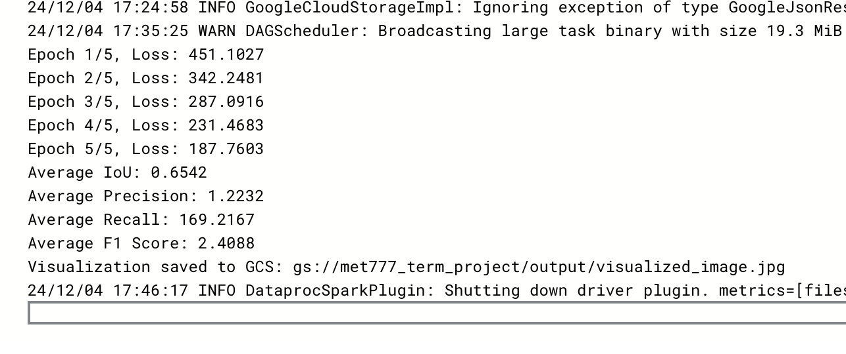
SSD (Faster inference)

Slide 15
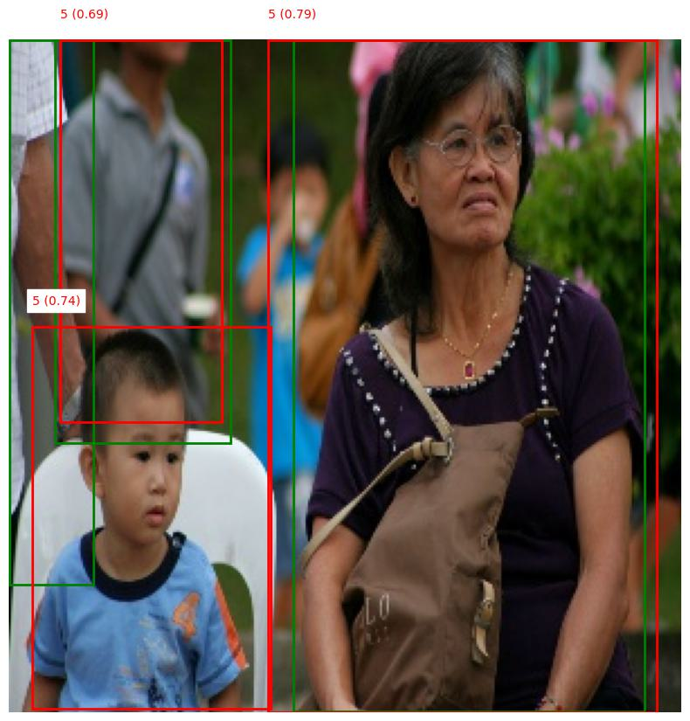

Slide 16
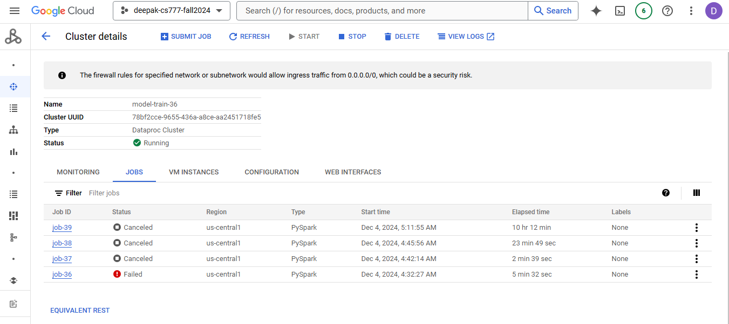
Faster R-CNN

Slide 17
Insights and Limitations
Distributed computing is critical for large-scale ML.
Preprocessing has a direct impact on model performance.
Dedicated GPU resources are essential.

Slide 18
Technical Stack
Programming Language: Python
Frameworks: PyTorch and PySpark
Cloud Platform: Google Cloud Storage
Tools: Distributed Data Parallel (DDP) for training.

Slide 19
Future Recommendations
Secure dedicated GPU resources.
Develop optimized distributed training scripts.
Explore advanced augmentation techniques for more generalised results.
Investigate more sophisticated architectures.

