Slide 1
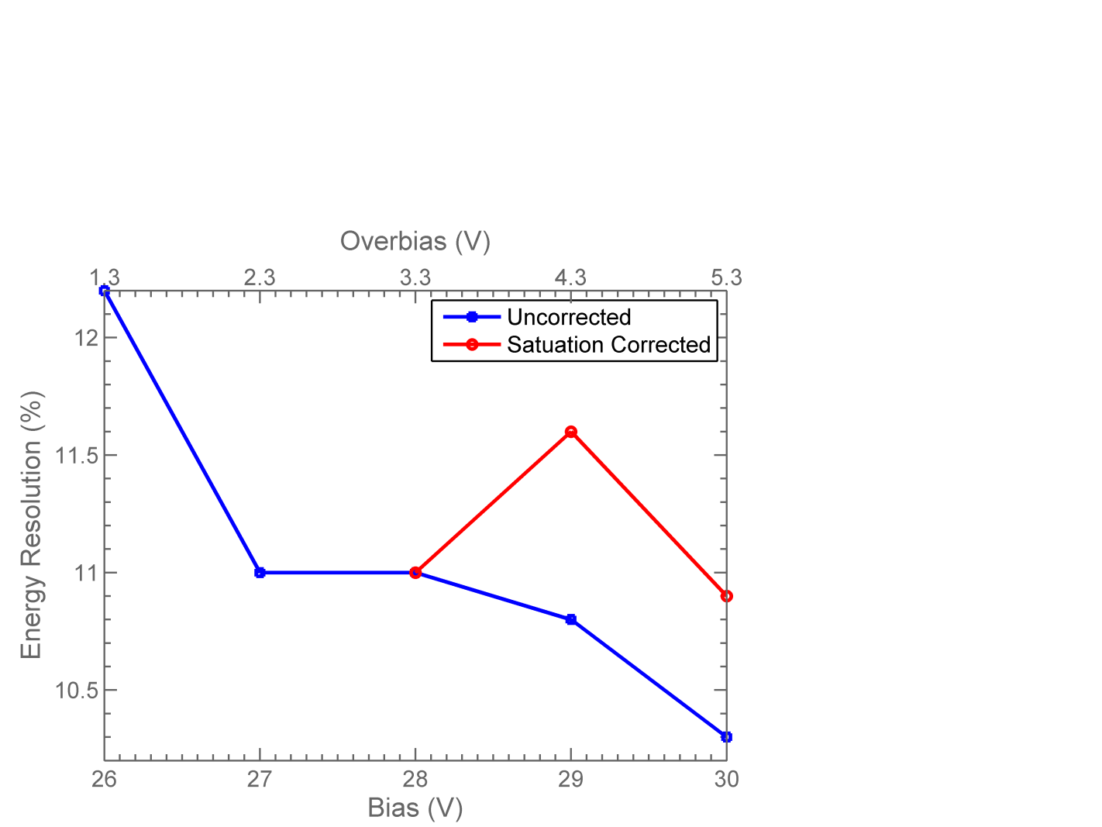
Energy Resolution as a function of SiPM Bias
3mm x 3mm MicroFC SiPM
3mm x 3mm x 30mm GAGG Crystal
Temp = 20ºC
Blue curve shows the energy resolution values ignoring saturation effect.
Red curve shows energy resolution at 29V and 30V corrected for effect of saturation.
** Assumes saturation correction factor at 30V is the same as correction factor at 29V. i.e. need to measure correction factor at 30V.

