Slide 1
Software Carpentry Workshop NIH Library
Dec 14th,15th,16th, & 18th (No class on Thurs!)
Instructors:
Adam Thomas, SFIM, NIMH
Giovanni Torres, HPC Core Facility (Biowulf), CIT
Helpers:
David McGaughey, Staff Scientist, OGVFB, NEI
Sponsored by Office of Data Science
Future Courses:
https://datascience.nih.gov/community/workforce/upcoming
Name tags? Sticky notes?

Slide 2
What is Software Carpentry?
Mission
To make researchers in science, engineering, and medicine more productive by teaching them basic lab skills for scientific computing

Slide 3
What is Software Carpentry?
The Problem
Scientists spend more and more time building and using software
Most are primarily self-taught
Hard to measure how well they do things, but anecdotal evidence suggests "not very"

Slide 4

What is Software Carpentry?
The Solution
Scientists teaching scientists
Two days of hands-on learning:
The Unix shell
Git and GitHub
Python or R
SQL
⇒ automate repetitive tasks
⇒ track and share work
⇒ build modular code
⇒ structure & manage data

Slide 5
What is Software Carpentry?
Outcomes
10-20% improvement in productivity is common
10X isn't rare
Do the old things faster
Tackle new problems
Ready for High Performance Computing (HPC), the cloud, big data, ...
Start doing open science

Slide 6
What is Software Carpentry?
The Details
Materials are all open access
Instructors are volunteers
Not for profit
How to get Involved
Become an instructor
Create and improve lessons
Help build tools
Learn more at http://www.swcarpentry.org

Slide 7
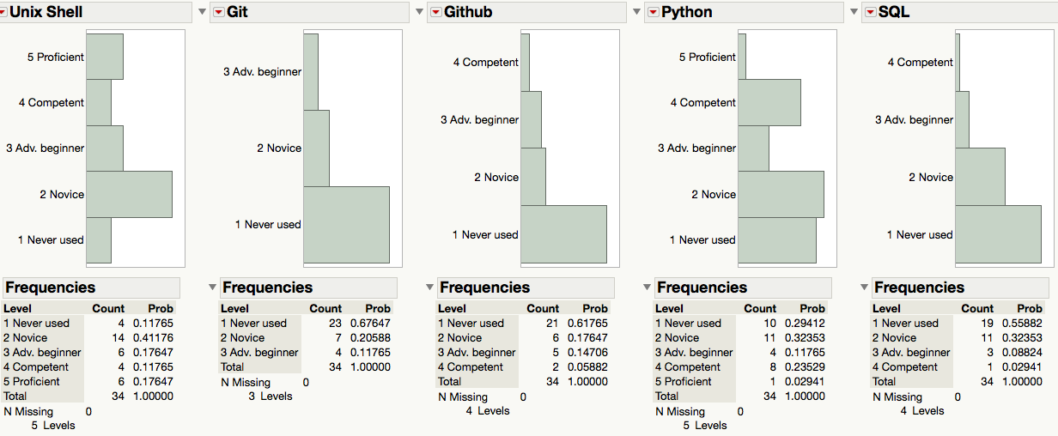
This weeks course You are not alone! Results from pre-workshop questionnaire
Peer Learning!

Slide 8
Course Tools
Exercise #1: Introduce yourself to your two neighbors
Exercise #2:
Open the etherpad link in your browser http://pad.software-carpentry.org/2015-12-14-NIH http://bit.ly/nih-epad
Type your name in the upper right hand corner
Type “Hi” in the chat box in the lower right hand corner
Summarize in your job/research as a single #hashtag in the main window on the left
Put a green sticky note on the back of your laptop

Slide 9
Course Tools
The instructors, helpers, and students will add helpful things to the etherpad regularly, so check it frequently
If you have a question but don’t want to interrupt the instructor, type it in the chat window
Put up a green sticky when prompted, put up a red sticky if you’re stuck and need help
http://www.socratic.com
All of the commands Adam types are in Dropbox here: http://bit.ly/agtCommands

Slide 10
Exercise #3
Make a new folder on your desktop called shell-novice
Download this file http://bit.ly/nih-sn-zip and put it in your new folder
Uncompress this file
Open a terminal

Slide 11
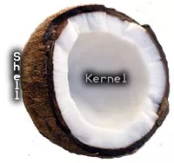
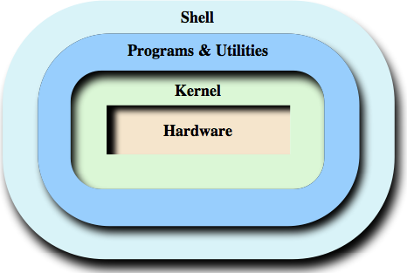
The Unix Shell

Slide 12
The File System

Slide 13
The File System

Slide 14
The File System

Slide 15
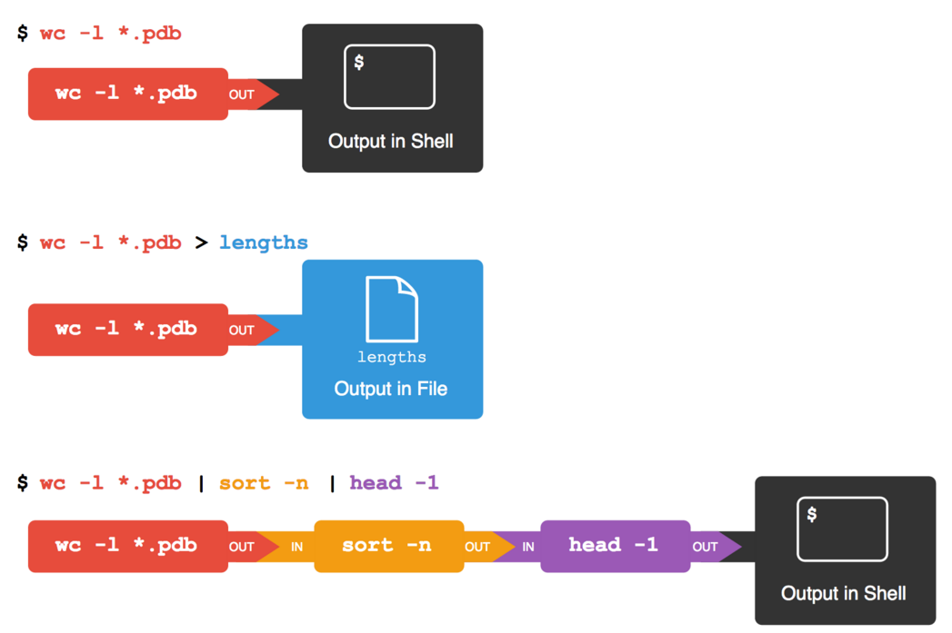
Connecting things: pipes and redirectors

Slide 16
Resources
All of this material is online:
There are youtube videos of other people teaching it:
The internet is filled with smart, procrastinating people who actually enjoy helping people like you
Learning how to ask good questionshttp://www.catb.org/esr/faqs/smart-questions.html

