Slide 1

Data Sharing and Open Science in Neuroimaging
Adam Thomas
Data Science and Sharing Team, FMRIF, NIMH

Slide 2
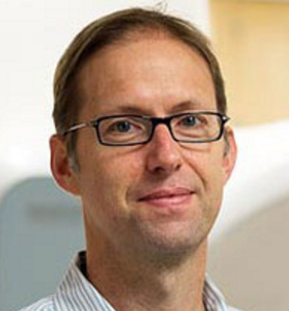



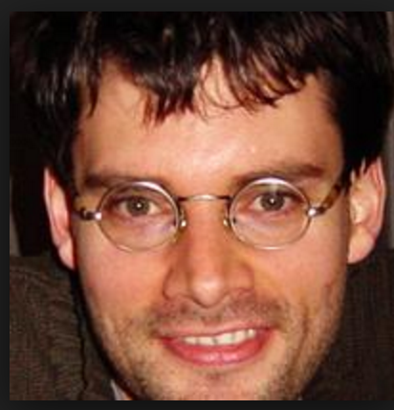


Credits
Material borrowed, adapted, and/or stolen from:
Russ Poldrack
Chris Gorgolewski
Brian Nosek
Tal Yorkoni
Niko Kriegeskorte
Tom Nichols
Phil Bourne

Slide 3
Outline
Why do we need Open Science?
What is Open Science?
How do I do Open Science?

Slide 4
Outline
Why do we need Open Science?
What is Open Science?
How do I do Open Science?

Slide 5
Outline
The Problem
What is Open Science?
How do I do Open Science?

Slide 6
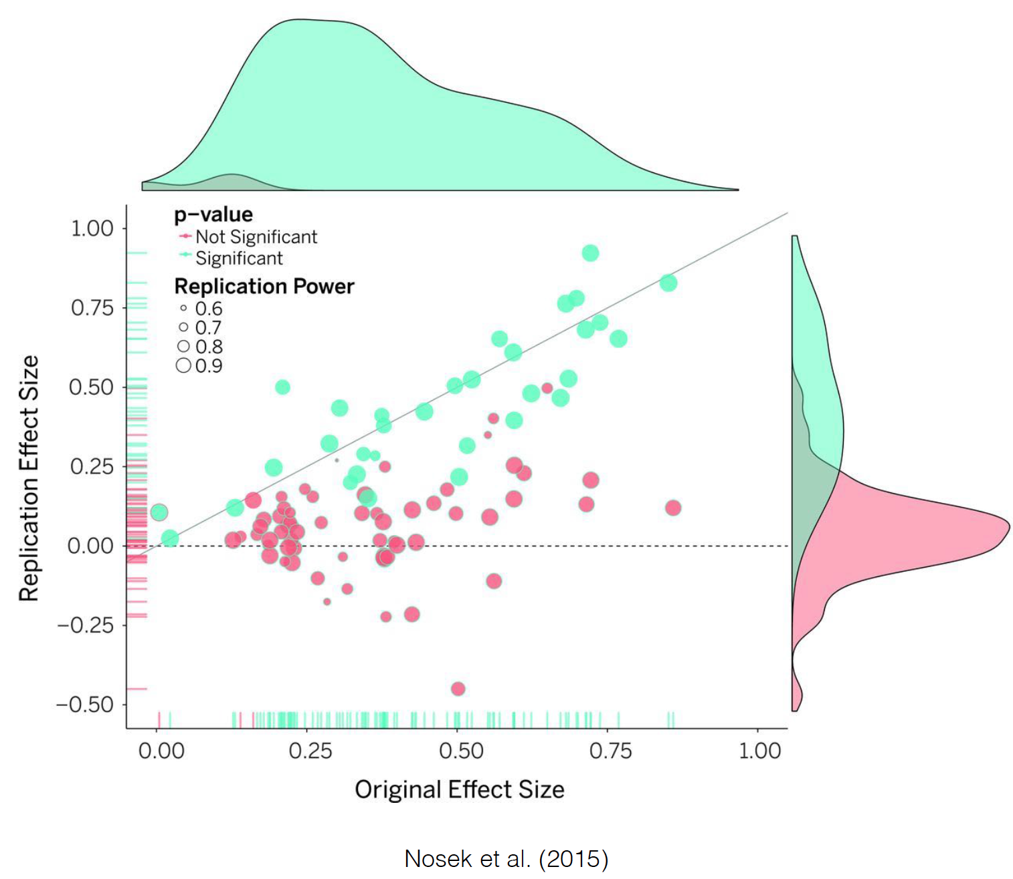
Problem: Reproducibility
OPEN SCIENCE: WHY ➔ WHAT ➔ HOW

Slide 7
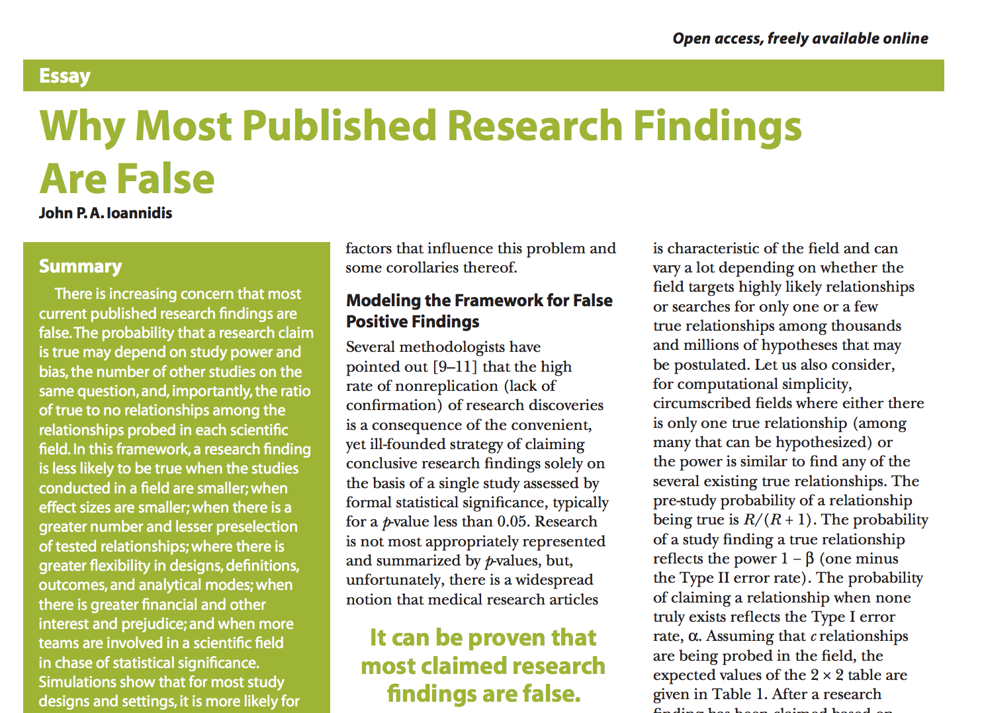


The Problem: Reproducibility
OPEN SCIENCE: WHY ➔ WHAT ➔ HOW

Slide 8
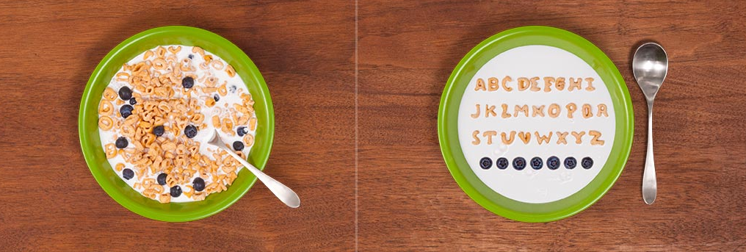
Problem:
Wasted time & resources
“How much time do you spend handling, reorganizing, and managing your data as opposed to actually doing science?”
Median answer is 80%
OPEN SCIENCE: WHY ➔ WHAT ➔ HOW

Slide 9

Problem:
Wasted Time & resources
Unpublished Data
File drawer problem
Lost staff & lost
metadata
Underutilized data
OPEN SCIENCE: WHY ➔ WHAT ➔ HOW

Slide 10

The Problem
Lack of transparency and reproducibility hinders integration
“The Blue Ribbon Panel proposes that basic and clinical groups in NIMH IRP be linked more closely than is generally the case in universities. Linking basic and clinical teams of investigators may facilitate the translational goals of understanding disease mechanisms and developing novel therapies. “

Slide 11
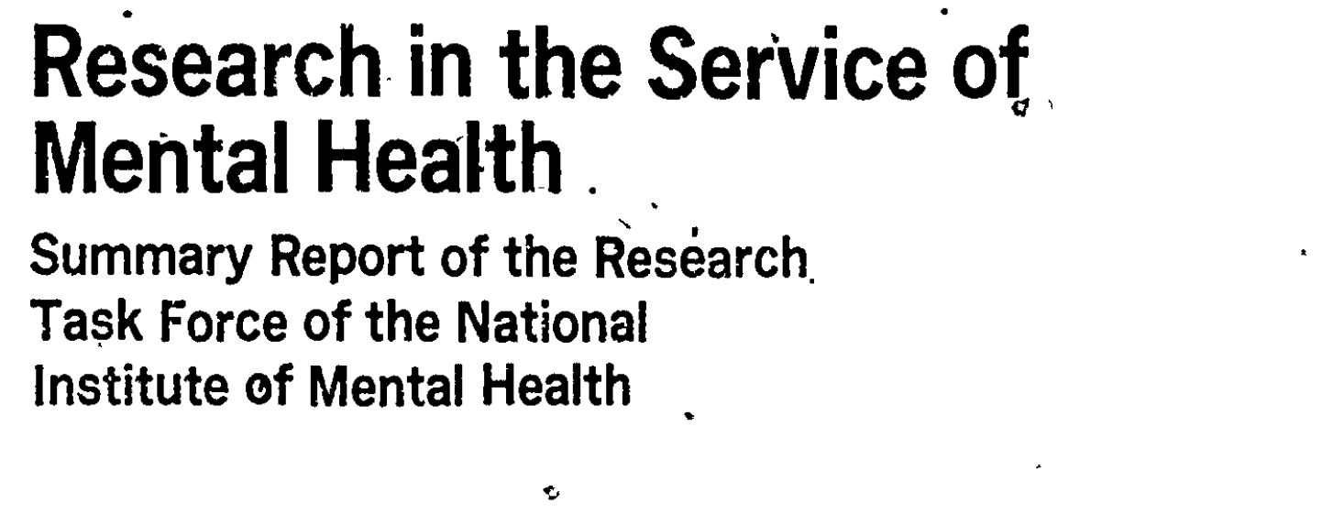
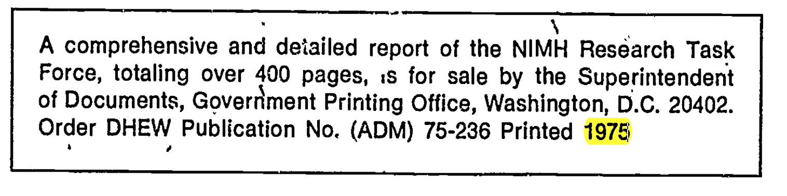
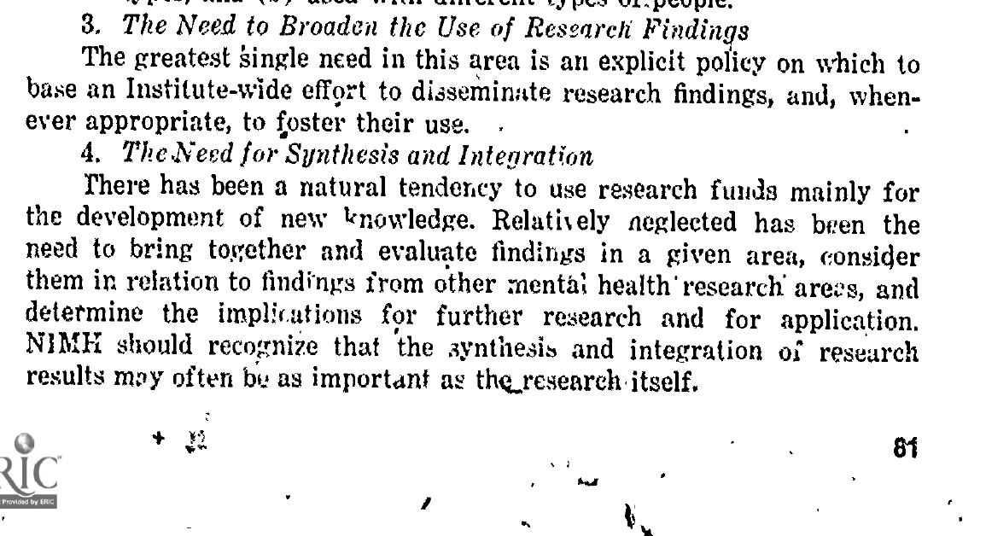
The Problem… is not new
“Relatively neglected has been the need to bring together and and evaluate findings in a given area and consider them in relation to findings from other mental health research areas […]
NIMH should recognize that the synthesis and integration of research results may often be as important as the research itself”
- Research Task Force of the NIMH, 1975

Slide 12
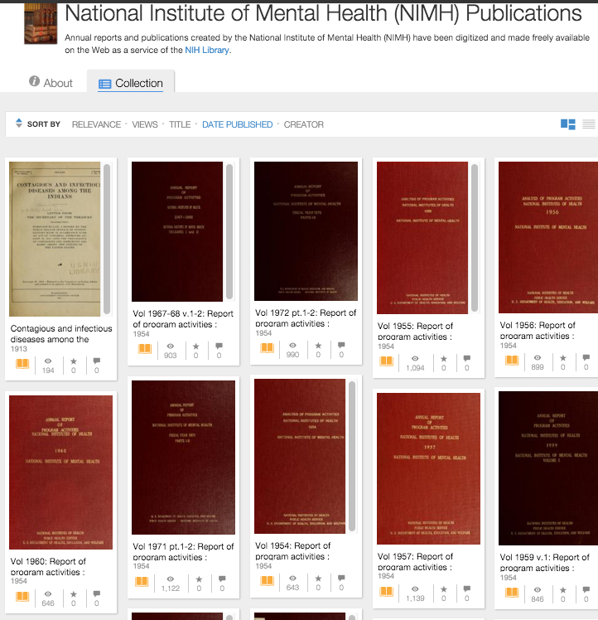
The Problem… is not new
https://archive.org/details/nimh-nihlibrary

Slide 13
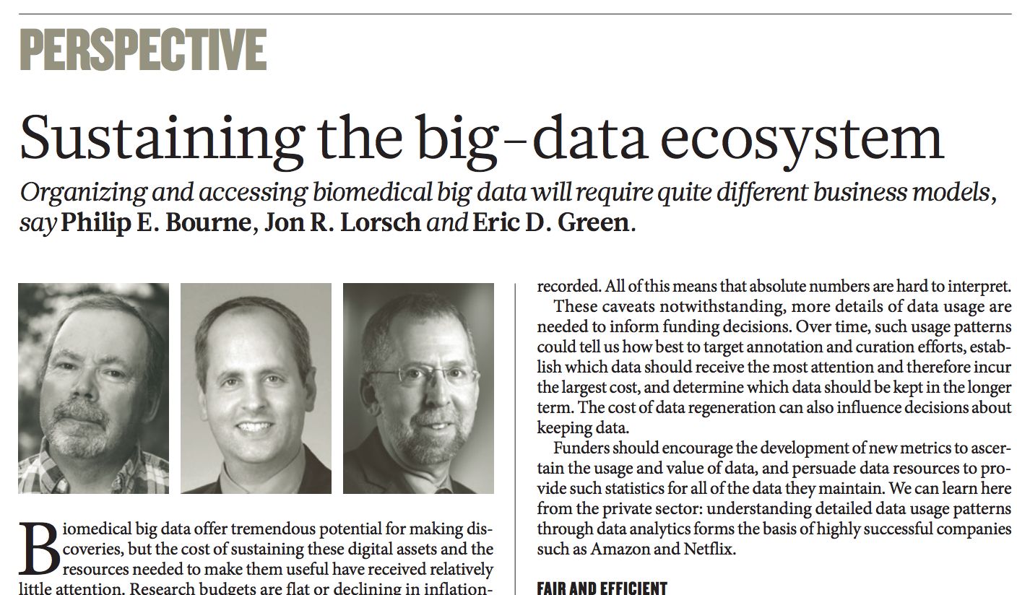
Problems: The big-data revolution
OPEN SCIENCE: WHY ➔ WHAT ➔ HOW

Slide 14
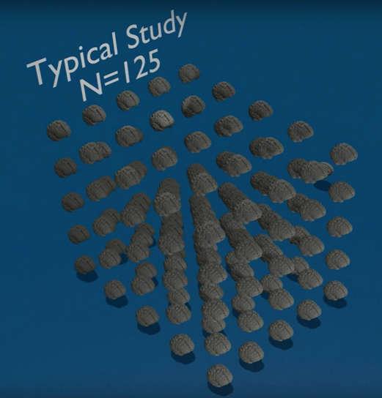
Problems: The big-data revolution
UK Biobank
Imaging
Initiative
OPEN SCIENCE: WHY ➔ WHAT ➔ HOW

Slide 15
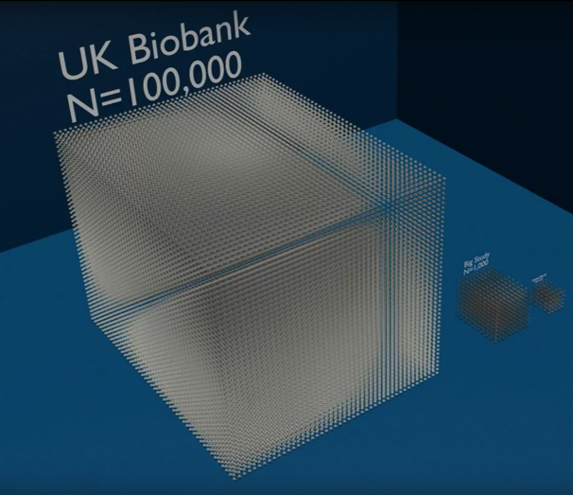
Problems: The big-data revolution
UK Biobank
Imaging
Initiative
OPEN SCIENCE: WHY ➔ WHAT ➔ HOW

Slide 16
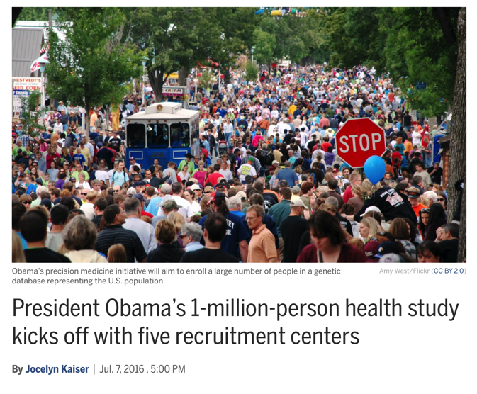
Problems: The big-data revolution
OPEN SCIENCE: WHY ➔ WHAT ➔ HOW

Slide 17
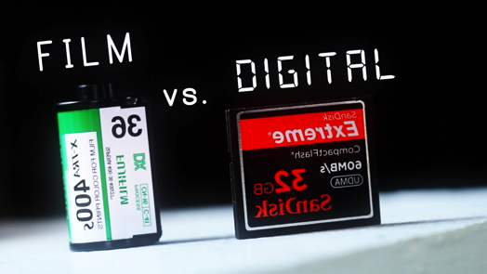

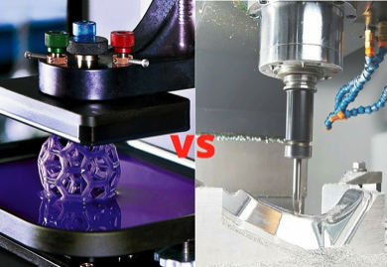
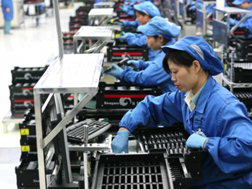
Problems: The big-data revolution
OPEN SCIENCE: WHY ➔ WHAT ➔ HOW
Notes:
Phil Bourne from the NIH Office of Data Science Slide

Slide 18
Outline
The Problem
  Reproducibility
  Wasted resources
  Lack of integration
  Ill-prepared to work with big datasets
What is Open Science?
How do I do Open Science?

Slide 19
Outline
Why do we need Open Science?
What is Open Science?
How do I do Open Science?

Slide 20
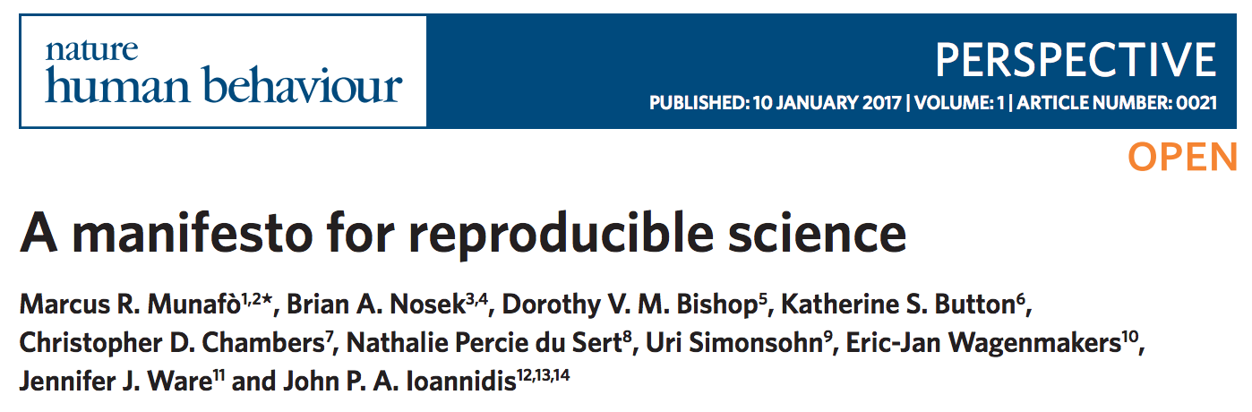
The Problem
Methods
  Cognitive Bias
  Methodological Training
  Independent Method support (and oversight)
  Encouraging Team Science
Reporting and dissemination
  Pre-registration
  Quality of Reporting (checklist & guidelines)
Reproducibility
  Transparency
  Data Sharing
Evaluation
  Peer Review
Incentives
  Changing cultural norms
  Badges

Slide 21
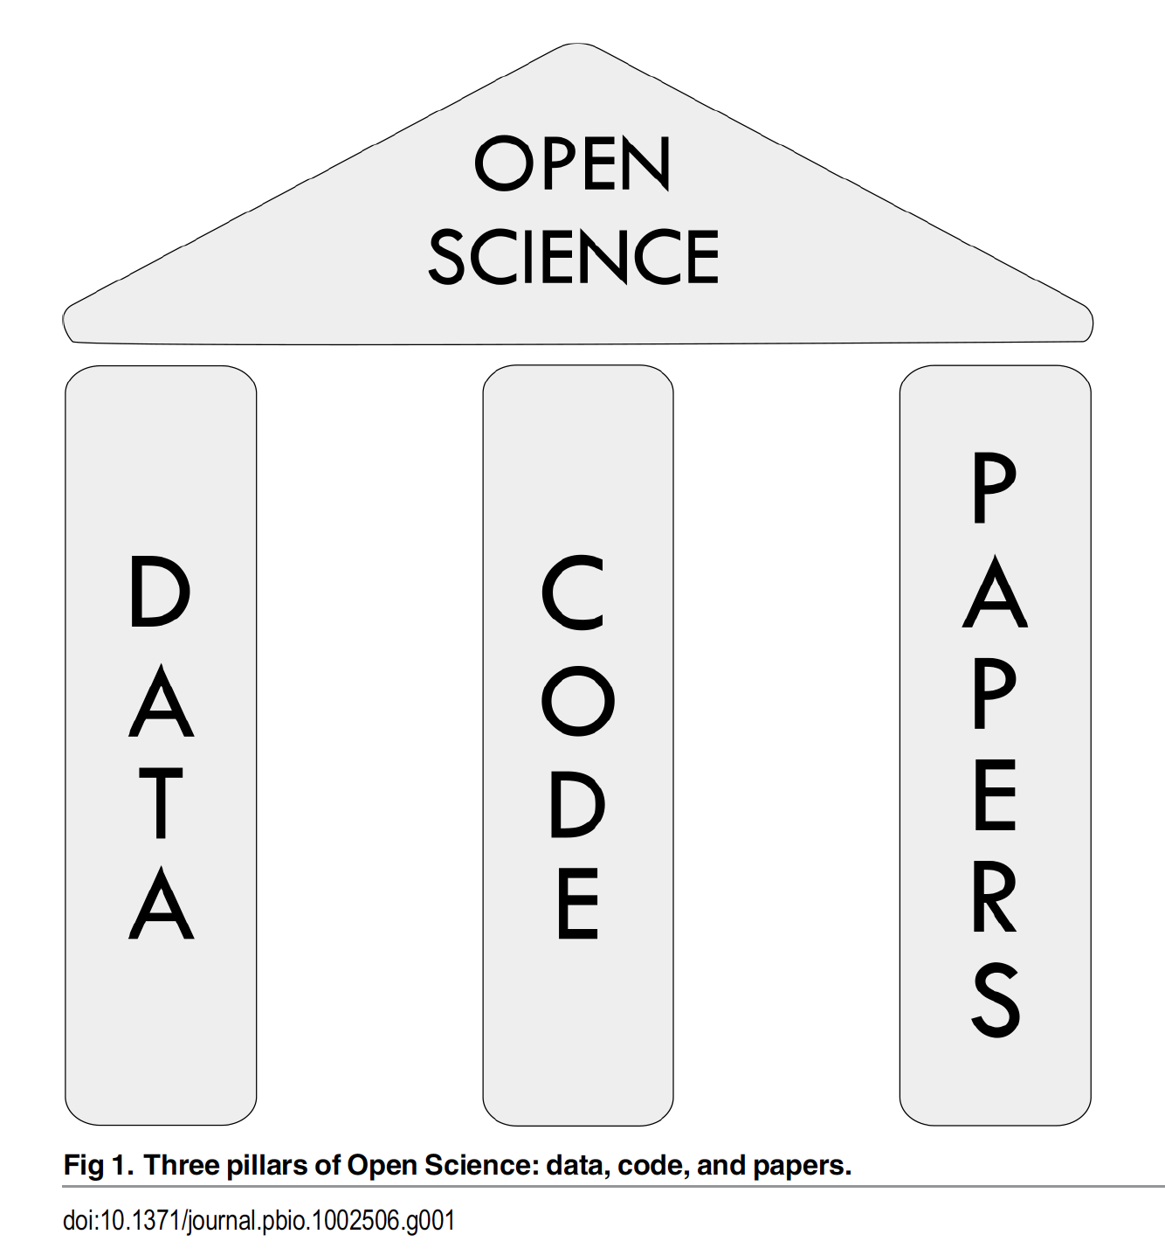
What is Open Science?
OPEN SCIENCE: WHY ➔ WHAT ➔ HOW

Slide 22
What is Open Data?
Data deposited in a public, community-recognized repository with a stable DOI
Follows FAIR Principle
Findable
Accessible
Intra-operable
Reusable
Should be deposited before publication
OPEN SCIENCE: WHY ➔ WHAT ➔ HOW

Slide 23
Open Data: Community recognized Repositories
MRI Specific Repos
OpenfMRI
COINS
FCP/INDI
LONI
LORIS
NITRC
XNAT Central
ANIMA*
BALSA*
Neuovault*
Data Agnostic Repos
FigShare
Dryad
DataVerse
Open Science
Framework
NIMH Data Archive
Coming soon: A dedicated MRI image repository for MRI studies conducted at intramural NIMH
* Statistical & derived data only
OPEN SCIENCE: WHY ➔ WHAT ➔ HOW

Slide 24
What is Open Code?
  Open code enables
  greater reproducibility
  (includes non-code methods)
OPEN SCIENCE: WHY ➔ WHAT ➔ HOW

Slide 25
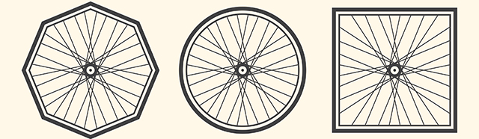
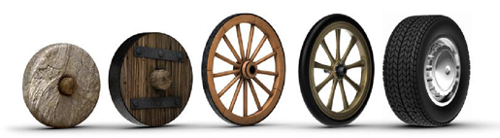
Open Code – Don’t Reinvent
Reuse and improve
OPEN SCIENCE: WHY ➔ WHAT ➔ HOW

Slide 26



Open Code - Version Control
Version control systems allows you to:
Store all of your analysis in a central repository
Keep a history of “snapshots” of your evolving analysis
Quickly switch between different versions of your analysis
Adopt and modify code from other scientists
Collaborate
OPEN SCIENCE: WHY ➔ WHAT ➔ HOW

Slide 27
What are Open Papers?
  Preprint posting
  Open access
  Open review
OPEN SCIENCE: WHY ➔ WHAT ➔ HOW

Slide 28


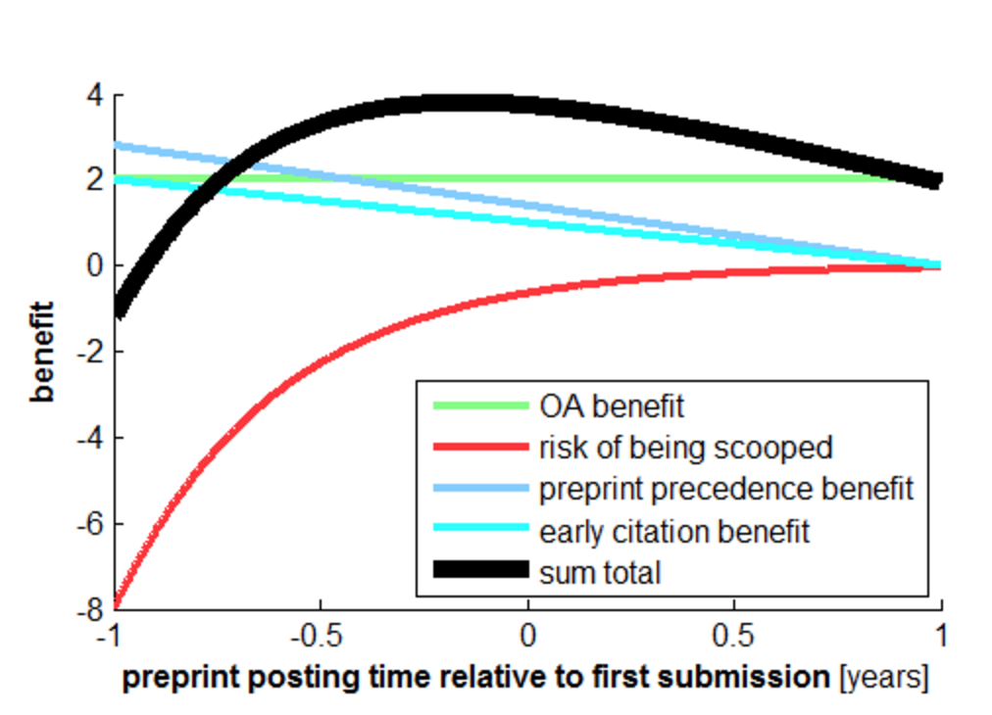
Open Papers: Preprint posting
  Benefits:
    Open access
    Catch errors
    Earlier citation
    Earlier precedence,
    prevent scooping
    Speed and improve final submission
Kriegeskorte (2016) DOI:10.15200/winn.145838.88372
OPEN SCIENCE: WHY ➔ WHAT ➔ HOW

Slide 29
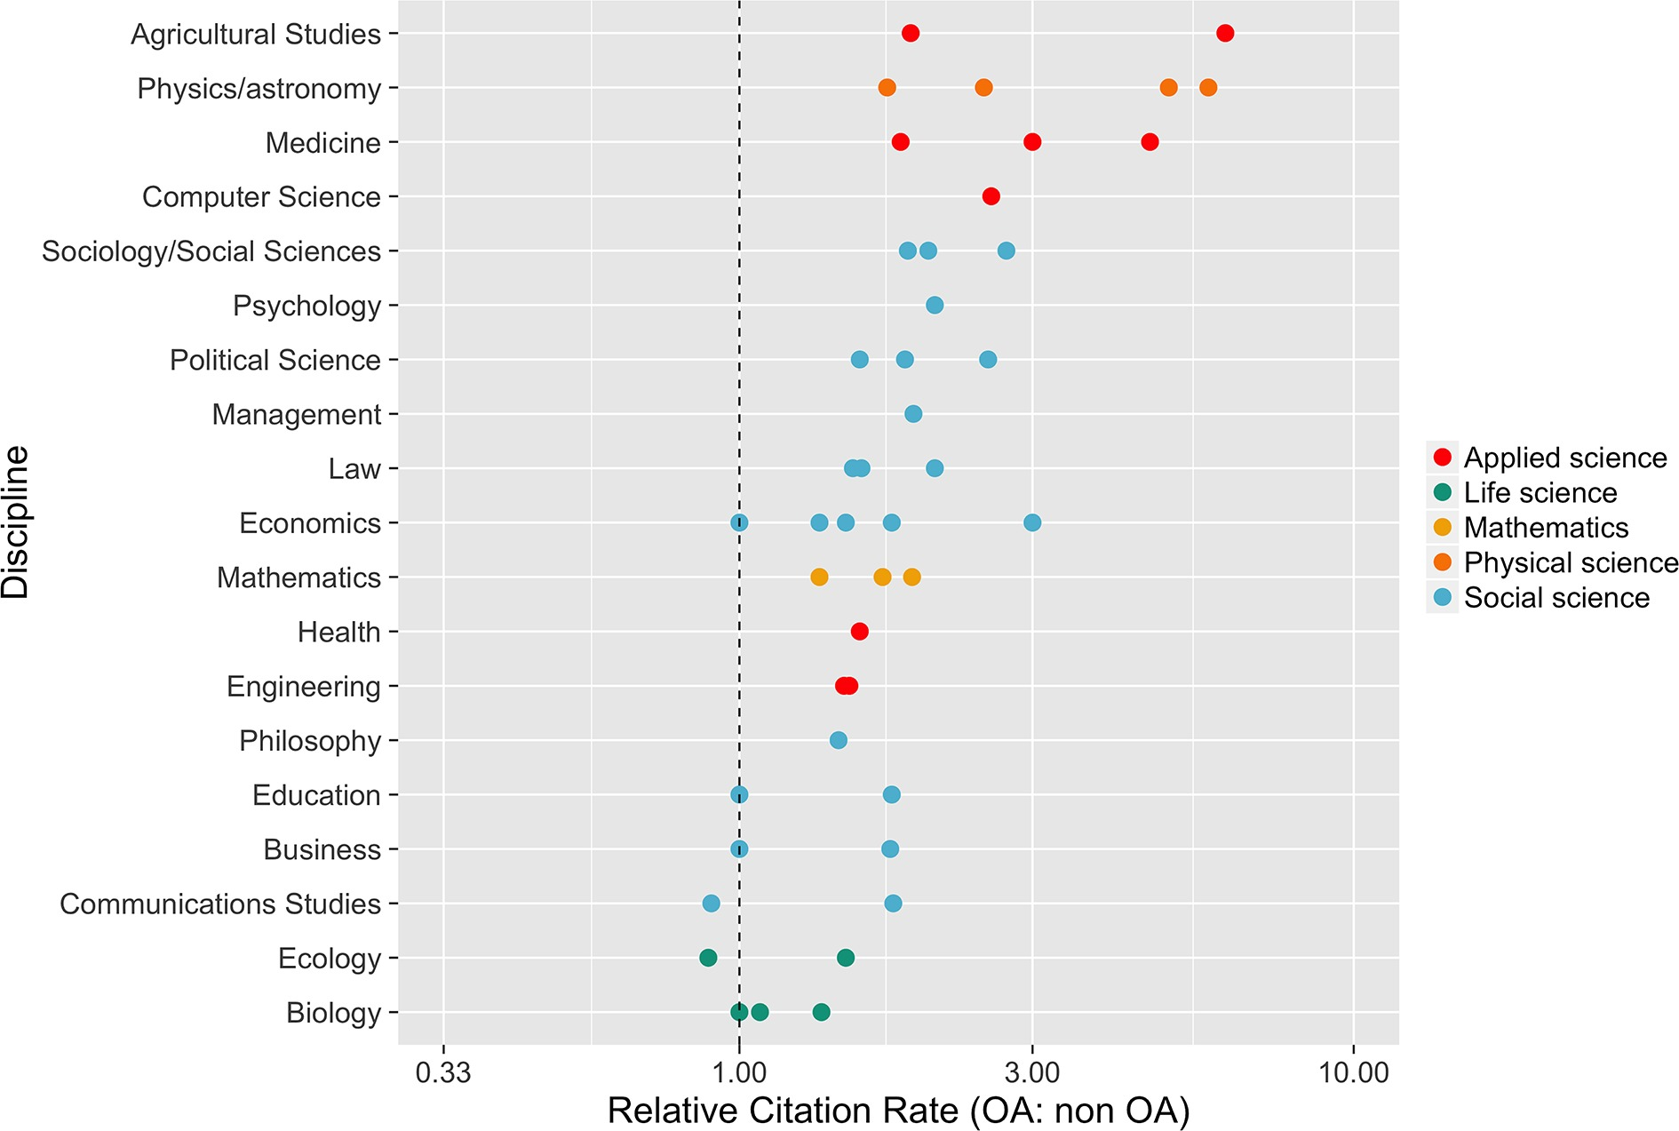
Open Access
Open access publication are cited more
https://elifesciences.org/content/5/e16800%20
mean citation rate of OA articles divided by mean citation rate of non-OA articles
OPEN SCIENCE: WHY ➔ WHAT ➔ HOW

Slide 30
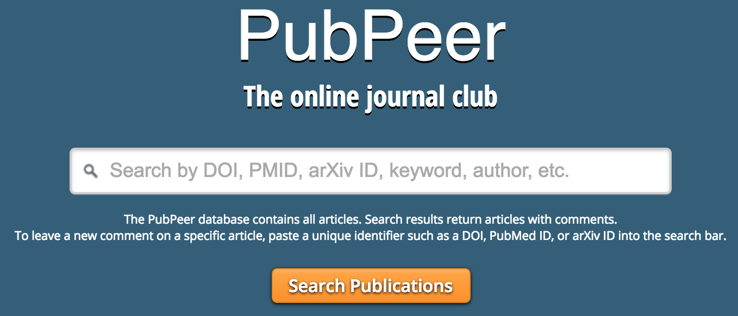

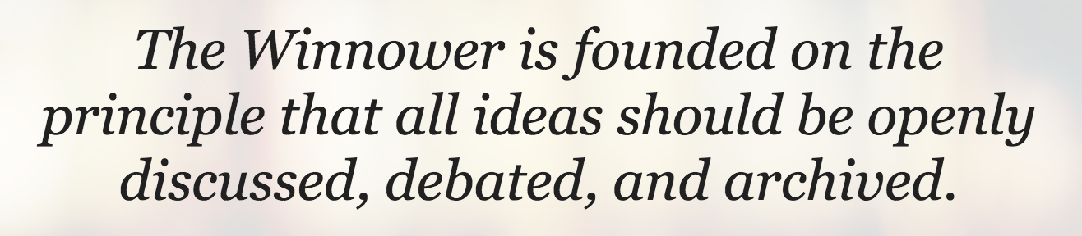
Open Review
Public discussion of pros and cons of submission
Optional anonymity
Prevent low-quality and or biased review
OPEN SCIENCE: WHY ➔ WHAT ➔ HOW

Slide 31
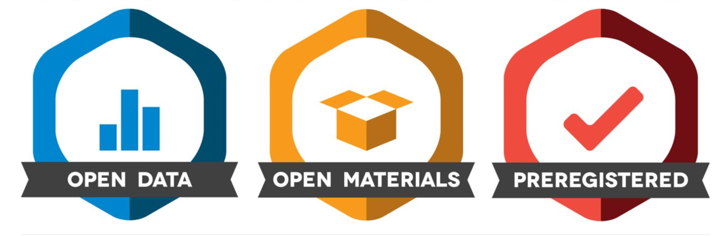
Incentives: Badges
OPEN SCIENCE: WHY ➔ WHAT ➔ HOW

Slide 32
Outline
Why do we need Open Science?
What is Open Science?
How do I do Open Science?
OPEN SCIENCE: WHY ➔ WHAT ➔ HOW

Slide 33

How – Plan Ahead
Get data sharing in your protocol:
  NIMH Data Sharing Commitee
  https://open-brain-consent.readthedocs.io
When designing, collecting, and analyzing
consult with standards documents:
  Enhancing Quality and Transparency of Health Research
  (EQUATOR) http://www.equator-network.org
  Best Practices in Data Analysis and Sharing in Neuroimaging using MRI (COBIDAS) http://dx.doi.org/10.1101/054262
OPEN SCIENCE: WHY ➔ WHAT ➔ HOW

Slide 34
Standards – EQUATOR & COBIDAS
EQUATOR: Different standards for different designs
  RCT, crossover, observational, etc.
COBIDAS Sections
  Experimental Design
  Image Acquisition
  Preprocessing
  Statistical Modeling
  Results
  Data Sharing
  Reproducibility
Both EQUATOR and COBIDAS focus on reporting,
Reviewing them in advance will help you plan and design your study
Also useful reference when reviewing papers
OPEN SCIENCE: WHY ➔ WHAT ➔ HOW

Slide 35
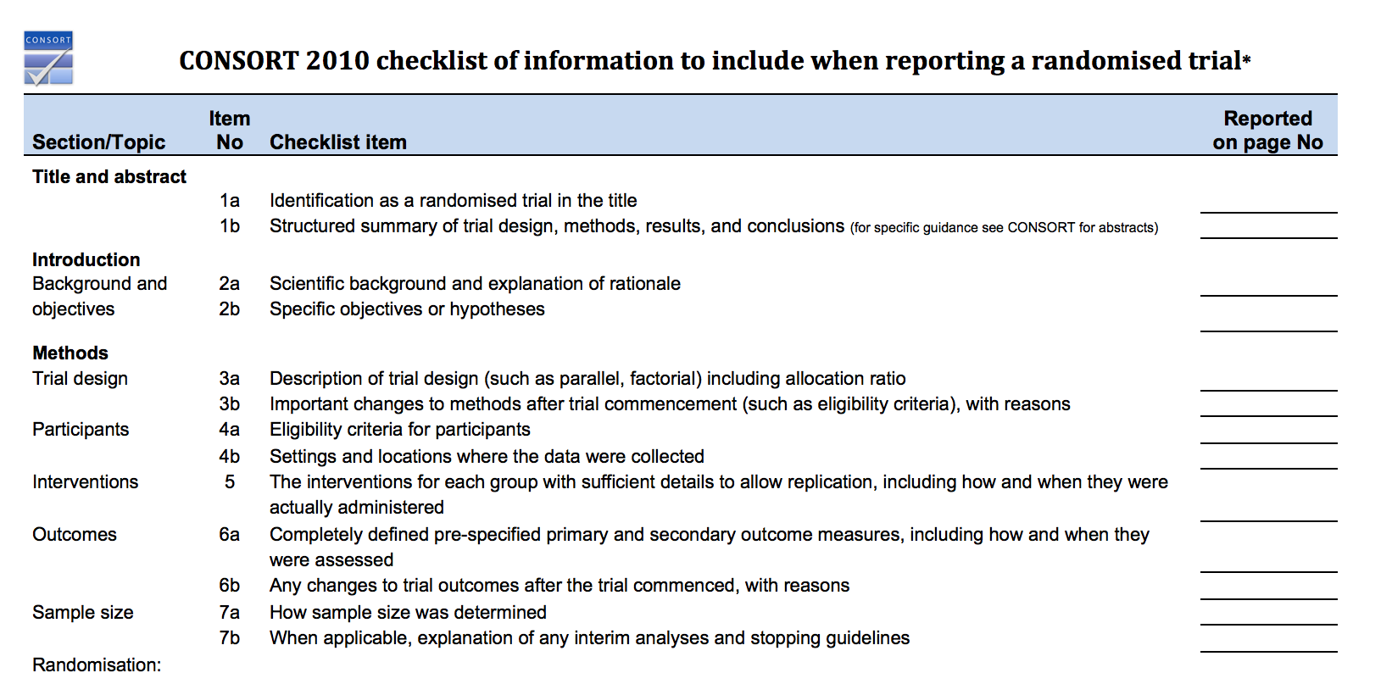
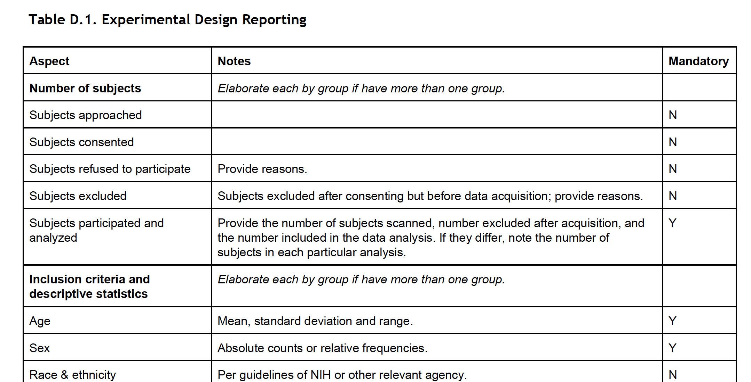
Standards – EQUATOR & COBIDAS
Checklists
OPEN SCIENCE: WHY ➔ WHAT ➔ HOW

Slide 36
COBIDAS – Highlights
Report scan parameters by exporting exam cards
Preprocessing include all steps applied to the data before and must be reported
For maximal transparency, report all regions of interest (ROIs) and/or experimental conditions examined as part of the research, so that the reader can gauge the degree of any HARKing
  Hypothesizing After The Results are Known
  It’s OK to explore your data, just be clear that that is what you’re doing
OPEN SCIENCE: WHY ➔ WHAT ➔ HOW

Slide 37
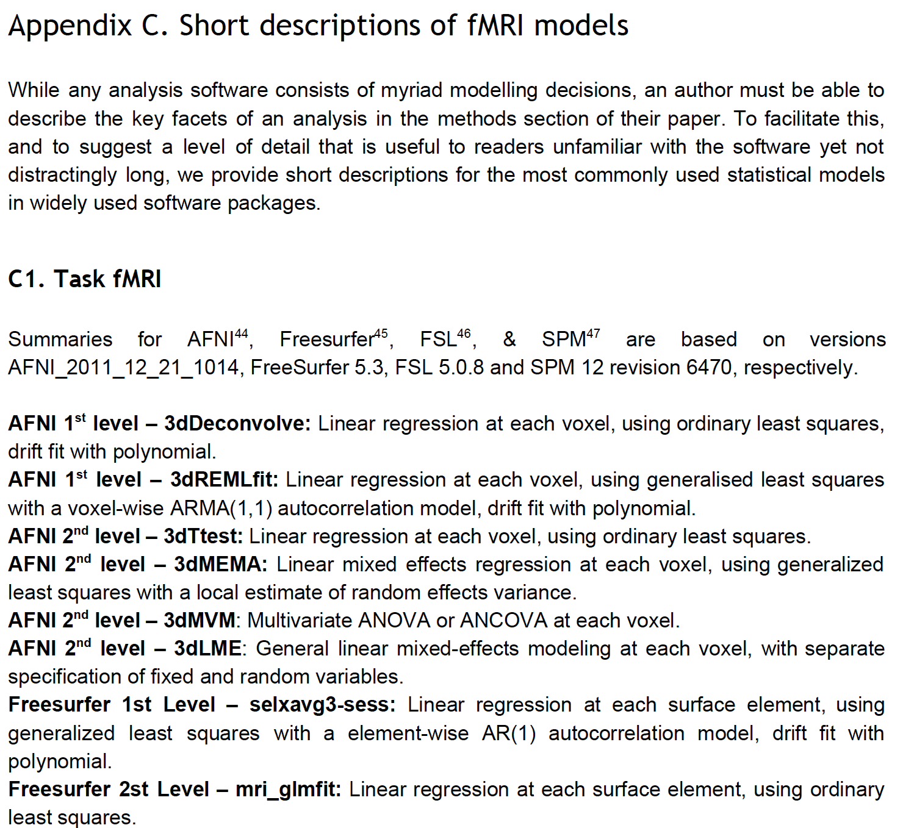
COBIDAS – 4. Statistical Modeling
Different reporting standards for different statistical approaches (univariate, multivariate, connectivity).
Appendix C: Translates software used to statistical language
OPEN SCIENCE: WHY ➔ WHAT ➔ HOW

Slide 38
COBIDAS – 5. Results
Mass univariate analyses should report:
  All Effects tested
  Tables of brain coordinates,
  Thresholded maps
  Extracted data
Functional Connectivity
Multivariate and Predictive Analysis
  Evaluation : Quality of predicted fit
  Interpretation: What does it mean
OPEN SCIENCE: WHY ➔ WHAT ➔ HOW

Slide 39
COBIDAS – 6. Data Sharing
Planning: “Data sharing is most onerous when done as an afterthought”
“a comprehensive data management plan—that involves all authors, collaborators, funding agencies, and publishing entities—is essential”
OPEN SCIENCE: WHY ➔ WHAT ➔ HOW

Slide 40
COBIDAS – 7. Reproducibility
Archiving: Think long term
  Open-source software is more likely to be available long term
  URLs “decay” over time. Use Digital Object Identifiers (DOI) instead
OPEN SCIENCE: WHY ➔ WHAT ➔ HOW

Slide 41

Organizing your data - BIDS
A simple and intuitive way to organize and describe your neuroimaging and behavioral data.
http://bids.neuroimaging.io
OPEN SCIENCE: WHY ➔ WHAT ➔ HOW

Slide 42
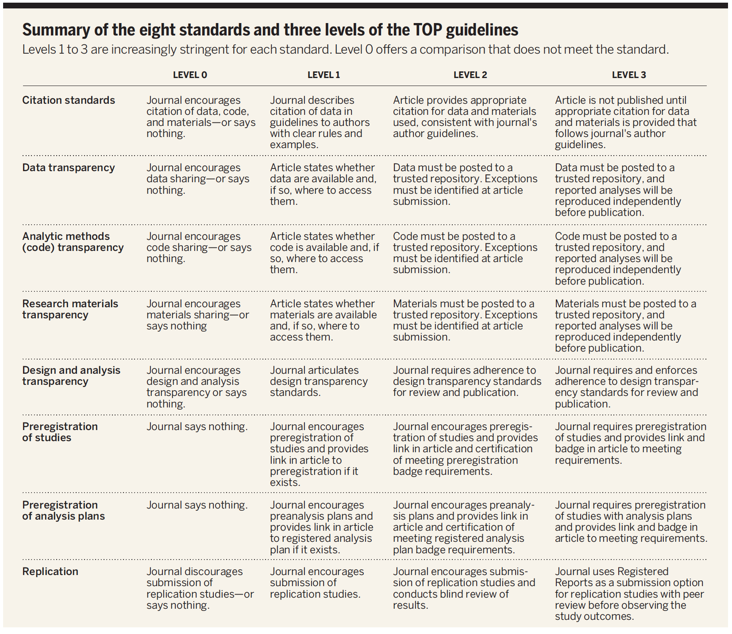
How to be Open – Choose your battles
Be open when you can, as you can
OPEN SCIENCE: WHY ➔ WHAT ➔ HOW

Slide 43




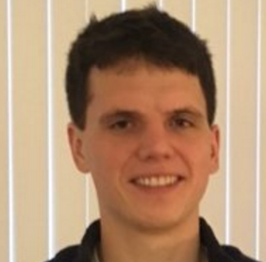


How to Open – You don’t have to do it alone
Training
Asking for help
  Data Science and Sharing Team
Adam Thomas John Lee DylanNielson
OPEN SCIENCE: WHY ➔ WHAT ➔ HOW

Slide 44




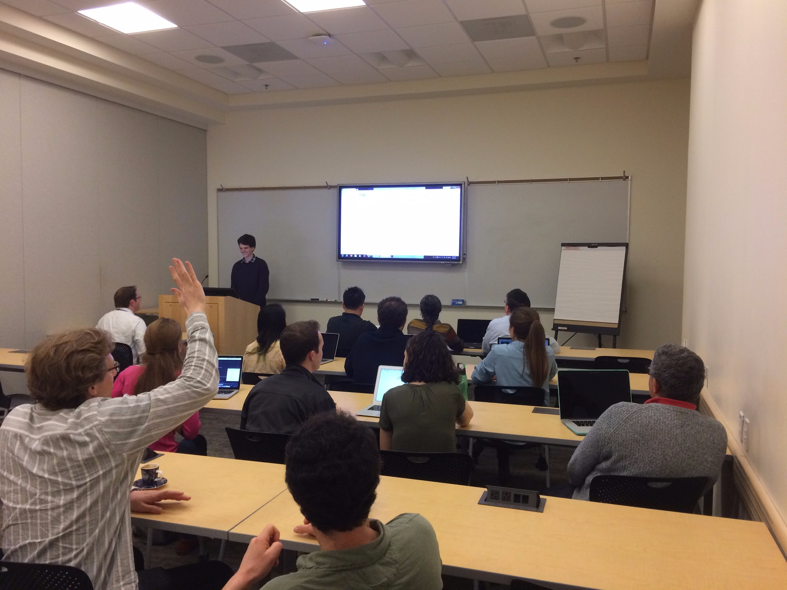
Data Science and Sharing Team’s
Workshop on Open and Reproducible Neuroscience
Mar 13-17th, 2017
45 applications, 25 students attended
16 hours of instruction on Python, Git, Data Repositories, Biowulf integration, Pre-registration, and statistical rigor
Instructors from Gallaudet, King’s College London, AFNI and Biowulf Teams
All course material available online:
https://github.com/nih-fmrif/NIMH_repro_2017
Next course Nov 2017

Slide 45
Summary and Take Homes
Science is changing (for the better) in both scope (big) and culture (open) to address future challenges
Open science strives to maximize reproducibility and transparency of data, code, and papers
Adopting Open Science practices yields benefits in productivity, impact, and reach
You don’t have to do it all at once, and you don’t have to do it alone
OPEN SCIENCE: WHY ➔ WHAT ➔ HOW

Slide 46
Thanks!
See online slides for more URLs and references: https://github.com/agt24
Questions?

