Slide 1

Library System
Group Number: 1
Members : AUNG THU MOE KANCHAN KUMAR SHAW ZAW YE NAING

Slide 2
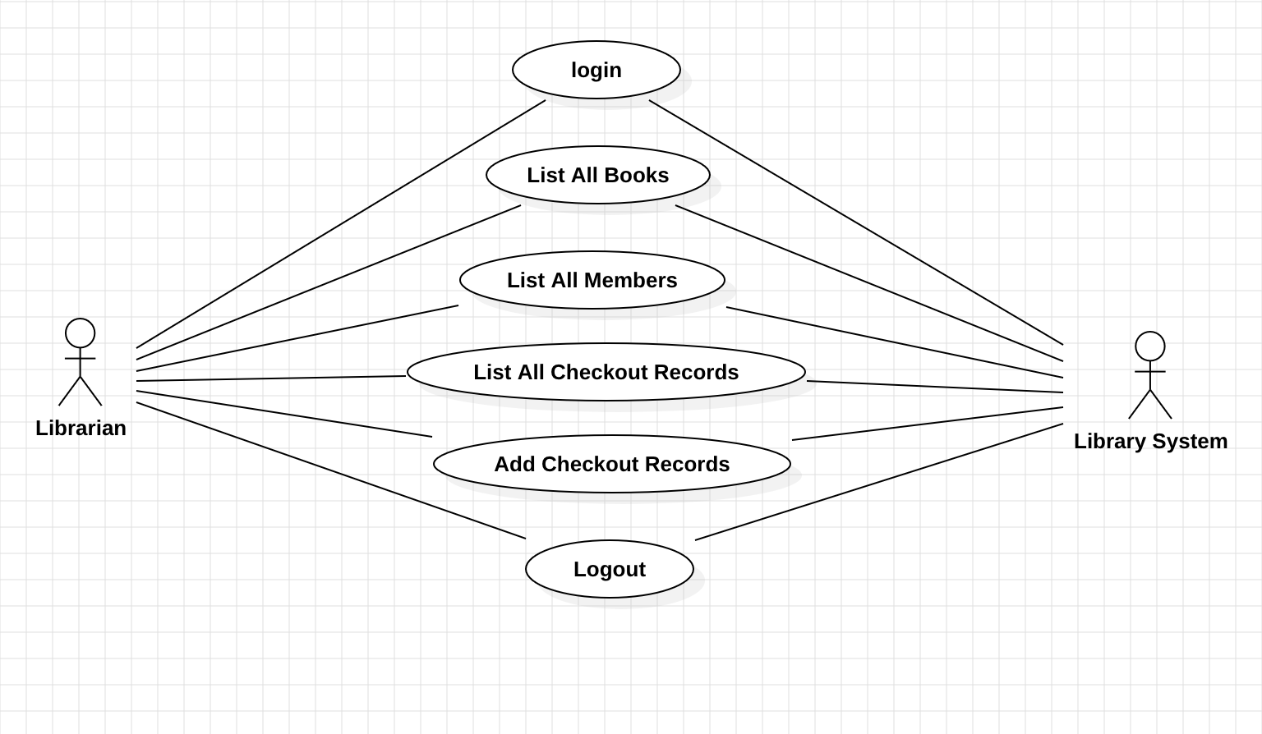
Use Case Diagram
Librarian

Slide 3
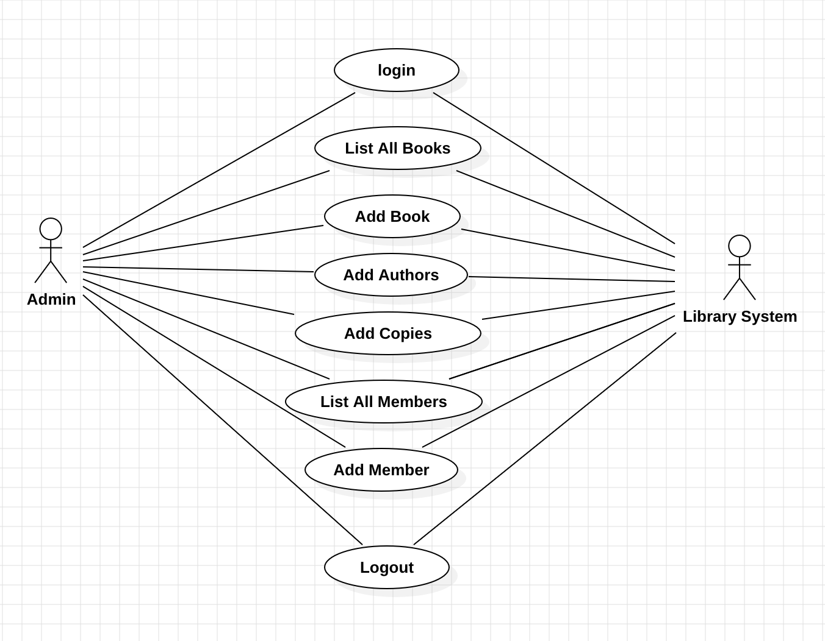
Use Case Diagram
Admin

Slide 4
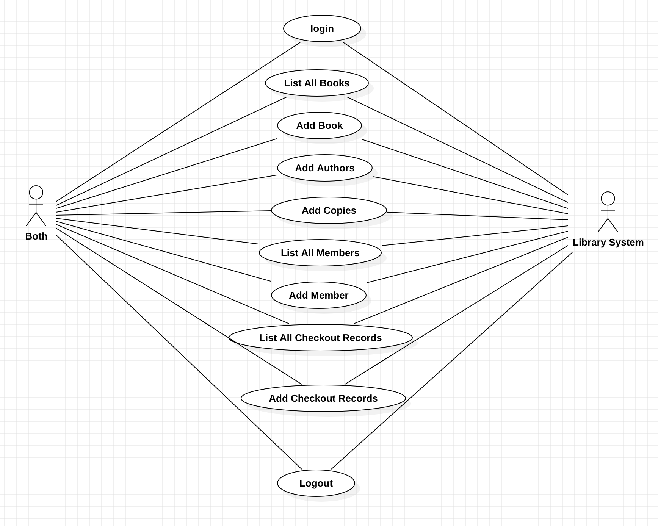
Use Case Diagram
Both

Slide 5
Detail Class Model

Slide 6
Sequence Diagram
Checkout Book Use case

Slide 7
Sequence Diagram
Add a copy of an existing book

Slide 8
Sequence Diagram
Add a new member

Slide 9
Basic Validation Rules
isRequired:
Validates that the input is not null or blank.
Usage: Useful for mandatory fields such as fist and last name for member and author, telephone, ISBN, title etc.
isNumericString:
Ensures that the input string contains only numeric characters.
Usage: Useful for numeric-only fields such ZIP codes, numbers of copies and max checkout length etc.
isNotEmpty:
Validates that a list is not empty or null.
Usage: Useful for fields that expect a list of items a list of authors, books etc.

Slide 10
Conclusion
This library management system serves as a practical embodiment of how technology can empower knowledge sharing and foster intellectual growth. By leveraging a structured and java approach, book managing, member registration, and checkout processes. This aligns with the principles of Science Technology Consciousness (STC) which emphasizes the interconnectivity between technology and human consciousness in advancing knowledge creation and dissemination.

Slide 11
Github Link
https://github.com/agthumoe/mpp-group1-project

