Slide 1

Library System
Group Number: 1
Members : AUNG THU MOE KANCHAN KUMAR SHAW ZAW YE NAING

Slide 2
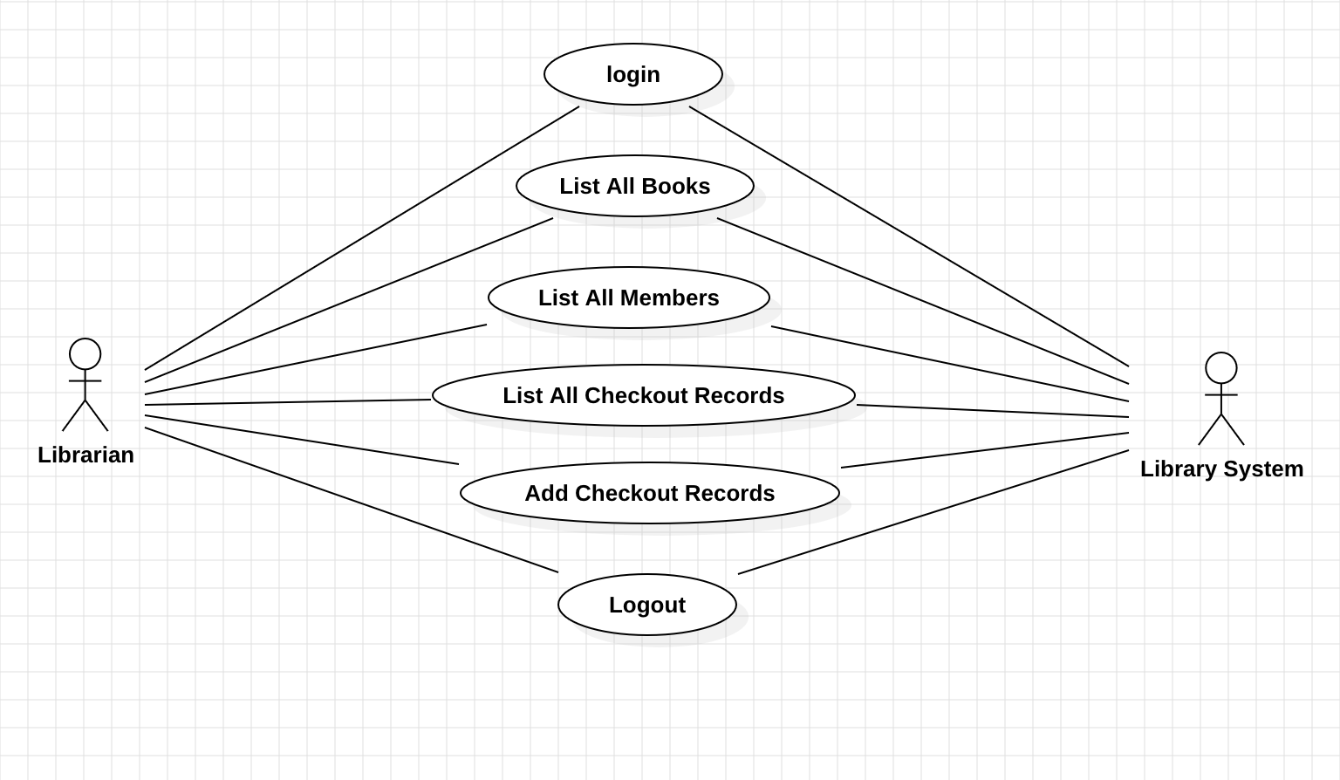
Use Case Diagram
Librarian

Slide 3
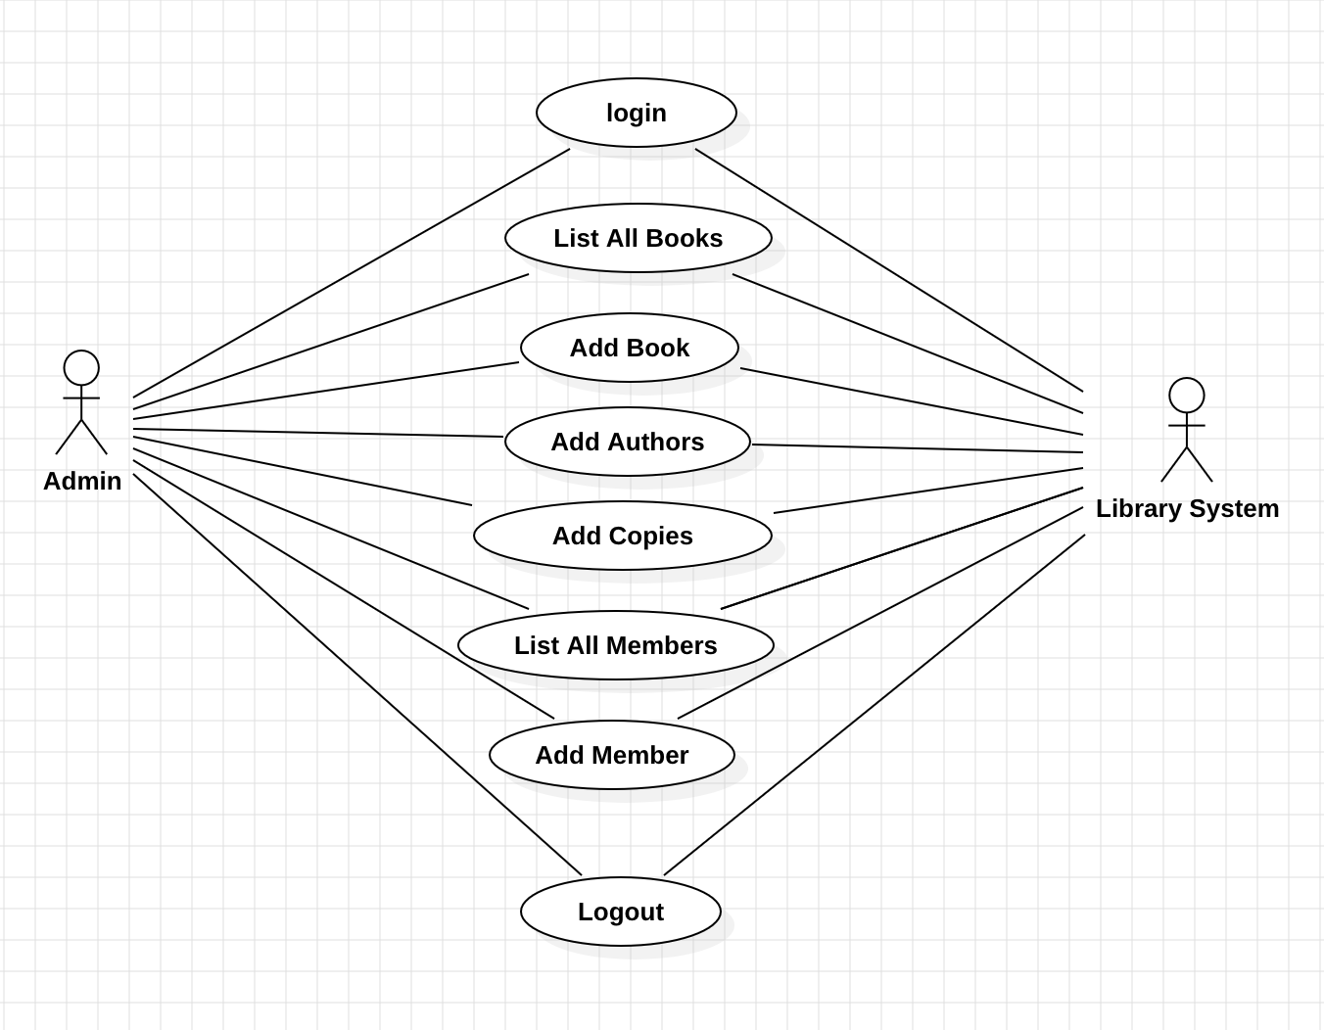
Use Case Diagram
Admin

Slide 4
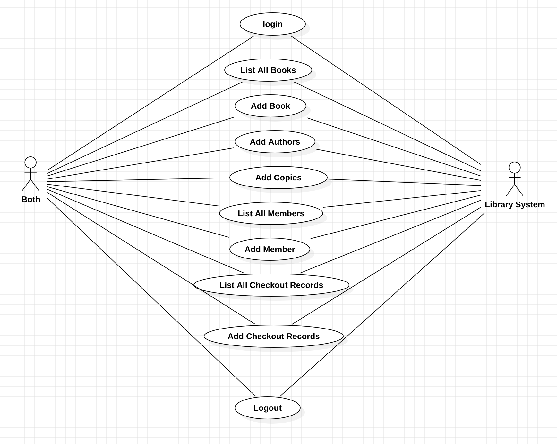
Use Case Diagram
Both

Slide 5
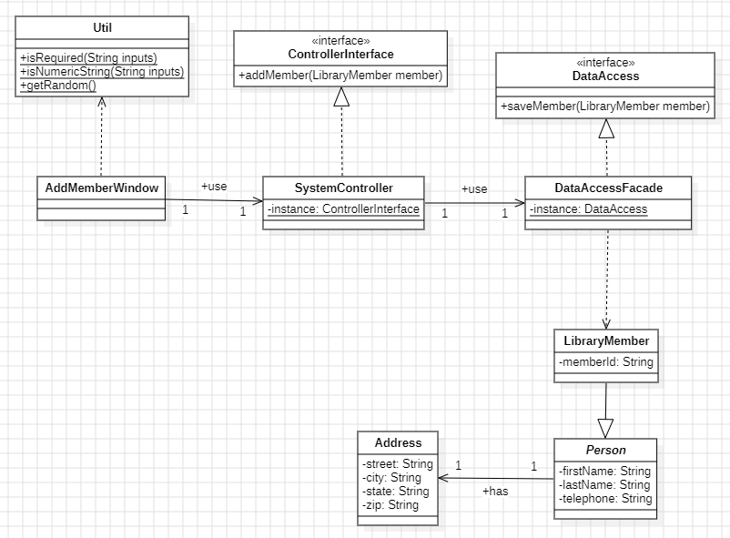
Detail Class Model

Slide 6
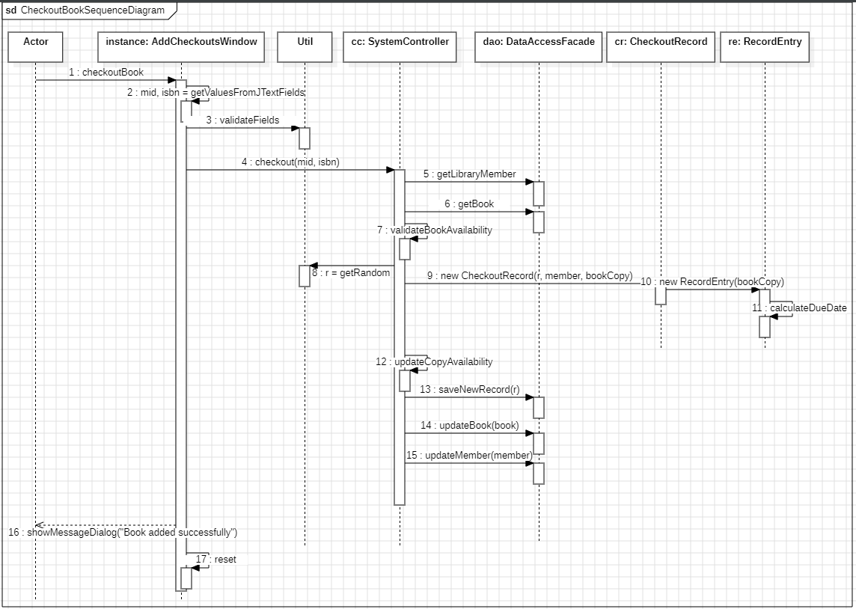
Sequence Diagram
Checkout Book Use case

Slide 7
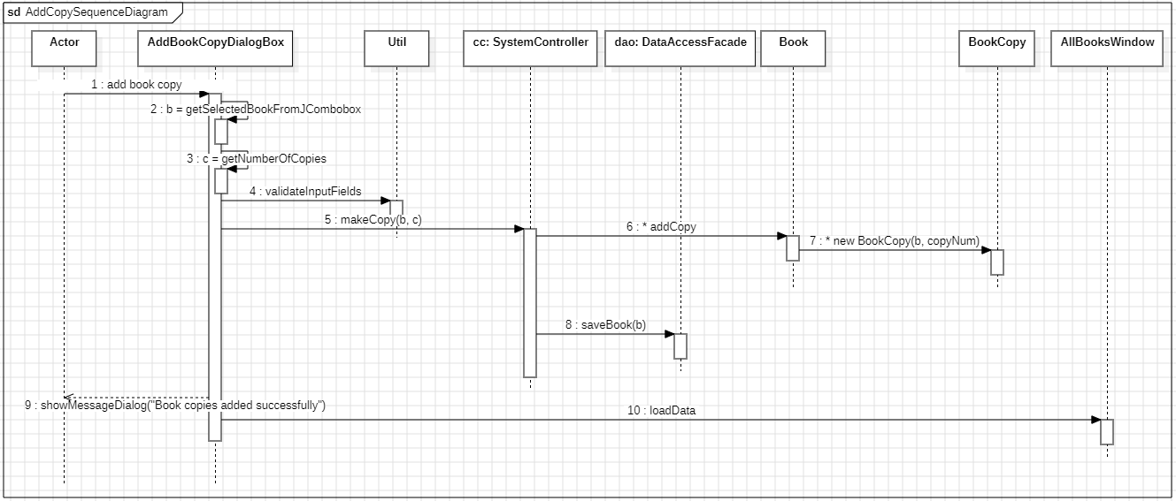
Sequence Diagram
Add a copy of an existing book

Slide 8
Sequence Diagram
Add a new member

Slide 9
Basic Validation Rules
We have a utility class named `Util`.
We made the class `final` so that no class can inherit it.
We made the constructor private, since utility class is not supposed to be instantiated.
Utility class has 5 static validation methods currently implemented
Each static method has `fieldName` parameter to be passed to compose a meaningful UI message.
Each method returns certain value such as String, type converted value (integer) or List depending on the requirements. The reason is that we can use this utility method can be wrapped around the string for easier usage. For example, String validateString = Util.isRequired(this.inputField.getText(), “First Name”);

Slide 10
Basic Validation Rules
isRequired:
Validates that the input is not null or blank.
Usage: Useful for mandatory fields such as fist and last name for member and author, telephone, ISBN, title etc.
isNumericString:
Ensures that the input string contains only numeric characters and check if the input string has expected
minimum and maximum length.
Usage: Useful for numeric-only fields such ZIP codes which requires 5 digits.
isNotEmpty:
Validates that a list is not empty or null.
Usage: Useful for fields that expect a list of items a list of authors, books etc.
isNumber:
Validates that the input value is a numeric value, cast the value into integer and validate if the number
is in between expected minimum and maximum value.
Usage: Useful for fields that expect a positive integer value such as number of copies and max checkout length

Slide 11
Conclusion
Design Patterns and the Principle of Effortlessness in TM
In TM, the mind naturally settles into a state of restful awareness effortlessly. Similarly, object-oriented design pattern is a well-established, well-proven solutions to common problems in software development, so that it allows developers to solve complex issues with less effort and more efficiently.
Swing UI and the Principle of Balance
While building UI design using Java Swing, there is a need of balance between functionality and aesthetics especially in given time frame. In STC, we learnt about the importance of balance in life and nature, how to live in harmony to create a stable and functional system in nature.

Slide 12
Github Link
https://github.com/agthumoe/mpp-group1-project
Individual pictures of class diagram and 3 sequence diagrams can also be found in Github repository.

