Slide 1
Adding UUIDs to STEP product information model
version 1.2
File: 20210314_00_GUID_CAX_IF_20210316.ppt
Allison Barnard Feeney
Thomas Thurman
Asa Trainer
Collaborators: Robert Lipman, Mikael Hedlind, Ian Parent, Ed Paff, Jan Nils, Larry Magiano

Slide 2
Agenda
Introduction
Requirements
CAX-IF Requirements
End-user Requirements
Derived Requirements
New System
Information Model
Example
Discussion
Reference information

Slide 3
Introduction
The UUID project is an extension to the permanent id project for topological_representation_item that was implemented in AP 242 ed2.
Additional requirements were captured, an information model was created and is under test and analysis to determine if it meets the requirements.
Disclaimer:
Portions of this report were prepared by Thomas Thurman. Mr. Thurman was funded under Award Nos. 70NANB19H011 and 70NANB20H215 from the National Institute of Standards and Technology (NIST), U.S. Department of Commerce.

Slide 4
CAX-IF Requirements
Need an external reference to a CAD object
CAD object id persistence upon transfer/iteration
Post-processor shall re-populate original CAD objects the system did not modify
Pre-processor shall generate a new STEP file populated with the same externally visible identifiers for unchanged CAD objects.
CAD object ownership
If you don’t own the CAD object, don’t modify it in your CAD system
CAD objects can result from an operation on an existing CAD object from another system.
CAD objects can be different representation of same data (e.g., cylinder)
Include STEP data supported by currently implemented recommended practices

Slide 5
End-user Requirements
Source: Jan Nils, John Van Horn, Larry Magiano (emails)
Provenance: Who do I blame?
Traceability to new products, versions, downstream processes:
Are these objects the same data objects in spite of different concrete syntax?
What is the predecessor to this data item?
I have measurement data. What does it apply to in the CAD model?
Scope
AP 242 pre-defined items (e.g., datum, product)
AP 242 pre-defined collections (e.g., geometric_tolerance)
User defined characteristics (e.g., {general_property, property_definition,…values}
User defined collections of characteristics (e.g., application of relationships of above)

Slide 6
Derived requirements captured to-date
Requirement | Derived Requirement
External Reference | UUID
CAD object id persistence | UUID with namespace
CAD object ownership | Namespace of CAD application
CAD object operation | Record operation with a relationship with roles (split, merge, derive, supersede, same-as,?)
Recommended practices | Defined SELECT type to specify those items in rec prac
Provenance for objects not already covered with information model defined designators | UUID with namespace
Provenance/tampered data | UUID is not a solution for tampered data: Use digital signature
Traceability | UUID with namespace
Scope for one item | UUID
Scope for a collection of items | Aggregate based UUID

Slide 7
New System based on UUID version 5
From ISO/IEC 9834-8:2014 Annex B {Namespace, name}
The name-based UUID is meant for generating a UUID from a name that is drawn from, and unique within, some name space.
…
The properties of name-based UUIDs generated in accordance with clause 14 and with a suitably chosen namespace will be as follows:
The UUIDs generated at different times from the same name in the same names-pace will be equal;
The UUIDs generated from two different names in the same namespace will be different with very high probability;
The UUIDs generated from the same name in two different namespaces will be different with very high probability;
If two name-based UUIDs are equal, then they were generated from the same name in the same namespace with very high probability.

Slide 8
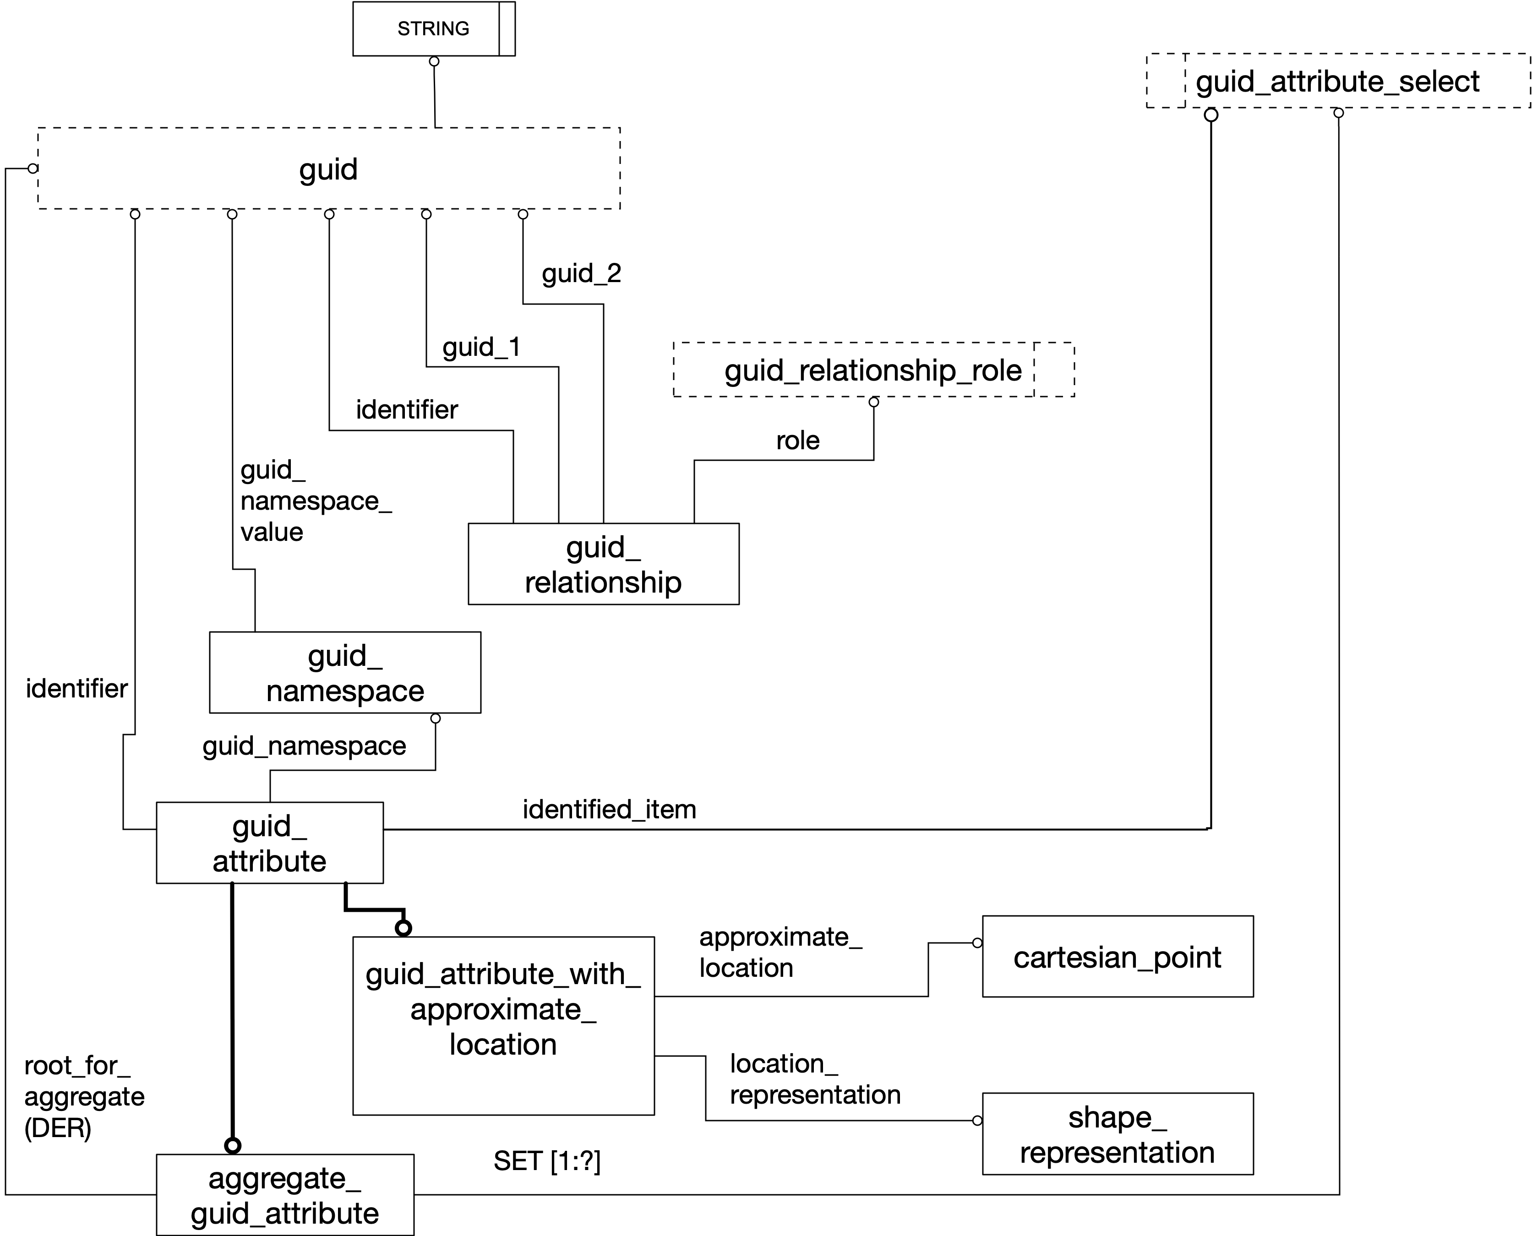
Current information model

Slide 9
Information model
Extend the “permanent id” approach
Add namespace structure
Add relationship with roles structure
Provide a root node for the aggregate
Provide a subtype for an approximate location for shape data.
Add more items to SELECT list
Link to Information model GitHub site:
https://github.com/allisonfeeney/guid-data
Link to sample registry GitHub site:
https://github.com/allisonfeeney/guid-data/tree/main/registry

Slide 10
Example

Slide 11
Discussion
Is version 5 useful approach?
How to create/manage registries?
Relationships:
Cylinder issue: Will add a “same-as” relationship role for the cylinder case.
Structure tree: A path structure could be useful.
Change management: AP 242 provides some PDM related capability to identify changes in individual product data items from one product_definition.
Applied_identification_assignment: Assign identification to items in PDM/PLM.
Id_attribute: not available for all product data items that might be covered by recommended practices.

Slide 12
Reference: Recommended practices considered
PDM usage guide
UDA
PMI
Supplemental geometry for design model

Slide 13
Reference: guid SELECT list (under consideration)
application_context,
characterized_object,
characterized_object_relationship,
context_dependent_shape_representation,
datum_feature,
datum_system,
derived_unit,
dimension_related_tolerance_zone_element,
dimensional_characteristic_representation,
dimensional_location,
dimensional_size,
founded_item,
general_property,
general_property_relationship,
geometric_tolerance,
geometric_tolerance_auxiliary_classification,
geometric_tolerance_relationship,
gps_filter,
gps_filtration_specification,
invisibility,
item_identified_representation_usage,
limits_and_fits,
maths_value_with_unit,
measure_qualification,
measure_with_unit,
named_unit,
placed_datum_target_feature,
plus_minus_tolerance,
product,
product_definition,
product_definition_formation,
product_definition_formation_relationship,
product_definition_relationship,
property_definition,
property_definition_representation,
representation,
representation_context,
representation_item,
representation_relationship,
runout_zone_orientation,
shape_aspect,
shape_aspect_relationship,
tolerance_value,
tolerance_with_statistical_distribution,
tolerance_zone_definition,
tolerance_zone_form,
topological_representation_item

