Slide 1
TEAM B: DIGIDESTINED
Project 04: Contention Resolution and Switching

Slide 2
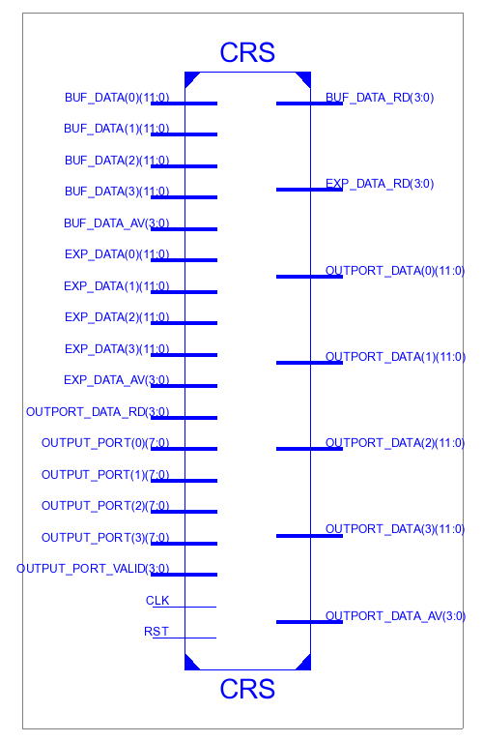

Slide 3
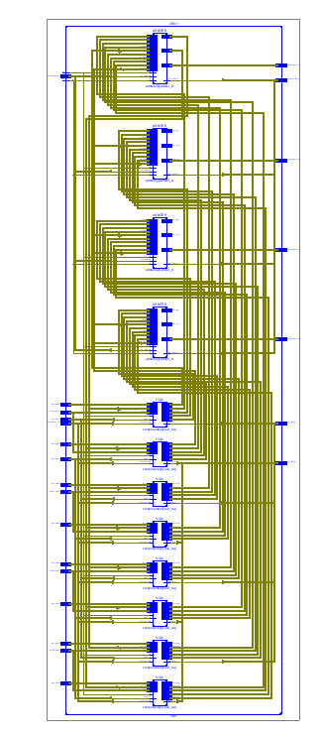

Slide 4
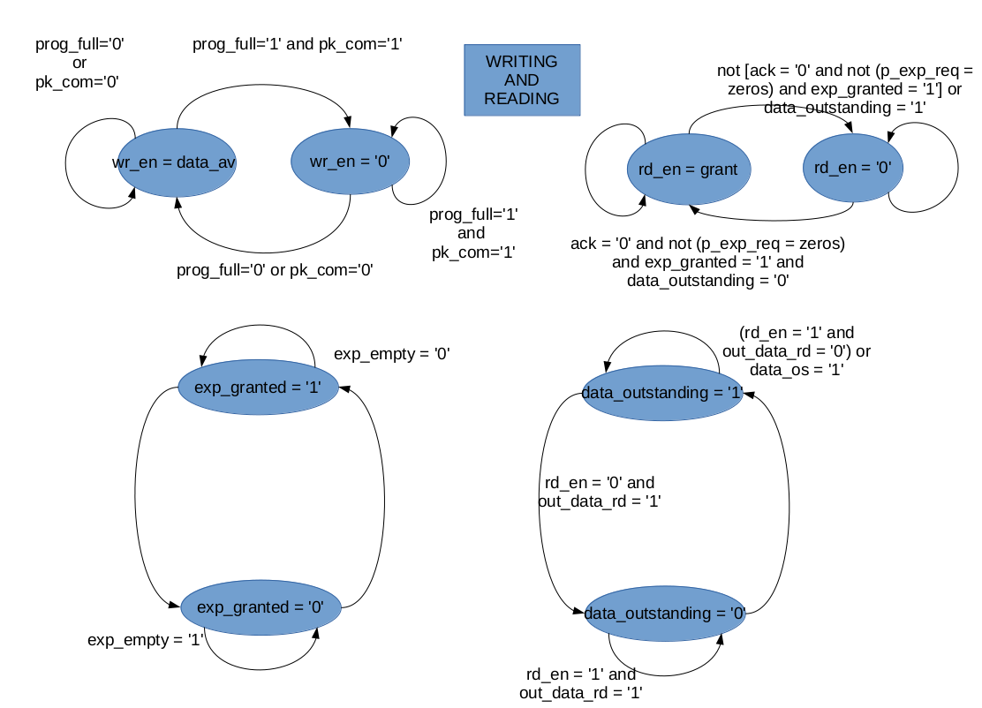

Slide 5
