Slide 1
Expectation Maximization (EM) Algorithm with GMM and clustering
ECE 5363: PATTERN RECOGNITION
CAPSTONE PROJECT

Slide 2
Presentation outline
Introduction: What is Expectation maximization (EM)?
Motivation: Why is EM important?
with GMM and clustering
Theory: How EM algorithm works?
with missing data (imputation)
Implementation: Application of EM (with real and fabricated data)
Discussion: Its significance and limitations
Conclusion: Final remarks

Slide 3
Introduction
EM is an iterative technique to find statistical parameters for a given dataset based on maximum likelihood expectation.
In 1977, the term ‘EM’ was first introduced in a paper by

Slide 4
Motivation
Presence of missing values in datasets often creates difficulties in applying different machine learning algorithms.
In many real- world problems, databases may contain missing values (e.g. survey, climate data, medical diagnostic report or due to the change of the data collecting process over time).
The simplest solution- disregard the features with missing values.
Not always feasible- specially with dataset with lots of missing data.
SOLUTION?? EM Algorithm

Slide 5
Missing data types
Missing Data Types
MCAR
NMAR
MAR
Missing (completely) at random:
Missing mechanism is independent
of any value in data set.
Not Missing at random:
Missing mechanism depends
on values of the data set.
Missing at random:
Missing mechanism depends on observed values only, but does not depend on
missing values of dataset.

Slide 6
Real- world example of missing data
Measured characteristics of several batches of plastic pellets ( values inspired from real problem)_{[2]}
Sample | size1 | size10 | size15 | density1 | density2 | density3
X32807 | 0.779 | 2.62 | 5.59
X33943 | 0.537 | 2.23 | 5.41 | 35.2 | 11.34 | 3.99
X42988 | 0.726 | 2.11 | 4.69 | 37.1 | 13.14 | 3.98
X44749 | 0.698 | 2.36 | 5.4 | 36.6 | 12.16 | 4.01
X45295 |  |  |  | 38.1 | 13.34 | 3.89
X46965 | 0.759 | 2.47 | 4.83 | 38.7 | 14.83 | 3.89
X49666 | 0.535 | 2.13 | 5.23
X50678 | 0.716 | 2.29 | 5.45 | 37.3 | 13.7 | 3.92
X52894 | 0.635 | 2.08 | 4.94

Slide 7

Expectation Step
$\sum_{l=1}^{K}{ln⁡(φ_{l})∗p\left(l | x_{i}, θ^{g}\right)}+ \sum_{l=1}^{K}{\sum_{i=1}^{N}{\ln\left(p_{l}\left(x_{i} | φ_{l}\right)\right)∗}p\left(l | x_{i}, θ^{g}\right)}$
$p\left(l | x_{i}, θ^{g}\right)=\frac{φ_{k}N\left(x_{i} \right|μ_{k}, σ_{k})}{\sum_{j=1}^{K}{φ_{j}N\left(x_{i} \right|μ_{j}, σ_{j})}}$
$φ=mixture weight$

Slide 8
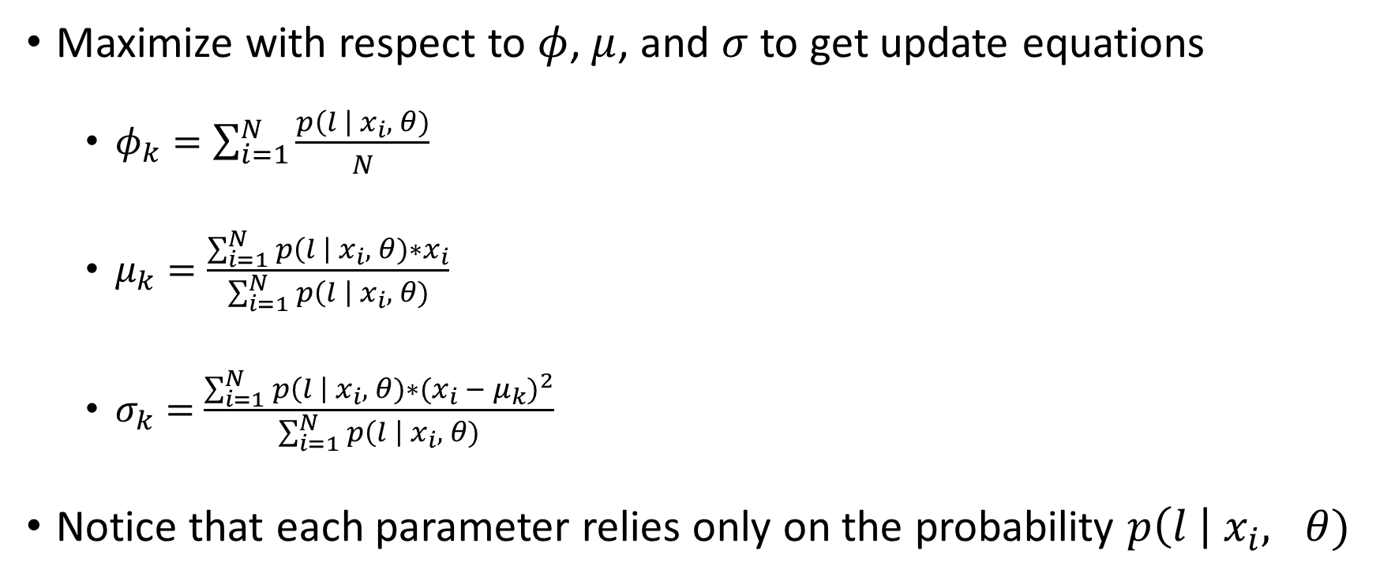
Maximization Step
Maximize with respect to $φ$, $μ$, and $σ$ to get update equations
$φ_{k}=\sum_{i=1}^{N}{\frac{p\left(l \right| x_{i}, θ)}{N}}$
$μ_{k}=\frac{\sum_{i=1}^{N}{p\left(l \right| x_{i}, θ)∗x_{i}}}{\sum_{i=1}^{N}{p\left(l \right| x_{i}, θ)}}$
$σ_{k}=$ $\frac{\sum_{i=1}^{N}{p\left(l \right| x_{i}, θ)∗{(x_{i} − μ_{k})}^{2}}}{\sum_{i=1}^{N}{p\left(l \right| x_{i}, θ)}}$
Notice that each parameter relies only on the probability $p\left(l \right| x_{i}, θ)$

Slide 9
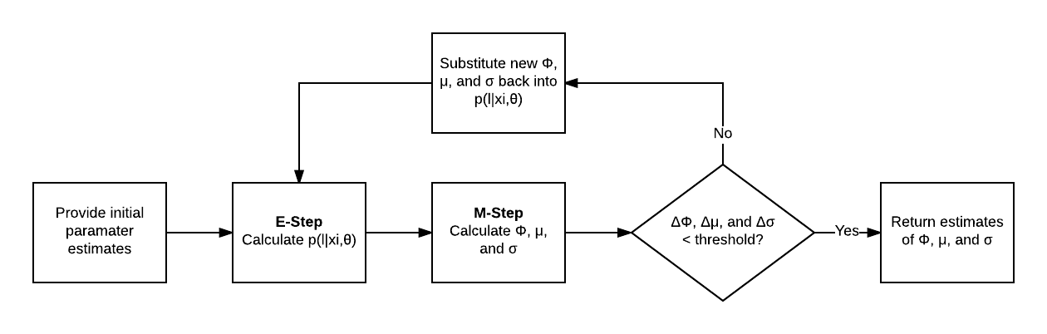
Iteration Cycle

Slide 10
Application: GMMs and Clustering
Can be used to estimate the parameters of Gaussian mixture models (GMMs)
Can estimate the parameters of each Gaussian distribution in a mixture
Can serve as simple fuzzy clustering classification

Slide 11
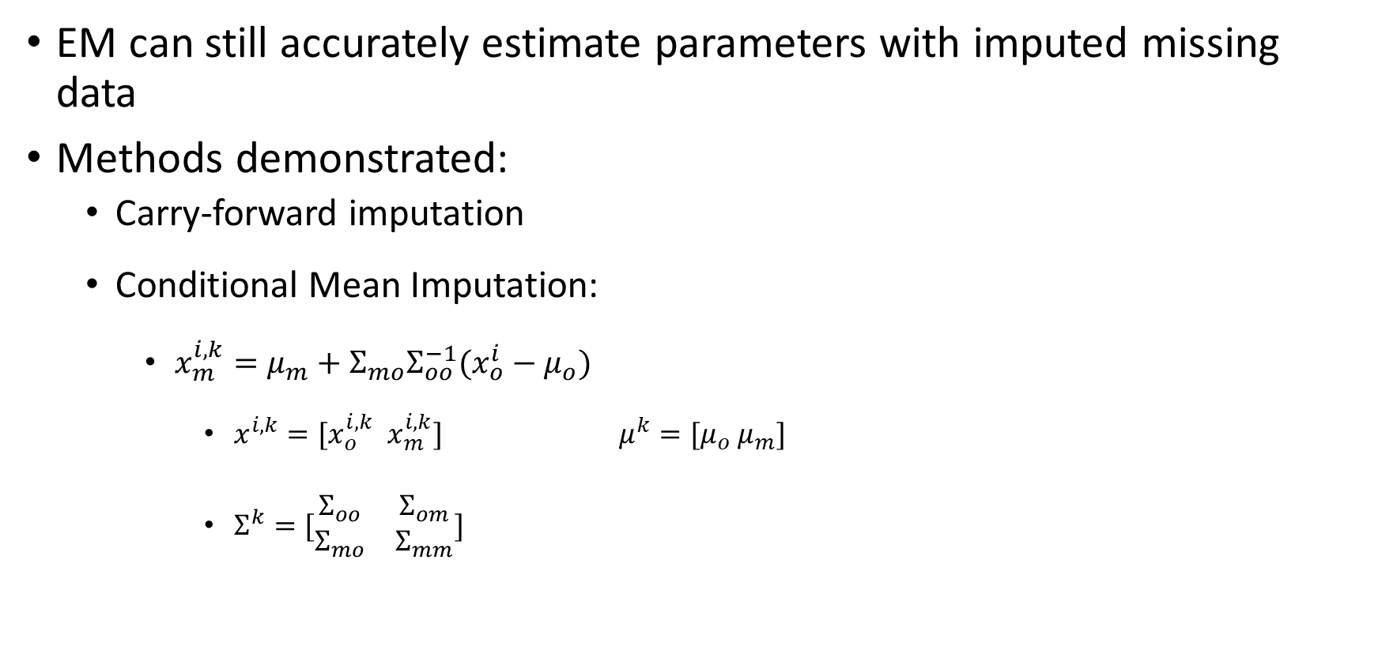
Application: Missing Data w/ Imputation
EM can still accurately estimate parameters with imputed missing data
Methods demonstrated:
Carry-forward imputation
Conditional Mean Imputation:
$x_{m}^{i,k}=μ_{m}+Σ_{mo}Σ_{oo}^{−1}(x_{o}^{i}−μ_{o})$
$x^{i,k}=[x_{o}^{i,k}$ $x_{m}^{i,k}]$ $μ^{k}=[μ_{o} μ_{m}]$
$Σ^{k}=[\begin{matrix}Σ_{oo} & Σ_{om} \\ Σ_{mo} & Σ_{mm}\end{matrix}]$

