Slide 1
Wireless communication basics: Linear modulation schemes
M.Sc. Vladimir Fadeev
vladimir_fadeev1993@mail.ru

Slide 2
Common scheme of communication system
Source
ADC
Source encoder
Channel encoder
Modulator
RF
part
Channel
Source decoder
Channel decoder
RF
part
Destination
DAC
Demodulator

Slide 3
Definition
In most media for communication, only a fixed range of frequencies is available for transmission.
One way to communicate a message signal whose frequency spectrum does not fall within that fixed frequency range, or one that is otherwise unsuitable for the channel, is to alter a transmittable signal (and shift it to the desirable range ) according to the information in your message signal.
This alteration is called modulation, and it is the modulated signal that you transmit.
The receiver then recovers the original signal through a process called demodulation.
By https://www.mathworks.com/help/comm/ug/digital-modulation.html

Slide 4
Different modulation schemes in different mobile generations
Specification | 2G | UMTS | LTE / LTE-A
UL | GMSK, QPSK | QPSK, 16-QAM (for HSUPA in 3GPP R7) | BPSK, QPSK, 16-QAM, 64-QAM
DL | GMSK, QPSK | QPSK, 16-QAM (for HSDPA in 3GPP R5) 64-QAM (for HSDPA in 3GPP R7) | BPSK, QPSK, 16-QAM, 64-QAM

Slide 5
How to learn more
See the following slides:
Atlanta RF (http://www.atlantarf.com/Downloads.php)
Digital Modulation – ASK
Digital Modulation – FSK
Digital Modulation-PSK-QAM
Dr. Mike Wolf’s lectures (https://www5.tu-ilmenau.de/nt/de/teachings/vorlesungen/ce_master/index.html)
Read more in MathWorks
https://www.mathworks.com/help/comm/ug/digital-modulation.html
Read relevant books, e.g.:
Goldsmith A. Wireless communications. – Cambridge university press, 2005.
Proakis, John G., et al. Communication systems engineering. Vol. 2. New Jersey: Prentice Hall, 1994.
Haykin S. Communication systems. – John Wiley & Sons, 2008. - p.366-368
Work hard!

Slide 6
M-PSK: Phase Shift-Keying

Slide 7
Why are they linear?
First, linear modulation types have a canonical form:
Carrier frequency
$$\left.s(t)=s_{I}(t)cos(2πf_{c}t)−s_{Q}(t)cos(2πf_{c}t\right)$$
In-phase
Quadrature
Low-pass signals that linearly correlate with an information signal.
Haykin S. Communication systems. – John Wiley & Sons, 2008. — C. 93

Slide 8

What is the M?
M means modulation order:
BPSK (2-PSK) => M=2;
QPSK (4-PSK) => M=4;
8-PSK => M=8.
The number of bits per modulation symbol depend on the modulation order:
$$N=\log_{2}M$$

Slide 9
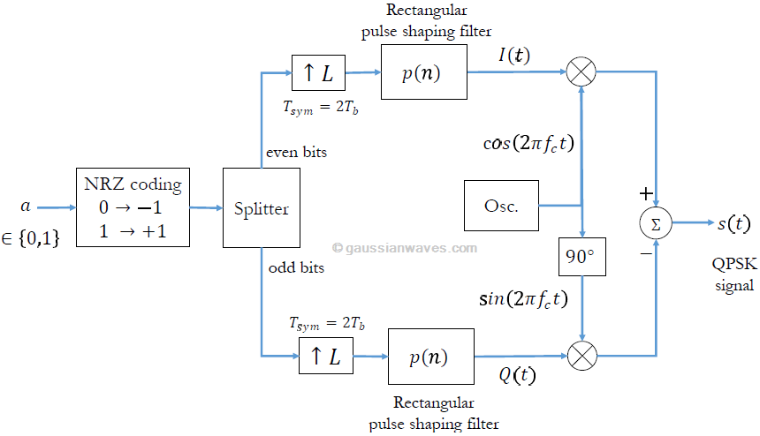
M-PSKs are passband modulations
To transmit real signals the carrier frequency fc is used. E.g., QPSK:
Non Return to Zero
https://www.gaussianwaves.com/2010/10/qpsk-modulation-and-demodulation-2/

Slide 10
The baseband analogs
Modulation scheme can also be modeled without consideration of the carrier frequency and bit duration.
Bits | Complex symbols
00 | 0,7+0,7i
01 | 0,7-0,7i
10 | -0,7+0,7i
11 | -0,7-0,7i
The baseband analogs can be used for research due to the main properties depend on the envelope (complex symbols).
Baseband representation
(e.g. QPSK)

Slide 11
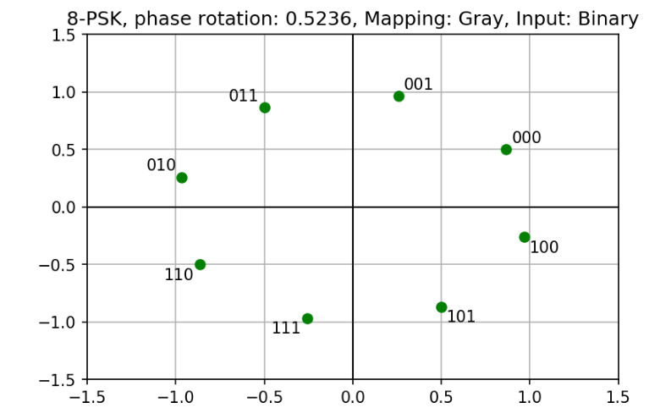
Baseband M-PSK: Main points
This type of modulation can be easily represented via the signal constellation.
Signal constellation may have some rotation (phase shift or phase offset). Usually noted as ϕ.
ϕ

Slide 12
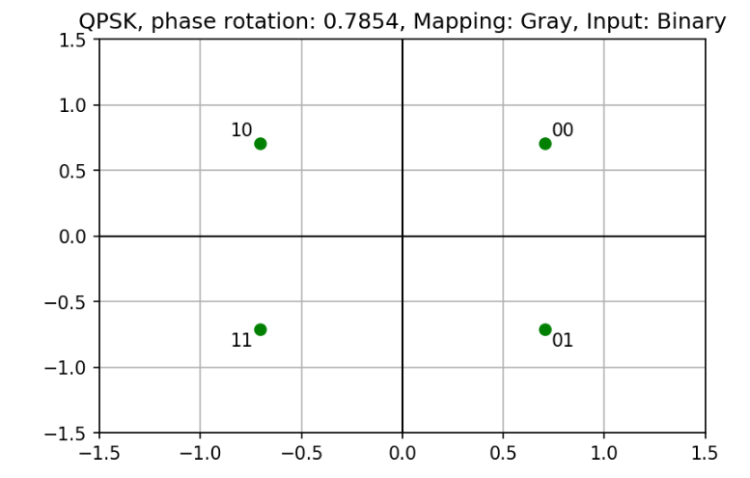
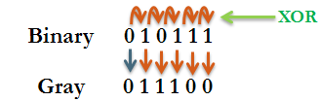
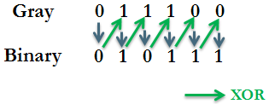
Gray and binary mapping
https://www.gaussianwaves.com/2012/10/natural-binary-codes-and-gray-codes/
Neighboring symbols are different to each other by one bit. More robust.

Slide 13
M-QAM: Quadrature Amplitude Modulation

Slide 14
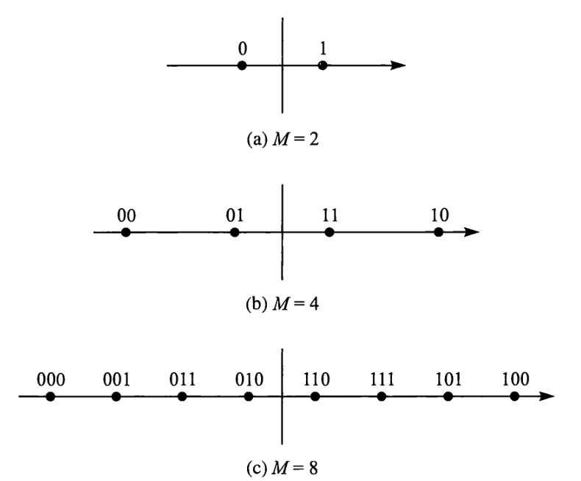
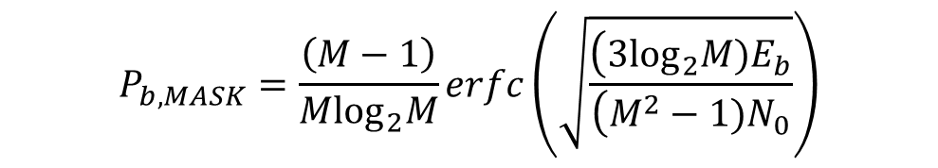
Changing of amplitude: M-ASK
ASK is the bandpass PAM
Practically, is not popular in wireless communication due to BER performance:
http://www.atlantarf.com/Downloads.php
$$P_{b,MASK}=\frac{\left(M−1\right)}{M\log_{2}M}erfc\left(\sqrt{\frac{\left(3\log_{2}M)E_{b}\right.}{\left(M^{2}−1)N_{0}\right.}}\right)$$
Used in cable and fiber optics transmission
Proakis J. G. Digital communications. 1995 //McGraw-Hill, New York.- p.100

Slide 15
M-QAM: Introduction
Changing of both phase and amplitude.
Rectangular representation is frequently used.
It is also linear.
The same relation between modulation order M and number of bits per modulation symbol as in M-PSK case.
This is also passband, but has the baseband analog.
The Gray mapping is also used.

Slide 16
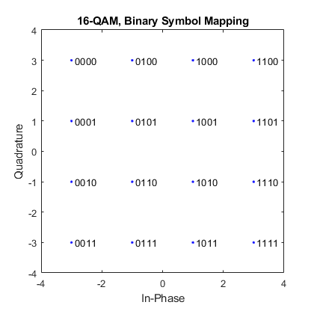
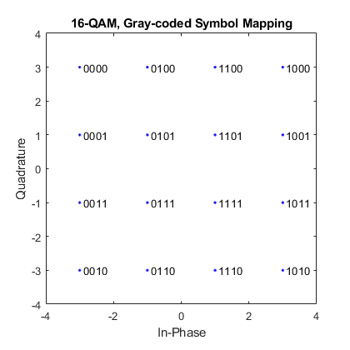
M-QAM examples: 16-QAM
https://www.mathworks.com/help/comm/gs/compute-ber-for-a-qam-system-with-awgn-using-matlab.html

Slide 17
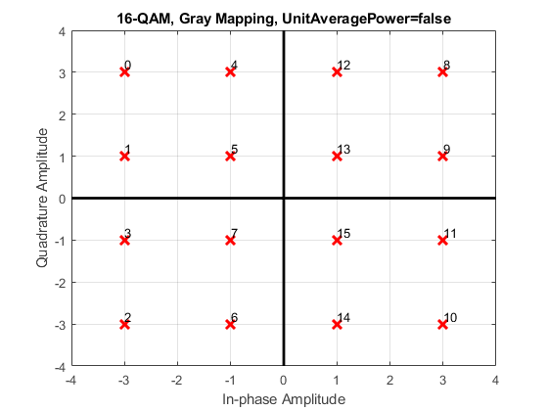
M-QAM examples: 16-QAM
https://www.mathworks.com/help/comm/gs/compute-ber-for-a-qam-system-with-awgn-using-matlab.html

Slide 18
M-PSK and M-QAM: other common points

Slide 19
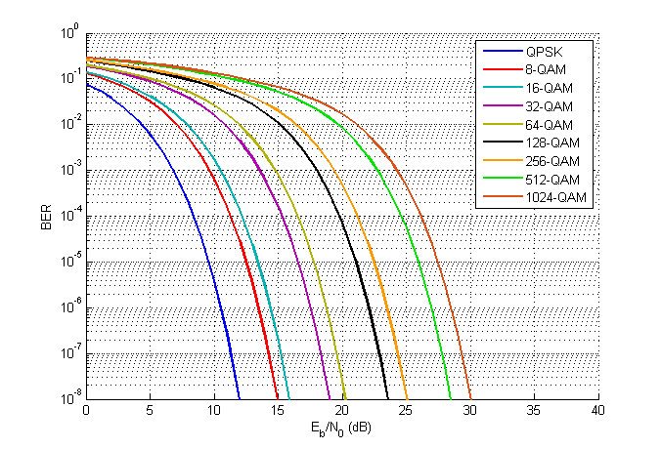
M-QAM (AWGN)
Actually, BER (or error probability) is the function of the dmin (minimum Euclidean distance) and SNR.
See more in Proakis J. G. Digital communications. 1995 //McGraw-Hill, New York. – p. 95-107
Use bertool command in command line in MatLab
or
berawgn() and berfading()
to obtain theoretical curves for different modulations.
It is a good tool to verify you models.
BER – Bit Error Ratio – how many wrong bits were received

Slide 20
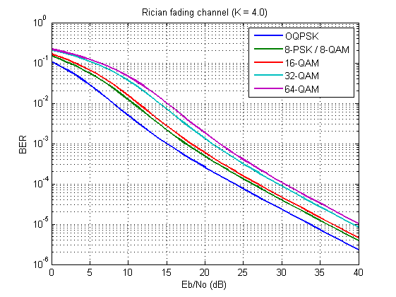
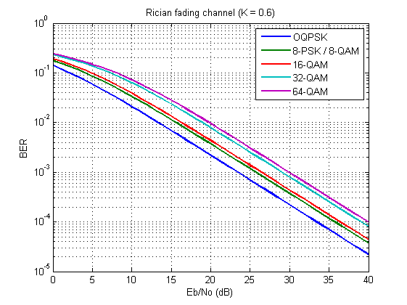
M-QAM (fading)
Values are changed, however order of the curves is the same.

Slide 21
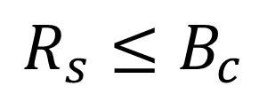

Gross bit rate
Gross bit rate Rb can be estimated throug the baud rate (symbol rate) Rs (number of changes of modulation parameter(-s) per second) and modulation order M (number of bits per symbol):
$$R_{b}=R_{s}\log_{2}M$$
Baud rate usually relates to the coherence bandwidth Bc (see more in [1]):
$$R_{s}≤B_{c}$$
[1] Goldsmith A. Wireless communications. – Cambridge university press, 2005. – p. 88-92

Slide 22
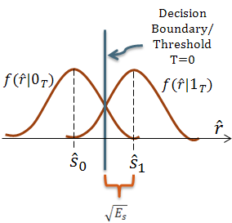
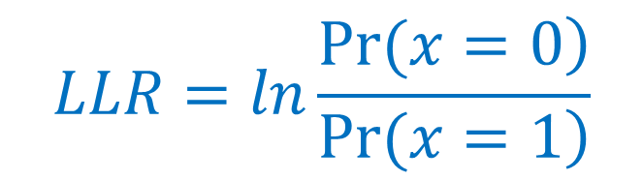
Two universal soft output demodulation algorithms
Two global approaches:
Hard output (0s and 1s)
Soft output (Log likelihood ratios)
$$LLR=ln\frac{\left.Pr(x=0\right)}{\left.Pr(x=1\right)}$$
https://i2.wp.com/www.gaussianwaves.com/gaussianwaves/wp-content/uploads/2012/07/PDF_of_BPSK_symbols.png?ssl=1
Work for both M-PSK and M-QAM

Slide 23
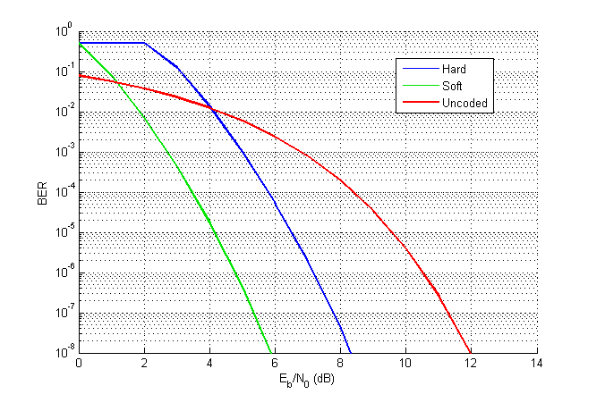
Where output type is the critical item
(Convolutional coded QPSK, AWGN)
BER – Bit Error Ratio – how many wrong bits were received

Slide 24
OFDM:
Orthogonal Frequency Division Multiplexing

Slide 25
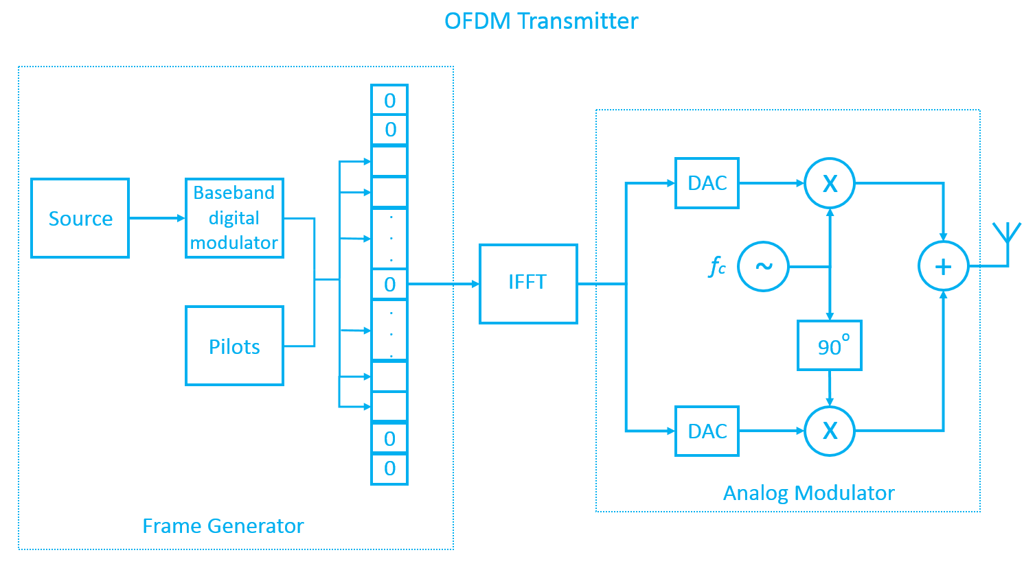
OFDM is also a linear modulation scheme
M-PSK or M-QAM

Slide 26
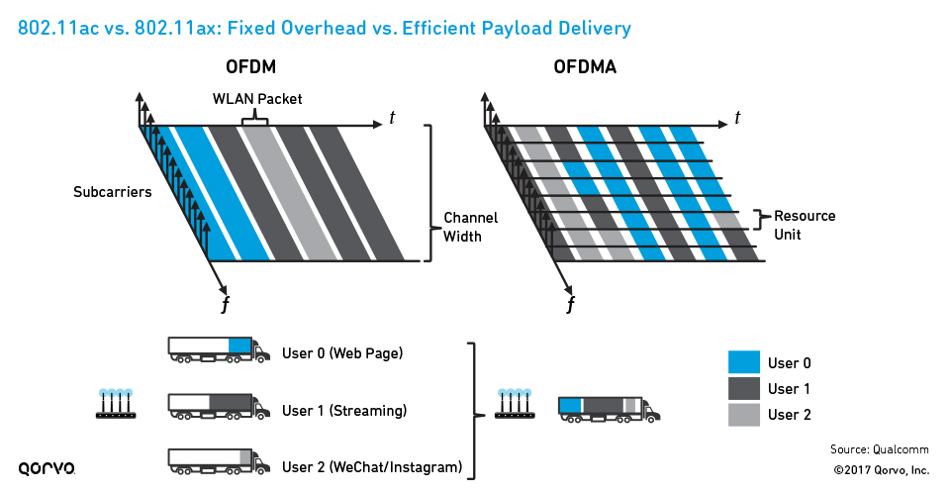
OFDMA: Orthogonal Frequency Division Multiple Access
the most popular evolution of OFDM in mobile communications
More in Prof. Dr.-Ing. habil. Andreas Mitschele-Thiel's lecture:
https://www.tu-ilmenau.de/fileadmin/public/iks/files/lehre/UMTS/11_LTE_Radio_ws18.pdf

Slide 27
Extra slides

Slide 28
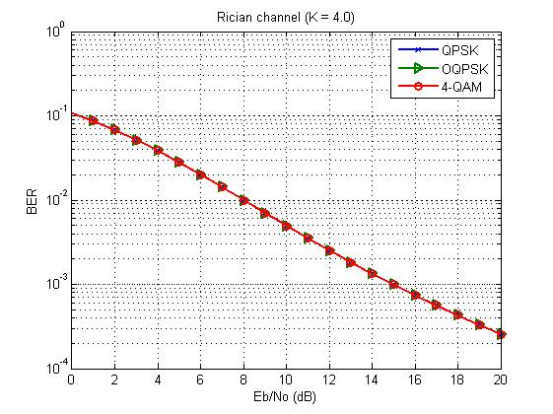
QPSK/4-QAM BER estimation hint
If you should estimate only BER you can use simpler tools for QPSK modeling.
This rule really works both for AWGN and fading channels.

Slide 29
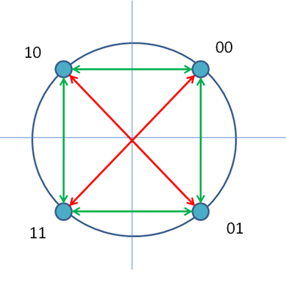
Why it is possible?
dmin
Q
Minimum Euclidean distances of QPSK, OQPSK and 4-QAM are the same.
Hence, QPSK, OQPSK and 4-QAM have the same BER performance for the same SNR.
-0,7+0,7i
0,7+0,7i
I
-0,7-0,7i
0,7-0,7i

Slide 30
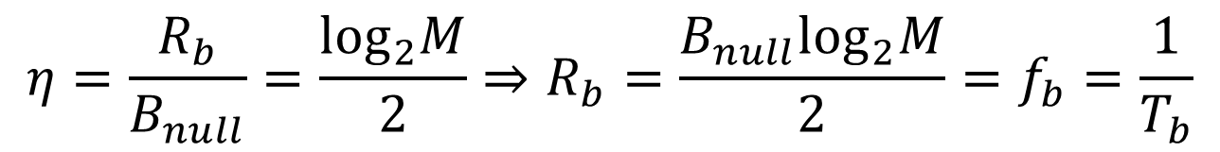
More about bit rate: spectral efficiency
For M-PSK and M-QAM modulation schemes following formulas [1 - 2] can be used for estimation of gross bit rate:
$$η=\frac{R_{b}}{B_{null}}=\frac{\log_{2}M}{2}⇒R_{b}=\frac{B_{null}\log_{2}M}{2}=f_{b}=\frac{1}{T_{b}}$$
Spectral efficiency
3dB or half-power bandwidth (Hz)
null-to-null bandwidth (Hz)
Bit duration (sec)
[1] Haykin S. Communication systems. – John Wiley & Sons, 2008. - p.366-368
[2] Link Budget Analysis: Digital Modulation - Part 3 - PSK & QAM
http://www.atlantarf.com/Downloads.php (date of the application is 22.03.2018)

Slide 31
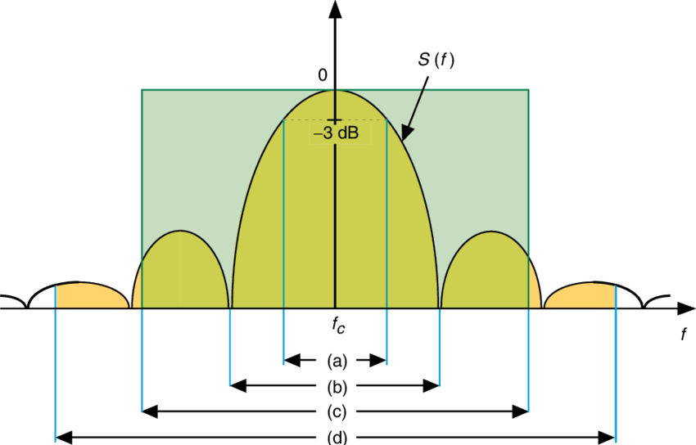
Bandwidths illustration
Some of the possible measures for spectral efficiency: (a) half-power bandwidth, (b) null-to-null bandwidth, (c) equivalent noise bandwidth, and (d) fractional power containment bandwidth.
https://www.researchgate.net/publication/255578726_Performance_Comparison_of_Selected_Bandwidth-Efficient_Coded_Modulations

Slide 32
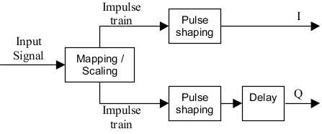
Pulse shaping: Main idea
Sometimes we need use bandwidth as efficient as possible.
For this pulse shaping procedure is usually used.
Pulse becomes longer in time domain
Pulse shaped OQPSK modulator block scheme
https://awrcorp.com/download/faq/english/docs/vss_system_blocks/OQPSK_TX.htm
Signal bandwidth becomes more narrow

Slide 33
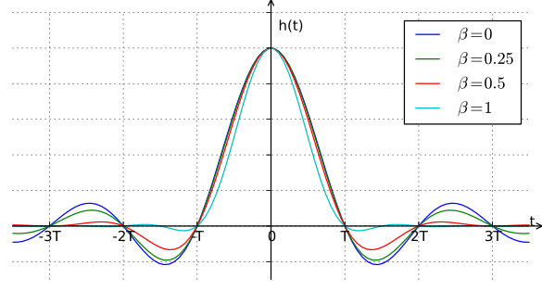
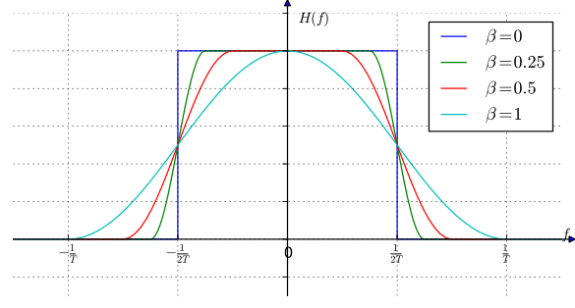
Example: Raised-cosine filter
With decreasing of the roll-off factor β we have more compact frequency response (more efficient usage of the spectrum).
However, β=0 is the ideal case with difficulties of implementation and synchronization
Impulse response
Frequency response
By Krishnavedala - Own work, CC BY-SA 3.0, https://commons.wikimedia.org/w/index.php?curid=15390895

