Slide 1
Spectral Study of 23 SNe Ia using PCA
  Reddening - Extinction
  or Intrinsic Diversity

Slide 2
Overview
Questions
Data
Processing
PCA
  Math
  Eigenvectors and Components
Cosmology
  Hubble Diagrams

Slide 3
Questions
Can we tell the difference between CCM like dust and intrinsic color variation in our population of supernovae?
Can we find a correlation between our weights and dispersion around the Hubble line, and can we reduce this dispersion?

Slide 4
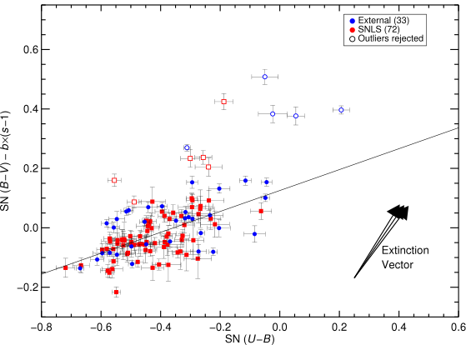
Conley et al. (2008)
Notes:
Conley et al. suggests that supernovae do not follow dust extinction. A single parameter dust law does not account for them. This is using optical data.

Slide 5
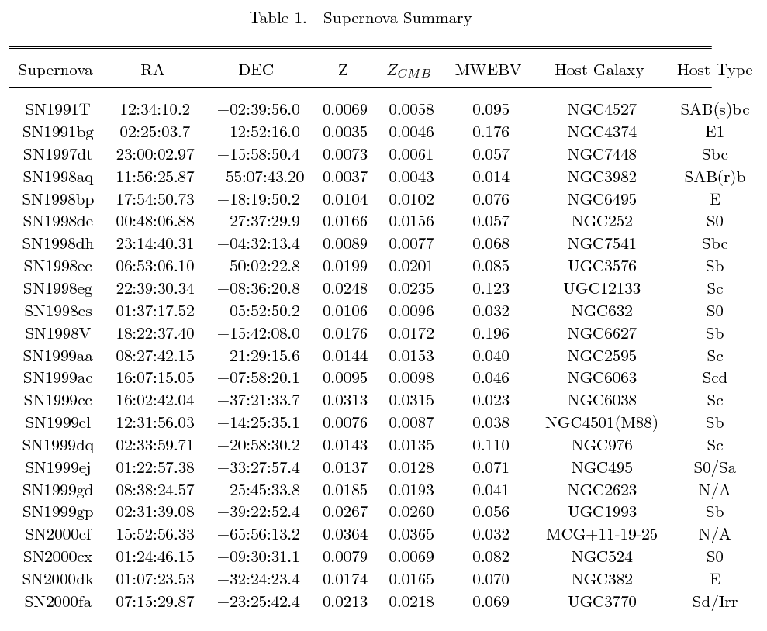
Supernovae

Slide 6
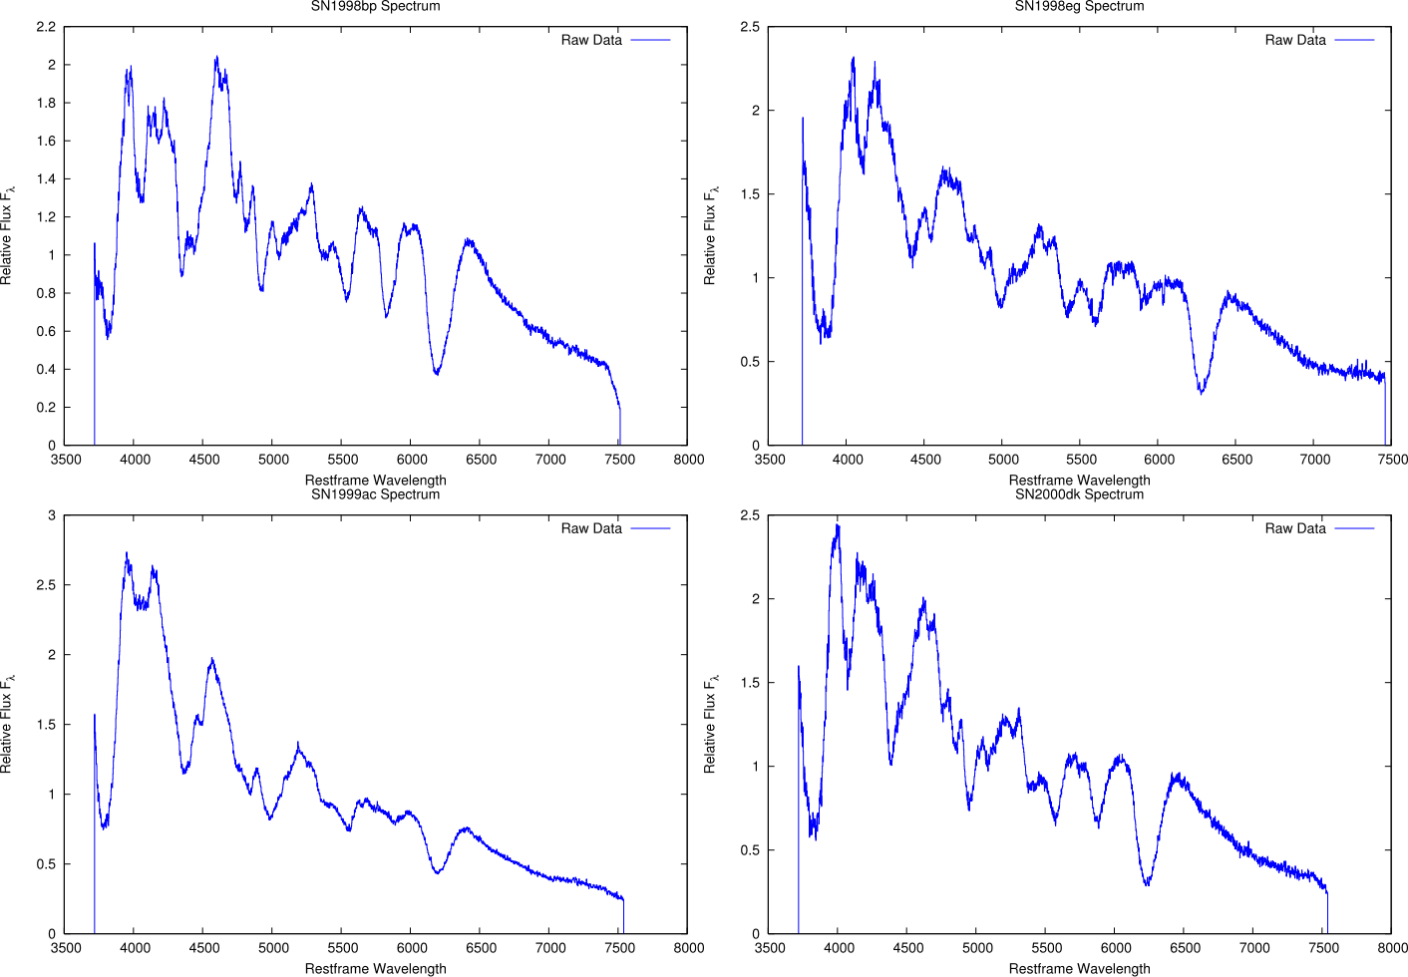
Spectra Data
Matheson et al. (2008)

Slide 7
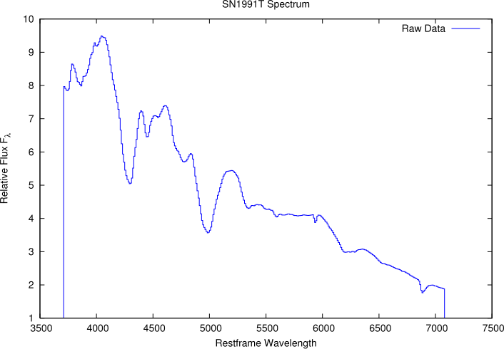
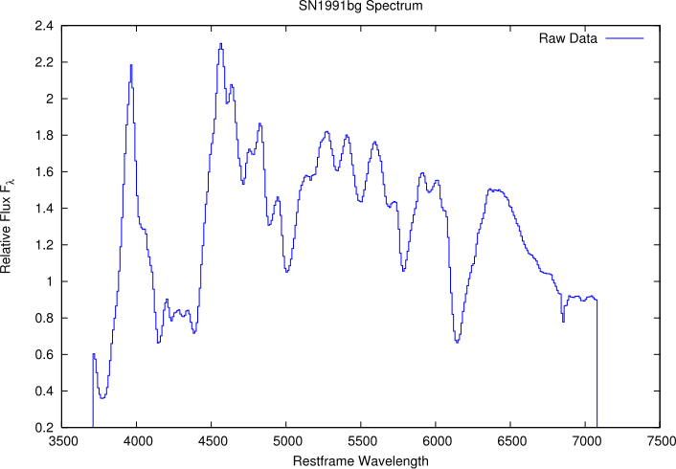
SN1991T and SN1991bg
Gomez et al. (1996)
Nugent et al. (2002)

Slide 8
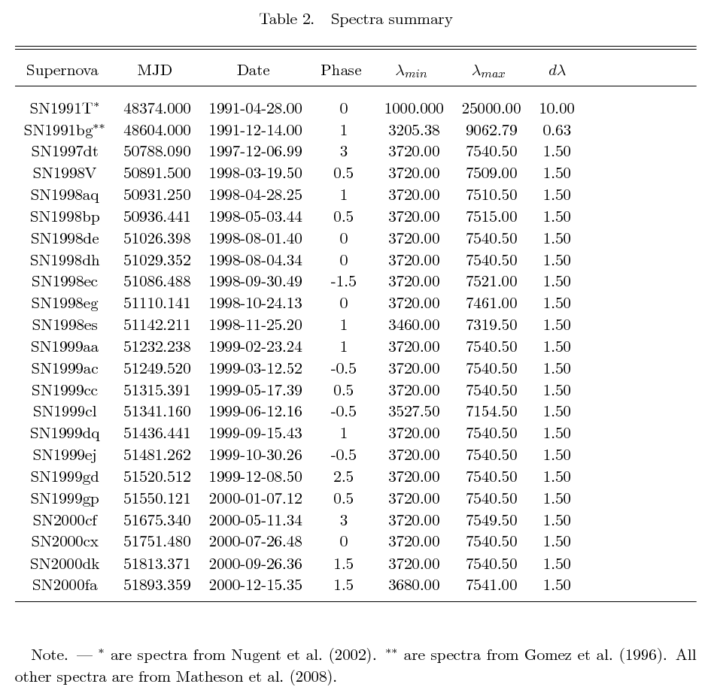
Spectra Overview

Slide 9
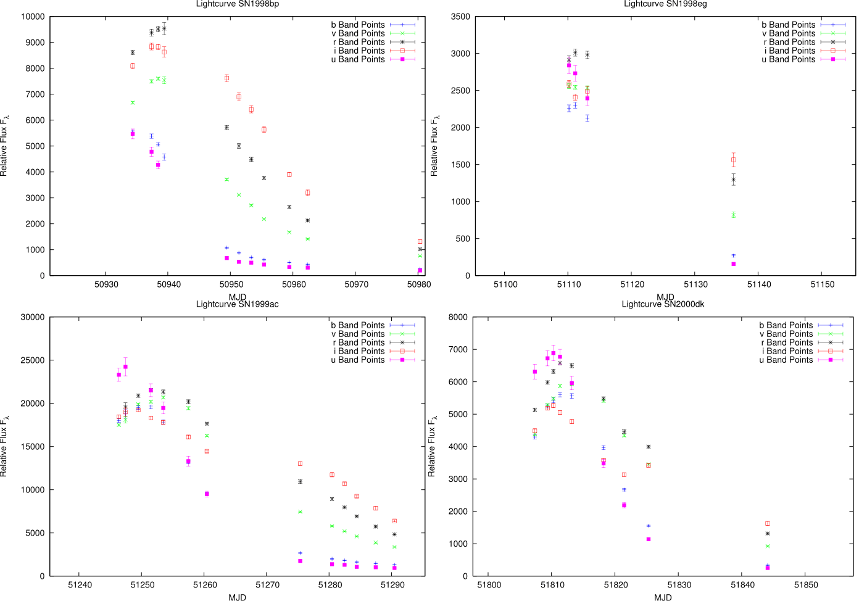
Light Curve Points
Jha et al. (2006)

Slide 10
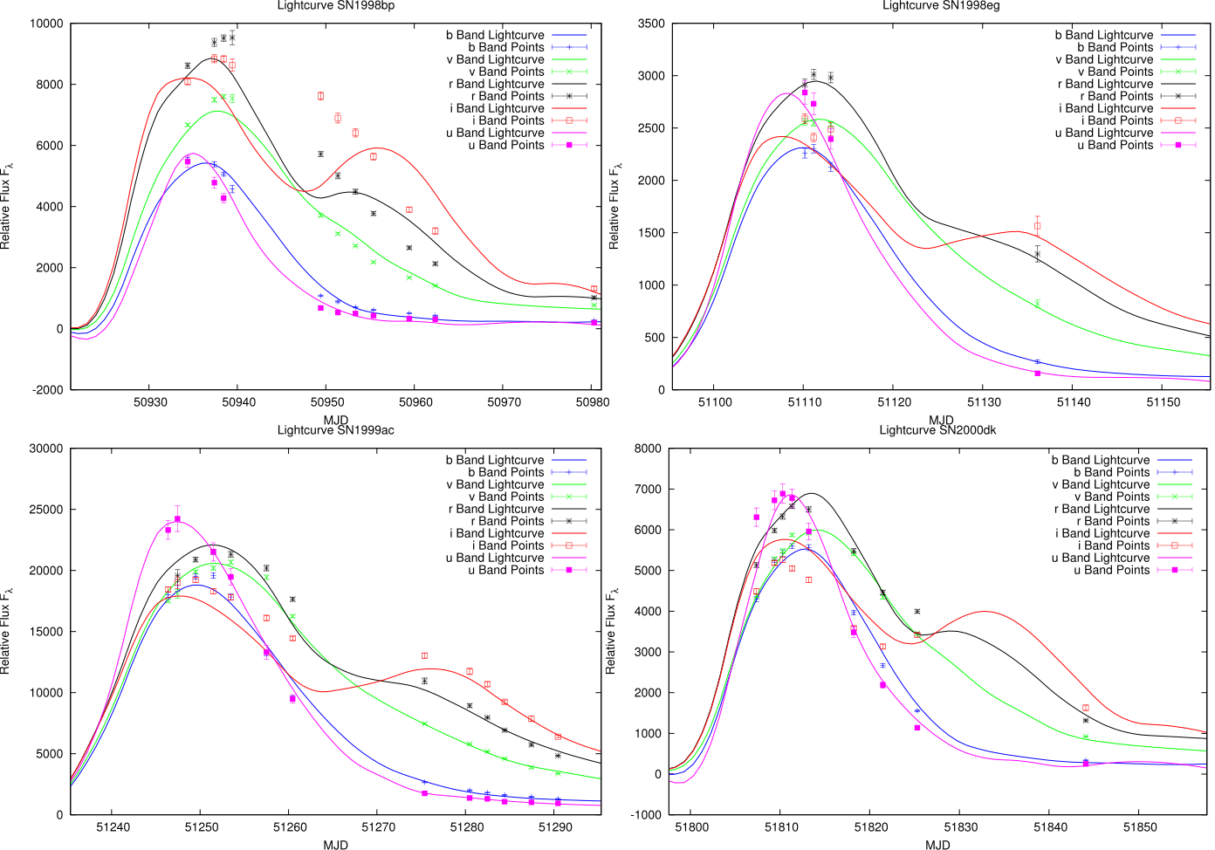
Light Curve Fits with SALT2

Slide 11
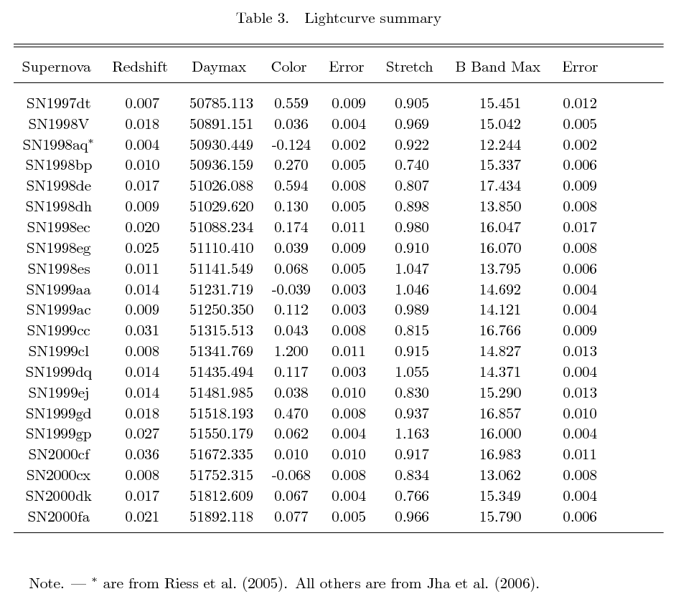
Light Curve Overview

Slide 12
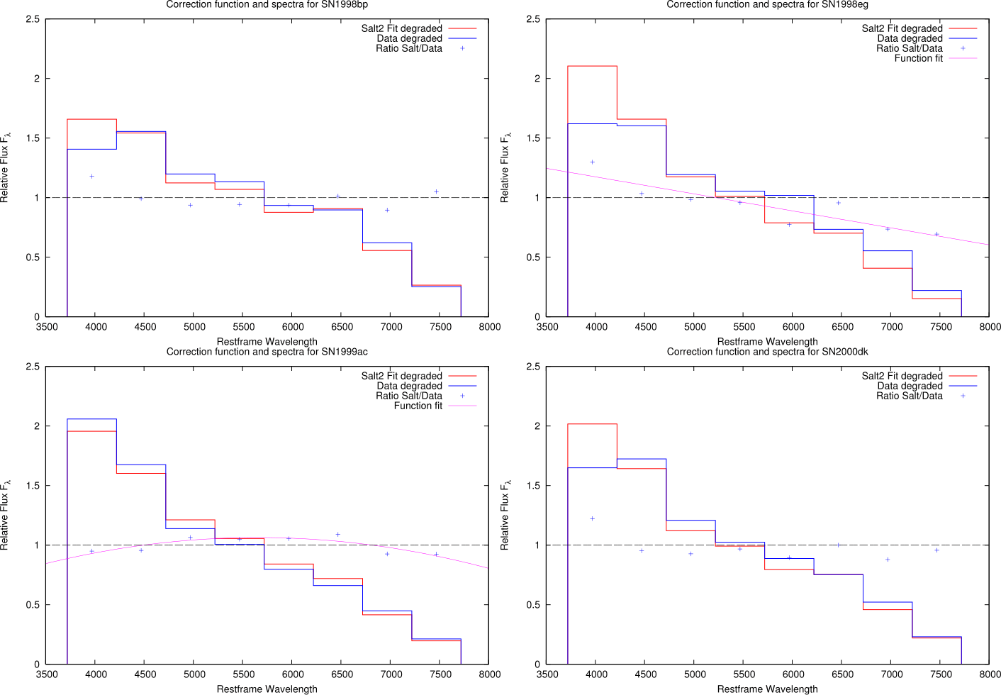
Flux Calibration

Slide 13
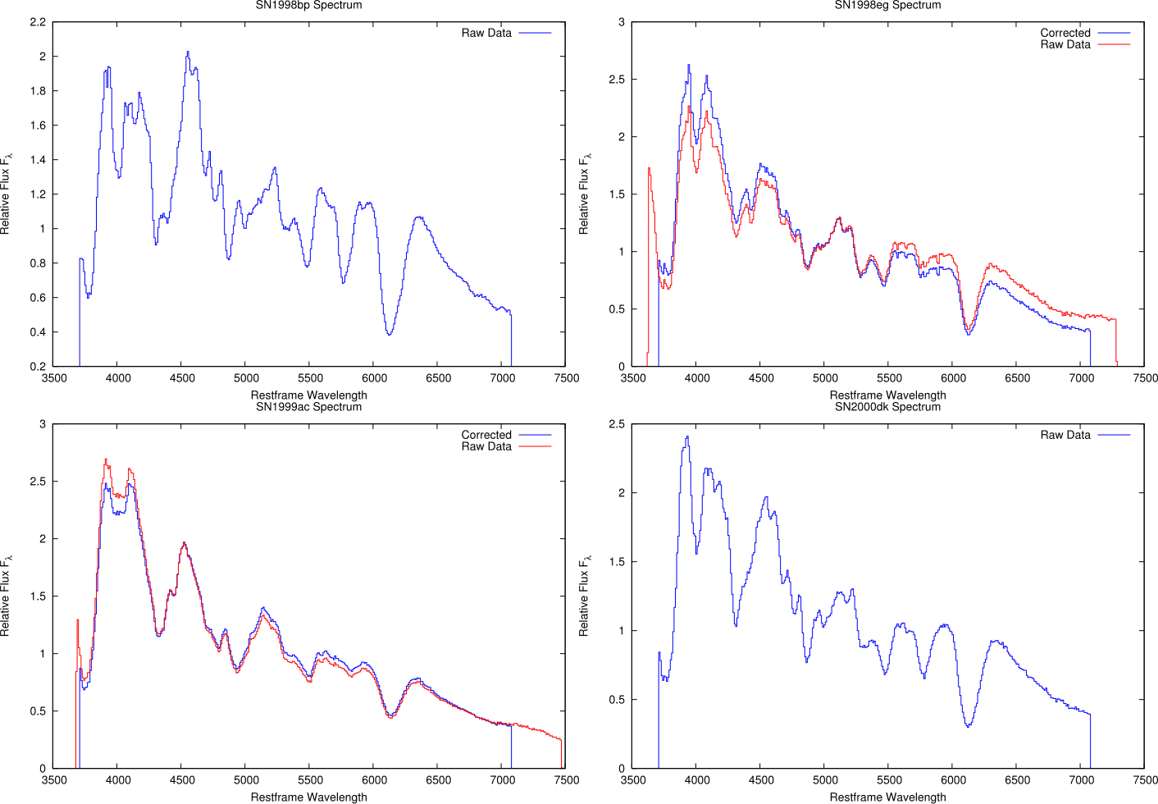
Flux Calibration

Slide 14
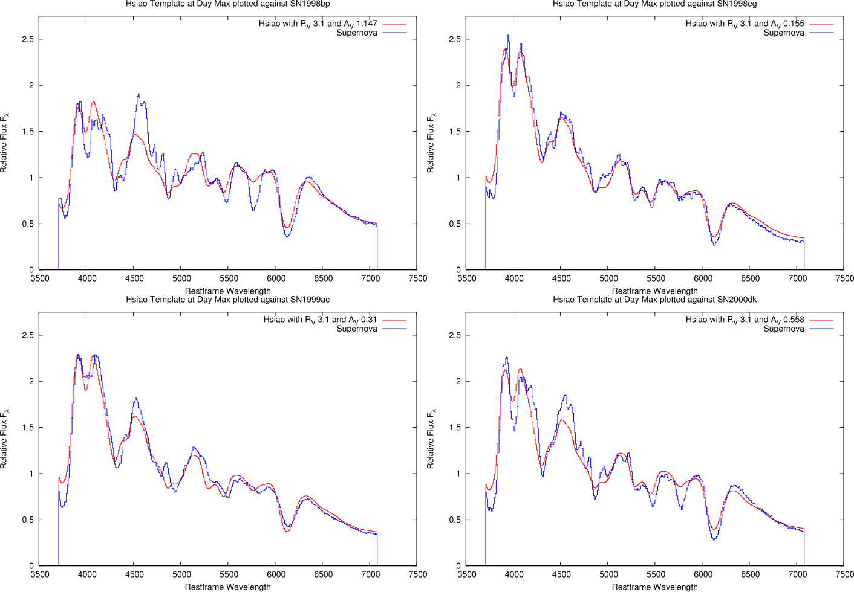
Hsiao Warped with Cardelli

Slide 15
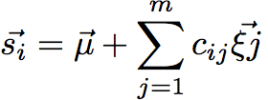


PCA Math

Slide 16

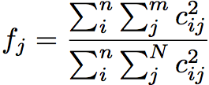
PCA Math

Slide 17
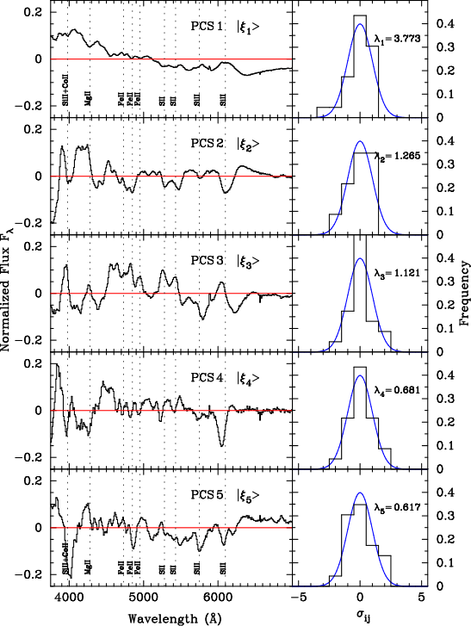
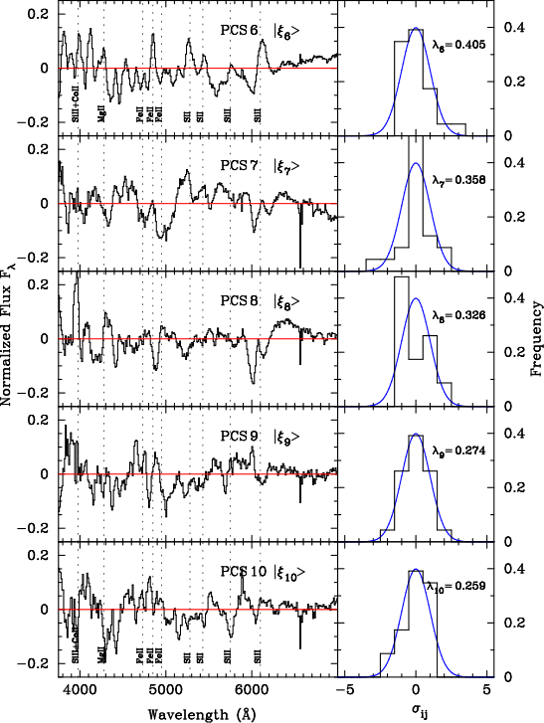
PCA: Components

Slide 18
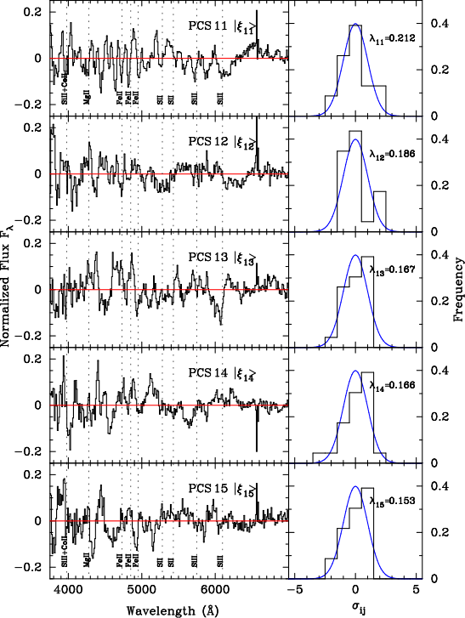
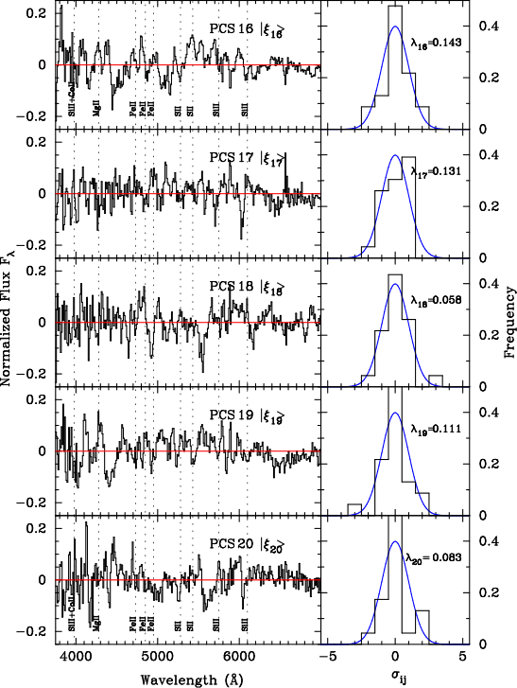
PCA: Components

Slide 19
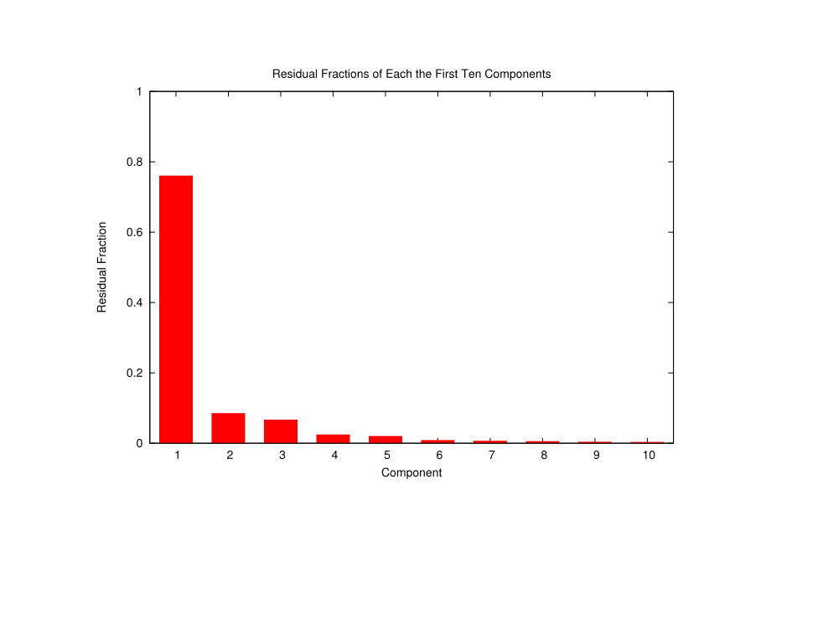
PCA: Components
76%
8.6%
6.7%
2.5%
2%

Slide 20
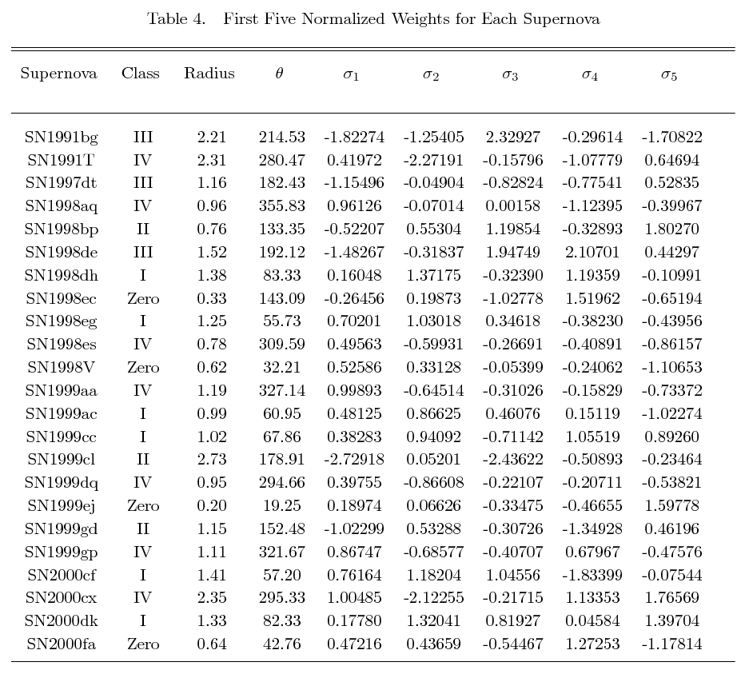
PCA: Components

Slide 21
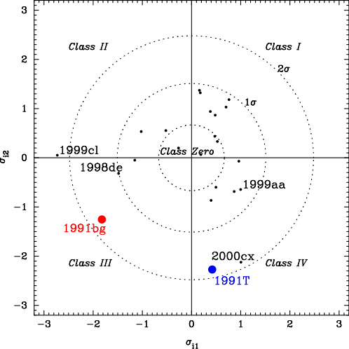
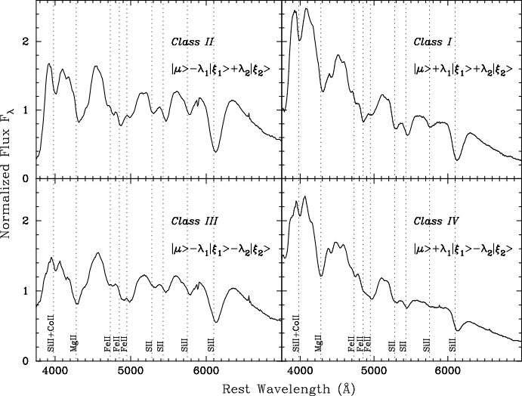
PCA: Sigma Sigma

Slide 22
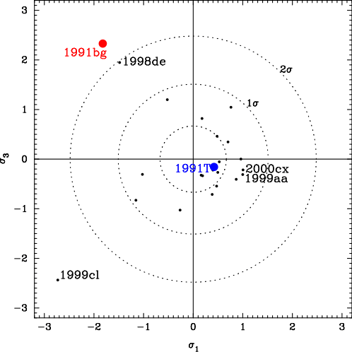
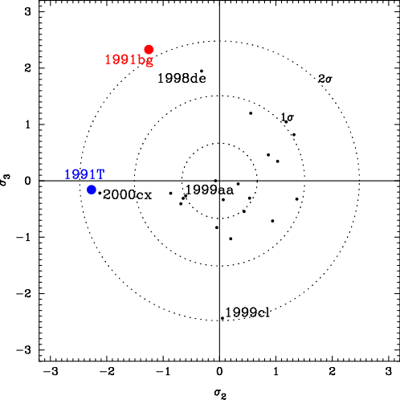
PCA: Sigma Sigma

Slide 23
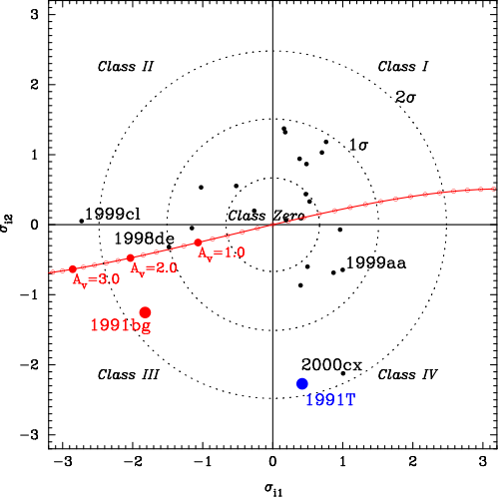
PCA: Sigma Sigma

Slide 24
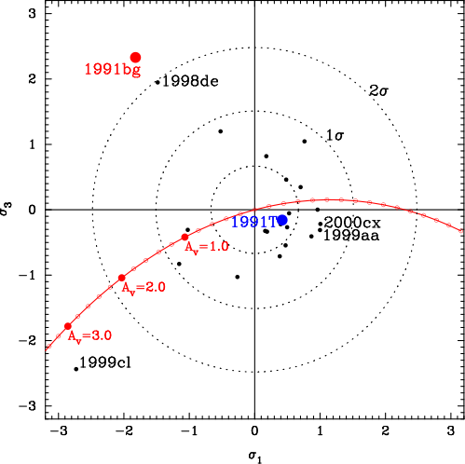
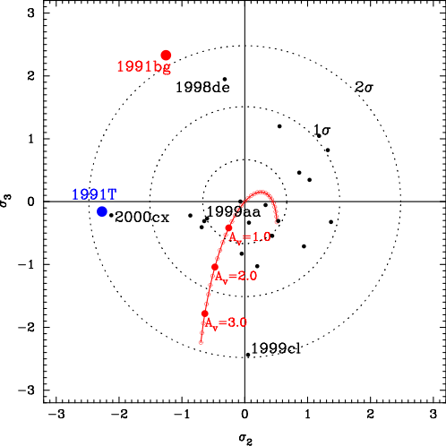
PCA: Sigma Sigma

Slide 25
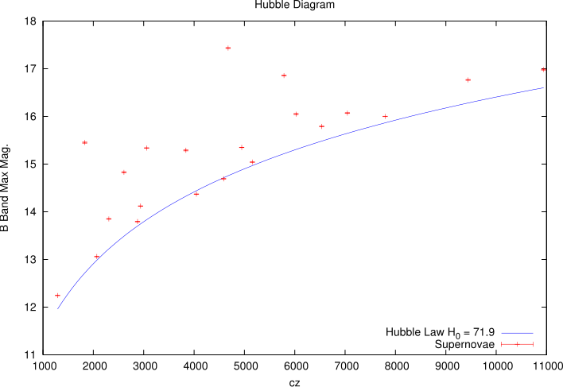
Cosmology: Raw Data

Slide 26
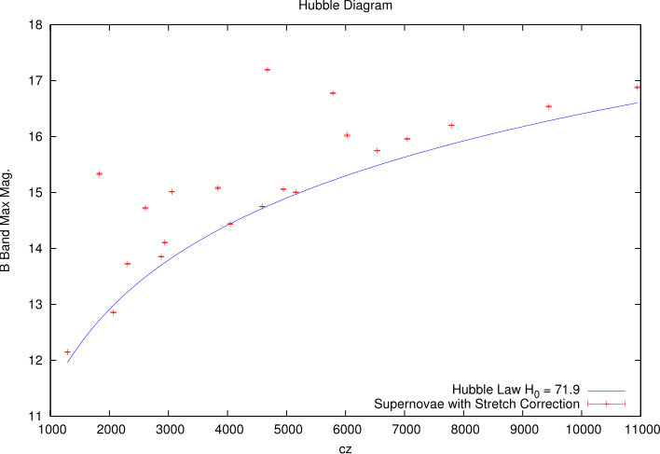
Cosmology: Stretch Corrected

Slide 27
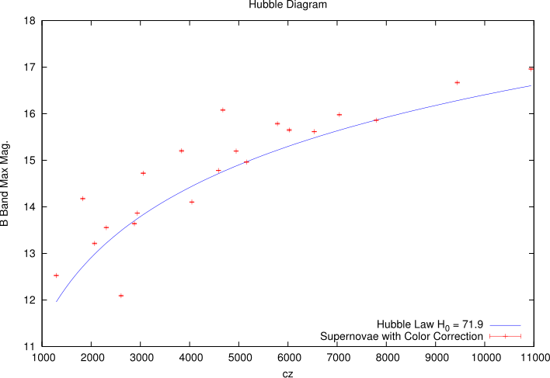
Cosmology: Color Corrected

Slide 28
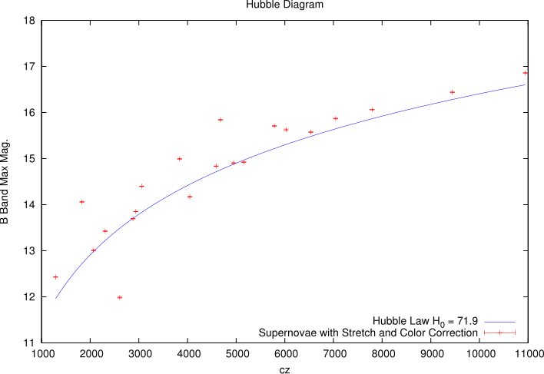
Cosmology: Stretch and Color Corrected

Slide 29
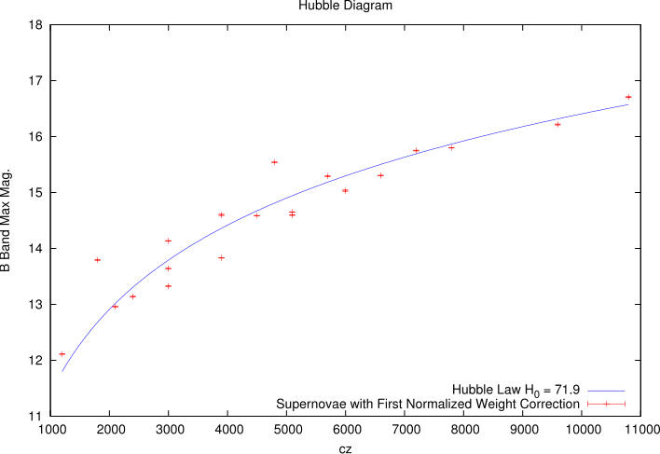
Cosmology: Weight 1 Corrected

Slide 30
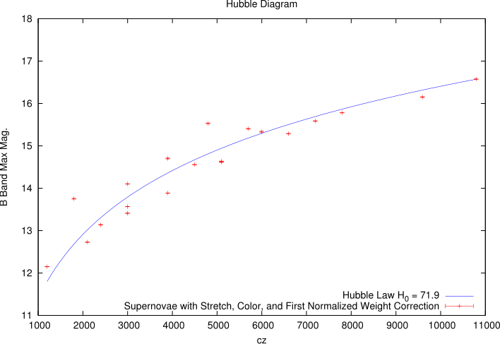
Cosmology: Color, Stretch, and Weight1 Corrected

Slide 31
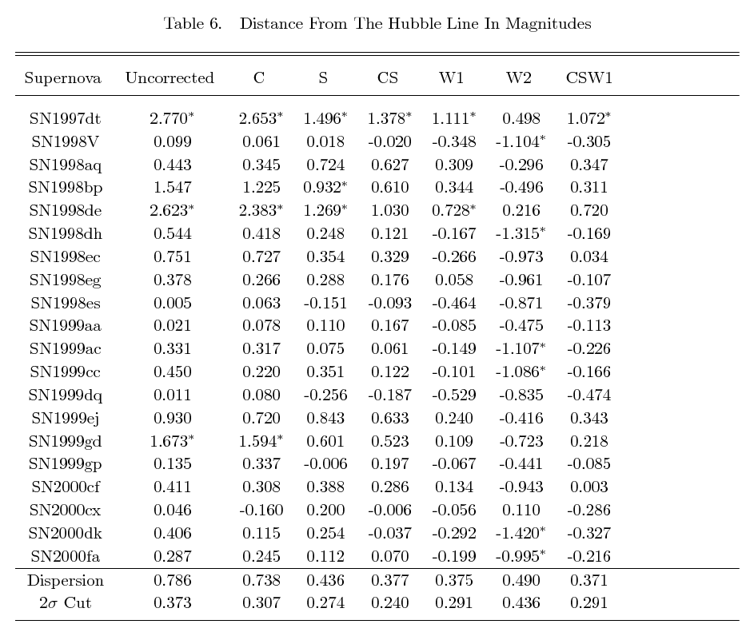
Cosmology: Overview

Slide 32
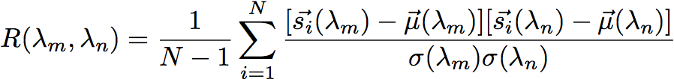
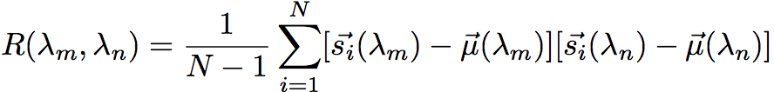
PCA Extra

Slide 33
Conclusion
We are able to determine that reddening is not due to Cardelli dust if Rv is fixed to 3.1
We see indications that using weights can tighten dispersion around the Hubble line.

