Slide 1
Spectral Analysis of 23 SNe Ia using PCA
Reddening - Extinction
or Intrinsic Diversity

Slide 2
Questions
Can we tell the difference between CCM like dust and intrinsic color variation in our population of supernovae?
Can we find a correlation between our weights and dispersion around the Hubble line, and can we reduce this dispersion?

Slide 3
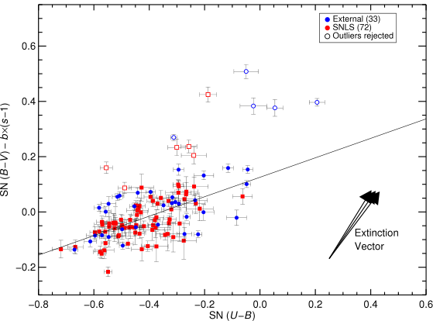
Conley et al. (2008)
Notes:
Conley et al. suggests that supernovae do not follow dust extinction. A single parameter dust law does not account for them. This is using optical data.

Slide 4
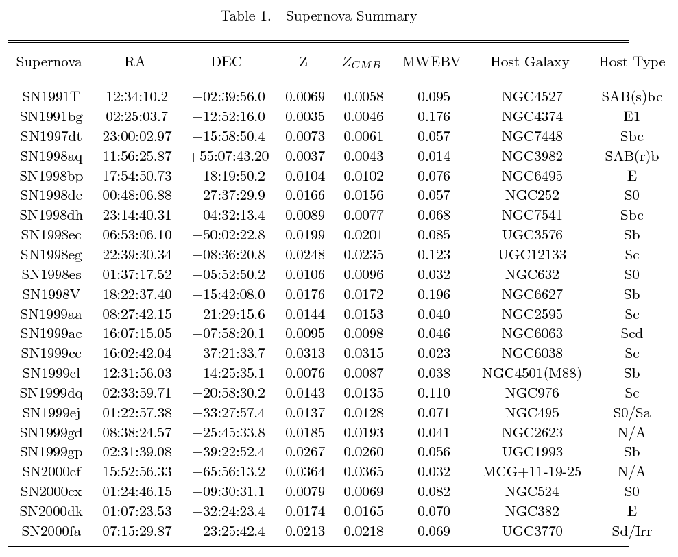
Supernovae

Slide 5
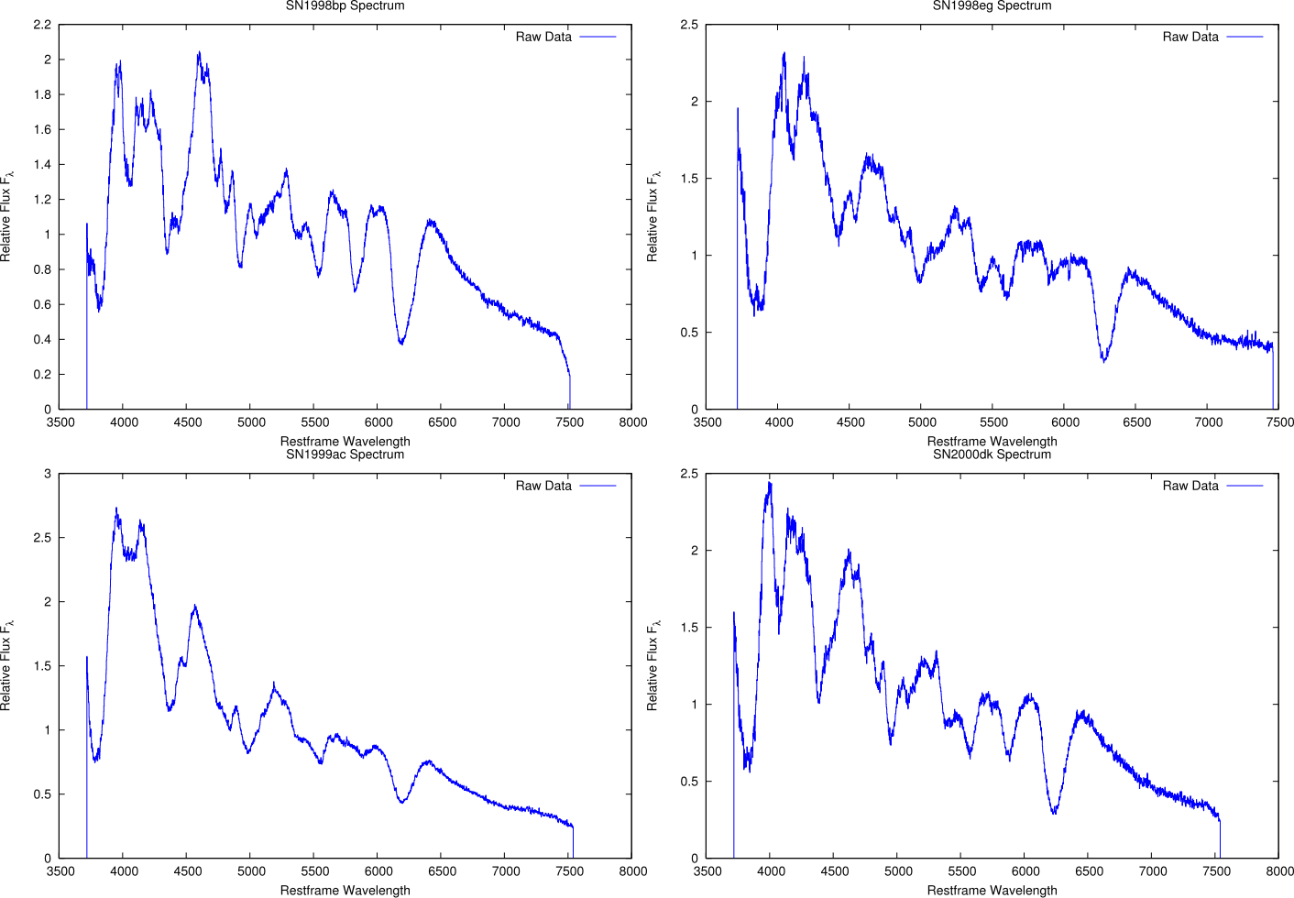
Data
Matheson et al. (2008)

Slide 6
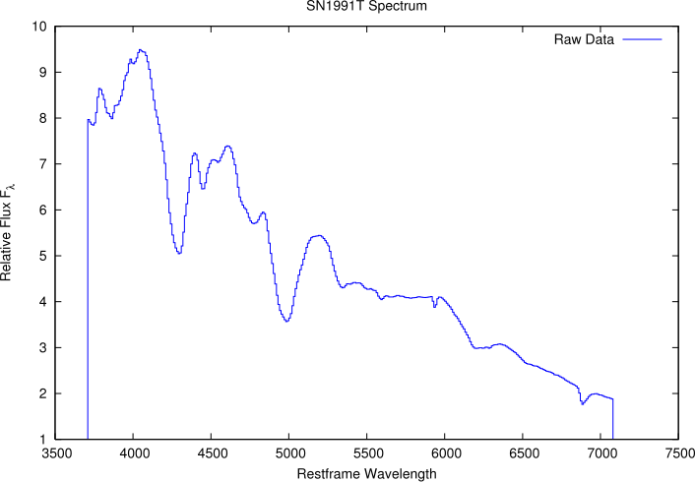
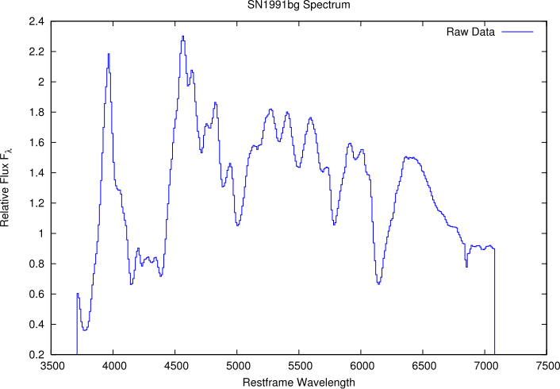
Data
Gomez et al. (1996)
Nugent et al. (2002)

Slide 7
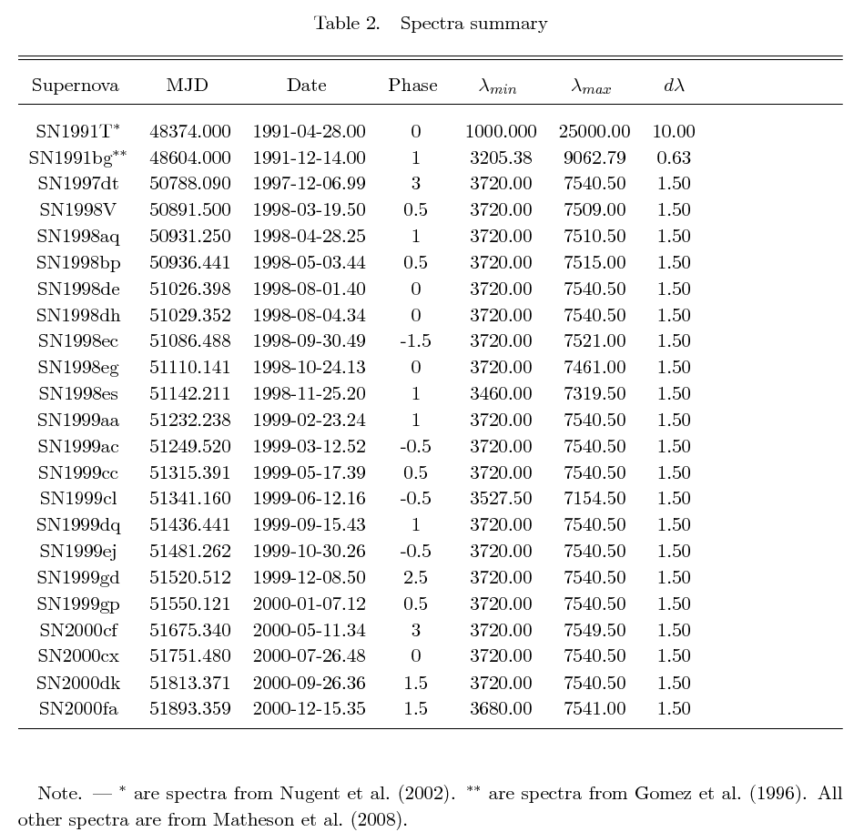
Data

Slide 8
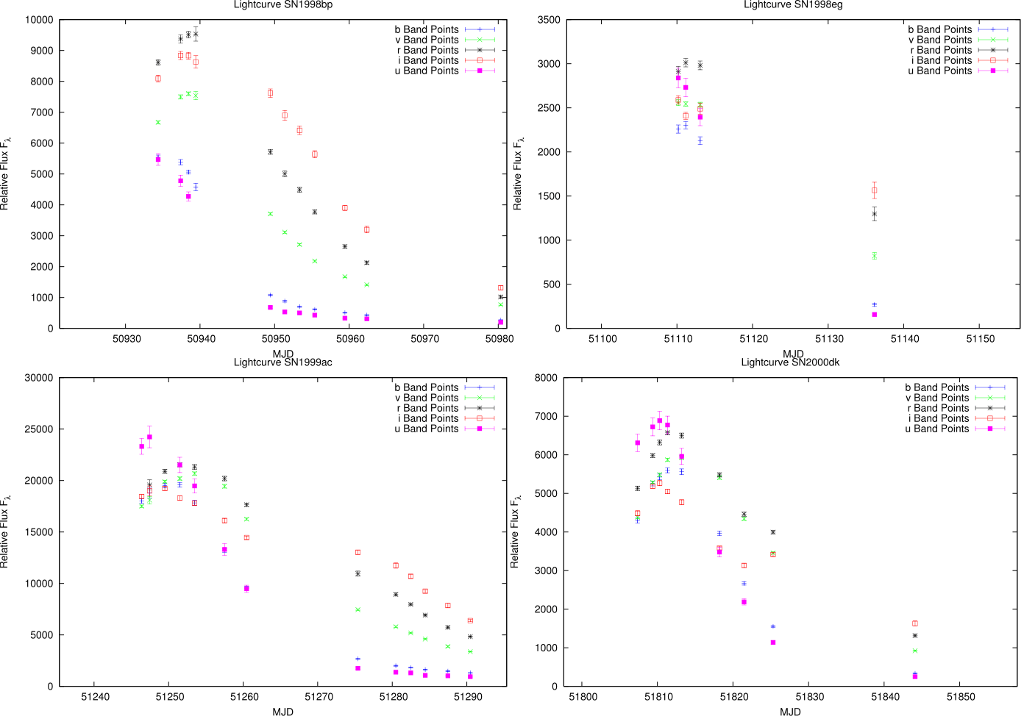
Data
Jha et al. (2006)

Slide 9
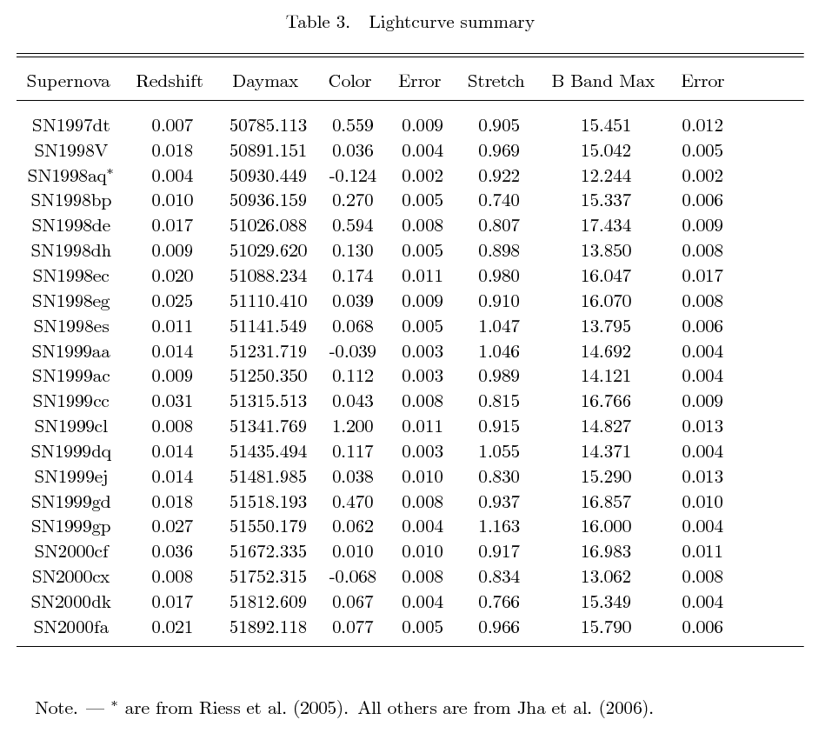
Data

Slide 10
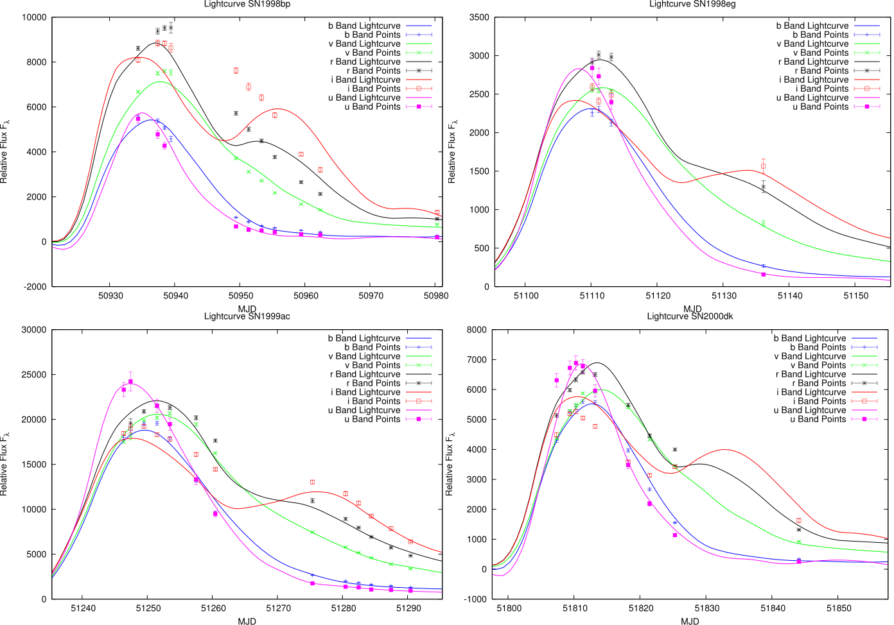
Processing

Slide 11
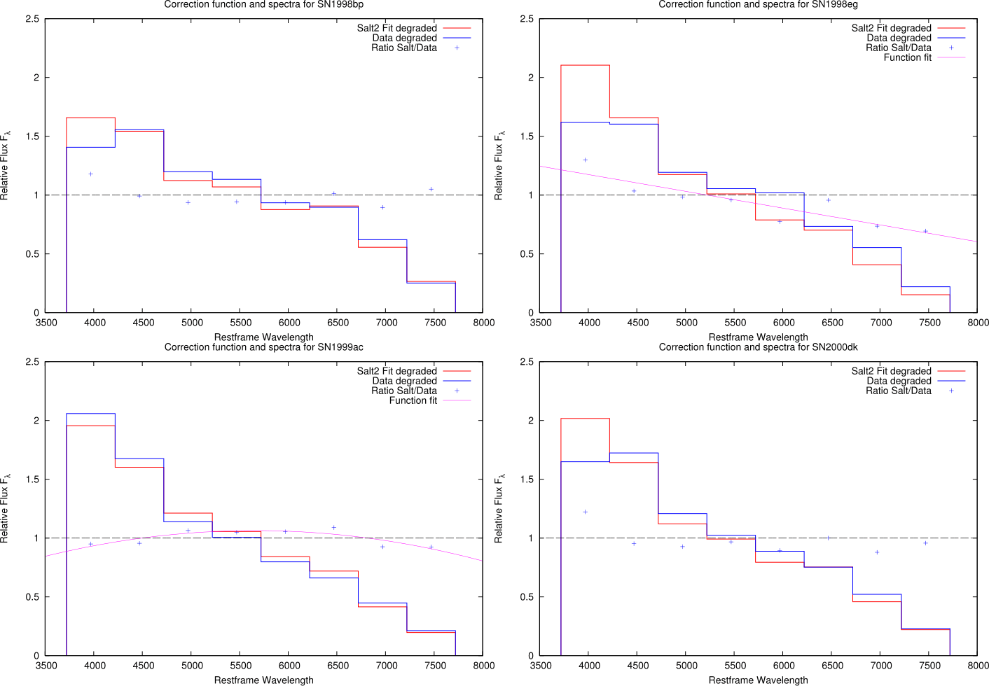
Processing

Slide 12
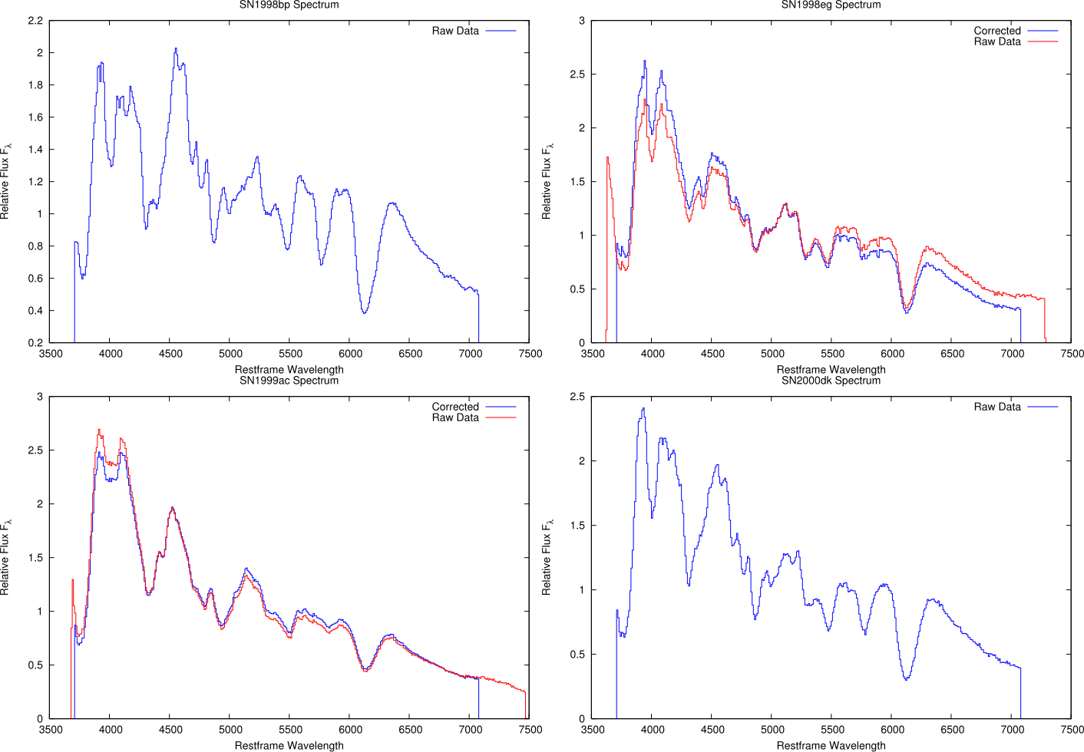
Processing

Slide 13
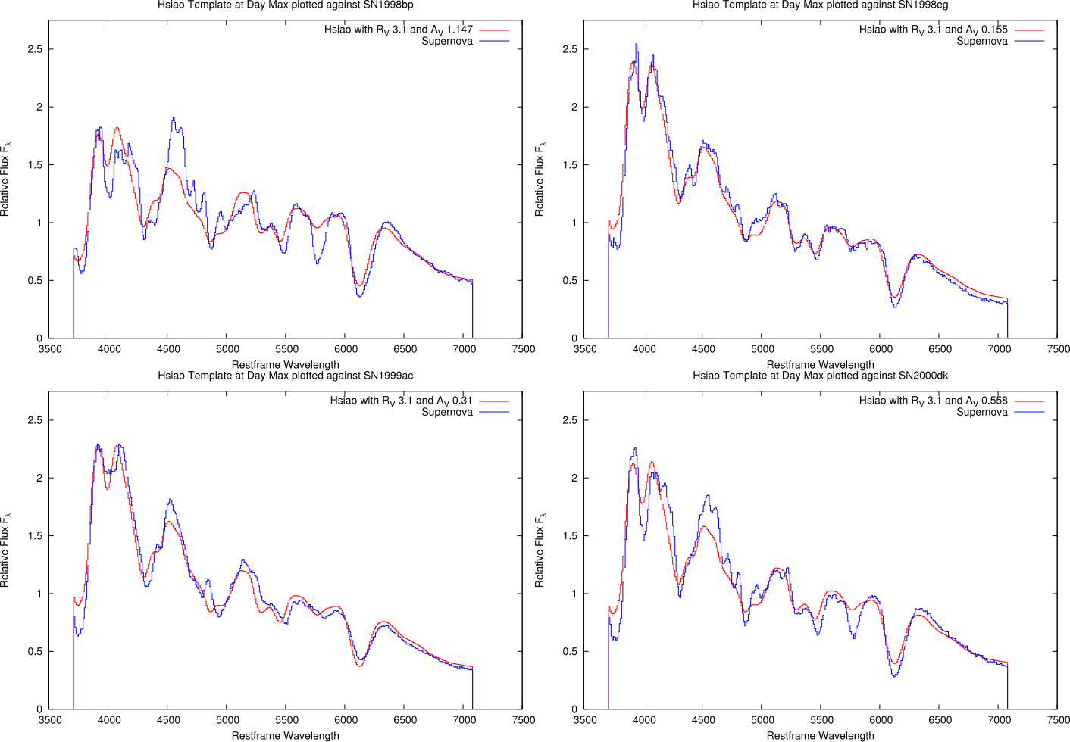
Color

Slide 14
PCA

Slide 15
PCA

Slide 16
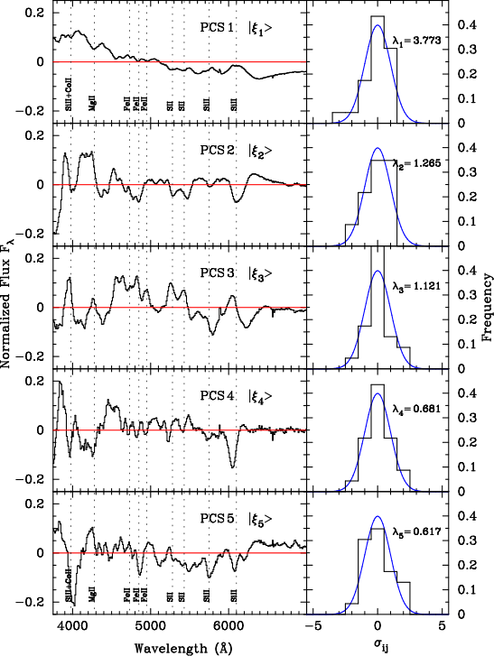
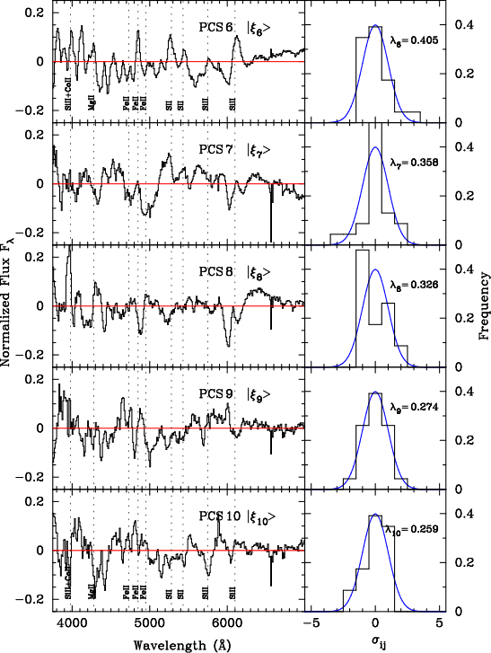
PCA: Components

Slide 17
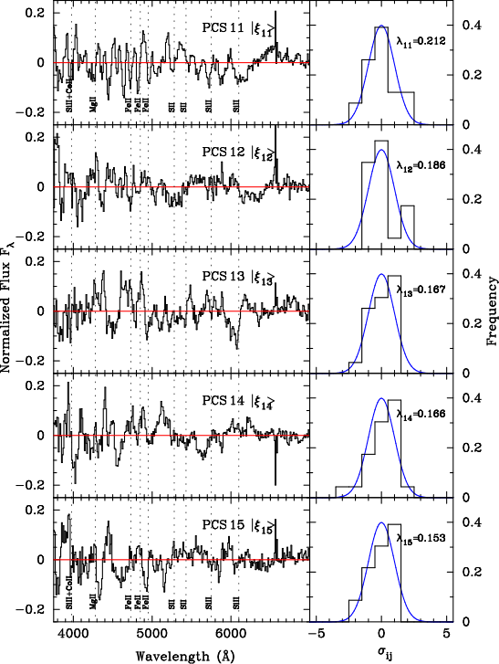
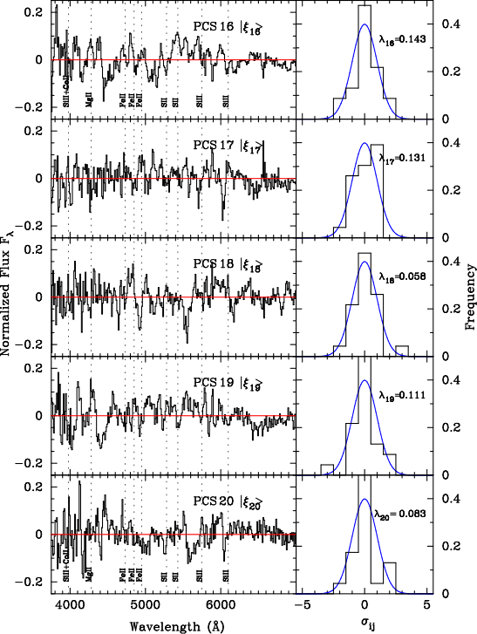
PCA: Components

Slide 18
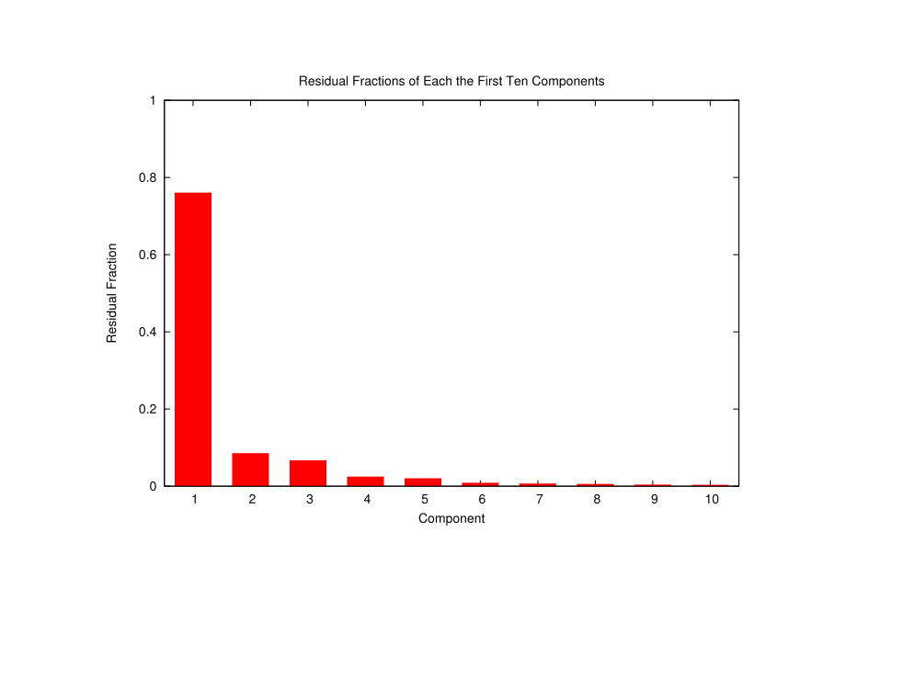
PCA: Components

Slide 19
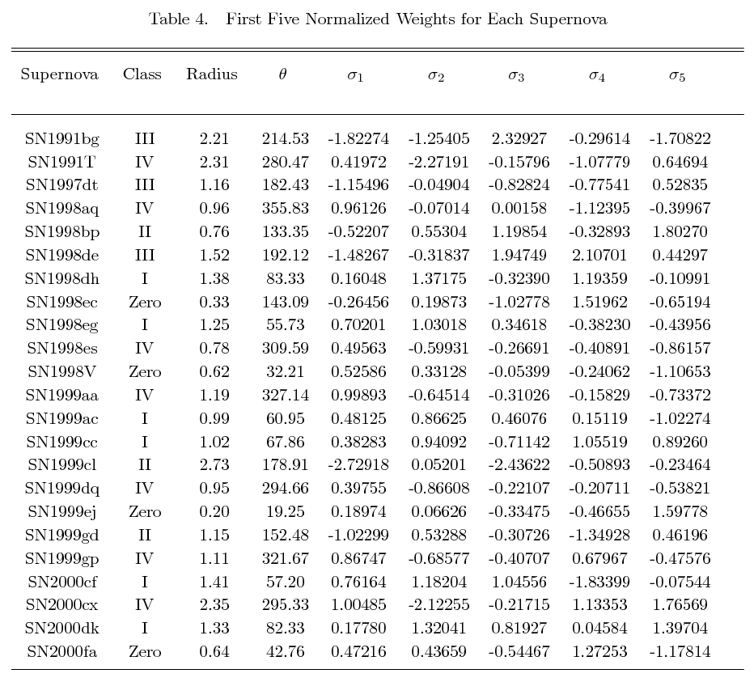
PCA: Components

Slide 20
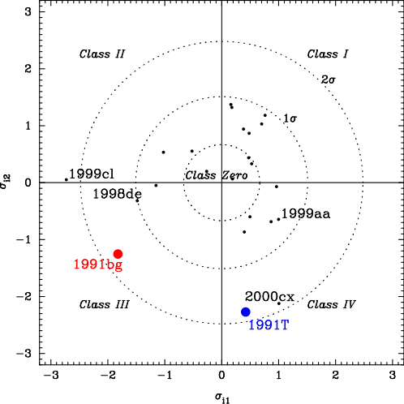
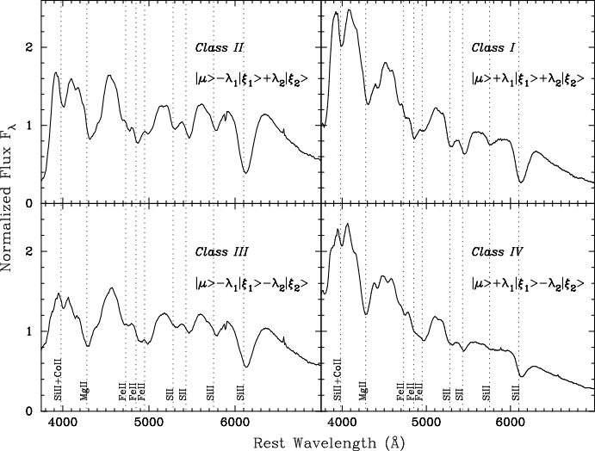
PCA: Sigma Sigma

Slide 21
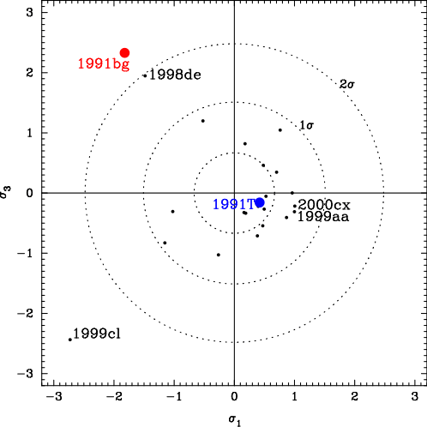
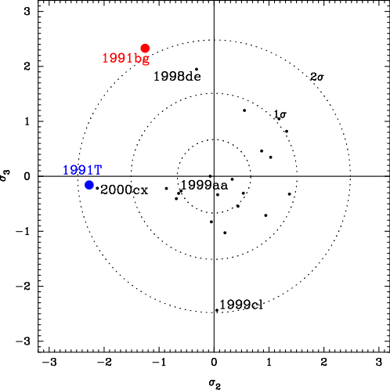
PCA: Sigma Sigma

Slide 22
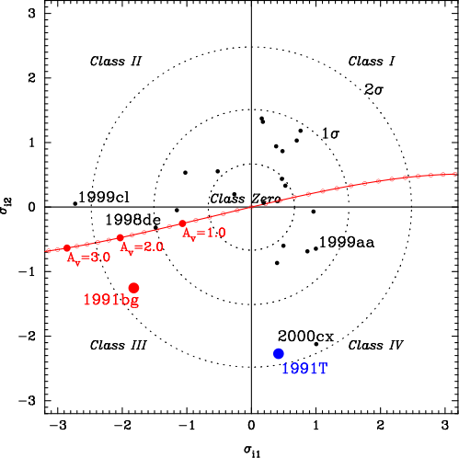
PCA: Sigma Sigma

Slide 23
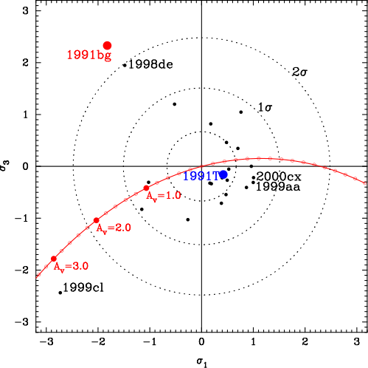
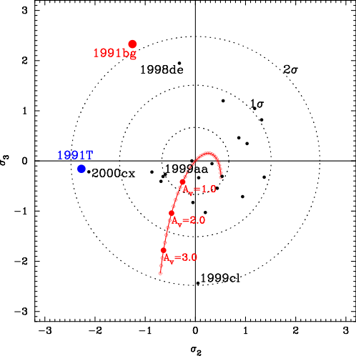
PCA: Sigma Sigma

Slide 24
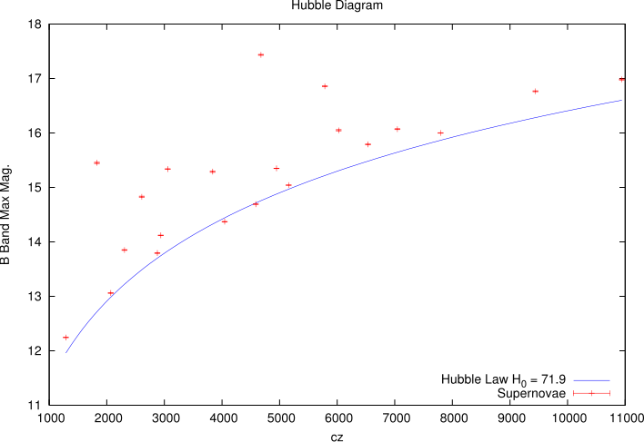
Cosmology

Slide 25
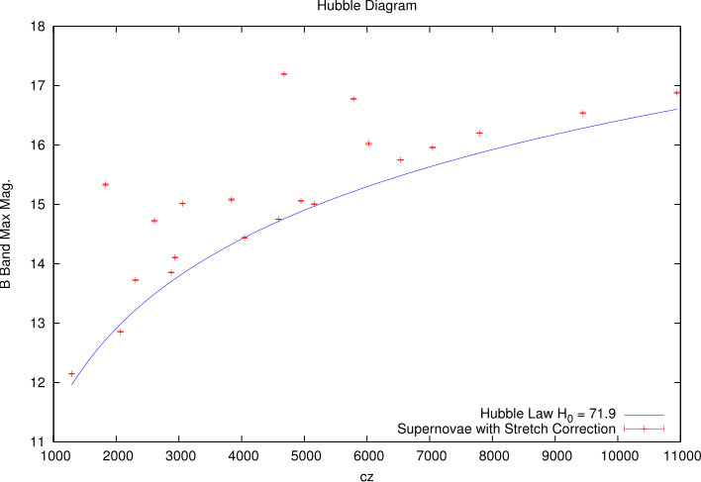
Cosmology

Slide 26
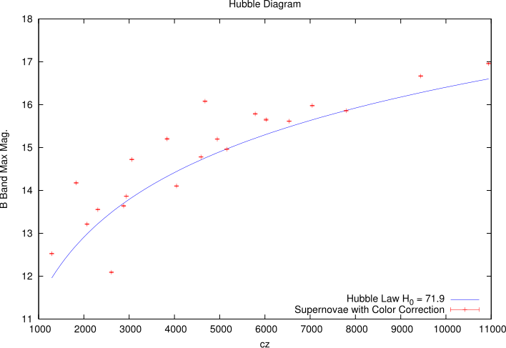
Cosmology

Slide 27
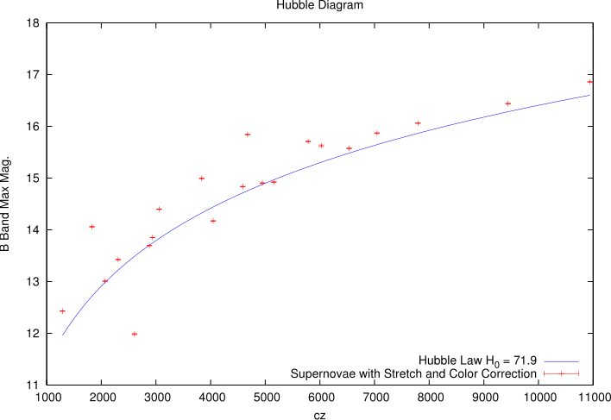
Cosmology

Slide 28
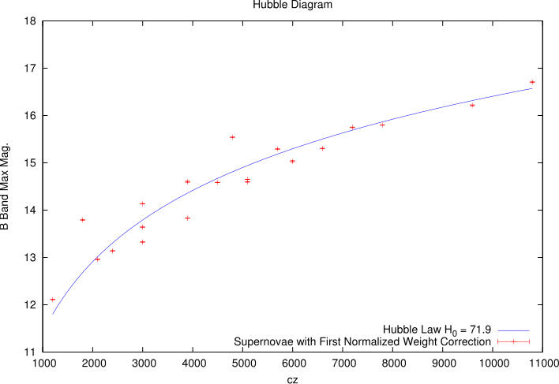
Cosmology

Slide 29
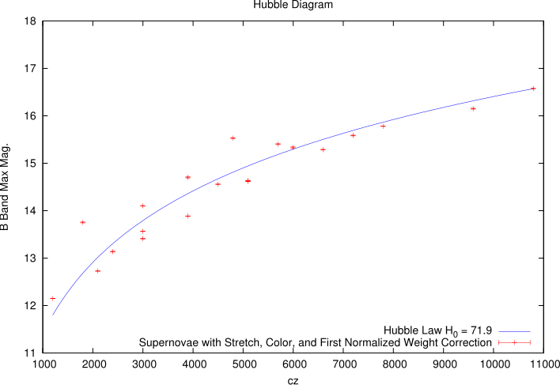
Cosmology

Slide 30
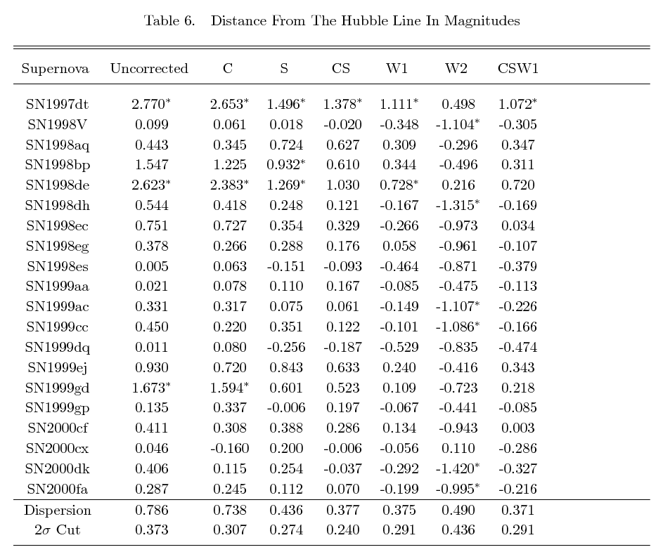
Cosmology

