Slide 1
Group 4
Augusto Gonzalez, dong wang, Andrew Nassem

Slide 2
Login use case description: main flow
User Action | System Response
1. User types in login credentials and clicks login button | 1. System confirms login data, retrieves Authorization Level and customizes the User Interface according to it.

Slide 3
New_member use case description: main flow
User Action | System Response
1. Administrator types in login credentials and clicks login button | 1. System confirms login data, retrieves Authorization Level and customizes the User Interface according to Administrator;
2. Administrator selects the option to add new member | 2. Form to create a new member is loaded
3. Administrator enters and submits member id, first name, last name, street, city, state, zip, telephone number | 3. System validates the data and it is persisted to storage.

Slide 4
checkout_book use case description: main flow
User Action | System Response
Librarian selects Checkout Book option
1. Librarian enters and submits member ID and ISBN number. | 1. Form to create a new member is loaded
2. Administrator enters and submits member id, first name, last name, street, city, state, zip, telephone number | 2. System checks if there exists such member ID and ISBN number and also if there is a copy of that book available. Then a new

Slide 5
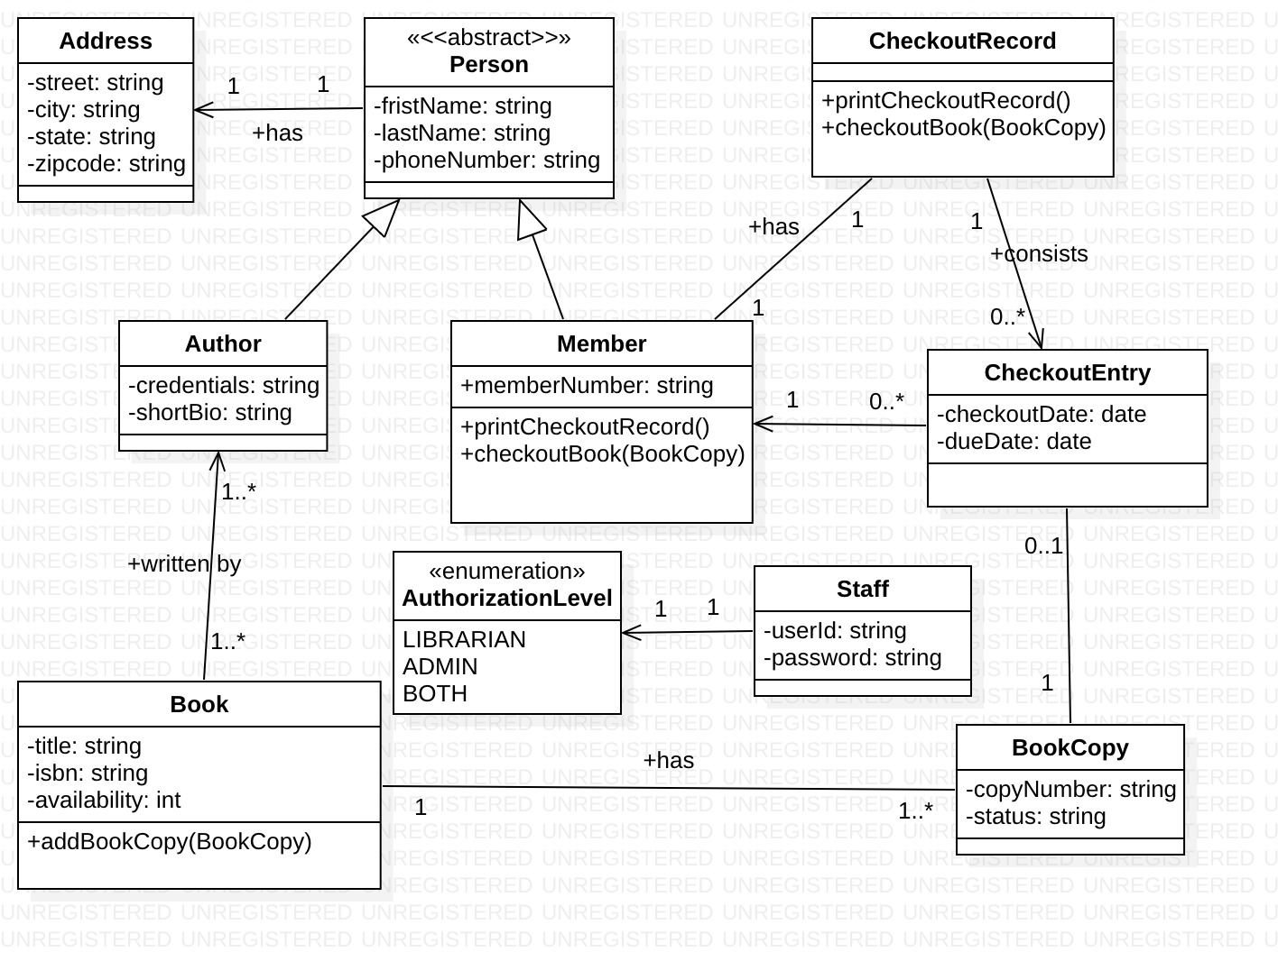
Class diagram

