Slide 1



HYPOTHESIS TESTING
JANUARY, 2020 | BRAZIL

Slide 2

HYPOTHESIS TESTING
Null Hypothesis H₀
True until proven false
Usually posits no relationship

Slide 3
HYPOTHESIS TESTING
Null Hypothesis H₀
True until proven false
Usually posits no relationship
Alternative Hypothesis
Negation of null hypothesis
Usually asserts specific relationship

Slide 4
HYPOTHESIS TESTING
Null Hypothesis H₀
True until proven false
Usually posits no relationship
Select Test
Pick from vast library
Know which one to choose
Alternative Hypothesis
Negation of null hypothesis
Usually asserts specific relationship

Slide 5
HYPOTHESIS TESTING
Null Hypothesis H₀
True until proven false
Usually posits no relationship
Select Test
Pick from vast library
Know which one to choose
Alternative Hypothesis
Negation of null hypothesis
Usually asserts specific relationship
Test Statistic
Convert to p-value
How likely it was just luck?

Slide 6
HYPOTHESIS TESTING
Null Hypothesis H₀
True until proven false
Usually posits no relationship
Select Test
Pick from vast library
Know which one to choose
Significance Level
Usually 1% or 5%
What threshold for luck?
Alternative Hypothesis
Negation of null hypothesis
Usually asserts specific relationship
Test Statistic
Convert to p-value
How likely it was just luck?

Slide 7
HYPOTHESIS TESTING
Null Hypothesis H₀
True until proven false
Usually posits no relationship
Select Test
Pick from vast library
Know which one to choose
Significance Level
Usually 1% or 5%
What threshold for luck?
Alternative Hypothesis
Negation of null hypothesis
Usually asserts specific relationship
Test Statistic
Convert to p-value
How likely it was just luck?
Accept or Reject
Small p-value? Reject H₀
Small: Below significance level

Slide 8

LADY TESTING TEA
Famous experiment:
Was tea added before or after milk?

Slide 9
LADY TESTING TEA
Null Hypothesis
(H₀)
Alternate Hypothesis
(H₁)
The lady cannot tell if milk was poured first
The lady can tell if milk was poured first

Slide 10
LADY TESTING TEA
Null Hypothesis
(H₀)
Alternate Hypothesis
(H₁)
The lady cannot tell if milk was poured first
The lady can tell if milk was poured first
It is good practice to assume that the null hypothesis is correct unless proven otherwise

Slide 11
LADY TESTING TEA
Null Hypothesis H₀
“Lady cannot tell difference”
Can’t tell if milk poured first

Slide 12
LADY TESTING TEA
Null Hypothesis H₀
“Lady cannot tell difference”
Can’t tell if milk poured first
Alternative Hypothesis
“Lady can tell difference”
Can indeed discern if milk poured first

Slide 13
LADY TESTING TEA
Null Hypothesis H₀
“Lady cannot tell difference”
Can’t tell if milk poured first
Select Test
8 cups, 4 of each type
Lady got all 8 correct
Alternative Hypothesis
“Lady can tell difference”
Can indeed discern if milk poured first

Slide 14
LADY TESTING TEA
Null Hypothesis H₀
“Lady cannot tell difference”
Can’t tell if milk poured first
Select Test
8 cups, 4 of each type
Lady got all 8 correct
Alternative Hypothesis
“Lady can tell difference”
Can indeed discern if milk poured first
Test Statistic
p-value = 1/70 = 1.4%
⁸C₄ = 70 combinations

Slide 15
LADY TESTING TEA
Null Hypothesis H₀
“Lady cannot tell difference”
Can’t tell if milk poured first
Select Test
8 cups, 4 of each type
Lady got all 8 correct
Significance Level
Choose 5% significance level
Part of design of experiment
Alternative Hypothesis
“Lady can tell difference”
Can indeed discern if milk poured first
Test Statistic
p-value = 1/70 = 1.4%
⁸C₄ = 70 combinations

Slide 16
LADY TESTING TEA
Null Hypothesis H₀
“Lady cannot tell difference”
Can’t tell if milk poured first
Select Test
8 cups, 4 of each type
Lady got all 8 correct
Significance Level
Choose 5% significance level
Part of design of experiment
Alternative Hypothesis
“Lady can tell difference”
Can indeed discern if milk poured first
Test Statistic
p-value = 1/70 = 1.4%
⁸C₄ = 70 combinations
Accept or Reject
1.4% < 5% → Reject H₀
Lady can indeed tell difference

Slide 17
LADY TESTING TEA
Experiment proved that she could

Slide 18
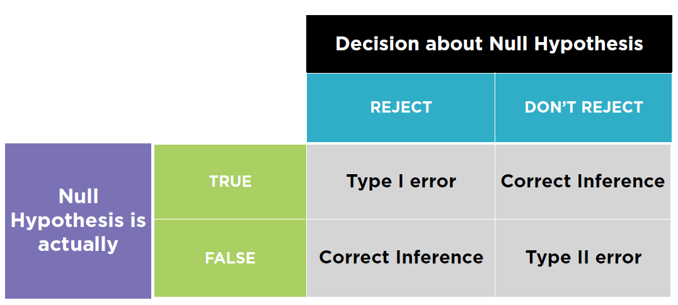

Slide 19
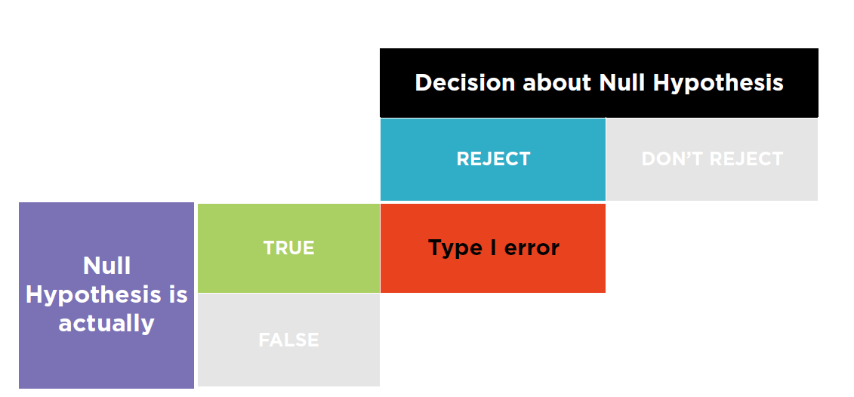
Claim the lady can tell the difference based on spurious test results which are not statistically significant

Slide 20
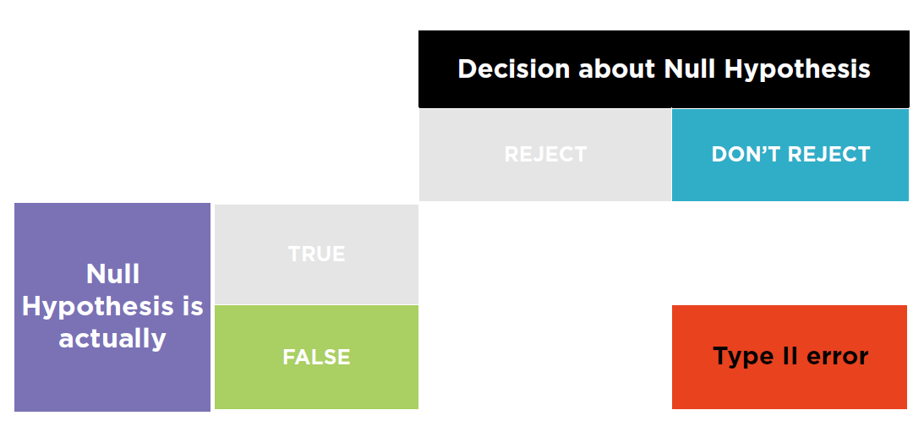
Fail to realize that the test for the alternative hypothesis was statistically significant

Slide 21
POWER of a Statistical Test
- Probability of rejecting H0 when H1 is true (high is good)
High statistical power implies low
probability of Type-II error
α of a Statistical Test
- α is probability of rejecting H0 when H0 is true (low is good)
p-value of a Statistical Test
p-value is compared to α to decide whether to accept H0
p-value should be as small as possible (i.e. below α-threshold)
Typical thresholds are: reject null hypothesis if p < 1% or p < 5%

Slide 22
Used to learn about differences in averages across two categories.
Example:
Average male baby birth weight =
Average female baby birth weight?
Outputs:
t-statistic: score which indicate how different the means are;
p-value: whether the t-statistic is significant or not. Low values of p means that the result cannot have happened by chance.
T-test

Slide 23
Two sample location test
ANOVA
Analysis of Variance
One-sample t-test
Example:
Imagine your provider says that a specific product has an average size of 30mm.
Your procedure would be:
Claim that the null-hypothesis is:
The mean size of the population is equal to 30mm. (H0: μ = 30mm)
You run the t-test and if the p-value is less that 0.05 (5%), you would have 95% confidence that the null-hypothesis could be rejected. That is: 95% confidence that the product DOES NOT have an average of 30mm. (H1: μ != 30mm)
Example:
AB-Testing.
Imagine you have an information of a group and then you perform an intervention.
You want to test whether the means of your control group is statistically significantly different from your treated group.
Basically, you are testing a one-sample t-test for the difference on their means.
Example:
You have more than two categories to check.
In the case that you have more than two categories to compare the means, the way to it is to use the analysis of variance.
This will only tell you whether there is some difference in some group. It will not tell you where the difference is.
Then you’d have to run multiple paired tests for each pair of categories.

Slide 24


