Slide 1

Masterclass: Hands-on Liberty for Developers
Graham Charters, STSM, Dev Advocacy Lead
Alasdair Nottingham, STSM, WebSphere Lead Architect
@gcharters
@nottycode

Slide 2
Ready to get your hands dirty?
The Masterclass is Open Sourced at: https://github.com/gcharters/open-liberty-masterclass
Follow the instructions in the ”Before you begin” section of the README.md to:
Install Pre-requisites
Prime Maven and Docker Caches

Slide 3
Mastersclass hands-on content
Open Liberty Masterclass
Table of Contents
Before you begin
Install Pre-requisites
Prime Maven and Docker Caches
The Application
Module 1: Build
Module 2: Feature-based Build
Module 3: Application APIs
Module 4: Server Configuration
Module 5: Externalizing Configuration
Module 6: Integration Testing
Module 7: Docker
Overriding Dev Server Configuration
Module 8: Support Licensing
Conclusion

Slide 4
Brief History

Slide 5
Liberty Goals
Efficient
Simple to use
Consistency
Just enough Application Server
Very good for virtualized environments
End of migration
Agile Ready
Notes:
Customers building cloud-native apps and microservices have a choice of the edition that best suits their needs when they want to get support.
For Web applications or microservices that rely only on the Web Profile, customers can select Liberty Core.
For applications that need to integrate with existing Java EE applications, for example using JMS, customers can select Liberty Base.
For a complete end-to-end DevOps pipeline that includes integration with GitHub, Jenkins, Zipkin, and Kubernetes (community edition, IBM Cloud private sold separately provides supported Kubernetes) then customers can select WebSphere Liberty ND (Network Deployment)
NOTE: Licensing conditions apply when running a mixed environment comprising both commercial WebSphere and Open Liberty (see later slide)
1 reasons we did what we did (GP)
[State what we believe:]
"We believe that the tools you choose shouldn’t make your job harder than necessary, or obscure what’s really going on under the covers because, at the end of the day, you are the one who has to support it."
"We believe you should be able to focus on getting your job done without worrying about how to wire together the technology you need to do it."
"We understand that whatever you're building is likely to be a part of something bigger."
Aimed initially at addressing developers needs to get away from "WebsFear"
Admin console 'may or may not need to restart server'.
Even before we released it, progressed to lightweight runtime but ALWAYS focussed on developer-first
Cloud motivation for small performant runtime: we needed our own solution in IBM for efficiency in public cloud.
1 Things we solved that are either unique or best in class (AN)

Slide 6
WebSphere Liberty
First shipped in WAS 8.5 in 2012
Servlet + JSP + JPA
Web Profile 6 in 2014
Java EE 7 in 2016 – first commercial product to certify
Java EE8 in 2018 – first to certify
Eclipse MicroProfile – first to deliver 1.0-1.4, 2.0-2.1

Slide 7
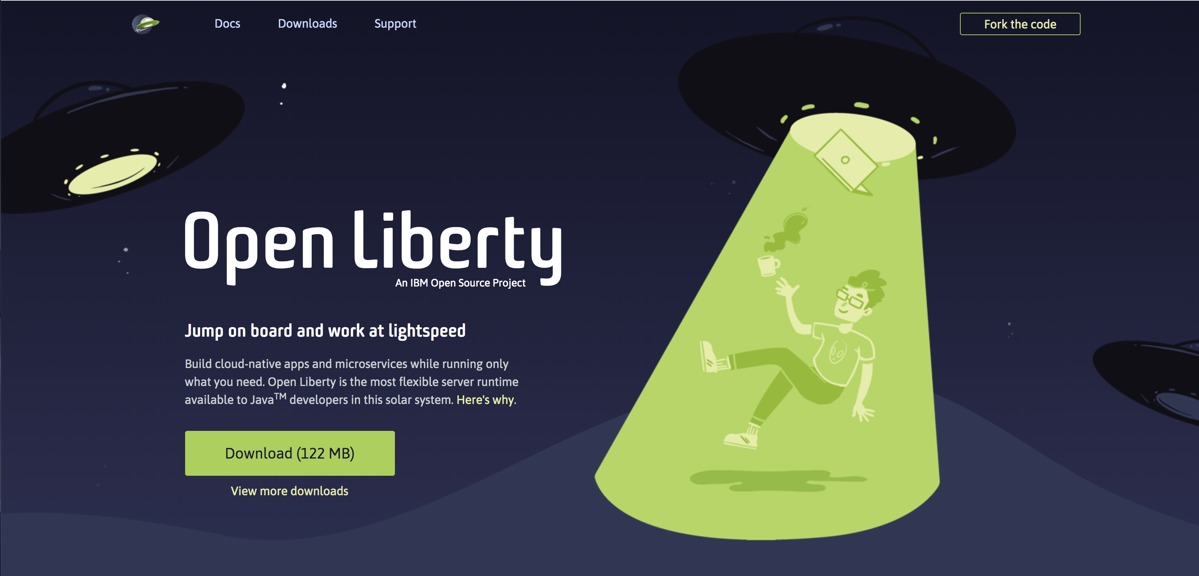
openliberty.io
Launched September 2017

Slide 8
Liberty Architecture

Slide 9


Fit for purpose
You control which features are loaded into each server instance
Java EE
<feature>jsf-2.3</feature>
<feature>servlet-4.0</feature>
jsp-2.3
jsf-2.3
servlet-4.0
http-1.1
appmgr
Kernel
Notes:
The server configuration allows you to control which features are loaded into a given server instance at a very fine-grained level, so you get exactly the function you want and no more.

Slide 10
Liberty Zero Migration
Zero config migration
Write once, run forever
Zero migration for apps
No behavior changes in existing features
New behaviors in new features
Choose your Java
Java 11, 8, 7
Adopt Open JDK
Eclipse OpenJ9
Hotspot

Slide 11
Features

Slide 12
Current Features 19.0.0.1
 | batchSMFLogging-1.0 | zosLocalAdapters-1.0 | zosTransaction-1.0
 | zosConnect-1.0 | zosRequestLogging-1.0 | zosWlm-1.0 | zosSecurity-1.0
 | collectiveController-1.0 | healthAnalyzer-1.0 | scalingController-1.0
clusterMember-1.0 | dynamicRouting-1.0 | healthManager-1.0 | scalingMember-1.0
cloudant-1.0 | Java EE 6 subset | batchManagement-1.0
couchdb-1.0 | mongodb-2.0 | mediaServerControl-1.0 |  | passwordUtilities-1.0
javaee-7.0 | rtcomm-1.0 | rtcommGateway-1.0 |  | wsSecurity-1.1
javaee-8.0 | sipServlet-1.0 | wsAtomicTransaction-1.2 |  | wsSecuritySaml-1.0
bells-1.0 | microProfile-2.1 | adminCenter-1.0 | usageMetering-1.0 | audit-1.0
concurrent-1.0 | opentracing-1.2 | apiDiscovery-1.0 | constrainedDelegation-1.0 | ldapRegistry-3.0
httpWhiteboard-1.0 | osgiAppIntegration-1.0 | bluemixUtility-1.0 | federatedRepository-1.0 | oauth-2.0
javaMail-1.6 | osgiBundle-1.0 | collectiveMember-1.0 | jwt-1.0 | openid-2.0
jaxb-2.2 | osgiConsole-1.0 | distributedMap-1.0 | jwtSso-1.0 | openidConnectClient-1.0
jdbc-4.2 | springBoot-2.0 | eventLogging-1.0 | restConnector-2.0 | openidConnectServer-1.0
jpaContainer-2.2 | wab-1.0 | logstashCollector-1.0 | serverStatus-1.0 | samlWeb-2.0
jsfContainer-2.3 | webProfile-6.0 | monitor-1.0 | sessionCache-1.0 | scim-1.0
json-1.0 | webProfile-7.0 | openapi-3.1 | sessionDatabase-1.0 | socialLogin-1.0
jsonbContainer-1.0 | webProfile-8.0 | productInsights-1.0 | timedOperations-1.0 | spnego-1.0
jsonpContainer-1.1 |  | requestTiming-1.0 | webCache-1.0 | transportSecurity-1.0
zOS
ND
Security
Base
Operations
Core
Open Liberty
New in 4Q18
New in 3Q18
New in 2Q18
New in 1Q18
APIs

Slide 13
Build
Module 1

Slide 14
Support for Maven and Gradle
Manage full server and application lifecycle through the two most popular build technologies.
Maven
liberty-maven-plugin
liberty-maven-app-parent
liberty-archtetype-*
Docs & Source: https://github.com/wasdev/ci.maven
Gradle
liberty-gradle-plugin
All the artefacts you need in Maven Central
https://search.maven.org/search?q=io.openliberty
https://search.maven.org/search?q=com.ibm.websphere

Slide 15
Feature-based Build
Module 2

Slide 16
Maven Composed Liberty
Maven Repository
commons
project xmlns="http://maven.apache.org/POM/4.0.0" xmlns:xsi="http://www.w3.org/2001/XMLSchema-instance" xsi:schemaLocation="http://maven.apache.org/POM/4.0.0 http://maven.apache.org/maven-v4_0_0.xsd">
<modelVersion>4.0.0</modelVersion>
<groupId>test</groupId>
<artifactId>serviceA</artifactId>
<packaging>war</packaging>
<version>1.0-SNAPSHOT</version>
depends on
javaee-api
wlp
Liberty Repository
serviceA.war
installs to
defaultServer
jaxrs-2.1

Slide 17
Maven Composed Liberty
Maven Repository
commons
jaxrs-2.1-api
project xmlns="http://maven.apache.org/POM/4.0.0" xmlns:xsi="http://www.w3.org/2001/XMLSchema-instance" xsi:schemaLocation="http://maven.apache.org/POM/4.0.0 http://maven.apache.org/maven-v4_0_0.xsd">
<modelVersion>4.0.0</modelVersion>
<groupId>test</groupId>
<artifactId>serviceA</artifactId>
<packaging>war</packaging>
<version>1.0-SNAPSHOT</version>
depends on
jaxrs-2.1
wlp
installs to
defaultServer
serviceA.war

Slide 18
Maven/Gradle
<dependencies> <dependency> <groupId>io.openliberty.features</groupId>
<artifactId>jaxrs-2.1</artifactId>
<type>esa</type> <scope>provided</scope> </dependency> <dependency> <groupId>io.openliberty.features</groupId> <artifactId>jsonb-1.0</artifactId> <type>esa</type> <scope>provided</scope> </dependency> </dependencies>
Maven Central

Slide 19
Application APIs
Module 3

Slide 20
Java EE 7
appClientSupport-1.0 | ejbPersistentTimer-3.2 | jaspic-1.1 | managedBeans-1.0
batch-1.0 | ejbRemote-3.2 | jaxb-2.2 | mdb-3.2
concurrent-1.0 | j2eeManagement-1.1 | jaxws-2.2 | wasJmsClient-2.0
ejb-3.2 | javaMail-1.5 | jca-1.7 | webProfile-7.0
ejbHome-3.2 | jacc-1.5 | jms-2.0 | wmqJmsClient-2.0
appSecurity-2.0 | jaxrsClient-2.0 | jsp-2.3
beanValidation-1.1 | jdbc-4.2 | managedBeans-1.0
cdi-1.2 | jndi-1.0 | servlet-3.1
ejbLite-3.2 | jpa-2.1 | ssl-1.0
el-3.0 | jsonp-1.0 | websocket-1.1
jaxrs-2.0 | jsf-2.2

Slide 21
Java EE 8
appClientSupport-1.0 | ejbHome-3.2 | jacc-1.5 | managedBeans-1.0
appSecurityClient-1.0 | ejbPersistentTimer-3.2 | jaxb-2.2 | mdb-3.2
batch-1.0 | ejbRemote-3.2 | jaxws-2.2 | wasJmsClient-2.0
concurrent-1.0 | j2eeManagement-1.1 | jca-1.7 | webProfile-8.0
ejb-3.2 | javaMail-1.6 | jms-2.0 | wmqJmsClient-2.0
appSecurity-3.0 | jaxrs-2.1 | jsonp-1.1 | websocket-1.1
beanValidation-2.0 | jaxrsClient-2.1 | jsf-2.3
cdi-2.0 | jdbc-4.2 | jsp-2.3
ejbLite-3.2 | jndi-1.0 | managedBeans-1.0
el-3.0 | jpa-2.2 | servlet-4.0
jaspic-1.1 | jsonb-1.0 | ssl-1.0

Slide 22
Eclipse MicroProfile
Open Tracing 1.1
Health Check 1.0
Metrics 1.1
Open API 1.0
Fault Tolerance 1.1
JWT 1.1
Config 1.3
CDI 2.0
JAX-RS 2.1
Rest Client 1.1
JSON-B 1.0
JSON-P 1.1

Slide 23
Eclipse MicroProfile
Builds on Java EE
By the Java EE community
Open Source at Eclipse
Multiple Implementations
@Path(“/”)
public class RestEE {
@GET @Counter @Traced
public String hello() {
return "Hello MicroProfile!!";
}
}
Notes:
@Bulkhead allows you to specify number of concurrent requests. waitingTaskQueue allows requests to be queued rather than failing. To use waitingTaskQueue, you also need to specify @Asynchronous to prevent immediate rejection.

Slide 24
Server Configuration
Module 4

Slide 25
Simple Config
<server>
<featureManager>
<feature>jsp-2.3</feature>
</featureManager>
<webApplication location=“myweb.war” contextRoot=“/” />
<applicationManager autoExpand="true"/>
</server>
server.xml
-Xmx1g
-Dsystem.prop=value
WLP_OUTPUT_DIR=/usr/wlp-out/
jvm.options
server.env

Slide 26
Composing Config
<server>
<httpEndpoint id=“defaultHttpEndpoint” host=“${host}” httpPort=“${http}” httpsPort=“${https}”/> </server>
configDropins/defaults/common-http.xml
<server>
<include location="https://myHost/ports.xml”/>
<variable name=“host” value=“${my.host}”/>
<variable name=“http” value=“${my.host.http}”/>
<variable name=“https” value=“${my.host.https}”/> </server>
configDropins/overrides/ports.xml
Notes:
Mention you can check in config.

Slide 27
Externalizing Configuration
Module 5

Slide 28
Variable Resolution
Liberty variable resolution happens top to bottom
server variables
Java system properties
bootstrap properties
env vars
Notes:
28
Describe background information that will be useful to help understand how this feature will be used or integrated into the product. Use this slide to cover existing concepts and the Key Concepts chart to cover new material that will need documentation.

Slide 29
Externalizing Config
<server>
<httpEndpoint id=“defaultHttpEndpoint” host=“*” httpPort=“${env.SERVER_HTTP_PORT}” httpsPort=“${env.SERVER_HTTPS_PORT}”/> </server>
configDropins/defaults/common-http.xml
Notes:
Mention you can check in config.

Slide 30
Eclipse MicroProfile
Inject Configuration
Sourced from
Properties file
Java system properties
Environment
@Path(“/”)
public class RestEE {
@Inject @ConfigProperty(“name”)
private String name;
@GET @Counter @Traced
public String hello() {
return "Hello " + name;
}
}
Notes:
@Bulkhead allows you to specify number of concurrent requests. waitingTaskQueue allows requests to be queued rather than failing. To use waitingTaskQueue, you also need to specify @Asynchronous to prevent immediate rejection.

Slide 31
Testing
Module 6

Slide 32
Testing
Use maven-surefire-plugin to run unit test
Use CDI dependency injection to make your code easy to mock & unit test
Use maven-failsafe-plugin to run integration test
liberty-maven-app-parent predefined executions help
Use Liberty Arquillian integration to run tests on a Liberty server

Slide 33
Docker
Module 7

Slide 34


Liberty in Docker
Third-party
PaaS
Public IaaS
IBM Softlayer
MS Azure
Amazon AWS
app and config
+
OpenShift
Cloud Foundry
liberty and java
=
+
os config
portable container
Private
+
Local Docker host
docker
FROM websphere-liberty
ADD myapp.war /config/dropins/myapp.war
Notes:
In any environment – bare metal, virtualised, cloud, containers – WAS is supported on a wide variety of operating systems and you can roll your own cloud using scripting, dev/ops tools, or a technology of your choice
* In the IBM Bluemix cloud, liberty runs on all three compute options:
in the original Bluemix environment: CloudFoundry PaaS or ‘Instant Runtimes’, liberty provides the Java runtime
* in the IBM Container Service, liberty servers can be wrapped in portable Docker containers and managed by the container service
WAS can be installed and run in VMs provided by the OpenStack VM service which is currently in Beta
Just available this month is ‘IBM Application Server on Cloud in Bluemix’ which will let users rent WAS instances in a shared environment
more info on Bluemix compute options: https://developer.ibm.com/bluemix/2015/08/05/bluemix-instant-runtimes-containers-or-virtual-machines/
* Liberty can be easily installed and configured in a private IaaS environment. Pure Application patterns for WebSphere make the deployment of servers more efficient.
* Public IaaS options are also available:
on IBM’s SoftLayer you can install and configure Liberty directly onto rented VMs, or get pre-configured instances from the ‘IBM Application Server on Cloud’ service, this time in a dedicated environment. You can also rent WAS instances on Microsoft Azure and Amazon Web Services
If you choose a non-IBM PaaS you can also run Liberty there. There is an open-source buildpack for CloudFoundry and Heroku, which forms the core of the Bluemix buildpack so is highly functional and very well tested. That buildpack is also wrapped to provide the liberty cartridge for use in the OpenShift PaaS.
So we provide a wide choice of cloud environments for running WAS, and the bottom line is that WAS Liberty is technically small and simple enough to run in any environment, and we want to support you in running Liberty in whatever environment you choose.

Slide 35

Making the most of Docker
Application
Application
App Server
JVM
JVM
O/S
O/S
thin war
fat jar
Notes:
Alasdair
Talk about exploiting docker and docker layers.
FAT jars are not your friend.
Docker, and kube are your friend and really the future for deployment

Slide 36
Support Licensing
Module 8

Slide 37


Buy WebSphere Liberty
Monthly VPC (List Price)
WebSphere ND
US$331
WebSphere
US$88.50
Liberty Core
US$43.70

Slide 38

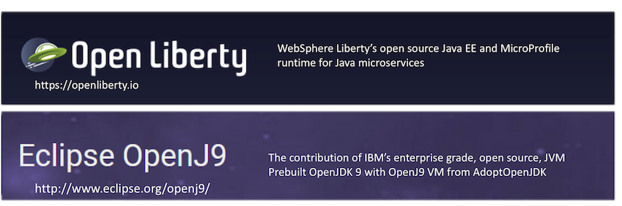
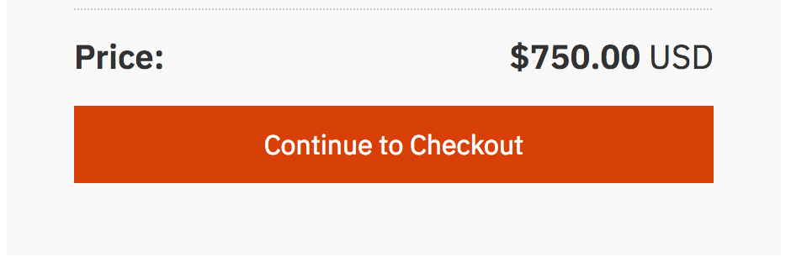

Support
Support for Open Liberty and OpenJDK on Eclipse OpenJ9 JVM
Buy support online on a per virtual-processor-core basis as your need arises.
Support for Open Liberty includes:
Unlimited number of support tickets
Standard support hours are 8am – 5pm Mon – Fri, or 24 x 7 x 364 for Severity level 1 (everyday except Dec 25th )
Immediate security fixes (PSIRT)
Ticket prioritization with a 2-hour response time
Once you buy support there is no update or change required to your app already running in production

Slide 39
Wrap-up

Slide 40
Mastersclass hands-on content
Open Liberty Masterclass
Table of Contents
Before you begin
Install Pre-requisites
Prime Maven and Docker Caches
The Application
Module 1: Build
Module 2: Feature-based Build
Module 3: Application APIs
Module 4: Server Configuration
Module 5: Externalizing Configuration
Module 6: Integration Testing
Module 7: Docker
Overriding Dev Server Configuration
Module 8: Support Licensing
Conclusion

Slide 41
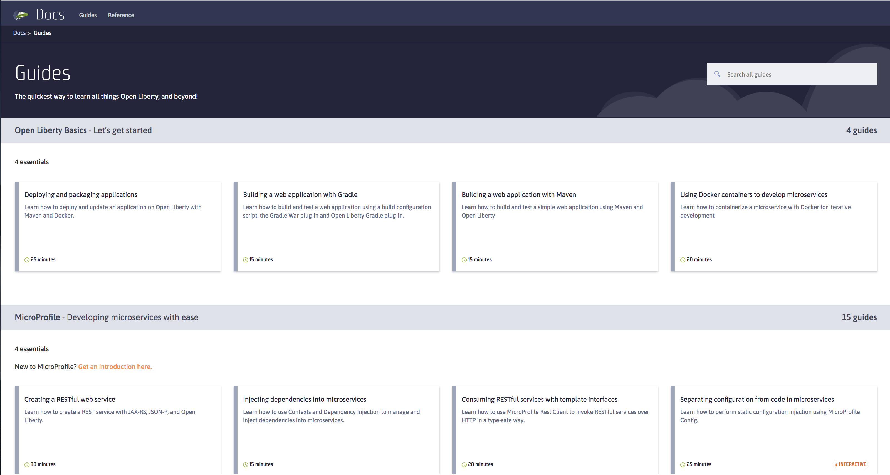

Slide 42


https://cloud.ibm.com/docs/java
http://ibm.biz/javanewsletter

Slide 43

WebSphere Customer Advisory Board – open invitation email: claudiab@us.ibm.com
Sign up now at Think
Influence deliverables
Choose your engagement level:
Stay ahead of the curve: more time commitment
Close the gap: quarterly involvement
At your own pace: impact longer term goals
Get involved.
Be successful.
IBM Cloud / © 2018 IBM Corporation
43
Notes:
No table, compelling reason to go.

Slide 44
WebSphere Customer Advisory Board - Engagement levels
Engagement level | Comm frequency | User group studies and testing | Contribute Code | Design discussions | Prototype feedback, pre-release code | Create joint assets (webcasts, quotes), roadmaps | Meetings, conferences, Think 2020
Stay ahead of the curve | Monthly
Close the gap | Quarterly
At your own pace | 2 times a year or more as requested
* subject to change based on input

Slide 45
WebSphere Customer Advisory Board – Open invitation
Do you get timely and relevant information from WebSphere?
What do you find most important? (Webcasts, Proof of Technology, Newsletters, conferences)
Join our WebSphere Customer Advisory Board – New for 2019
Share your modernization and Cloud Journey
Share experience at private and public forums
Join us for Webcast, meet ups
Joint articles, blogs
Become our trusted advisors – help us prioritize on next-gen features
Design Thinking - help improve user experience before we write the first line of code
Get involved and be successful
email: claudiab@us.ibm.com
IBM Confidential
45

