Slide 1
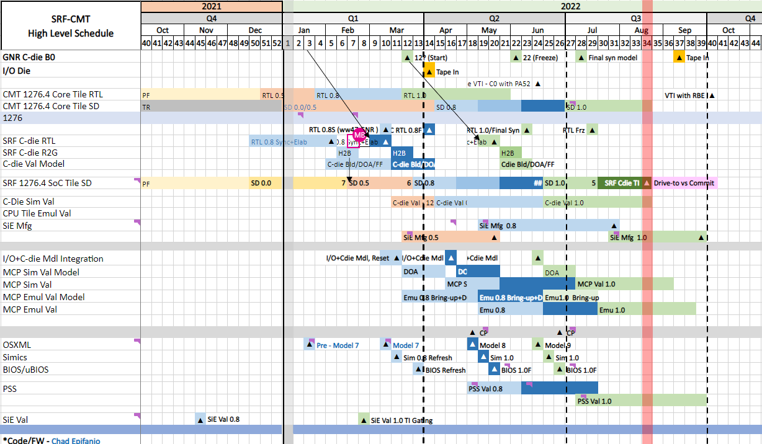
Pre-Si schedule
Notes:
GNR-B0 dates will have some impact on SRF timeline as it moves, required to have 4wk difference between TI

Slide 2
MFG MPE High Level Tasks
SIE 0p5
50% HVM UM Validation completed.
TVPV and TP Infrastructure ready to start 0p8.
50% HVM usage model validation completed.
Full HVM reset passing with injections
TVPV infrastructure ready to support HVM content conversion
Emulation capability enabled/bring up
Strategies defined for Die Recovery, UPS, Qual
Audit SRF pin map for TIU reuse
MTL/GRR/GNR Learnings incorporated
PPV content 100k/10k reviewed.
TP development infra ready
Notes:
PPV Test Program development for HST/STHI = 100% python, arquitecture,

Slide 3
MFG MPE High Level Tasks
SIE 0p5
SIE 0p8
50% HVM UM Validation completed.
TVPV and TP Infrastructure ready to start 0p8.
90% HVM UM Validation completed. TVPV infrastructure exercised, and content integrated with Test Program.
50% HVM usage model validation completed.
Full HVM reset passing with injections
TVPV infrastructure ready to support HVM content conversion
90% HVM usage model validation completed
Full HVM reset passing (injection less)
All reset flavors passing in Sim/Emu
Emulation capability enabled/bring up
Strategies defined for Die Recovery, UPS, Qual
Audit SRF pin map for TIU reuse
Run emulation on targeted breadth content
Mock1 & Mock2 Executed
VTPSim capability enabled
MTL/GRR/GNR Learnings incorporated
PPV content 100k/10k reviewed.
TP development infra ready
SIU Tspec submitted for SRF CDIE
PPV/CMV Python migration/scripting completed
PPV Test Program development for HST/STHI
Notes:
PPV Test Program development for HST/STHI = 100% python, arquitecture,

Slide 4
MFG MPE High Level Tasks
SIE 1p0
TI
C-Die w16
IO-Die w19
Power On
Wafer: Cdie w30, IO die w34
MCP: X1-AP w37, X3-AP w41, X2-SP w45
Full feature A0 Silicon, Content and Test Program (PRQ worthy)
Be ready for PO (Final audits, offline Val learnings, Test Cell Validation)
HVM DFT and content fully validated.
Clean Content Gen Infra for Sort/Class
(VTPSIM/Emu)
Prime Coding completed for all templates
SIU/TIU/BIB Validation
100% Ready Sort/Class/HBI/PPV TP including content
Automation for PO data analysis
PO/VIS Sku Stack closure.
Debug content validated (babysteps)
MTL/7nm or SPR Learnings incorporated
PPV N-1 Pre PO
PPV/CMV Python migration/Aguila/Test Cards POC 100% completed
Debug Tools/Flows Up and running.
(Redline, Blueline, MV, etc)
Plan B development and validation
What IF... (STF 400/200, SSN 200/100, Tap)
Online (SPR/ICX)+ Offline TP-Prime Code validation
Corner cases (HFM-LFM, PO Fuse String, BI cases)
Test Cell Validation
Mechanical units
Audit
Handshake with databases (Midas, Brita, Aqua). HRY collateral and baseline stablish.

Slide 6
HARDWARE COMPONENTS – Milestone Criteria Intel Unified Quality Release Criteria (QRC)
Vector | ES1 | ES2 | QS | PRQ
REQUIREMENTS: Requirements & Change Control (POR and Landing Zone add, drop, & KPI targets) | All platform visible changes approved by platform CCB PRT and PSIRT feedback formally dispositioned and requirements updated¹ |  |  | No requirement changes from QS PRT/PSIRT feedback dispositioned
DEVELOPMENT COMPLETION: Design, Feature, Configuration Completion, SKU readiness (Silicon, package, programmable logic & reference code) | Design complete: No deferred IP/features, Final HW interfaces, features, and all power management flows enabled and verified per POPL3/EC | Silicon & FW/MCU Feature complete: Final package/module, All TTM Si/HW features enabled, Full speed IO, All TTM SKU’s defined and fusing tested | PRQ Candidate: Silicon, Package, Module, MCU, MRC, & other reference code. Final configurations: All production fusing & SKU’s verified | Final programmable logic, FW and MCU/binaries. No customer visible HW change from same SKU at QS. LTR checklist complete²
COLLATERAL: Design, Tool & Optimization Guides (Include EDS, PDG, Errata, Operating range limits) | Design guides updated with post-silicon data and operating limits documented | Tool and optimization guidelines ready for release (EV, thermal, power, turbo) | Final design, tool, & optimization guides incorporate customer feedback | No design collateral changes from QS, Errata finalized
DEFECTS/BUGS: Customer Impact assessment of ingredient defects; Intel & Customer Sighting Trends | Do not prevent customer use of Alpha features, including all power mgmt. states. Record # by priority and total % open³ | Do not prevent use of all PRQ/PV features, or need customer HW change. Record # by priority and total % open³ | All sightings evaluated, PRQ gates have root cause & proven mitigation. Record # by priority and total % open³ | All critical exposure & must-fix/P1 sightings resolved/verified. Record # by priority & % open³
STABILITY: Fail Rate: Cycling & Duration (Relevant states/flows/usages, breadth/depth) | DPMO < 2K (recommend < 1K, w/ > Alpha cycles/system), HW limiters root-caused⁴ | DPMO < 500 (recommend <250, w/ > Beta cycles/system), HW limiters root-caused⁴ | DPMO < 300 (recommend < 150, with > QS cycles/system)⁴ | DPMO < 200 (recommend < 100, with > PV cycles/system)⁴
KPI: All component KPI’s within X% of target (Power, Performance, Responsiveness) at POR freq, voltage, temp conditions | Targets ratified. All KPIs functional. Platform-related KPI’s <50% deviation from PRQ target | TDP < 5%, All other < 35% deviation from PRQ target. Do not block any Platform KPI’s | < 5% deviation from PRQ target. Do not block any Platform KPI’s | < 5% deviation & No customer visible KPI change from QS
COMPLIANCE: Standards & Cert (IEEE/industry) and Regulatory/Ecology Compliance | Cert plan ratified, test infra. & SW Ready | Pre-Cert 100% attempted | Pass all internal Pre-Cert tests | All interface cert requirements met
 | Reg. plan in CMAP, Initial labels/docs done | Eco. BOM assessed, Reg. prelim test done | Eco. MRA & PRLC done, Reg. test pass | MDDS, DOC, and Certs completed
VALIDATION: Minimum FW/SW quality level, % Content Attempted⁵ and % Tests Pass vs. PRQ | BKC with code complete FW/MCU/MRC, ≥70% PRQ Plan Attempted⁵, ≥ 50% Pass | All BKC FW/SW ≥ Alpha, 100% PRQ Plan Attempted⁵, ≥ 80% Pass | All BKC FW/SW ≥ Beta, 99% Pass, Regression complete on release SKU | All BKC FW/SW ≥ Prod Candidate⁵ 100% Passed or dispositioned
ELECTRICAL: Spec, Margin, UPM, BER, Settings | Acceptable margins at nominal, Spot check done on all interfaces | Acceptable margin & spec compliance across PVT | Projections ≤ target (UPM/FIT/BER), Final recipe/settings | No marginality changes from QS
LEGAL: Global Tax & Trade Requirements | Speed updated, Import/Export approved | Speed updated, Import/Export approved | Finalize classification | Country-specific approval noted
SECURITY: SDL Lifecycle, Scan & Settings Verification | S3 done and updated in SDL tool. All IPAS & patch space reqs met⁶ | Prod fuse/settings defined and tested. All IPAS & patch space reqs met⁶ | S4 done and updated in SDL tool. All IPAS & patch space reqs met⁶ | S5 done & updated in SDL tool. All IPAS & patch space reqs met⁶
MANUFACTURING QUALITY: PHI (Tester Coverage and Assembly quality), Process Health (RISO), DPM, TDP & Operating Conditions (Volt/Temp/Freq.) | PRQ PHI & RISO goals ratified, Test/screen in place with 100% breadth @ kill, < 50K Outgoing DPM, Any POR freq & TDP combo, Nominal V/T | PHI & RISO on track, Test/screen with 100% depth @ kill, < 10K Outgoing DPM, Non-Turbo frequency in POR range & available across all TTM TDPs | Meet QS PHI goals & RISO target, < 2K Outgoing DPM & Identify PRQ gaps Max Frequency per TDP, V/T meets spec PRQ screen capacity analysis completed | Meet PRQ PHI Goals & RISO target, < 500 Outgoing DPM⁷ No V/T/F change from QS, ATM approves screening capacity
RELIABILITY: Early Life & End of Life Failure Rate⁸ | < 50K DPM 30-day failure rate⁸ | < 10K DPM 30-day failure rate⁸ | < 2K DPM 30-day & Meet QS EOL⁸ | < 800 DPM 30-day & Meet EOL⁸
CUSTOMER READINESS: Package/Module & SMT Line Cert | Package MAS Rev 1.0 published, SMT line piloted Internally | Customer SMT and design feedback incorporated | Package MAS Rev 2.0 published Overall SMT yield target met | Package/Module Cert Complete
INTEGRATED PLATFORM: | Review and disposition component-related defects from latest platform BKC validation using milestone FW/MCU/MRC. Platform milestone-gating issues resolved⁹
References are in the Notes section of this slide Intel Confidential
Notes:
Guidelines and requirements that appear within parenthesis do not require a formal exception.
1. PRT: Problem Response Team, PSIRT: Product Security Incident Response Team, IPU: Intel Platform Updates
Roles & Responsibilities:
It is expected that notification of PRT/PSIRT’s comes from the PRT Chair/Technical Team Lead or IPU BU Rep.
MC is accountable for BU-approved plan, including product risk assessment, implementation plan, and timeline to ensure customers are protected from repeat PRT/PSIRT-related issues.
Additional information on the PRT and IPU processes can be found here:
https://sharepoint.amr.ith.intel.com/sites/PRTHome/SitePages/PRT%20Teams%20Home.aspx
http://goto.intel.com/prtspec
2. LTR = “Long Term Retention” enables Intel to support and maintain our products post-launch. Unless otherwise documented for a specific BU or product, the default retention period assumption is 10 years post-PRQ. Hardware at PRQ and Integrated Platforms at PV should complete the respective LTR checklists located here: http://goto/ltrchecklists.
LTR checklist for HW Includes Class Test, Manufacturing, and System Validation checklists.
3. Defects/Bugs: Record the TOTAL # of open defects in post-silicon phase, by priority or exposure (i.e. critical, high, medium and low) and TOTAL open. Total % open = (total # of open defects/total # of submitted defects) x 100
Exposure assessment should be relative to PRQ/PV (not the same as priority which is milestone specific). Include defects of all types (E.G. stability, functional, non-functional) and escalated from any internal or external source (telemetry, customer).
Must Fix (P1): A must fix defect is a business impactful issue that can be escalated from any internal or external source (E.G. platform, ingredient, telemetry or customer). Determination of must fix needs to comprehend both engineering and customer impact at that phase of development. E.G. Impact at Alpha will be different than impact at Beta. Engineering impact should be assessed by relevant sysdebug or equivalent forum and customer impact should be assessed by relevant customer facing rep. For a defect, if customer impact is judged to be acceptable but engineering impact is assessed as must fix, the defect should still be counted as a must fix.
Critical count threshold must include functional defects but does not need to include telemetry or non-functional defects evaluated in stability, KPI and compliance vectors.
Priority definitions are in the “Defect Tracking Standard (https://soco.intel.com/docs/DOC-2505271)”.
4. Teams should set their number of systems, cycles, durations, and content per a statistically valid and Business Unit (BU) approved test plan that will yield accurate DPMO results (Ex. CCG NIC, goto/NIC). If stability testing cannot be completed on the recommended number of systems (e.g. 10), the total number of opportunities must still be met. For example, if plan was 1000 cycles x 10 systems, with 8 systems, new minimum must be 1250 per system or equivalent. Five systems is generally considered the absolute minimum number of systems. The number of unique BKCs and HW/SW config variations that require stability testing should be reviewed and approved by the BU. The HW component DPMO is set intentionally lower (i.e. higher quality bar) than the platform level at certain milestones, which is possible because component teams may remove other known unstable HW or SW ingredients to focus on the specific HW being assessed. Ex. at ES2, the stability testing may have been completed with the Alpha SW stack which has a platform DPMO expectation of 2000, but he ES2 HW must also support a later release of Beta SW which will require <= 500 DPMO.
DPMO and cycles/system recommendation aligns to Nickel Conformance 2.0 targets. Exceptions are not required for recommended criteria which appear in parenthesis.
5. Attempt rate = Pass rate + Fail rate. Blocked test cases are not part of ‘Attempted’ (e.g. Total no of test cases = 1000, No of blocked test cases = 100, no of failed test cases = 50, no of passed test cases = 850, then attempt rate = 90%, pass rate = 85%.)
Some portion of the PRQ testing must be done with the BKC full software stack at production candidate (PC) level or better. What is PC? Because some programs may release PRQ and PV at nearly the same time, the QRC avoids saying PV software must be previously “released”, else we have a chicken/egg problem. Not all teams have a formal “PC” milestone for SW and UQRC does not require it. The term is used in this context to highlight that the SW stack has no KNOWN issues that would block customer use of the SW for launching their product. Ex. A set of drivers that pass internal ingredient PV criteria may come together and be a “production candidate (aka PV candidate). That SW stack will not become PV quality level until internal integration/validation testing has been completed and critical customer feedback/issues have been addressed.
6. Follow SDL requirement “Scan binaries for known vulnerabilities” in SDL classic (https://sp2010.amr.ith.intel.com/sites/sdl/Pages/Lists/Activities.aspx#ActivityID=106). See full IPAS security requirements in the UQRC Reference Material slides in this assessment package.
SOC microcode patch space requirements can be found here: https://wiki.ith.intel.com/pages/viewpage.action?pageId=1418965740. Note: Security level (S3, S4, S5) are not completed unless updated in SDL tool.
7. Outgoing DPM targets may vary dependent on measurement socket. Ex: < 500 DPM @ PPV, < 200 DPM @ EQA at PRQ. See iQual for product specific details.
8. Must meet product-specific Reliability goals defined in iQual. Early Life fail rate based on 30-day failures. For QS, expect 50% extended life test done and trending to meet end of life goal for all targeted market segments. For PRQ, meet failure rate goal at end of life for all targeted market segments.
9. Similar to older HW QRC versions that required “Platform Interoperability”. Before ship release and quality declaration, Integrated platform regression testing should be completed and results collected in support of Integrated Platform requirements, sufficient to enable initial grading, but does not require closure of all issues or closure of platform-related exceptions. Can leverage N-1 BKC testing if no changes expected to HW dependent FW/MCU/MRC/Pcode/Ucode/etc.
Platform milestone-gating issues should be resolved such that HW defects do not block Platform milestones. For example, ES1 should not block Platform Alpha, ES2 should not block Platform Beta, etc. If Platform milestone-gating HW defects are not resolved by HW milestone declaration, then an Exception should be filed.

Slide 7
