Slide 1
SBFT Introduction
Instructor: Julio Gutierrez

Slide 2
Agenda:
Topic: | Duration:
Functional Test Introduction | 5 min
SBFT introduction | 5 min
Types of SBFT | 15 min
Readout Results | 15 min
High Level SBFT Test Flow | 15 min
Q & A | 5

Slide 3

Functional Test Introduction
What is a functional test?
“Functional testing verifies device architecture; its coverage occurs when signal paths are exercised and correct functional behavior occurs”
Test writing flow
Some DFTs used for test writing:
ATM, TAM, MailBox, WDAR, DDR Read/Return, etc.
Machine Readable
Deploy format:
ASM
OBJ
LDAT
Libraries
Built Test
Assembly test
VAULT + TVPV
TESTER
MAX FILE
Human Readable

Slide 4
SBFT Introduction
What is SBFT?
The acronym stands for Structural Base Functional Test, it refers to a test method that enables application of at-speed functional test on low-pin-count structural tester.

Slide 5
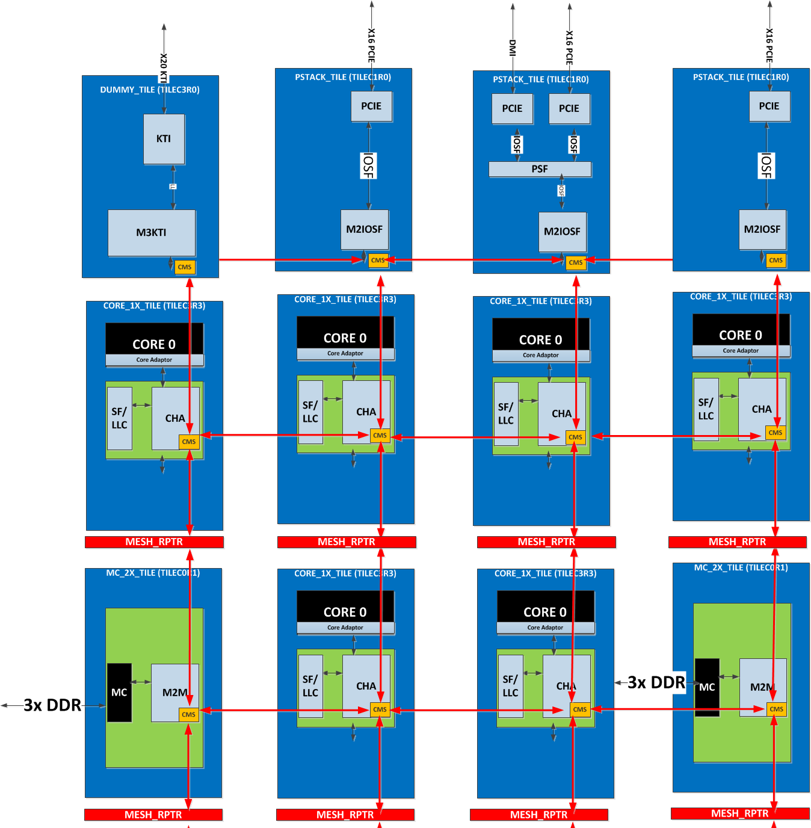
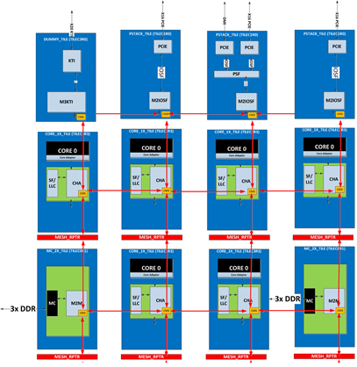
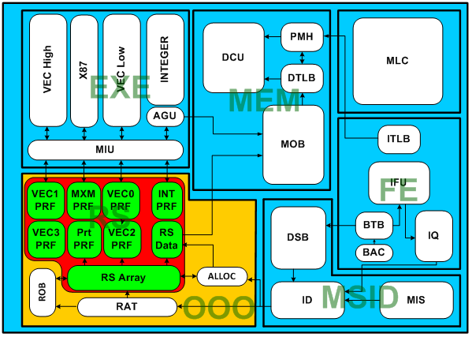
SBFT content types
Core Coverage:
SBFT MLC
Functional test is loaded into MLC memory
Cores are isolated to prevent a failing core from interfering with the other cores
Capability for parallel testing
High reusability across products.
MLC Test
Functional Test
MLC Test

Slide 6

SBFT content types
Core Coverage:
SBFT LLC
Functional test is loaded into LLC memory
Tile/Slice are isolated to prevent a failing Tile/Slice from interfering with the other cores
Capability for parallel testing
High reusability across products.
Functional Test
LLC Test

Slide 7
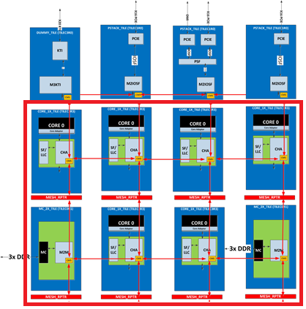
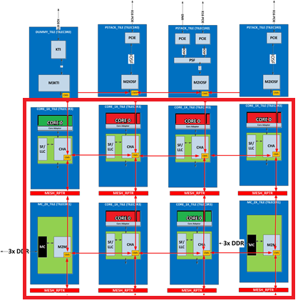
SBFT content types
Uncore Coverage:
SBFT FCX (Full Chip) (CLR/IIO/QPIs/MCs)
Portions of the Functional test is loaded into all the LLCs
DUT is configured to enable specific sections .
Single Test execution.
Only two cores enable to execute the test.
Content is Product/Chop specific content.
Functional Test
FCX Test 1/6
FCX Test 2/6
FCX Test 3/6
FCX Test 4/6
FCX Test 5/6
FCX Test 6/6

Slide 8
SBFT content types
Uncore Coverage:
SBFT MOFC (Mesh Only Full Chip):
Same test is loaded across all LLCs.
Communication across all the tiles is enable
Test is self adaptive to core count changes since all the information leaves on all tiles.
Content is Product specific content.
Functional Test
MOFC Test

Slide 9
SBFT Results
Architectural Results.
Thread Status Check.
Check is the core completed the test successfully and reach the HALT instruction.
Performance Monitor Counters.
Core registers which can be configured to count certain events; e.g.
# micro-ops retired
# macro-ops
# cache misses
Hard to predict the results without simulation
Explicit Register Results.
Counters and registers can be combined to have a more robust result.
Expected result is provided by the test writer and typically is ACED.

Slide 10
SBFT Results
Signature Results
Signature
Based on Scan cells inserted across the device.
There are many scanout chains throughout the CPU that are collected in scubs (scanout FUB = Functional Unit Block )
Linear Feedback shift register (LFSR): is a shift register whose input bit is a linear function of its previous state.
Adds visibility to the internal status of the device.
Requires very stable initial state (no X’s)
Masking can be executed by scan cell, scan chain or SCUB depending on the product.

Slide 11
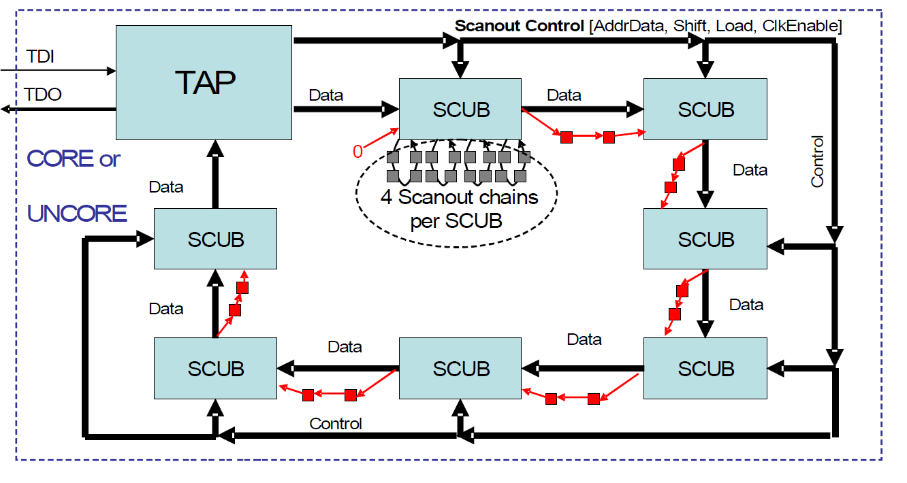
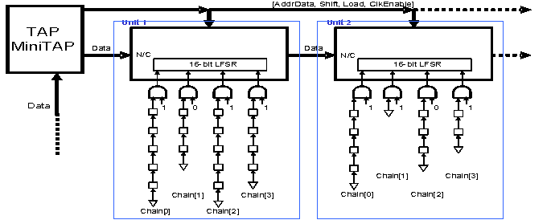
Scanout Scub loop Block Diagram

Slide 12
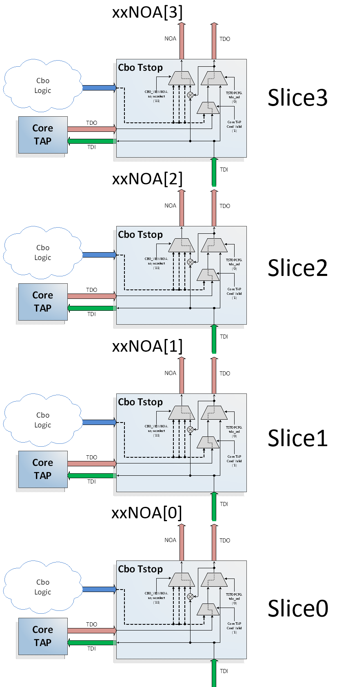
SBFT Results
Signature Results:
Self_Signature:
This is a DFT where we use a core to determine if other cores have passed or failed the test.
It requires a set-up of a reference core
Expected result are logical lows since it is based on XORs.

Slide 13
High Level SBFT Test Flow
Reset
Generic CPU bring-up
Fuse config:
Core enabling
Cache repair
Ratios
PLL trim/lock
Core reset
PCU stall
Set I/O’s to known state
MCI/NTI/STF configuration
FIVR settings

Slide 14
High Level SBFT Test Flow
Setup Segment 130/Precat
Isolation of the sub_section of the device
Mapping of the caches (Saving a section for the CleanX)
Loading of the cleanX
Core reset

Slide 15
High Level SBFT Test Flow
Load
CleanX execution starts through MBP Read CleanX results
Mapping of the caches (avoiding section where CleanX is loaded)
Core reset
Load the test into caches (CPL)

Slide 16
High Level SBFT Test Flow
Execute
Execution flag through MBP
Wait for test to finish execution:
Wait time cycles are idle state
Divided in the Main Memory and Subroutine Memory to be “ratio agnostic”
Some product include an end of test pulse trigger by the Halt instruction in the core to ensure test completed and speed up the wait time fine tuning.

Slide 17
High Level SBFT Test Flow
Unload
Thread Status check
Read out self check results
Read out performance monitor results
Read out Signature

Slide 18
Expected Bins
Bin 44
General SBFT Bin for FG content
Bin 45
Searches

Slide 19
Reference information
ITMH

