Slide 1
IDSK
Intra Die Statistical Kill
SBFT - MPE

Slide 2
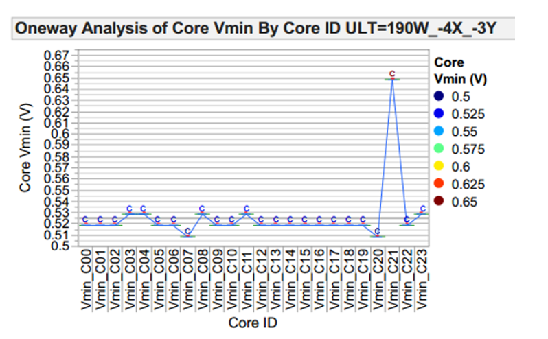
Intra Die Statistical Kill (IDSK)
This infrastructure measures Intra die core performance and performs defeature once an outlier core has been identified.
It is a statistical method used to analyze the performance between cores based on the Vmin behavior per core, to establish a core disablement.

Slide 3
Once Vmin distribution per core is acquired, IDSK test computes the mean value, the covariance, the standard deviation and the Z-score for each core.
Tagging the ones with a given delta from mean and updating valid core tracking structure and disabling possible bad cores

Slide 4

Z-score and Vmin Delta
Equation 1. Z-score Calculation
Equation 2. Vmin Delta Calculation

Slide 5
Structural defects can be pointed using this software solution since it detects the cores that may not necessarily fail in the tests (patterns) but are outliers of the Vmin distribution.

Slide 6
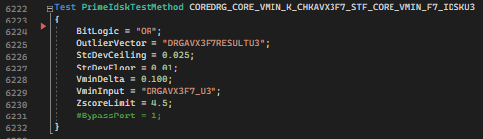
IDSK instance parameters
Parameter Name | Required? | Type | Comments
VminInput | Yes | String | Incoming VMIN string
OutlierVector | Yes | String | Outgoing tracking structure GSDS
BitLogic | Yes | Choice | Kill for zscore AND/OR vmin_delta. Values are AND(Default) or OR
StdDevFloor | Yes | Double | Minimum standard deviation allowed
StdDevCeiling | Yes | Double | Maximum standard deviation allowed
ZscoreLimit | Yes | Double | Sigma kill limit
VminDelta | Yes | Double | Maximum vmin difference allowed

Slide 7
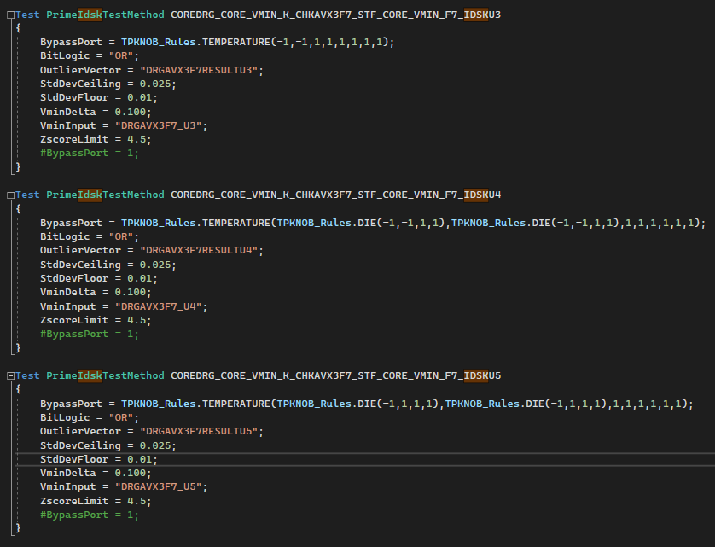
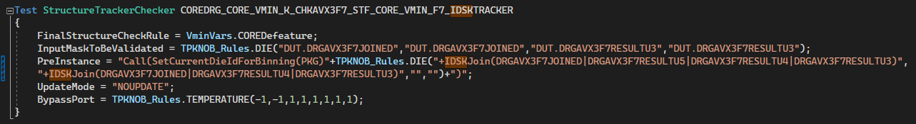

Slide 8
Data log output
Data | Description
Mean | Mean of all valid Vmin values provided
Standard Deviation | Std deviation parameter calculated in idsk test
Standard Deviation Fixed | Std deviation after user provided Ceiling and Floor are applied
IDSK Cores to Kill | IDSK cores identified to be defeatured in the tracking structure (different from the XOR between the incoming core configuration and the outlier cores identified)
InputVminValues | All vmin values provided (not just valid ones)
Median | Median value for all the enabled cores
Max | Highest Vmin core value from all the enabled cores
Min | Lowest Vmin core value from all the enabled cores
FlagForOutliers | 1 if outlier was detected 0 if no outliers were detected

Slide 9
Data log output
Mean | standardDeviation | standardDeviationFixed |
IDSK Cores to Kill | InputVminValues | Median | Max | Min | FlagForOutliers
Example:
0.8605|0.0109|0.0109|
00000000000000000000001000000000000000000000|
0.855,0.863,0.873,0.868,0.86,0.865,0.85,0.863,0.863,0.853,0.86,0.86,0.875,0.85,0.865,0.843,0.863,0.858,0.855,0.843,0.858,0.86,0.912,0.855,0.853,0.855,0.868,0.863,0.855,0.858,0.855,0.853,0.873,0.853,0.85,0.863,0.873,0.87,0.86,0.863,0.868,0.853,0.858,0.85|
0.86|0.912|0.843|1
TestResult:b00000000000000000000001000000000000000000000|Incoming:b00000000000000000000000000000000000000000000|Outgoing:b00000000000000000000000000000000000000000000

Slide 10
Exit Ports
Exit Port | Condition | Description
-2 | Alarm | Any alarm condition
-1 | Error | Any software condition error
0 | Fail | Failing condition
1 | Pass | Passing condition

Slide 11
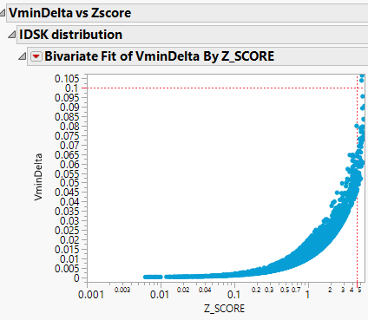

Script analysis

Slide 12
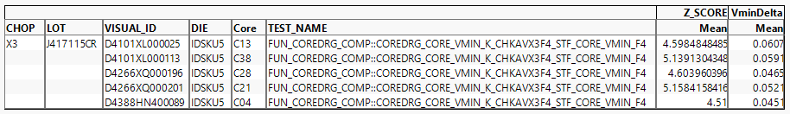
Script analysis

Slide 13
QA failure example
QA failure:
74YU559700150 | U5 | FUN_COREDRG_COMP::COREDRG_CORE_VMIN_K_SRHAVX2F7_STF_CORE_VMIN_F7_DRAGONMLCMTT_7912::CORETracking | TestResult:b00000000000000000000001000000000000000000000| Incoming:b00000000001000000000000000000000000000000000| Outgoing:b00000000001000000000001000000000000000000000
IDSK results:
74YU559700150 | FUN_COREDRG_COMP::COREDRG_CORE_VMIN_K_CHKAVX3F7_STF_CORE_VMIN_F7_IDSKU5 | 0.8605|0.0109|0.0109|00000000000000000000001000000000000000000000|0.855,0.863,0.873,0.868,0.86,0.865,0.85,0.863,0.863,0.853,0.86,0.86,0.875,0.85,0.865,0.843,0.863,0.858,0.855,0.843,0.858,0.86,0.912,0.855,0.853,0.855,0.868,0.863,0.855,0.858,0.855,0.853,0.873,0.853,0.85,0.863,0.873,0.87,0.86,0.863,0.868,0.853,0.858,0.85|0.86|0.912|0.843|1

Slide 14
Useful links: https://dev.azure.com/mit-us/PrimeWiki/_wiki/wikis/PrimeWiki.wiki/99519/Idsk

