Slide 1


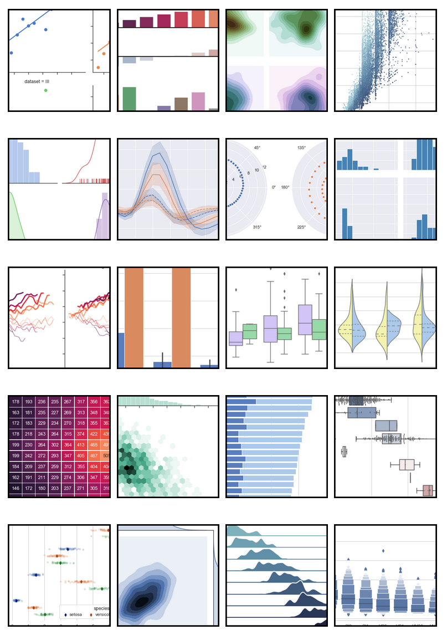
PyGFETdb & PANDAS
https://github.com/aguimera/PyGFETdb/tree/DbV15
PyGFETdb branch DbV15
Quantities for units management
Return NaN in case of errors for better pandas integration
1/f noise fitting improved to ovoid pick up noise.
Easy to use graphical library for basic statistics
Mix qualitative and numerical fields in same data-frame
A lot of built-in functions to manage data (sort, select, filter .…)
Natural bridge to statistical programs such as R.

Slide 2
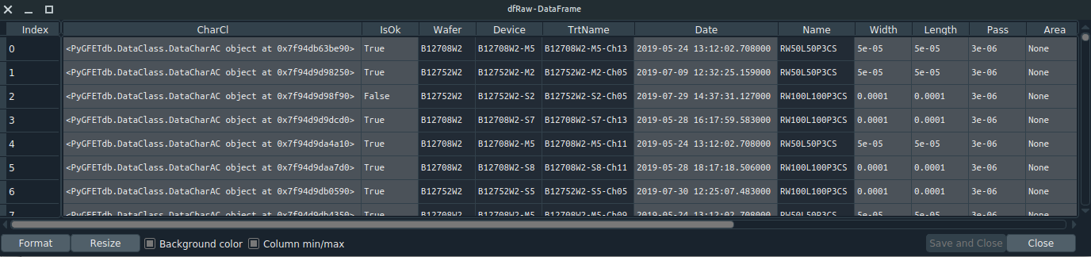
Example: DataBase_2_pandas.py
Generate a pandas data-frame with the Database information.
‘CharCl’ column contains the custom DataClass which is used for calculating any new value related with the characterization.

Slide 3
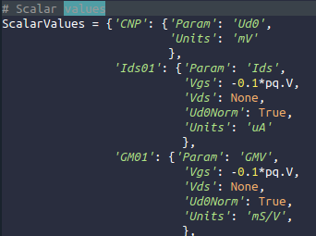
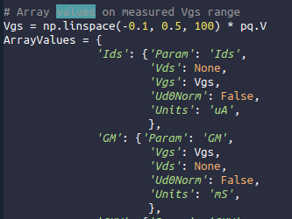
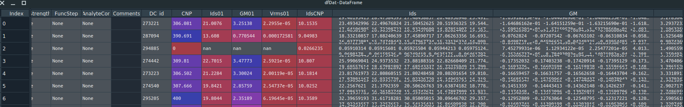
Example: PandasBasedAnalysis_1.py
Calculates values from ‘CharCl’ and generates new columns for each one.
Only tested for characterizations with 1 Vds point. Some rework have to be done for more Vds points, but it should work.
Scalar Values
Array Values
Array values should be computed over the same Vgs range for a dataset homogenisation.
NaN is placed at invalid Vgs points.
NaN values can be easily managed by statistical functions

Slide 4
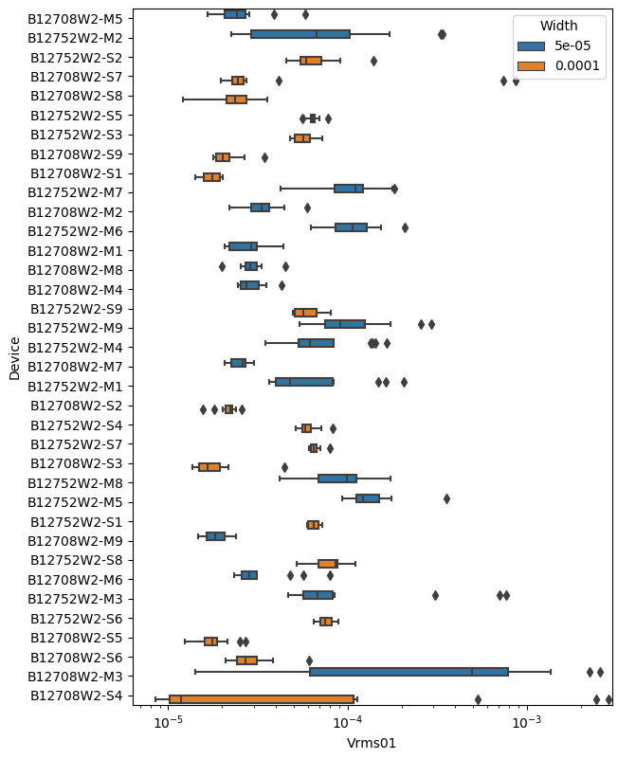
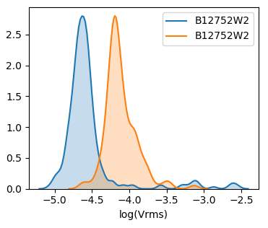
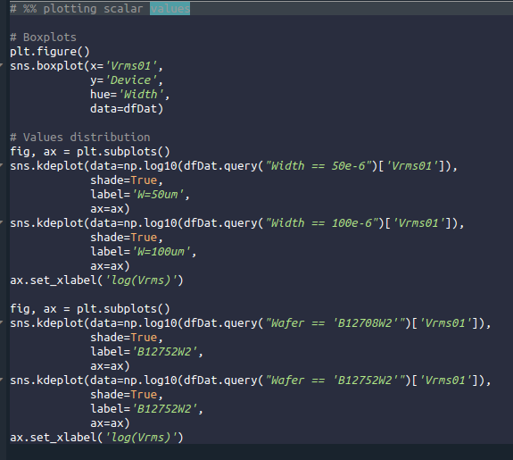
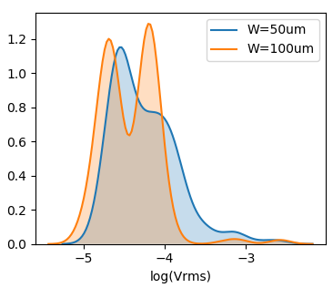
Example: PandasBasedAnalysis_seaborn.py
Scalar values can be easily managed and plotted with seaborn library
More analysis examples in:
https://seaborn.pydata.org/examples/index.html

Slide 5
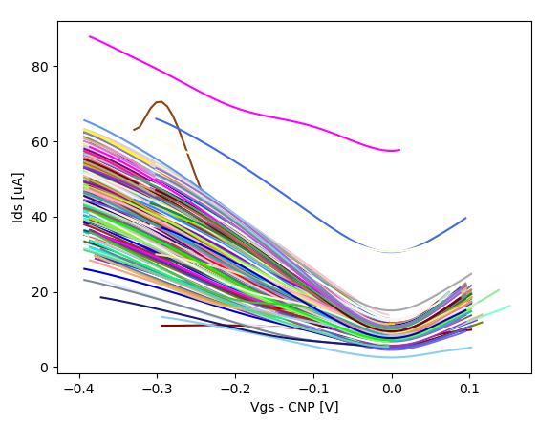
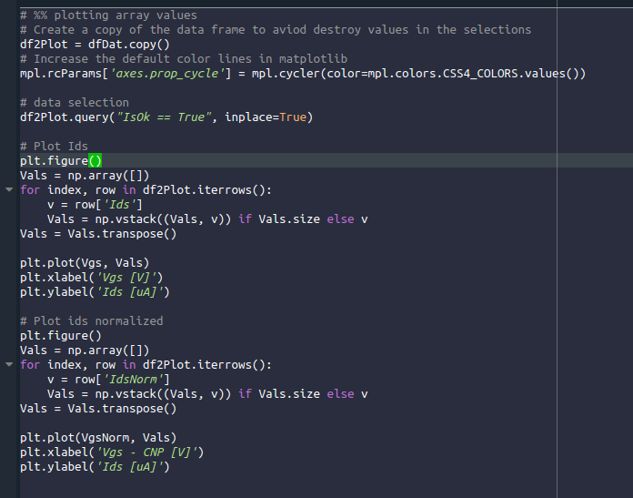
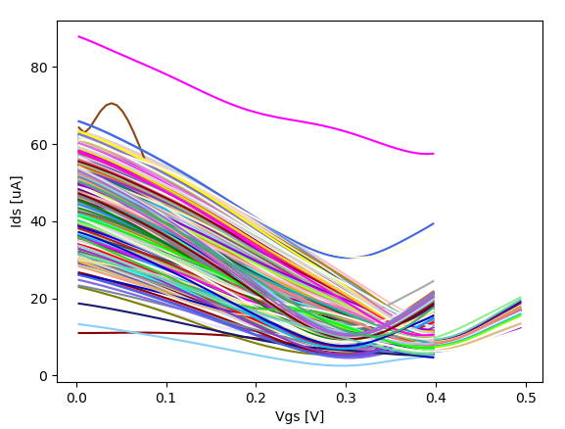
Example: PandasBasedAnalysis_2.py
Array values can be plotted after stacking it.
NaN values are automatically avoided by plotting function.

Slide 6
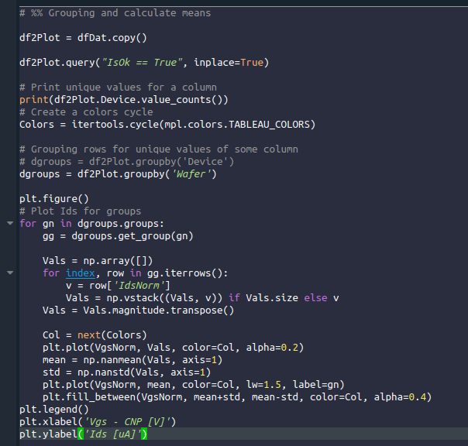
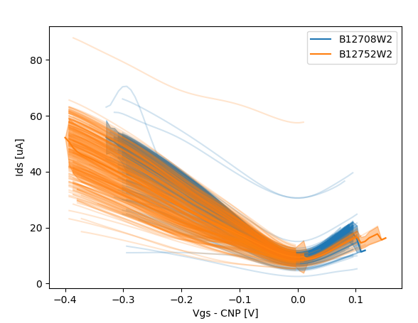
Example: PandasBasedAnalysis_2.py
Values can be grouped by columns unique values
np.nanmean calcualte the mean value excluding NaN values

Slide 7
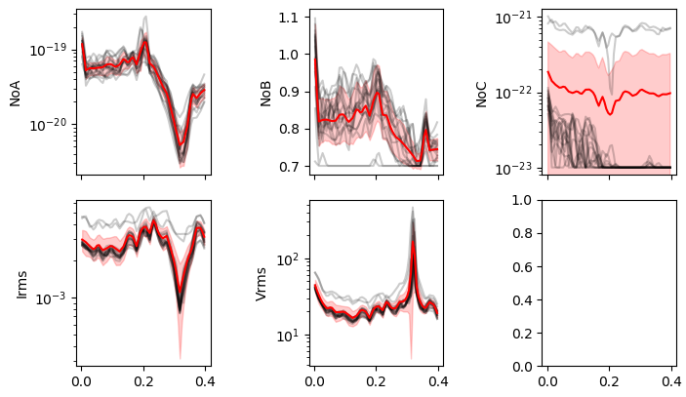
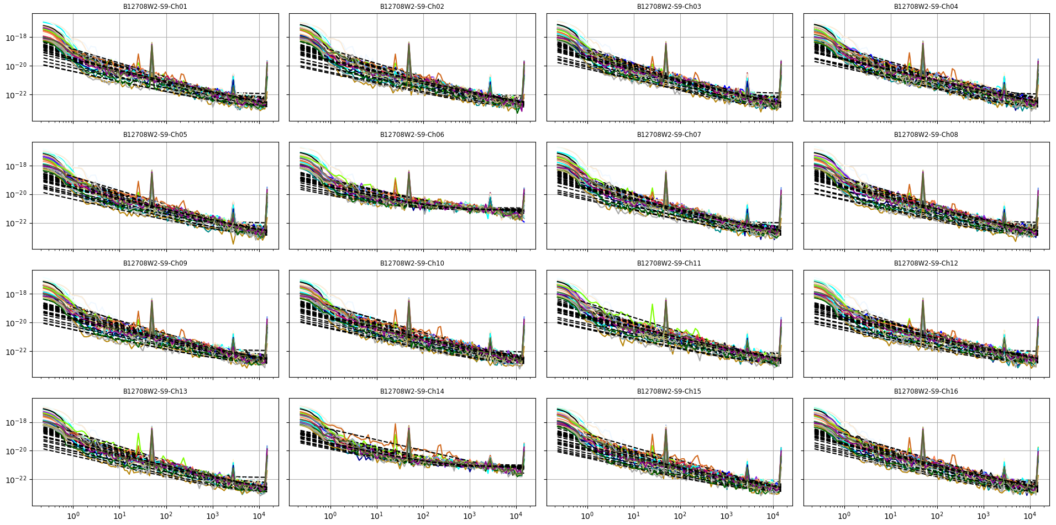
Example: PandasBasedAnalysis_2.py
1/f and thermal noise fitting improved.
In this case 2 channels presents higher thermal noise.
Noise measurements close to electronic floor noise.

Slide 8
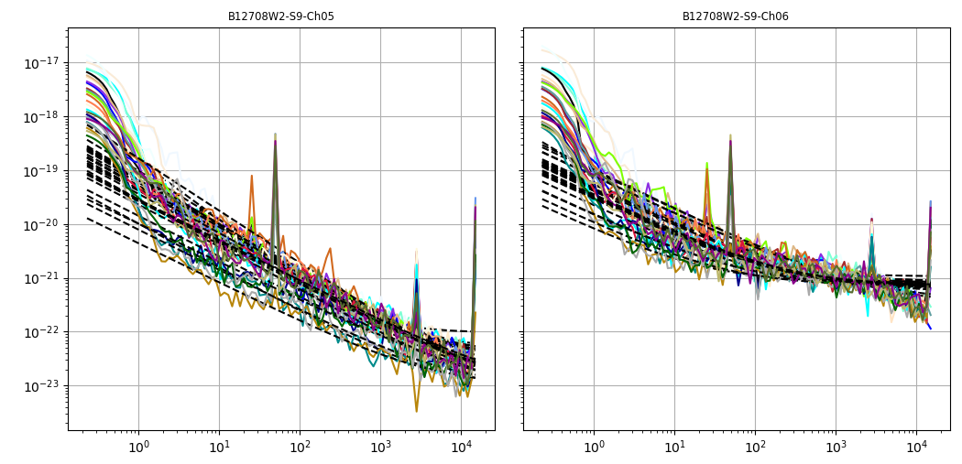
Example: PandasBasedAnalysis_2.py
1/f and thermal noise fitting improved.
In this case 2 channels presents higher thermal noise.
Noise measurements close to electronic floor noise.
For noise measurements it could be better to use 100 mV of Vds

