Slide 1

LITERARI.LY
A Literary Assistant
-Adam lenart, ankith gunapal & sandip Palit

Slide 2

Problem statement
How do you write a successful piece of literature?
Helping authors choose the best expression
to reach their target audience
Books
Blogs
Technical Publications

Slide 3
Application idea
Frequency
User query
Rating
Category

Slide 4
Data sources
Google n-grams dataset: fixed dataset with the frequency of 1 to 5 word expressions in published books and magazines over time from about 1500 until now.
Google Books API : text searches returning bibliographical information
Good Reads API: reviews, ratings, tags of books
Frequency
Rating, category
Google N-grams
Google Books
Good Reads
+

Slide 5
Volume * Variety * VELOCITY
Volume: *Google N-gram: 3.5 TB data stored in our S3 bucket (only English bigrams)
* we used a 15 GB subset of it for bigrams starting with “AB...”
Variety: * JSONs from Google Books, GoodReads API calls
* Google N-gram CSVs
Velocity: * Kibana dashboard refreshes search history every X seconds
Services used: * Amazon EC2
* Amazon S3
* Amazon RDS
Tools used: * Apache Spark (PySpark, SparkR)
* PostgreSQL
* Kibana
* Shiny, D3
* Python, R

Slide 6

DATA Challenges
Thousands of compressed CSV files in Google N-gram database, with some files taking 2-3 GB of space
Good Reads has a restriction of 1 API call per second
Filtering data from Good Reads such that we get Ratings for books written in English with a valid ISBN
Filtering data from Google Books such that we get Ratings, ISBN and valid category for books .
Amazon S3 maintains the Google N-gram database in an encoded format, requires building Hive/Spark with LZOCodec.

Slide 7
ER DIAGRAM

Slide 9
Architecture * Kibana dashboard
Data stored in HDFS from GoodReads
Query from User
Google Books query
Merged Result using Spark
ElasticSearch + Kibana

Slide 10
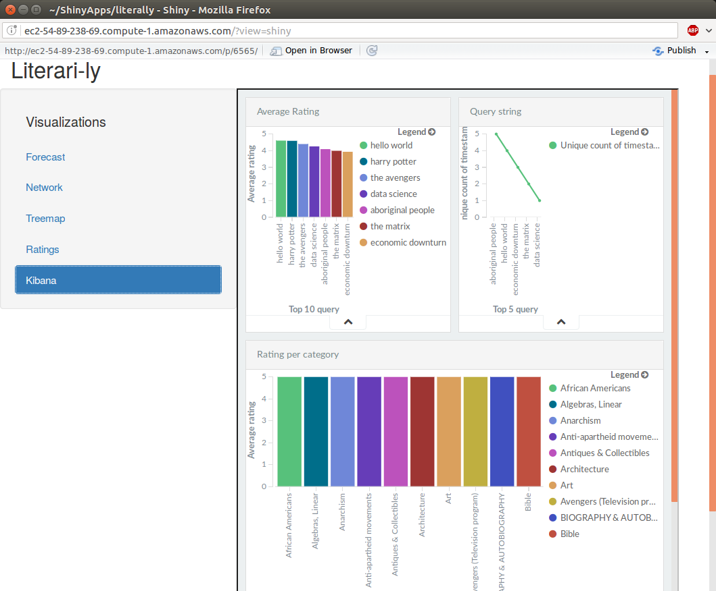

Slide 11
Architecture * Rating and categories
Data stored in Amazon RDS from GoodReads
Query from User
Google Books query
Merged Result using R
Shiny

Slide 12
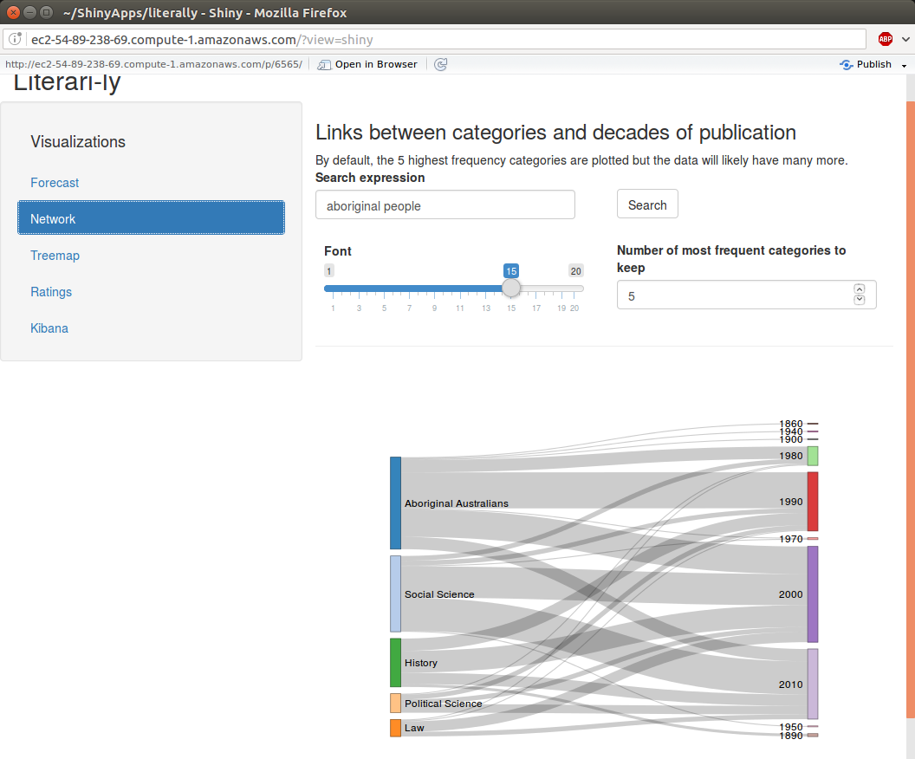

Slide 13
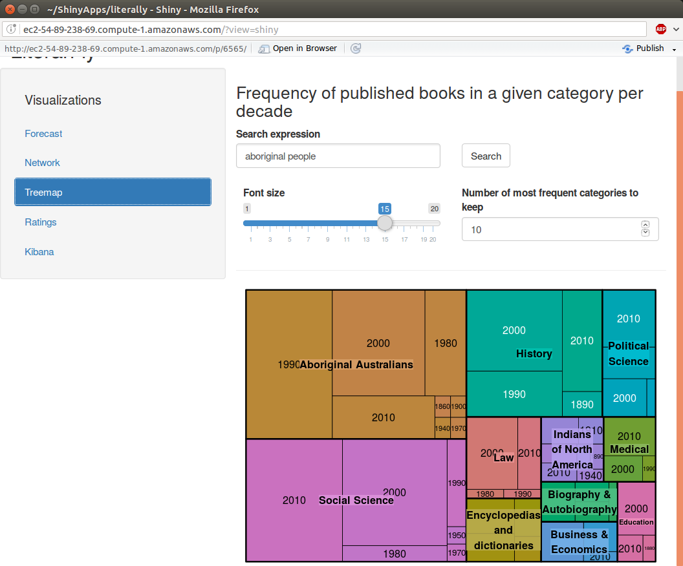

Slide 14
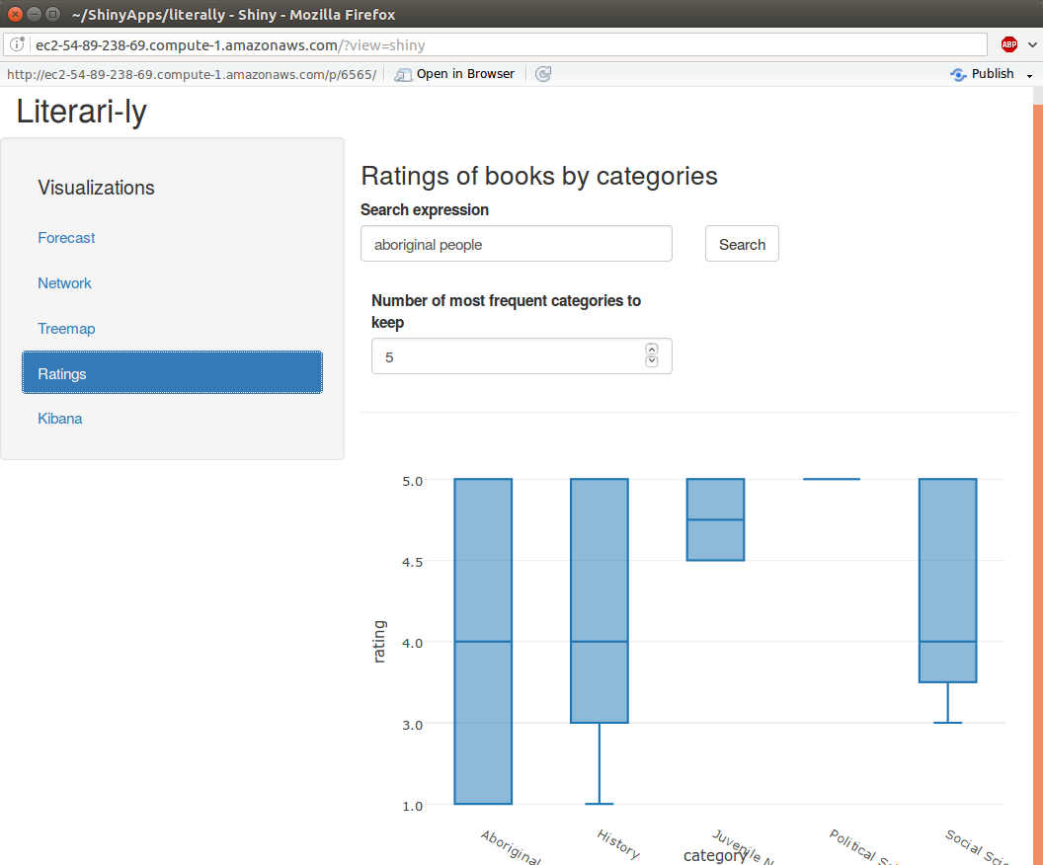

Slide 15
Architecture * Forecasting
Google N grams stored in HDFS
SparkR
Shiny
Query from User

Slide 16
