Slide 1
Coffee Lid 2.0

Slide 2
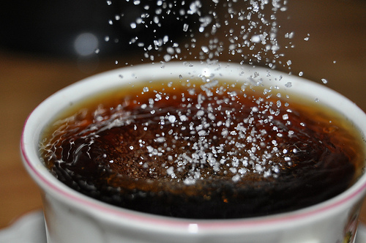
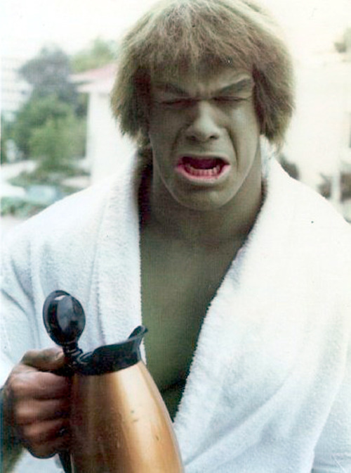
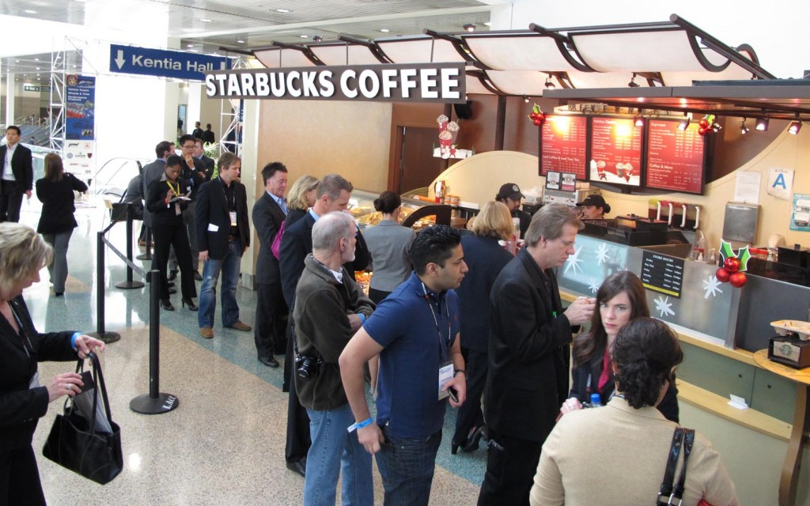
The Problem
Your coffee getting cold waiting?
Spending more time than you need to?
Hate waiting in lines?
Don’t like the amount of sugar added?
Want a better experience?

Slide 3
Market
Starbucks sells 2.3 billion cups of coffee a year
Assuming 50% of the drinks they sell are cappuccinos, that is 1.15 billion cups a year
On an average 250 cups/day of coffee are sold in a drive-thru businesses
Estimated drive-thru businesses in US = 211000, hence number of cups sold/day = 52.75 million

Slide 4
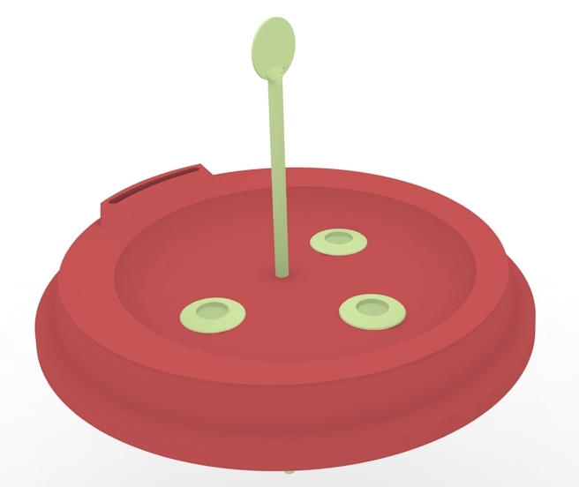
Our Solution
Innovative new design

Slide 5
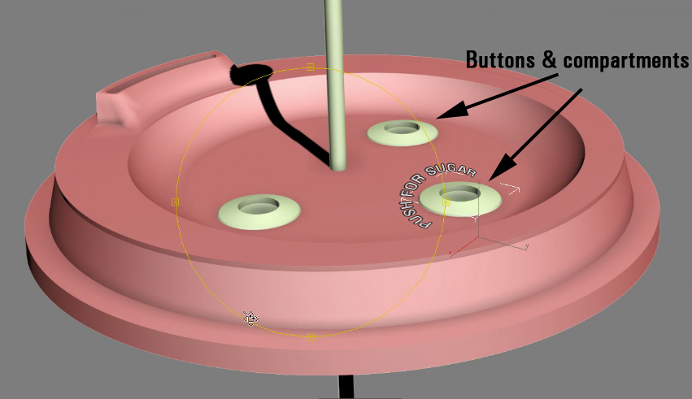
Lid contains buttons made from the same material as the lid
The buttons control a compartment that holds sugar/milk
No Additional manufacturing cost

Slide 6
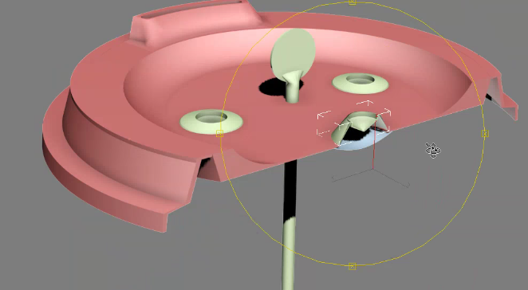
Cross-sectional view of the lid

Slide 7
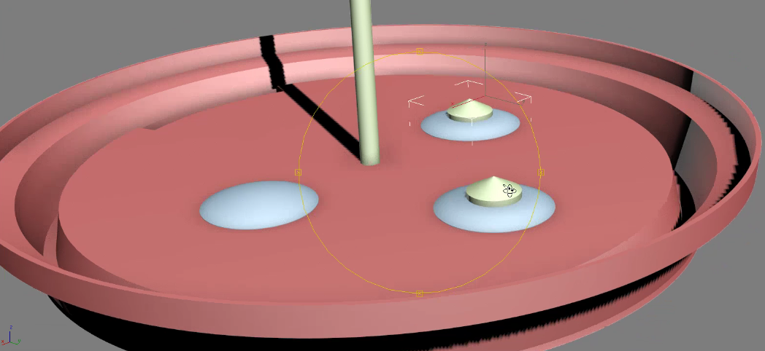
Once pressed, the button pierces a membrane to release contents from the compartment

Slide 8
Value Proposition
Refreshing new design
Gets the job done – no more waiting
Offers customization – customer can choose how much sugar he wants to add
Very convenient – Just put the lid on your coffee & you are good to go
Customer satisfaction goes up
Waiting time is reduced by 25%

Slide 9
Competition
Traditional lid manufacturers like SOLO, Sweetheart, Dart, Dixie
None of them have a design like ours
Our product shows innovation – people love innovation
Manufacturing costs are virtually the same while we offer better functionality and design
Current lids cannot match up to our functionality
Makes efficient use of the space available in a lid

Slide 10
How are we going to make money?
Obtain orders from coffee shops on the number of lids they want
Get the lids manufactured
Charge a license fee of 1 cent per cup sold to coffee shops.
If Starbucks sells Cappuccino with our lid, we are looking at a license fee of $11.5 million.

Slide 11
The Team
Ankith Gunapal
Previous design experience in a multinational corporation.
Good with numbers, market analysis.
Currently pursuing Masters in Telecommunication
Deepesh Sunku
Student entrepreneur
Previous experience in starting a business
Pro at digital marketing
Currently pursuing Masters in Telecommunication
Krishna Prasad Puttaswamy Gowda
Previous experience as a systems engineer
Organized events as the President of Student Council of India at UMD
Currently pursuing Masters in Telecommunication

Slide 12
We will use the prize money to…
$2000 will be used to manufacture the lids in bulk
These lids will be used to get the product out in public, will be used in cafes in and around the university
$400 for marketing – hold events to give out free coffees to promote the product
$100 for improving the design based on user reviews

