Slide 2
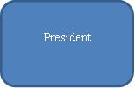
Organization Structure
President
R & D
Marketing
Production
Finance

Slide 3
Team Baldwin
Ankith Gunapal - CEO
Irma Wahlstrom - VP, R&D
Xinliang Ding - VP, Marketing
Boyang Hu - VP, Production
Shreyas Gandhi - VP, Finance

Slide 4
Agenda
Overview of the sensor market
Who are we?
Financial highlights of 2020
Product line up
Continuing Operations
Analysis of financial results
How do we improve the numbers
What next for Baldwin?
Lessons learnt from running Baldwin

Slide 5
Overview of the sensor market
Potential annual revenue of $1.5 billion
Sensor Industry continues to grow at 14% annually
A safe investment choice!

Slide 6
Overview of the sensor market
Segment | Revenue(in million $) | Growth Rate(in %)
Traditional | 356.6 | 9.2
Low End | 342.1 | 11.7
High End | 312.8 | 16.2
Performance | 254.2 | 19.8
Size | 239.6 | 18.3
All the segments are growing & profitable!

Slide 7
Who are we?
Vision
To be the most trusted sensor company in the world.
Mission
Thrive to innovate & provide premium quality sensors to our customers

Slide 8
Who are we?
Goals
Introduce a new product every year
Increase automation to the maximum
Reduce carbon footprint by 30%
Strategy
Broad differentiation

Slide 9
Who are we?
Segment | Percentage of market share
Traditional | 27.6
Low End | 30.1
High End | 23.9
Performance | 13.4
Size | 11.8
Highest market share in traditional, low end and high end segment

Slide 10
Who are we?
Where we stand
Overall market leader in the industry for 8 years in a row
Highest market share of 22.02% with the next highest being 19.77%

Slide 11
Financial highlights of 2020
Gross Revenue of $331.4 million, highest ever achieved by any company in the industry
Growth in sales by 39.9%, highest achieved by Baldwin in a year
Stock price rose to $101.16, the highest for Baldwin

Slide 12
Traditional--Baker

Slide 13
Initial Units sold: 961
Highest Units sold: 2032 (2020) TOP 2
Market share of 2020: 14% TOP 2
Average Units sold: 1618
From 2012 to 2020, our Units sold of Traditional segment (Baker) grows from 961 to as high as 2032. And in 2020, we reached the second highest units sold (2032) among all the company except Beast which is another product in our Traditional segment.

Slide 14
● Customer awareness reached 90% in year 2019 and is more than 80% after the third year. ● Customer accessibility reached 100% after 2018. ● Customer survey has a increasing trend and arrived 78 in 2018, which is a very high number.

Slide 15
Traditional—Beast (New product)

Slide 16
Highest Units sold: 2089 (2020) TOP 1
Market share of 2020: 14% TOP 1
From 2017 to 2020, our Units sold of Traditional segment (Beast) grows from 990 to as high as 2089. And has a average unit sold of 1518, which is very high.

Slide 17
Low end--Bead

Slide 18
Initial Units sold: 1493
Highest Units sold: 3961 (2020) TOP 1
Market share of 2020: 18% TOP 1
Average Units sold: 2688
From 2012 to 2020, our Units sold of Low end (Bead) grows from 1493 to as high as 3961. And in 2020, we reached our highest units sold (3961) among all the company.

Slide 19
We invest a lot in promotion budget and sale budget. As a result, Bead’s Customer awareness reached 80% after 2018 and increased as high as 92% in 2020. For, Customer accessibility, it reached to 100% after 2018.

Slide 20
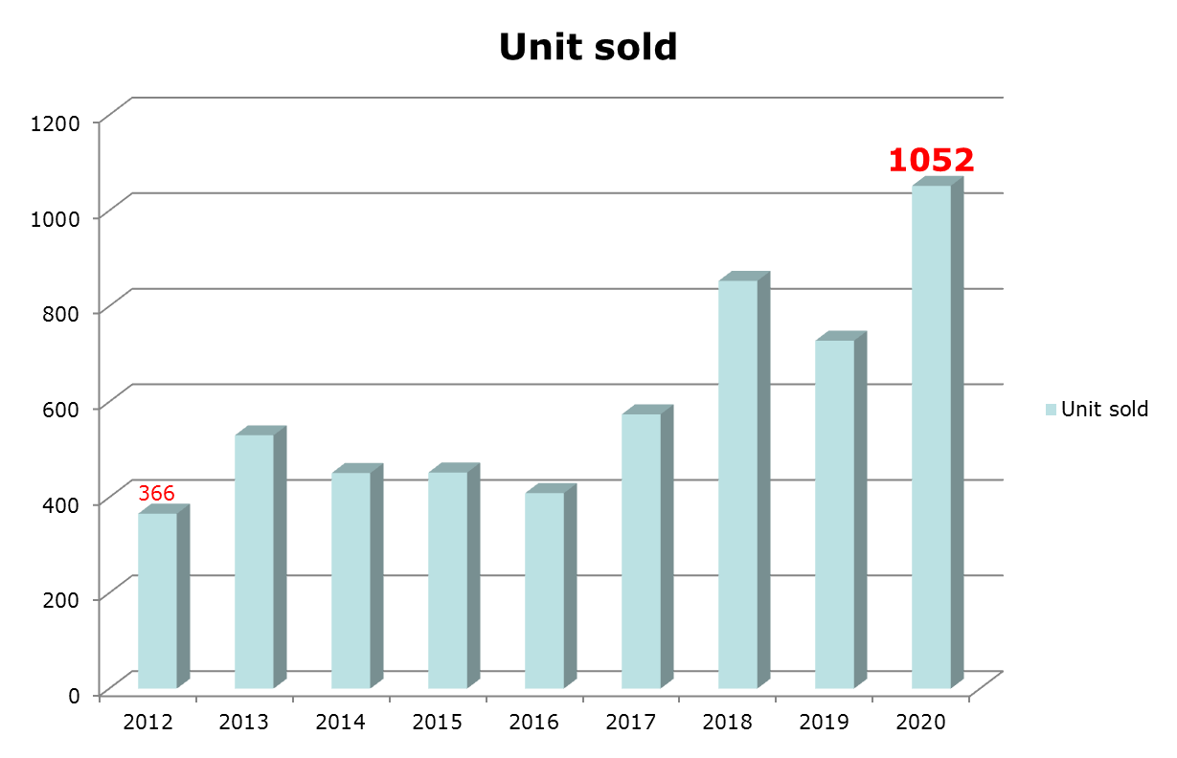
High end--Bid

Slide 21
Initial Units sold: 366
Highest Units sold: 1052 (2020) TOP 1
Market share of 2020: 12% TOP 1
From 2012 to 2020, our Units sold of High end (Bid) grows from 366 to as high as 1052. And in 2020, we reached our highest units sold among all the company.

Slide 22
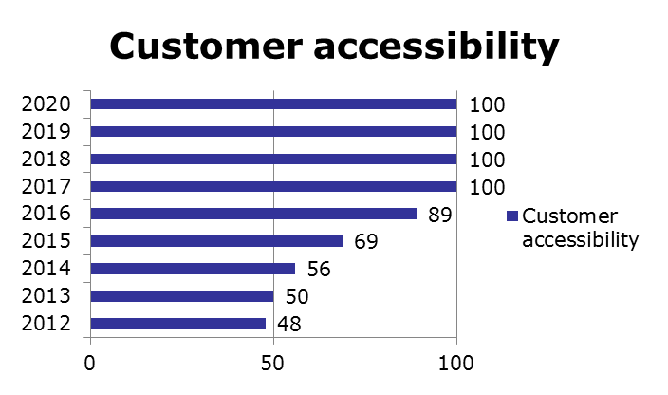
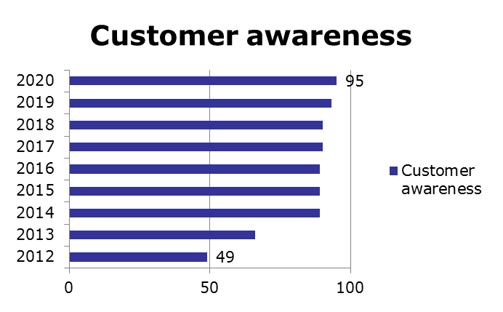
From these two graphs, we can see Bid’s Customer awareness increased from 49% to 95% in 2020. Customer accessibility increased from 48% to 100% after 2017.

Slide 23

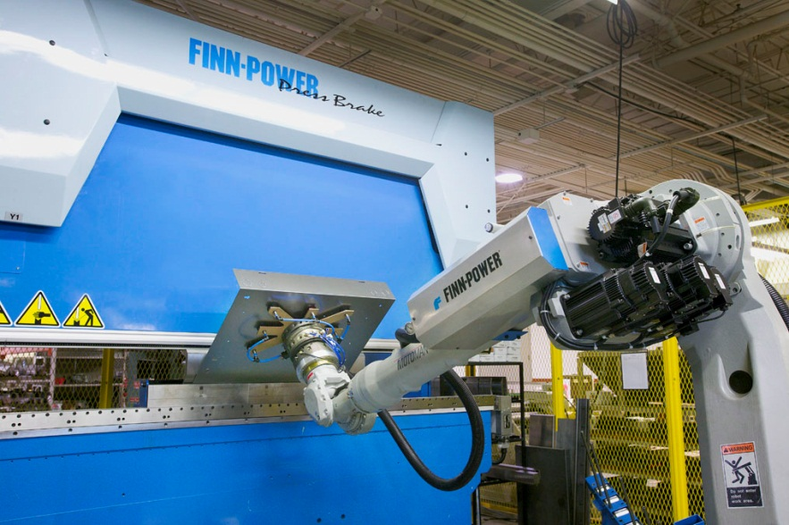

Presentation of Continuing Operations
Improve TQM
Increase Automation
Higher customer awareness and accessibility

Slide 24
Presentation of Continuing Operations
TQM-compared with other companies
Cumulative Impacts | Andrews | Baldwin | Chester | Digby | Erie | Ferris
Material Cost Reduction | 11.80% | 11.80% | 11.80% | 11.80% | 11.80% | 11.80%
Labor Cost Reduction | 14.00% | 14.00% | 14.00% | 14.00% | 14.00% | 13.97%
Reduction R&D Cycle Time | 40.01% | 40.01% | 40.01% | 40.01% | 40.01% | 40.01%
Reduction Admin Costs | 60.02% | 60.02% | 60.02% | 60.02% | 58.98% | 60.02%
Demand Increase | 14.40% | 14.40% | 14.40% | 14.40% | 14.40% | 14.40%
Total investment in TQM | $43,700 | $40,204 | $58,000 | $40,501 | $47,800 | $36,700
We spent almost the least but achieved the same cumulative impacts at last. For Ferris, we achieved the impacts much more earlier than them (3 years), this means we are the most efficient and wise company in investing in TQM.
(in thousands)
Notes:
24

Slide 25
Presentation of Continuing Operations
Increase Automation
Automation | Initial | Latest
Trad | 5 | 8
Low end | 6 | 10
High end | 5 | 5
Perf | 4 | 6
Size | 3 | 6
Our automation keep in increasing until it reached to the ideal automation for each segment. We are the first one to increase automation and benefit a lot in lowering our labor cost which makes us keep leading in the market.

Slide 26
Presentation of Continuing Operations
Higher customer awareness
Promotion budget | Total | Average | awareness | Highest change
Baker | $16,800,000 | $2,100,000 | 93% | 38%
Bead | $16,300,000 | $2,037,500 | 92% | 40%
Bid | $17,200,000 | $2,150,000 | 95% | 46%
Bold | $14,400,000 | $1,800,000 | 91% | 45%
Buddy | $14,400,000 | $1,800,000 | 90% | 44%
Bind | $11,800,000 | $1,475,000 | 90% | 90%
Beast | $11,600,000 | $1,450,000 | 84% | 84%
Beauty | $8,700,000 | $1,087,500 | 77% | 77%
For every segment, we have at least one product which has the highest customer awareness in the market. And 6 of 8 of all our products have the highest customer awareness!

Slide 27
Presentation of Continuing Operations
Higher customer accessibility
Sales budget | Total | Average | accessibility | Highest change
Baker | $15,645,000 | $1,955,625 | 100% | 46%
Bead | $15,266,000 | $1,908,250 | 100% | 60%
Bid | $15,211,000 | $1,901,375 | 100% | 52%
Bold | $14,375,000 | $1,796,875 | 100% | 63%
Buddy | $14,375,000 | $1,796,875 | 100% | 48%
Bind | $9,965,000 | $1,245,625 | 100% | 100%
Beast | $8,490,000 | $1,061,250 | 100% | 100%
Beauty | $5,902,000 | $737,750 | 100% | 100%
Highest in the industry for the latest 5 years.
All segments achieved 100% customer accessibility from 2018 to 2020, which is the only company who did this.

Slide 28
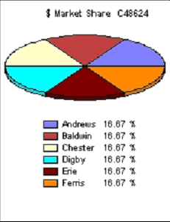
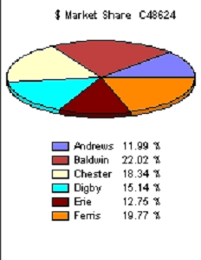
Presentation of Continuing Operations
Market share between 2012 and 2020
Market share of 2012
Market share of 2020
22.02% the highest in the industry!

Slide 29

Financial DATA of the SENSOR gIANT
BALDWIN

Slide 30
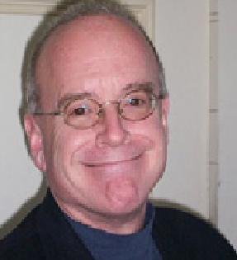

HIGH Sales = Profits
What distinguishes an average company from the outstanding?
-High sales(+Average lead of 20-30 million)

Slide 31
Steps taken to Increase sales
Gradually increased sales and promotion budget from an average of 1.5M$ to 2.5M$.(Especially in Higher markets like Traditional, Low & high end)
Gradually Increased Production Capacity
Produced Premium Quality Sensors (w.r.t positioning, age, MTBF etc)

Slide 32
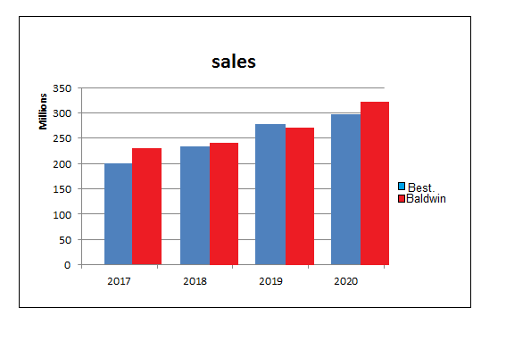

Slide 33
Profits increased steadily to almost 35M$ By year 2020 as compared to Market average of 30M$

Slide 34
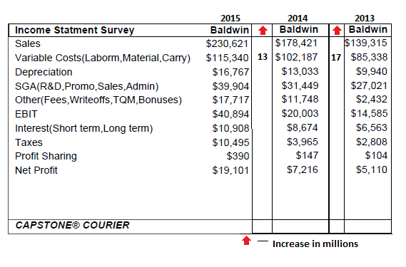
Reduction In Variable costs via investment in TQM Note: Costs reduced by 4M$ rather then an expected increase of 5M$ due to increase in production

Slide 35
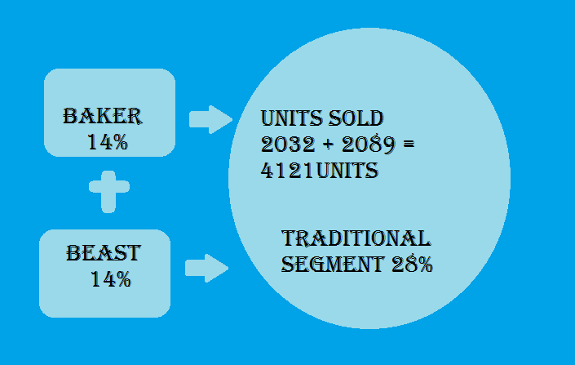
Investments in R & D (Year 2020)
Note : 4121 units each priced $23 generated a revenue of $94,783 as compared to 2nd best Echo & Eat– 64M$ (18%)

Slide 36
Leverage
Ratio of Assets to Equity Critical Figure of merit to determine difference balance R.O.E & R.O.A
Leverage
 | Year | Baldwin | Best Competitor
 | 2012 | 2 | 2
 | 2013 | 2 | 1.8
 | 2014 | 1.6 | 1.7
 | 2015 | 1.7 | 2.3
 | 2016 | 1.8 | 1.8
 | 2017 | 1.8 | 1.6
 | 2018 | 1.9 | 1.6
 | 2019 | 1.9 | 1.3
 | 2020 | 1.9 | 1.3

Slide 37
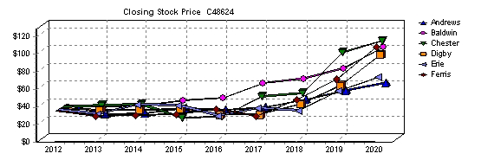
Baldwin is pleased to announce a stock price of $101.16(Year2020)
Note : Steady increase in Stock Price suggests Financial Stability &Stock Price is a close representation of Cumulative Profits

Slide 38
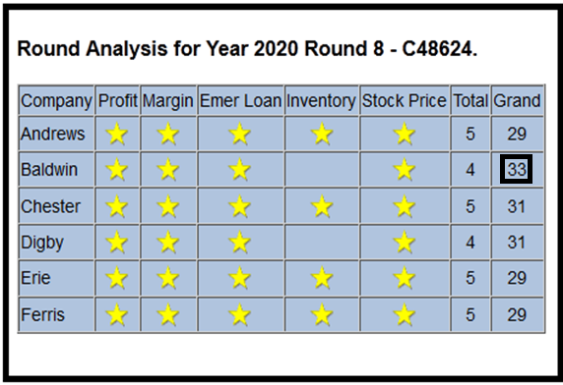
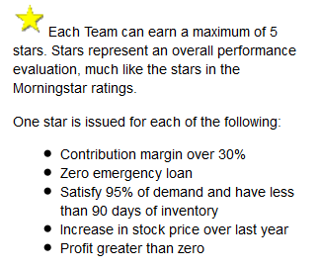

Slide 39
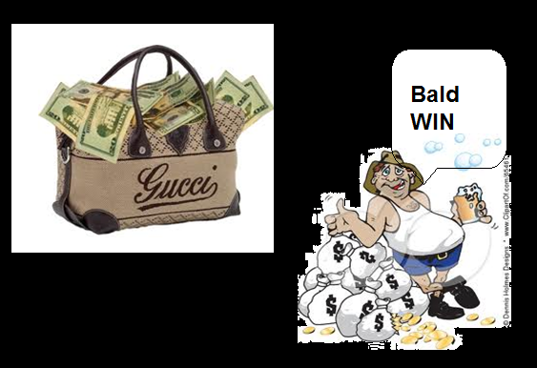
Performing up to the expectations

Slide 40
What is next for Baldwin…

Slide 41
Potential revenue Industry/segment
At year 8 we have captured 24.11% Almost 1/4 of the total market much higher than our closest competitor who has only 18.75%
Year
Revenue per segment at current prices: Traditional:$23.00 Low end:$15.00 High end:$37.50 Performance:$31.00 Size:$32.00
How did we do it? Baldwin focuses on the Segments with the highest potential of revenue: - Years 1 thru 8: Traditional, Low end and High end - Years 9 thru 13: High end, Performance, Size and Low end

Slide 42
Strategy for the next 5 years
Broad Differentiation
With this strategy we expect to increase our market share to 28.74 in year 13

Slide 43
Based on our strategy We have planned the following products to be released within the next 5 years
Product | Segment | Year of Introduction | Market share/ segment Before new product % | Products/segment Before new product | Average market share Per product/ segment % | Projected market share with new product/ segment %
Bravo | Size | 9 | 11.84 | 1 | 11.84 | 23.68
Boss | Performance | 10 | 12.95 | 1 | 12.95 | 25.90
Bull | High End | 11 | 26.38 | 2 | 13.19 | 39.56
Bear | Performance | 12 | 26.98 | 2 | 13.49 | 40.46
Bebe | Size | 13 | 28.38 | 2 | 14.19 | 42.57

Slide 44
Projected Revenue per segment for the next 5 years
at current prices
Year
Total revenue of
$1,194,598 by year 13
Increasing our market share from 24.11% in year 8 to 28.74% in 5 years
Traditional:$23.00 Low end:$15.00 High end:$37.50 Performance:$31.00 Size:$32.00

Slide 45
Long term strategy
Transnational expansion within the next 10 years
Capitalize on growing population and dependency on electronic equipment
Emerging markets in Asia and Latin America
Currently evaluating the creation of a wholly-owned subsidiary that would protect our intellectual property rights

Slide 46
R&D Activities for future programs

Slide 47
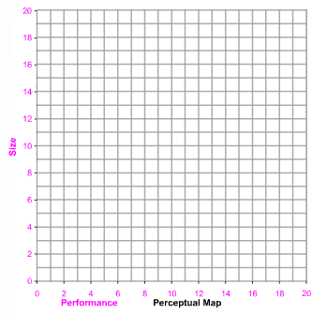
Traditional Segment
Ideal Spot Location
Year | Performance | Size
8 | 10.6 | 9.4
9 | 11.3 | 8.7
10 | 12 | 8
11 | 12.7 | 7.3
12 | 13.4 | 6.6
13 | 14.1 | 5.9
Beast
Baker

Slide 48
Low End Segment
Ideal Spot Location
Year | Performance | Size
8 | 5.7 | 14.3
9 | 6.2 | 13.8
10 | 6.7 | 13.3
11 | 7.2 | 12.8
12 | 7.7 | 12.3
13 | 8.2 | 11.8
Beauty
Bead

Slide 49
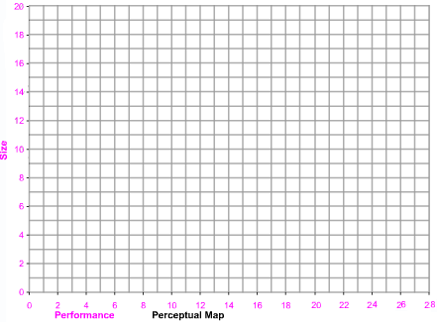
High End Segment
Ideal Spot Location
Year | Performance | Size
8 | 16.1 | 3.9
9 | 17 | 3
10 | 17.9 | 2.1
11 | 18.8 | 1.2
12 | 19.7 | 0.3
13 | 20.6 | 0.1
Bid
Bind
Bull
Will Introduce Bull in Year 11

Slide 50
Performance Segment
Ideal Spot Location
Year | Performance | Size
8 | 17.4 | 10.4
9 | 18.4 | 9.7
10 | 19.4 | 9
11 | 20.4 | 8.3
12 | 21.4 | 7.6
13 | 22.4 | 6.9
Bold
Boss
Bear
Will Introduce Boss in Year 10
Bear in Year 12

Slide 51
Size Segment
Ideal Spot Location
Year | Performance | Size
8 | 9.6 | 2.6
9 | 10.3 | 1.6
10 | 11 | 0.6
11 | 11.7 | 0.3
12 | 12.4 | 0.15
13 | 13.1 | 0.075
Buddy
Bravo
Bebe
Will Introduce Bravo in Year 9
Bebe in Year 13

Slide 52
Why you must invest with us…

Slide 53
Our products are the best in the market
Customer survey is the highest for our products compared with the competition for 4 of the 5 segments:
Traditional
Low End
Performance
Size

Slide 54
You would be investing in the company with the highest annual increasing market share per segment
%
Year
In 5 years we will capture 28.74% of the market, valued at more than $3.5 billion at current prices, for a total expected revenue of $1,194,598 for year 13

Slide 55
Increasing annual revenue per segment
Year
You would be enjoying the benefits of $3.8 billion dollars in accumulated revenue for the next 5 years
Revenue per segment at current prices Traditional:$23.00 Low end:$15.00 High end:$37.50 Performance:$31.00 Size:$32.00

Slide 56
Money on top on money, as our margin will increase annually too!
%
Year
Total expected margin of 48.45% by year 13: $230,382,405
almost one quarter of a billion dollars of total
expected margin for year 13!

Slide 57
Lessons learnt from running Baldwin
Achieving high levels of automation is expensive but cost effective in the long run
Invest in improving R&D cycle time

