Slide 1
Q3 2026 Kickoff
Aguna — 2026-08-05
Notes:
Perkenalkan tim baru sebelum mulai. Sebutkan target 12% YoY.

Slide 2
Goals for the Quarter
Ship the reporting pipeline v2
Onboard 3 new enterprise customers
Reduce p95 API latency by 30%
Notes:
Latency: fokus di endpoint /search yang p95-nya 2.4s sekarang.

Slide 3
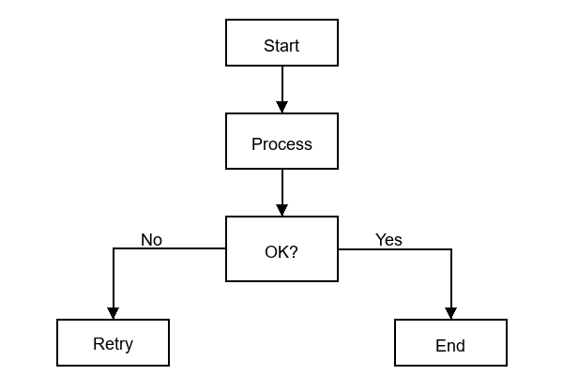
Ingestion Pipeline

Slide 4
Bookings by Region
Notes:
Highlight APAC Q2 sebagai puncak. Jangan lupa mention EMEA recovery.

