Slide 1
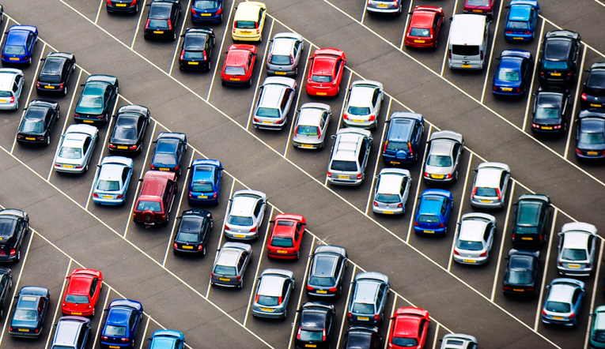
ARDUINO GROUP PROJECT
CAR PARKING SYSTEM
Group:9

Slide 2


WHY THIS PROJECT
No human no mistakes.
Less work more productivity.
Making human’s life easier.
Improvements of technology.

Slide 3

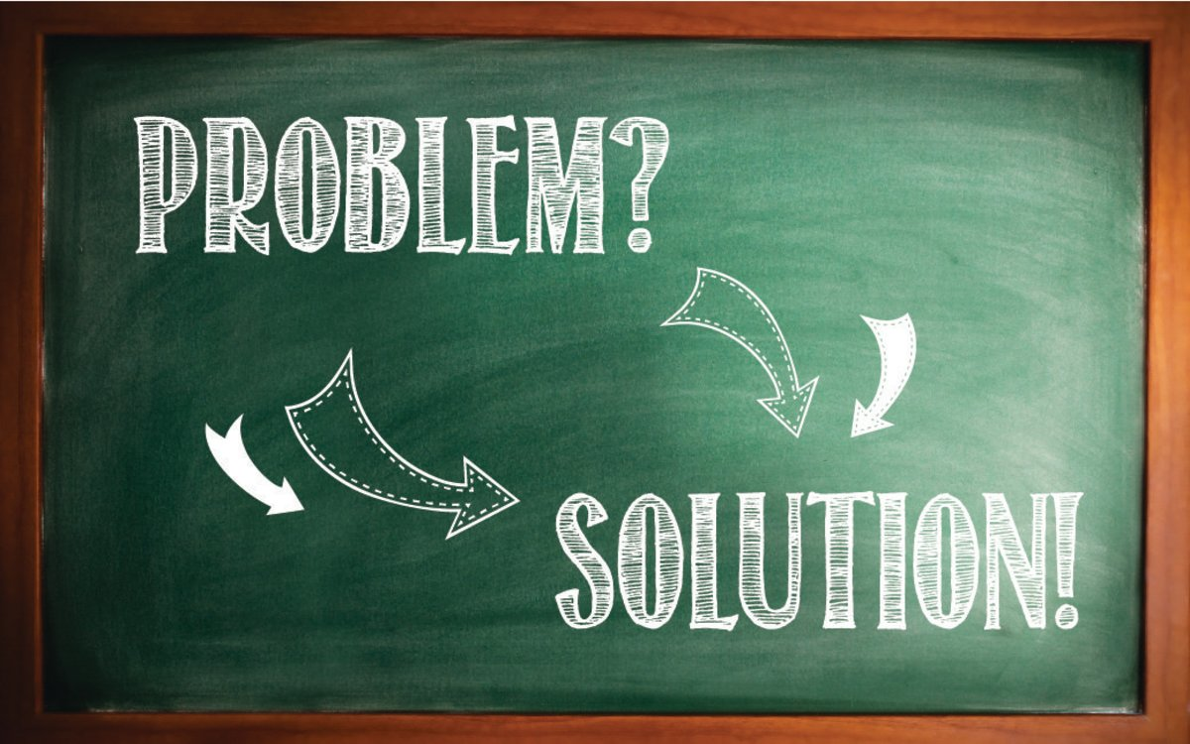
WORKABLE SOLUTIONS FOR PROBLEM
Automatically opening and closing the door.
Showing current parkingslots on LCD.
Directions for possible mistakes.

Slide 4
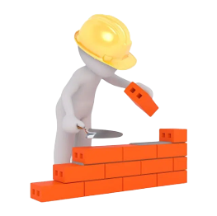
USED MATERIALS
HC-SR04 Ultrasonic Sensors
Servo motors
Lcd
Buzzer
Arduino UNO

Slide 5
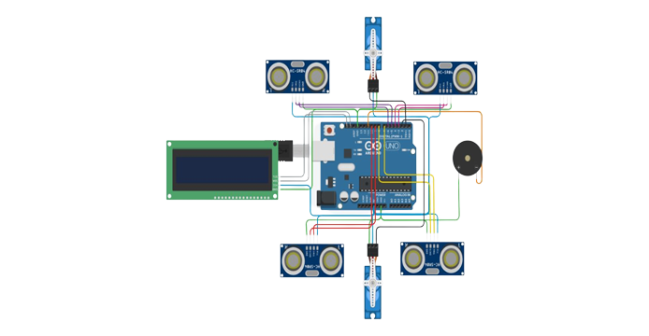
CONNECTIONS SCHEMA ON ARDUINO

Slide 6
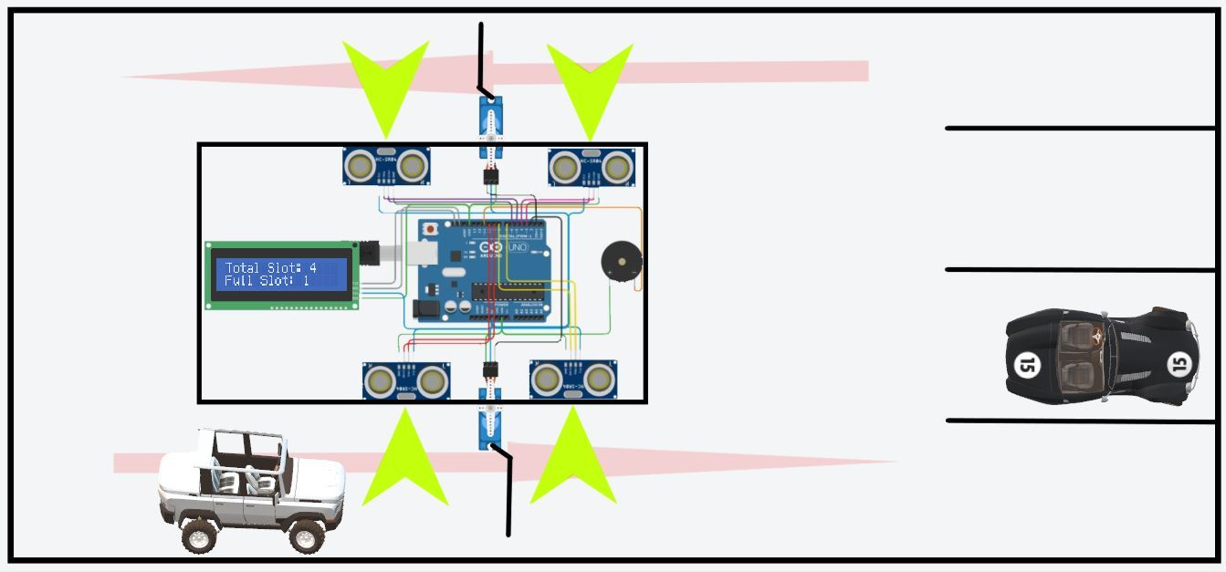
YOU CAN ALSO SPLIT YOUR CONTENT
White
Is the color of milk and fresh snow, the color produced by the combination of all the colors of the visible spectrum.

Slide 7
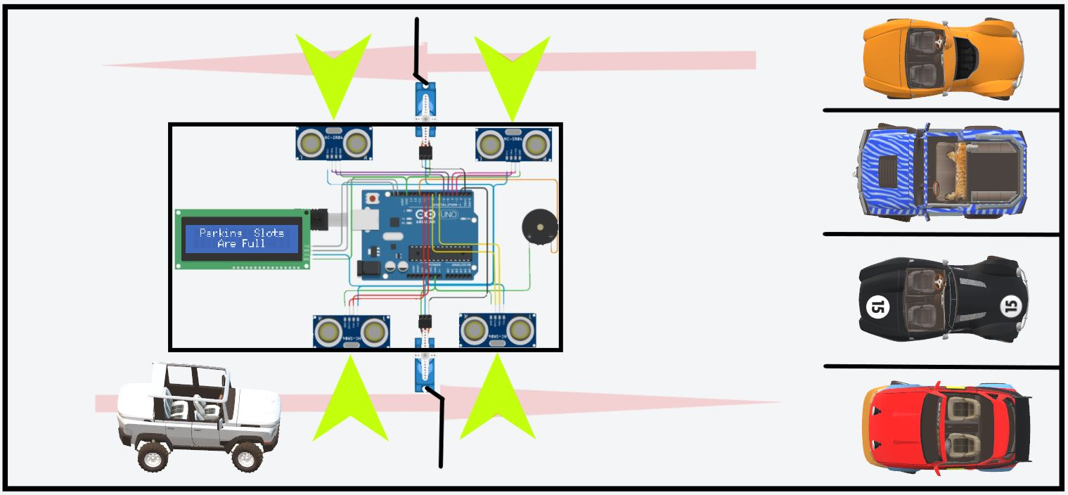
IN TWO OR THREE COLUMNS
Yellow
Is the color of gold, butter and ripe lemons. In the spectrum of visible light, yellow is found between green and orange.
Blue
Is the colour of the clear sky and the deep sea. It is located between violet and green on the optical spectrum.
Red
Is the color of blood, and because of this it has historically been associated with sacrifice, danger and courage.

Slide 8
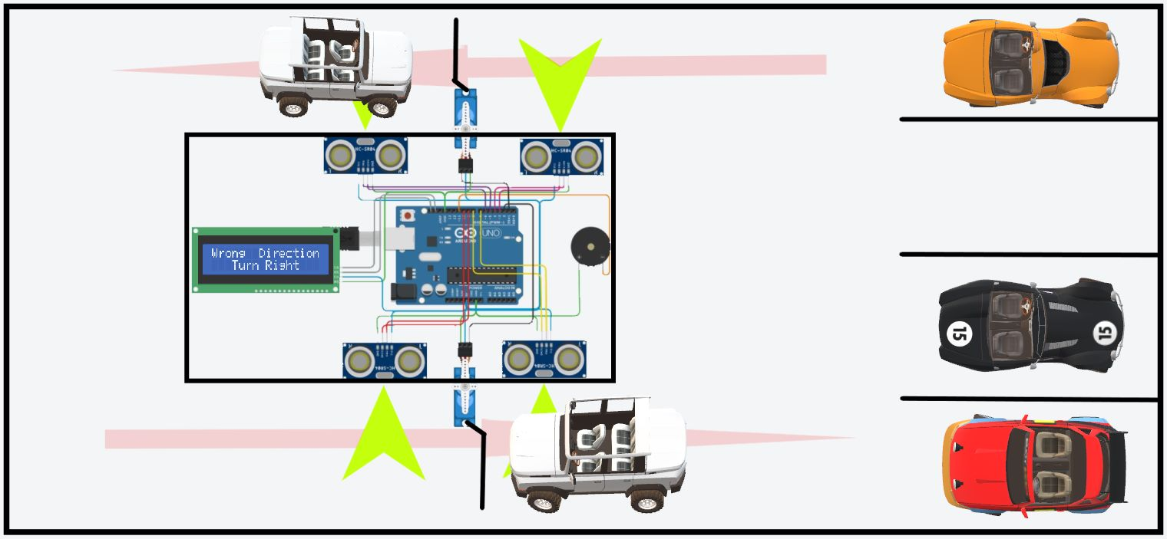
A PICTURE IS WORTH A THOUSAND WORDS
A complex idea can be conveyed with just a single still image, namely making it possible to absorb large amounts of data quickly.

Slide 9

DIAGRAMS TO EXPLAIN SITUATIONS
Operations are carried out quickly without human beings.
Cost is lower than while there is people.
The most usable system for modern age.
Actually this system is used anyplace at where cars used.
For example; inside the bazaar, bus terminal, car parks etc.

Slide 10
CREDITS
Special thanks to all the people who made and released these awesome resources for free:
Presentation template by SlidesCarnival
Photographs by Google Stock Pictures
Illustrations by Çağrı TİRELİOĞLU

Slide 11

THANKS FOR LISTENING <3

