Slide 1
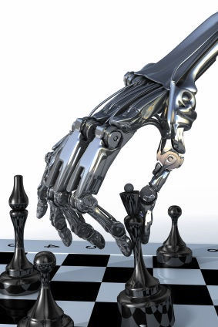
Adversarial Search
Aka Games
Chapter 6
Some material adopted from notes by Charles R. Dyer, University of Wisconsin-Madison

Slide 2
Overview
Game playing
  State of the art and resources
  Framework
Game trees
  Minimax
  Alpha-beta pruning
  Adding randomness

Slide 3
Why study games?
Interesting, hard problems that require minimal “initial structure”
Clear criteria for success
A way to study problems involving {hostile, adversarial, competing} agents and the uncertainty of interacting with the natural world
People have used them to asses their intelligence
Fun, good, easy to understand, PR potential
Games often define very large search spaces
  chess 35¹⁰⁰ nodes in search tree, 10⁴⁰ legal states

Slide 4
State of the art
Chess:
  Deep Blue beat Gary Kasparov in 1997
  Garry Kasparav vs. Deep Junior (Feb 2003): tie!
  Kasparov vs. X3D Fritz (November 2003): tie!
Checkers: Chinook is the world champion
Checkers: has been solved exactly – it’s a draw!
Go: Computer players are decent, at best
Bridge: “Expert” computer players exist, but no world champions yet
Poker: Poki regularly beats human experts
Check out the U. Alberta Games Group

Slide 5
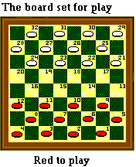
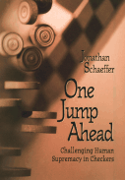
Chinook
Chinook is the World Man-Machine Checkers Champion, developed by researchers at the University of Alberta
It earned this title by competing in human tournaments, winning the right to play for the (human) world championship, and eventually defeating the best players in the world
Visit http://www.cs.ualberta.ca/~chinook/ to play a version of Chinook over the Internet.
“One Jump Ahead: Challenging Human Supremacy in Checkers”, Jonathan Schaeffer, 1998
See Checkers Is Solved, J. Schaeffer, et al., Science, v317, n5844, pp1518-22, AAAS, 2007.

Slide 6
Chess early days
1948: Norbert Wiener's book Cybernetics describes how a chess program could be developed using a depth-limited minimax search with an evaluation function
1950: Claude Shannon publishes one of first papers on playing chess “Programming a Computer for Playing Chess”
1951: Alan Turing develops on paper the first program capable of playing a full game of chess
1962: Kotok and McCarthy (MIT) develop first program to play credibly
1967: Mac Hack Six, by Richard Greenblatt et al. (MIT) idefeats a person in regular tournament play

Slide 7
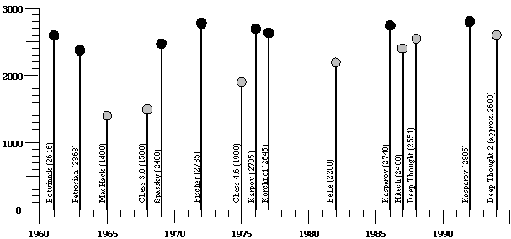
Ratings of human & computer chess champions

Slide 8
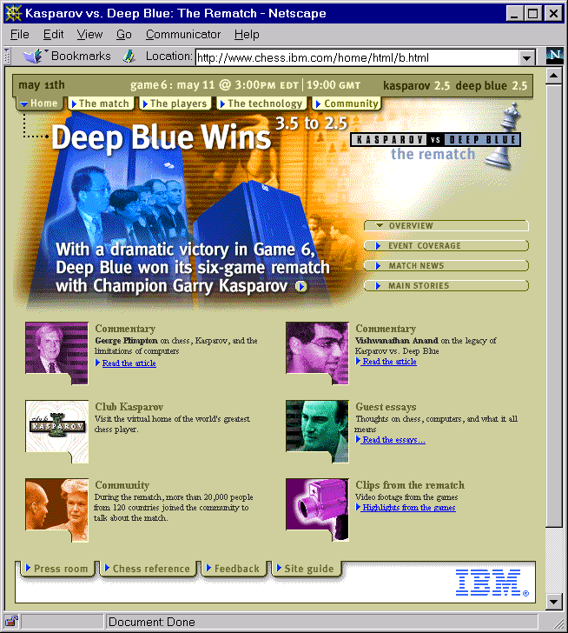
1997

Slide 9
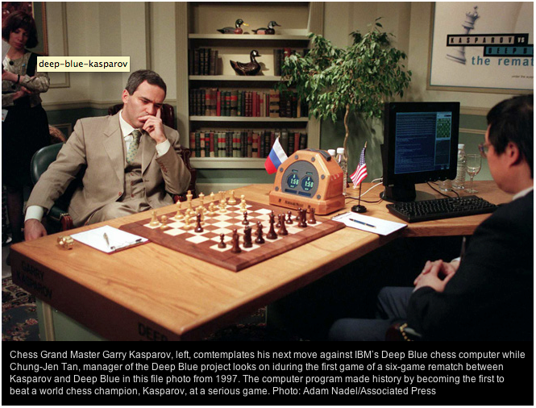
1997

Slide 10
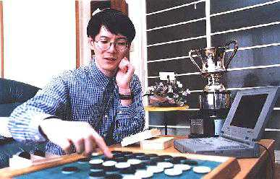
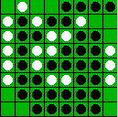
Othello: Murakami vs. Logistello
open sourced
Takeshi Murakami
World Othello Champion
1997: The Logistello software crushed Murakami, 6 to 0
Humans can not win against it
Othello, with 10²⁸ states, is still not solved

Slide 11
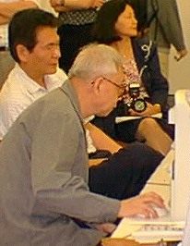
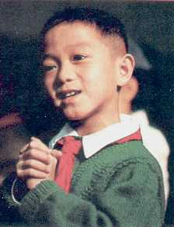
Go: Goemate vs. a young player
Name: Chen Zhixing
Profession: Retired
Computer skills:
self-taught programmer
Author of Goemate (arguably the best Go program available today)
Gave Goemate a 9 stone
handicap and still easily
beat the program,
thereby winning $15,000
Jonathan Schaeffer

Slide 12
Go: Goemate vs. ??
Name: Chen Zhixing
Profession: Retired
Computer skills:
self-taught programmer
Author of Goemate (arguably the strongest Go programs)
Go has too high a branching factor for existing search techniques
Current and future software must rely on huge databases and pattern-recognition techniques
Gave Goemate a 9 stone
handicap and still easily
beat the program,
thereby winning $15,000
Jonathan Schaeffer

Slide 13
Typical simple case for a game
2-person game
Players alternate moves
Zero-sum: one player’s loss is the other’s gain
Perfect information: both players have access to complete information about the state of the game. No information is hidden from either player.
No chance (e.g., using dice) involved
Examples: Tic-Tac-Toe, Checkers, Chess, Go, Nim, Othello
But not: Bridge, Solitaire, Backgammon, Poker, Rock-Paper-Scissors, ...

Slide 14
Can we use …
Uninformed serch?
Heuristic Search?
Local Search?
Constraint based search?

Slide 15
How to play a game
A way to play such a game is to:
  Consider all the legal moves you can make
  Compute new position resulting from each move
  Evaluate each to determine which is best
  Make that move
  Wait for your opponent to move and repeat
Key problems are:
  Representing the “board” (i.e., game state)
  Generating all legal next boards
  Evaluating a position

Slide 16
Evaluation function
Evaluation function or static evaluator is used to evaluate the “goodness” of a game position
  Contrast with heuristic search where evaluation function is a non-negative estimate of cost from the start node to a goal and passing through given node
Zero-sum assumption permits a single evaluation function to describe goodness of board w.r.t. both players
  f(n) >> 0: position n good for me and bad for you
  f(n) << 0: position n bad for me and good for you
  f(n) near 0: position n is a neutral position
  f(n) = +infinity: win for me
  f(n) = -infinity: win for you

Slide 17
Evaluation function examples
Example evaluation function for Tic-Tac-Toe
  f(n) = [# 3-lengths open for me] - [# 3-lengths open for other]
  where a 3-length is a complete row, column, or diagonal
Alan Turing’s function for chess
  f(n) = w(n)/b(n) where w(n) = sum of the point value of white’s pieces and b(n) = sum of black’s
  Traditional piece values are
    Pawn:1
    Knight, bishop: 3
    Rook: 5
    Queen: 9

Slide 18
Evaluation function examples
Most evaluation functions specified as a weighted sum of positive features
  f(n) = w₁*feat₁(n) + w₂*feat₂(n) + ... + w_{n}*feat_{k}(n)
Example features for chess are piece count, piece values, piece placement, squares controlled, etc.
Deep Blue had >8K features in its evaluation function

Slide 19
That’s not how people play
People use “look ahead”
i.e., enumerate actions, consider opponent’s possible responses, REPEAT
Producing a complete game tree is only possible for simple games
So, generate a partial game tree for some number of plys
  Move = each player takes a turn
  Ply = one player’s turn
What do we do with the game tree?

Slide 20
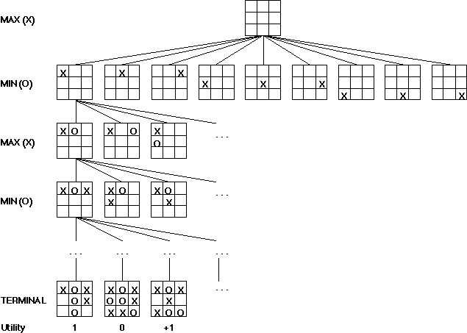

Slide 21
Game trees
Problem spaces for typical games are trees
Root node represents current board configuration; player must decide best single move to make next
Static evaluator function rates a board position f(board):real, >0 for me; <0 for opponent
Arcs represent the possible legal moves for a player
If it is my turn to move, then the root is labeled a "MAX" node; otherwise it is labeled a "MIN" node, indicating my opponent's turn.
Each tree level has nodes that are all MAX or all MIN; nodes at level i are of opposite kind from those at level i+1

Slide 22
Game Tree for Tic-Tac-Toe
MAX nodes
MAX’s play →
MIN nodes
MIN’s play →
Terminal state
(win for MAX) →
Here, symmetries are used to reduce branching factor

Slide 23
Minimax procedure
Create start (MAX) node with current board configuration
Expand nodes down to some depth (a.k.a. ply) of lookahead in the game
Apply evaluation function at each leaf node
“Back up” values for each of the non-leaf nodes until value is computed for the root node
  At MIN nodes, backed-up value is minimum of values associated with its children.
  At MAX nodes, backed-up value is maximum of values associated with its children.
Pick operator associated with child node whose backed-up value determined value at the root

Slide 24
Minimax theorem
Intuition: assume your opponent is at least as smart as you and play accordingly
  If she’s not, you can only do better!
Von Neumann, J: Zur Theorie der Gesellschafts-spiele Math. Annalen. 100 (1928) 295-320
  For every two-person, zero-sum game with finite strategies, there exists a value V and a mixed strategy for each player, such that (a) given player 2's strategy, the best payoff possible for player 1 is V, and (b) given player 1's strategy, the best payoff possible for player 2 is –V.
You can think of this as:
  Minimizing your maximum possible loss
  Maximizing your minimum possible gain

Slide 25
Minimax Algorithm
2
2
1
2
1
2
7
1
8
2
7
1
8
2
7
1
8
This is the move
selected by minimax
2
Static evaluator
value
2
1
MAX
MIN
2
7
1
8

Slide 26
Partial Game Tree for Tic-Tac-Toe
f(n) = +1 if the position is a win for X.
f(n) = -1 if the position is a win for O.
f(n) = 0 if the position is a draw.

Slide 27
Why use backed-up values?
Intuition: if evaluation function is good, doing look ahead and backing up values with Minimax should be better
A non-leaf node N’s backed-up value is value of best state that MAX can reach at depth h if MIN plays well
  “well” : same criterion as MAX applies to itself
If e is trustworthy, then backed-up value is better estimate of how favorable STATE(N) is than e(STATE(N))
We use a horizon h because our time to compute a move is limited

Slide 28
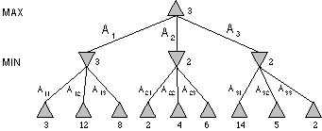
Minimax Tree
MAX node
MIN node
value computed
by minimax
f value

Slide 29
Alpha-beta pruning
We can improve on the performance of the minimax algorithm through alpha-beta pruning
Basic idea: “If you have an idea that is surely bad, don't take the time to see how truly awful it is.” -- Pat Winston
MAX
>=2
We don’t need to compute the value at this node
No matter what it is, it can’t affect value of the root node
MIN
=2
<=1
MAX
2
7
1
?

Slide 30
Alpha-beta pruning
Traverse search tree in depth-first order
At MAX node n, alpha(n) = max value found so far
At MIN node n, beta(n) = min value found so far
  Alpha values start at -∞ and only increase, while beta values start at +∞ and only decrease
Beta cutoff: Given MAX node n, cut off search below n (i.e., don’t generate/examine any more of n’s children) if alpha(n) >= beta(i) for some MIN node ancestor i of n
Alpha cutoff: stop searching below MIN node n if beta(n) <= alpha(i) for some MAX node ancestor i of n

Slide 31
Alpha-Beta Tic-Tac-Toe Example

Slide 32
Alpha-Beta Tic-Tac-Toe Example
The beta value of a MIN
node is an upper bound on
the final backed-up value.
It can never increase
β = 2
2

Slide 33
Alpha-Beta Tic-Tac-Toe Example
The beta value of a MIN
node is an upper bound on
the final backed-up value.
It can never increase
β = 1
2
1

Slide 34
Alpha-Beta Tic-Tac-Toe Example
α = 1
The alpha value of a MAX
node is a lower bound on
the final backed-up value.
It can never decrease
β = 1
2
1

Slide 35
Alpha-Beta Tic-Tac-Toe Example
α = 1
β = 1
β = -1
2
1
-1

Slide 36
Alpha-Beta Tic-Tac-Toe Example
α = 1
β = 1
β = -1
Search can be discontinued below
any MIN node whose beta value is
less than or equal to the alpha value
of one of its MAX ancestors
2
1
-1

Slide 37
Alpha-beta general example
MAX
3
MIN
3
2 - prune
14
1 - prune
3
12
8
2
14
1

Slide 38
Alpha-Beta Tic-Tac-Toe Example 2
0
5
-3
3
3
-3
0
2
-2
3
5
2
5
-5
0
1
5
1
-3
0
-5
5
-3
3
2

Slide 39
0
0
5
-3
3
3
-3
0
2
-2
3
5
2
5
-5
0
1
5
1
-3
0
-5
5
-3
3
2

Slide 40
0
0
0
5
-3
3
3
-3
0
2
-2
3
5
2
5
-5
0
1
5
1
-3
0
-5
5
-3
3
2

Slide 41
0
0
-3
0
5
-3
3
3
-3
0
2
-2
3
5
2
5
-5
0
1
5
1
-3
0
-5
5
-3
3
2

Slide 42
0
0
-3
0
5
-3
3
3
-3
0
2
-2
3
5
2
5
-5
0
1
5
1
-3
0
-5
5
-3
3
2

Slide 43
0
0
0
-3
0
5
-3
3
3
-3
0
2
-2
3
5
2
5
-5
0
1
5
1
-3
0
-5
5
-3
3
2

Slide 44
0
0
3
0
-3
3
0
5
-3
3
3
-3
0
2
-2
3
5
2
5
-5
0
1
5
1
-3
0
-5
5
-3
3
2

Slide 45
0
0
3
0
-3
3
0
5
-3
3
3
-3
0
2
-2
3
5
2
5
-5
0
1
5
1
-3
0
-5
5
-3
3
2

Slide 46
0
0
0
0
3
0
-3
3
0
5
-3
3
3
-3
0
2
-2
3
5
2
5
-5
0
1
5
1
-3
0
-5
5
-3
3
2

Slide 47
0
0
0
0
3
0
-3
3
5
0
5
-3
3
3
-3
0
2
-2
3
5
2
5
-5
0
1
5
1
-3
0
-5
5
-3
3
2

Slide 48
0
0
0
0
3
2
0
-3
3
2
0
5
-3
3
3
-3
0
2
-2
3
5
2
5
-5
0
1
5
1
-3
0
-5
5
-3
3
2

Slide 49
0
0
0
0
3
2
0
-3
3
2
0
5
-3
3
3
-3
0
2
-2
3
5
2
5
-5
0
1
5
1
-3
0
-5
5
-3
3
2

Slide 50
0
0
2
0
2
0
3
2
0
-3
3
2
0
5
-3
3
3
-3
0
2
-2
3
5
2
5
-5
0
1
5
1
-3
0
-5
5
-3
3
2

Slide 51
0
0
2
0
2
0
3
2
0
-3
3
2
0
5
-3
3
3
-3
0
2
-2
3
5
2
5
-5
0
1
5
1
-3
0
-5
5
-3
3
2

Slide 52
0
0
0
2
0
2
0
3
2
0
-3
3
2
0
5
-3
3
3
-3
0
2
-2
3
5
2
5
-5
0
1
5
1
-3
0
-5
5
-3
3
2

Slide 53
0
0
0
2
0
2
0
3
2
0
-3
3
2
5
0
5
-3
3
3
-3
0
2
-2
3
5
2
5
-5
0
1
5
1
-3
0
-5
5
-3
3
2

Slide 54
0
0
0
2
0
2
0
3
2
1
0
-3
3
2
1
0
5
-3
3
3
-3
0
2
-2
3
5
2
5
-5
0
1
5
1
-3
0
-5
5
-3
3
2

Slide 55
0
0
0
2
0
2
0
3
2
1
0
-3
3
2
1
-3
0
5
-3
3
3
-3
0
2
-2
3
5
2
5
-5
0
1
5
1
-3
0
-5
5
-3
3
2

Slide 56
0
0
0
2
0
2
0
3
2
1
0
-3
3
2
1
-3
0
5
-3
3
3
-3
0
2
-2
3
5
2
5
-5
0
1
5
1
-3
0
-5
5
-3
3
2

Slide 57
0
0
0
2
1
0
2
1
0
3
2
1
0
-3
3
2
1
-3
0
5
-3
3
3
-3
0
2
-2
3
5
2
5
-5
0
1
5
1
-3
0
-5
5
-3
3
2

Slide 58
0
0
0
2
1
0
2
1
0
3
2
1
0
-3
3
2
1
-3
-5
0
5
-3
3
3
-3
0
2
-2
3
5
2
5
-5
0
1
5
1
-3
0
-5
5
-3
3
2

Slide 59
0
0
0
2
1
0
2
1
0
3
2
1
0
-3
3
2
1
-3
-5
0
5
-3
3
3
-3
0
2
-2
3
5
2
5
-5
0
1
5
1
-3
0
-5
5
-3
3
2

Slide 60
0
0
0
2
1
0
2
1
-5
0
3
2
1
-5
0
-3
3
2
1
-3
-5
0
5
-3
3
3
-3
0
2
-2
3
5
2
5
-5
0
1
5
1
-3
0
-5
5
-3
3
2

Slide 61
0
0
0
2
1
0
2
1
-5
0
3
2
1
-5
0
-3
3
2
1
-3
-5
0
5
-3
3
3
-3
0
2
-2
3
5
2
5
-5
0
1
5
1
-3
0
-5
5
-3
3
2

Slide 62
1
0
1
0
2
1
0
2
1
-5
0
3
2
1
-5
0
-3
3
2
1
-3
-5
0
5
-3
3
3
-3
0
2
-2
3
5
2
5
-5
0
1
5
1
-3
0
-5
5
-3
3
2

Slide 63
1
0
1
0
2
1
2
0
2
1
-5
2
0
3
2
1
-5
2
0
-3
3
2
1
-3
-5
2
0
5
-3
3
3
-3
0
2
-2
3
5
2
5
-5
0
1
5
1
-3
0
-5
5
-3
3
2

Slide 64
1
0
1
0
2
1
2
0
2
1
-5
2
0
3
2
1
-5
2
0
-3
3
2
1
-3
-5
2
0
5
-3
3
3
-3
0
2
-2
3
5
2
5
-5
0
1
5
1
-3
0
-5
5
-3
3
2

Slide 65
Alpha-beta algorithm
function MAX-VALUE (state, α, β)
;; α = best MAX so far; β = best MIN
if TERMINAL-TEST (state) then return UTILITY(state)
v := -∞
for each s in SUCCESSORS (state) do
v := MAX (v, MIN-VALUE (s, α, β))
if v >= β then return v
α := MAX (α, v)
end
return v
function MIN-VALUE (state, α, β)
if TERMINAL-TEST (state) then return UTILITY(state)
v := ∞
for each s in SUCCESSORS (state) do
v := MIN (v, MAX-VALUE (s, α, β))
if v <= α then return v
β := MIN (β, v)
end
return v

Slide 66
Effectiveness of alpha-beta
Alpha-beta guaranteed to compute same value for root node as minimax, but with ≤ computation
Worst case: no pruning, examine b^{d} leaf nodes, where nodes have b children & d-ply search is done
Best case: examine only (2b)^{d/2} leaf nodes
  You can search twice as deep as minimax!
  Occurs if each player’s best move is 1st alternative generated
In Deep Blue, alpha-beta pruning meant that average branching factor at each node was about six instead of about 35!

Slide 67
Other Improvements
Adaptive horizon + iterative deepening
Extended search: retain k>1 best paths (not just one) extend tree at greater depth below their leaf nodes to help dealing with the “horizon effect”
Singular extension: If a move is obviously better than the others in a node at horizon h, expand it
Use transposition tables to deal with repeated states
Null-move search: assume player forfeits move; do a shallow analysis of tree; result must surely be worse than if player had moved. Can be used to recognize moves that should be explored fully.

Slide 68
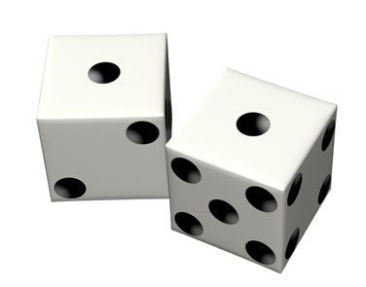
Stochastic Games
In real life, unpredictable external events can put us into unforeseen situations
Many games introduce unpredictability through a random element, such as the throwing of dice
These offer simple scenarios for problem solving with adversaries and uncertainty

Slide 69
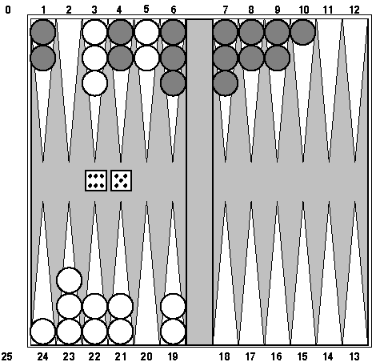
Example: Backgammon
Backgammon is a two-player game with uncertainty.
Players roll dice to determine what moves to make.
White has just rolled 5 and 6 and has four legal moves:
  5-10, 5-11
  5-11, 19-24
  5-10, 10-16
  5-11, 11-16
Such games are good for exploring decision making in adversarial problems involving skill and luck

Slide 70
Why can’t we use MiniMax?
Before a player chooses her move, she rolls dice and then knows exactly what they are
And the immediate outcome of each move is also known
But she does not know what moves her opponent will have available to choose from
We need to adapt MiniMax to handle this

Slide 71
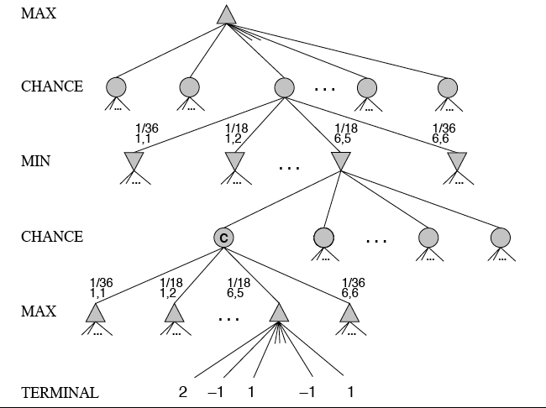
MiniMax trees with Chance Nodes

Slide 72
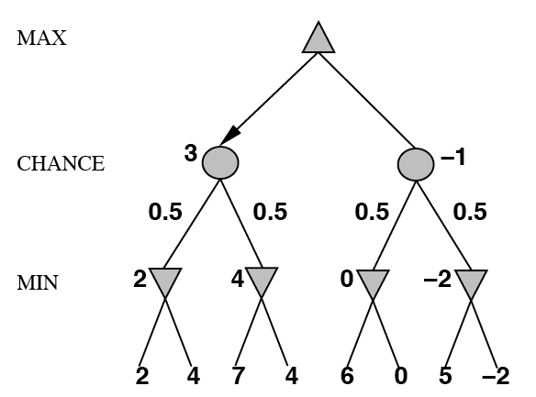
Understanding the notation
Max’s move 1
Max’s move 2
Min flips coin
Min knows possible moves
Board state includes chance outcome
determining what moves are available

Slide 73
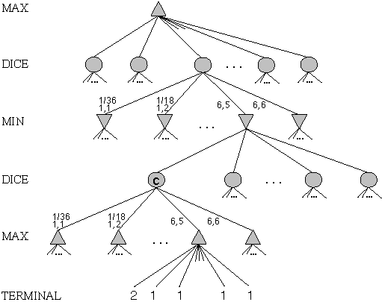
Game trees with chance nodes
Chance nodes (circles) represent random events
For a random event with N outcomes, chance node has N children; probability is associated with each
2 dice: 21 distinct outcomes
Use minimax to compute values
for MAX and MIN nodes
Use expected values for
chance nodes
Chance nodes over max node:
expectimax(C) = ∑_{i}(P(d_{i})*maxval(i))
Chance nodes over min node:
expectimin(C) = ∑_{i}(P(d_{i})*minval(i))
Min
Rolls
Max
Rolls

Slide 74
Impact on Lookahead
Dice rolls increase branching factor
  21 possible rolls with two dice
Backgammon: ~20 legal moves for given roll
  ~6K with 1-1 roll (get to roll again!)
At depth 4: 20 * (21 * 20)**3 ≈ 1.2B boards
As depth increases, probability of reaching a given node shrinks
  value of lookahead diminished and alpha-beta pruning is much less effective
TDGammon used depth-2 search + good static evaluator to achieve world-champion level

Slide 75
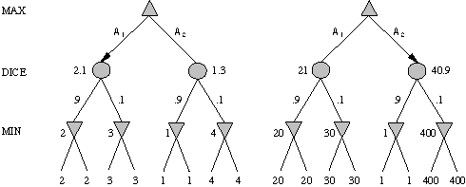
Meaning of the evaluation function
A1 is best move
A2 is best move
2 outcomes with probabilities {.9, .1}
With probabilities and expected values we must be careful about the meaning of values returned by static evaluator
relative-order preserving change of static evaluation values doesn’t change minimax decision, but could here
Linear transformations are OK

Slide 76
Games of imperfect information
Example: card games, opponent's initial cards unknown
  Can calculate a probability for each possible deal
  Like having one big dice roll at beginning of game
Possible approach: minimax over of each action in each deal; choose action with highest expected value over all deals
Special case: if action is optimal for all deals, it's optimal
GIB bridge program, approximates this idea by
  1) generating 100 deals consistent with bidding information
  2) picking the action that wins most tricks on average

Slide 77
High-Performance Game Programs
Many game programs are based on alpha-beta + iterative deepening + extended/singular search + transposition tables + huge databases + ...
For instance, Chinook searched all checkers configurations with 8 pieces or less and created endgame database of 444 billion board configurations
Methods are general, but implementation is improved by many specifically tuned-up enhancements (e.g., the evaluation functions)

Slide 78
Other Issues
Multi-player games
  E.g., many card games like Hearts
Multiplayer games with alliances
  E.g., Risk
  More on this when we discuss game theory
  Good model for a social animal like humans, where we are always balancing cooperation and competition

Slide 79
AI and Games II
AI also of interest to the video game industry
Many games include ‘agents’ controlled by the game program that could be
  Adversaries, in first person shooter games
  Collaborators, in a virtual reality game
Some game environments used as AI challenges
  2009 Mario AI Competition
  Unreal Tournament bots

Slide 80
Perspective on Games: Con and Pro
“Chess is the Drosophila of artificial intelligence. However, computer chess has developed much as genetics might have if the geneticists had concentrated their efforts starting in 1910 on breeding racing Drosophila. We would have some science, but mainly we would have very fast fruit flies.” John McCarthy, Stanford
“Saying Deep Blue doesn’t really think about chess is like saying an airplane doesn't really fly because it doesn't flap its wings.”
Drew McDermott, Yale

Slide 81

General Game Playing
General Game Playing is an idea
developed by Professor Michael
Genesereth of Stanford
See his site for more information
Goal: don’t develop specialized systems to play specific games (e.g., Checkers) very well
Goal: design AI programs to be able to play more than one game successfully
Work from a description of a novel game

Slide 82
General Game Playing
Stanford’s GGP is a Web-based system
Complete, logical specification of many different games in terms of:
    relational descriptions of states
    legal moves and their effects
    goal relations and their payoffs
Management of matches between automated players and of competitions involving many players and games

Slide 83
GGP
Input: logical description of a game in a custom game description language
  Game bots must
    Learn how to play legally from description
    Play well using general problem solving strategies
    Improve using general machine learning techniques
Yearly completions since 2005, $10K prize
Java General Game Playing Base Package

Slide 84
GGP Peg Jumping Game
; http://games.stanford.edu/gamemaster/games-debug/peg.kif
(init (hole a c3 peg))
(init (hole a c4 peg))
…
(init (hole d c4 empty))
…
(<= (next (pegs ?x)) (does jumper (jump ?sr ?sc ?dr ?dc)) (true (pegs ?y))
(succ ?x ?y)) (<= (next (hole ?sr ?sc empty)) (does jumper (jump ?sr ?sc ?dr ?dc)))
…
(<= (legal jumper (jump ?sr ?sc ?dr ?dc)) (true (hole ?sr ?sc peg))
(true (hole ?dr ?dc empty)) (middle ?sr ?sc ?or ?oc ?dr ?dc) (true (hole ?or ?oc peg)))
…
(<= (goal jumper 100) (true (hole a c3 empty)) (true (hole a c4 empty))
(true (hole a c5 empty))
…
(succ s1 s2)
(succ s2 s3)
…

Slide 85
Tic-Tac-Toe in GDL
(role xplayer)
(role oplayer)
;; Initial State
(init (cell 1 1 b))
(init (cell 1 2 b))
...
(init (control xplayer))
;; Dynamic Components
(<= (next (cell ?m ?n x))
(does xplayer (mark ?m ?n))
(true (cell ?m ?n b)))
(<= (next (cell ?m ?n o))
(does oplayer (mark ?m ?n))
(true (cell ?m ?n b)))
…
...
(<= (next (control xplayer))
(true (control oplayer)))
(<= (legal ?w (mark ?x ?y))
(true (cell ?x ?y b))
(true (control ?w)))
(<= (legal xplayer noop)
(true (control oplayer)))
(<= (legal oplayer noop)
(true (control xplayer)))
...
(<= (goal xplayer 100) (line x))
...
(<= (goal oplayer 0) (line x))
...
See ggp-base repository: http://bit.ly/RB49q5

Slide 86
A example of General Intelligence
Artificial General Intelligence describes research that aims to create machines capable of general intelligent action
Harkens back to early visions of AI, like McCarthy’s Advise Taker
  See Programs with Common Sense (1959)
A response to frustration with narrow specialists, often seen as “hacks”
  See On Chomsky and the Two Cultures_x000b_of Statistical Learning

